Slide 1
QSA Prerequisites and Deadlines
John Bernecker
Supervisor, Resource Integration
1/9/2018

Slide 2
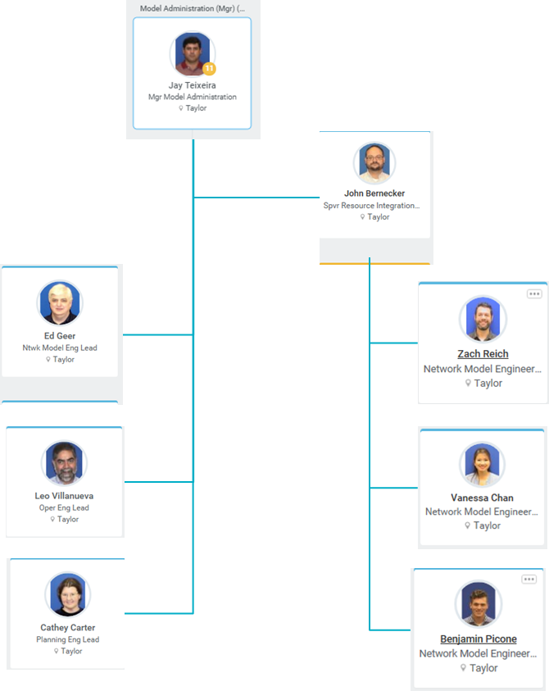
Resource Integration Team

Slide 3
QSA Prerequisites
Planning Guide §6.9 requirements met
  All Planning Model data required by the Resource Registration Glossary
  Air permits (if necessary)
  Water rights (if necessary)
  Signed SGIA (initial or amended)
  Notice to proceed and financial security
FIS studies approved
Reactive study approved
System improvements or mitigation plans identified in studies as required prior to synchronization
Notes:
Planning Model data includes PSCAD model

Slide 4
QSA Deadlines
All-Inclusive Generation Resource Initial Synchronization Date | Last Day for an IE to Meet Prerequisites | Completion of Quarterly Stability Assessment
Upcoming January, February, March | Prior August 1 | End of October
Upcoming April, May, June | Prior November 1 | End of January
Upcoming July, August, September | Prior February 1 | End of April
Upcoming October, November, December | Prior May 1 | End of July

Slide 5
February 1, 2018 QSA Deadline
All-Inclusive Generation Resources that fail to meet the QSA prerequisites by February 1, 2018 will not be eligible for Initial Synchronization in July, August, or September 2018
Resources that miss the February 1, 2018 deadline will have their synchronization date (and the corresponding COD) slip by at least one quarter
ERCOT Resource Integration has sent updates to IEs regarding status of QSA prerequisites for February 1 deadline
Notes:
If a resource expects to synchronize in Q3 2018 and has not received an update, let us know.

Slide 6
Questions
Contact:
  ResourceIntegrationDepartment@ercot.com
  Jay.Teixeira@ercot.com
  John.Bernecker@ercot.com

