Slide 1
Improvements to Look-Ahead Security Constrained Economic Dispatch (LASCED) Projected Prices
QSE Managers Working Group
Sean Chang
Market Analysis
1/8/2018

Slide 2
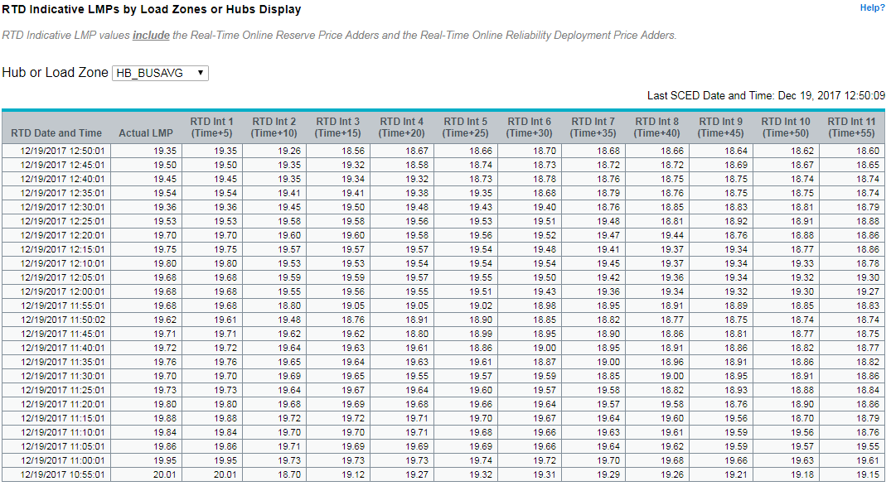
Introduction
Look-Ahead Security Constrained Economic Dispatch (LASCED) is required by 6.5.7.3 (11)
Also known as Real-Time Dispatch (RTD) or Indicative Pricing
Currently provides indicative pricing up to an hour ahead
Multi-Interval Real-Time Market (MIRTM) studies found improvements that can be applied to SCED and LASCED

Slide 3
Improvements for LASCED
Use the new Short-Term Load Forecast
Change wind HSL coefficients to use a persistence forecast
Modify GTBD calculation methodology
Decouple ramp rate constraints

Slide 4
New Short-Term Load Forecast
A new Short-Term Load Forecast (STLF) was implemented summer 2017
The operator can select between using the mid-term load forecast, the old STLF, or the new STLF
The selected load forecast is used in both SCED and LASCED
Reference: 10/24/2016 SAWG Meeting – MIRTM Demand and Wind Estimation Update

Slide 5
Change Wind HSL Coefficients to Persistence
Change coefficients to assume same wind HSLs as current value
LASCED implementation:
$Wind Resource HSL\left(i\right)=$ $A∗TelemHSL\left(t\right)$
$$+ B ∗Telem HSL\left(t−5 min.\right)$$
$$+ C ∗Telem HSL \left(t−10 min.\right)$$
$$+ D∗TelemHSL\left(t−15 min.\right)$$
$$+ E∗STWPF(Hr\left(t\right))$$
t = current time
TelemHSL = current telemetered HSL
STWPF = vendor Short-Term Wind Power Forecast
i = 5-Minute LASCED intervals
(ex: i=6 represents 30 min. in the future)
Coefficients | A | B | C | D | E
Current | 0.9 | 0.025 | 0.015 | 0.01 | 0.05
Persistence | 1 | 0 | 0 | 0 | 0
Reference: 10/24/2016 SAWG Meeting – MIRTM Demand and Wind Estimation Update

Slide 6
Modified GTBD Methodology
A new methodology for calculating GTBD of LASCED intervals has been found to be an improvement over current methodology
Current LASCED Implementation
$$LASCED GTBD\left(i\right)=\left\{\begin{aligned}SCED GTBD i=1 \\ {STLF}_{i}+DCTie_{i} i>1\end{aligned}\right.$$
Modified Methodology:
$$LASCED GTBD\left(i\right)=\left\{\begin{aligned}SCED GTBD i=1 \\ TelemMW_{0}+\left(STLF_{i}−STLF_{0}\right)+\left(DCTie_{i}−DCTie_{0}\right) i>1\end{aligned}\right.$$
TelemMW₀ = sum of telemetered generation output at LASCED run time
i = 5-minute LASCED intervals
(ex: i=6 represents 30 minutes in the future)
Reference: 10/24/2016 SAWG Meeting – MIRTM Demand and Wind Estimation Update

Slide 7
Improvements
New short-term load forecast improvement
Modified GTBD methodology improvement
Persistence wind HSL improvement
LASCED Horizon | MAE of LASCED GTBD (Current STLF) | MAE of LASCED GTBD (New STLF) | Improvement
15 minutes | 167.0 MW | 148.3 MW | 18.7 MW (11.2%)
30 minutes | 245.2 MW | 204.8 MW | 40.4 MW (16.5%)
LASCED Horizon | MAE of LASCED GTBD (Current STLF) | MAE of LASCED GTBD (New STLF) | Improvement
15 minutes | 148.3 MW | 121.5 MW | 26.8 MW (18.1%)
30 minutes | 204.8 MW | 175.3 MW | 29.5 MW (14.4%)
LASCED Horizon | MAE of Current Wind HSL Methodology | MAE of Persistence Wind HSL Methodology | Improvement
15 minutes | 197.7 MW | 154.1 MW | 43.6 MW (22.1%)
30 minutes | 352.6 MW | 281.3 MW | 71.3 MW (20.2%)
Results based on May 1, 2016 – September 30, 2016 from 10/24/2016 SAWG Presentation
Reference: 10/24/2016 SAWG Meeting – MIRTM Demand and Wind Estimation Update

Slide 8
Decouple Ramp Rate Constraints
One reason LASCED was created was to act as a pre-cursor to Multi-Interval Real-Time Market. By decoupling ramp rate constraints, LASCED can behave more like a predictive sequential SCED run.
Current LASCED Implementation
Ramp rates are coupled so that all future intervals are optimized together for the least cost overall solution (i.e. ramp pre-posturing for future events)
Decoupled LASCED Implementation
Behaves more like actual SCED results by having each interval optimized independently:
The output base points from the first interval outputs fed into the second interval inputs and dispatch limits recalculated, etc.

Slide 9
Next Steps
Currently expect that implementation can be done with minimal, internal impact
We will create an internal request to make the enhancements
Can provide updates on progress at future QMWG meetings

