Slide 1
Resource Integration Workshop
18 December 2017

Slide 2
Recap of Aug 30, 2017 Workshop
ERCOT presented possible changes that are being considered but not being proposed at this time
  Little or no debate during workshop
  Asked that comments be sent to jteixeira@ercot.com
Planning Guide changes PGRR52, PGRR54, NPRR809
Demo of GINR application under development
Discussion of RARF Replacement project

Slide 3
The Goal
Resource Integration & On-going Operations (RIOO) Application
Phase 1 – GINR tool built to handle
on-line submissions of generation
interconnection requests.
Phase 2 – RARF replacement effort to
remove dependence on spreadsheets.
GINR
RARF
replacement
tbd

Slide 4
GINR Features
On-line submission of interconnection requests (INR)
On-line payment capability for ERCOT fees
On-going management of projects submitted
  Document management
  E-sign capability
  Project lifecycle tracking
  Contact updates
  Submit project data modifications

Slide 5
Perks
Paperless generation interconnection request submissions
Quicker project request submissions
  Reduced mail expenses
On-line payment option easily identified to projects
Continuous transparency of project status
One stop shop for INR project submissions

Slide 6
GINR Demo Agenda
Submitting an interconnection request (INR)
Making updates to an INR (Change Request)
Transmission Service Provider Usage

Slide 7
GINR Project
Submitting an Interconnection Request (INR)

Slide 8
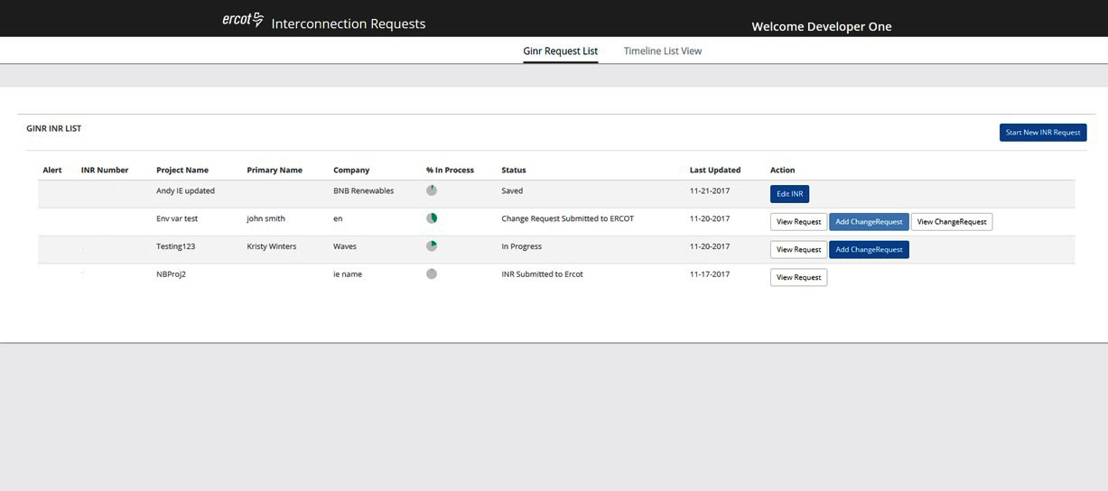
INR Create – IE Dashboard

Slide 9
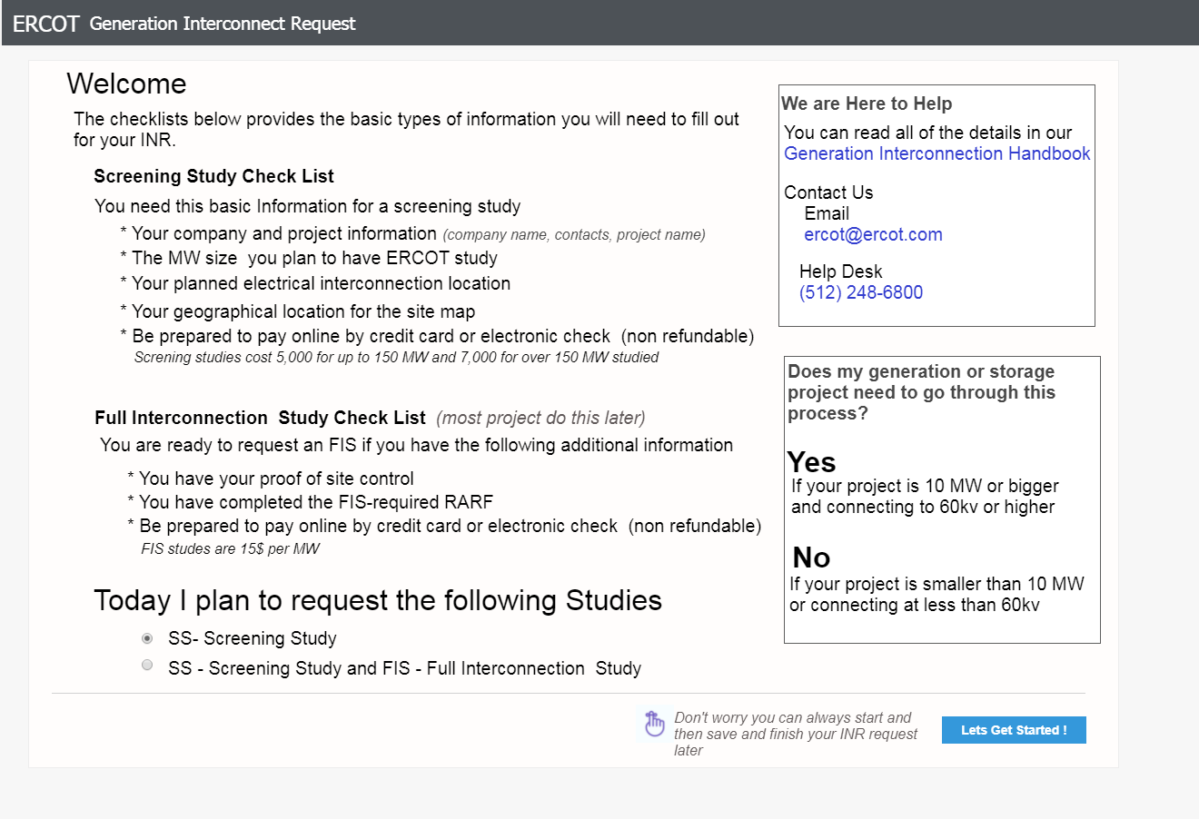
INR Create – Welcome – (wireframe)

Slide 10
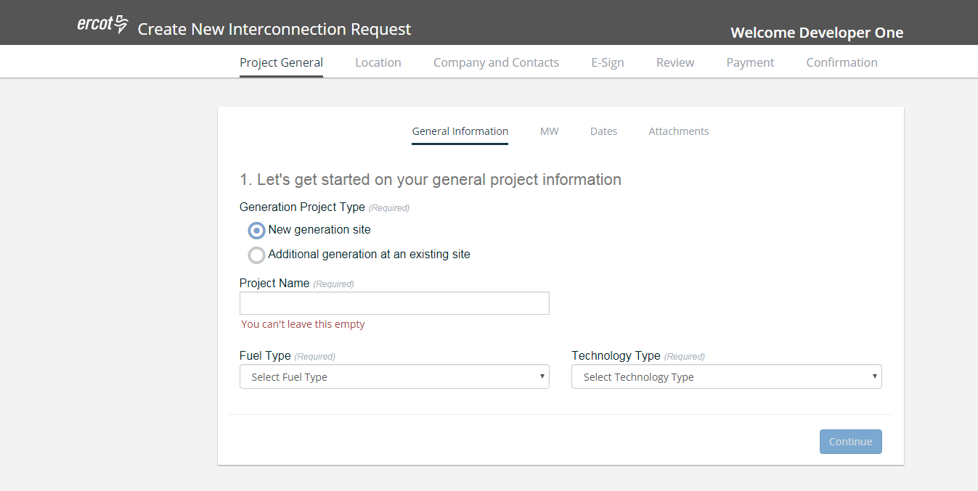
INR Create – General Information

Slide 11
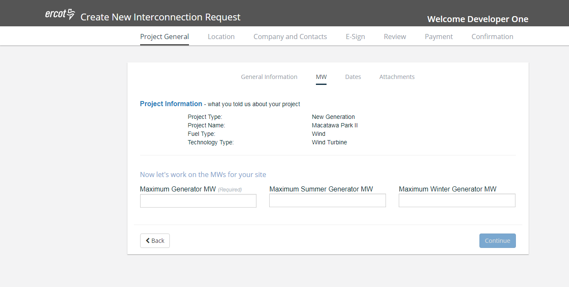
INR Create – MW

Slide 12
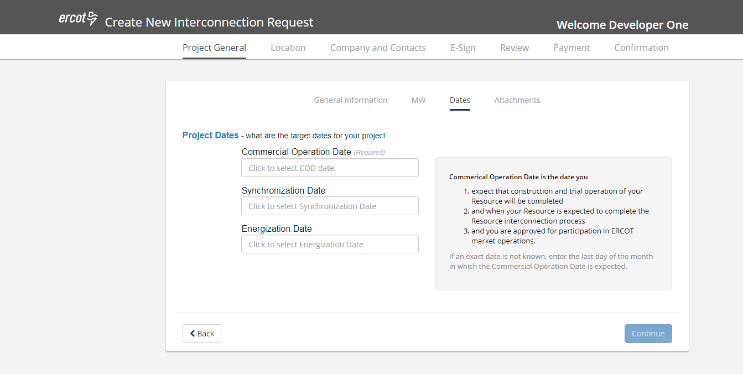
INR Create – Dates

Slide 13
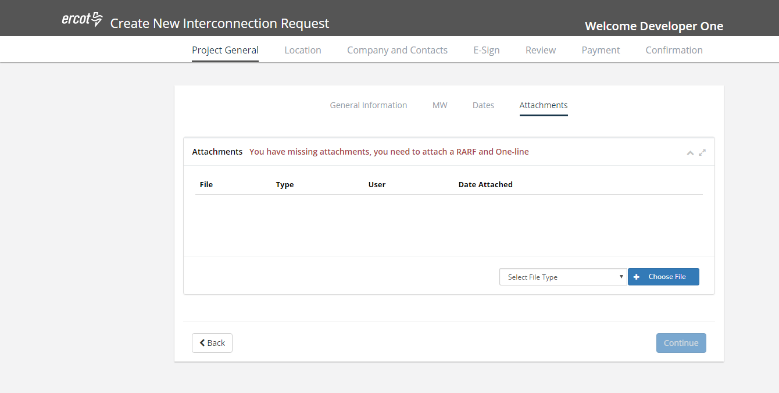
INR Create – Attachments

Slide 14
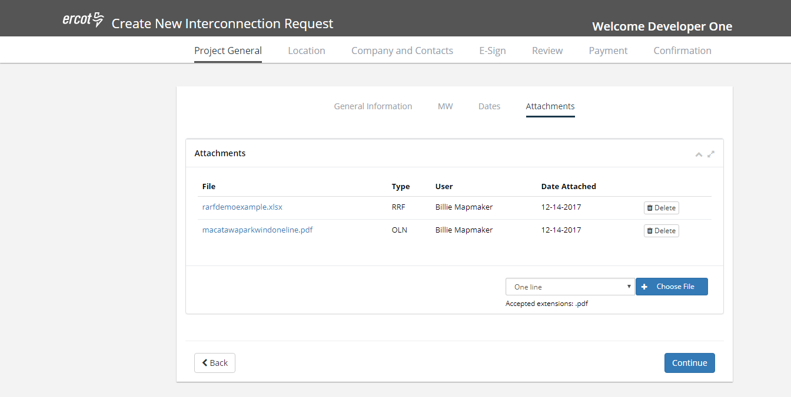
INR Create – Attachments added

Slide 15
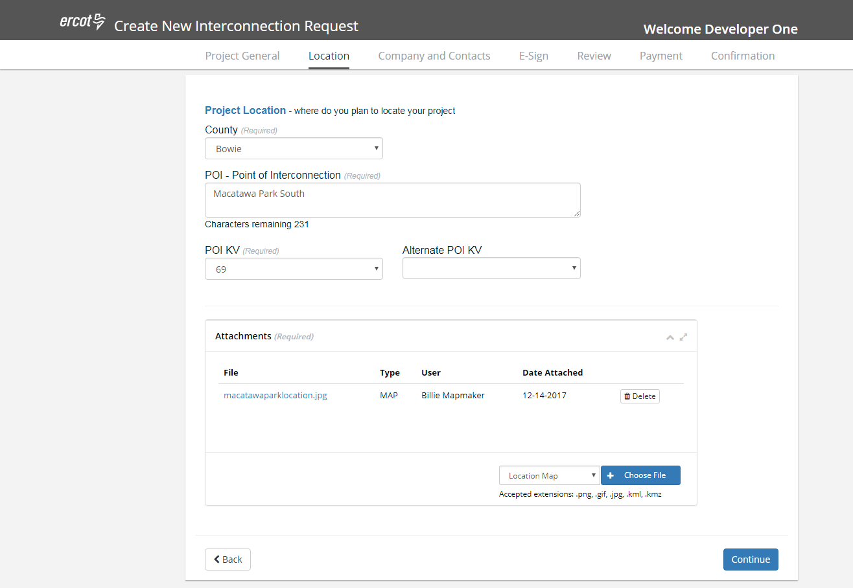
INR Create – Location

Slide 16
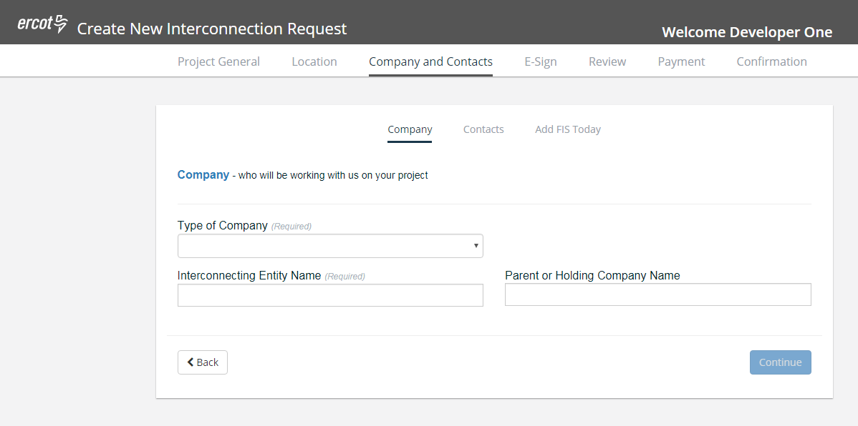
INR Create – Company

Slide 17
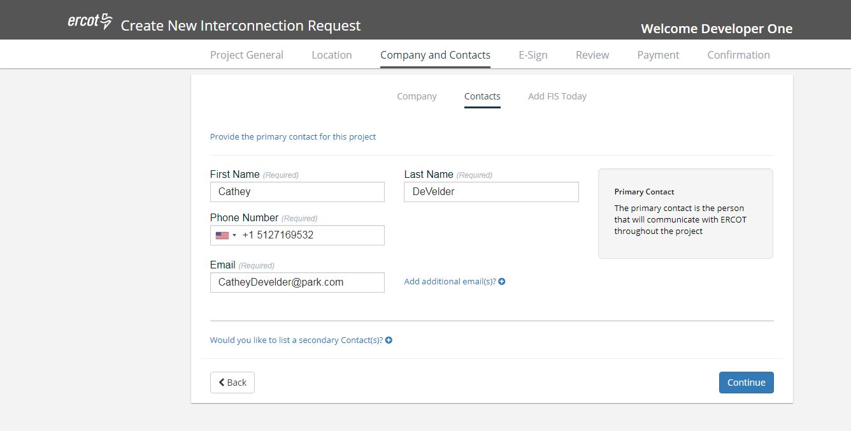
INR Create – Contacts

Slide 18
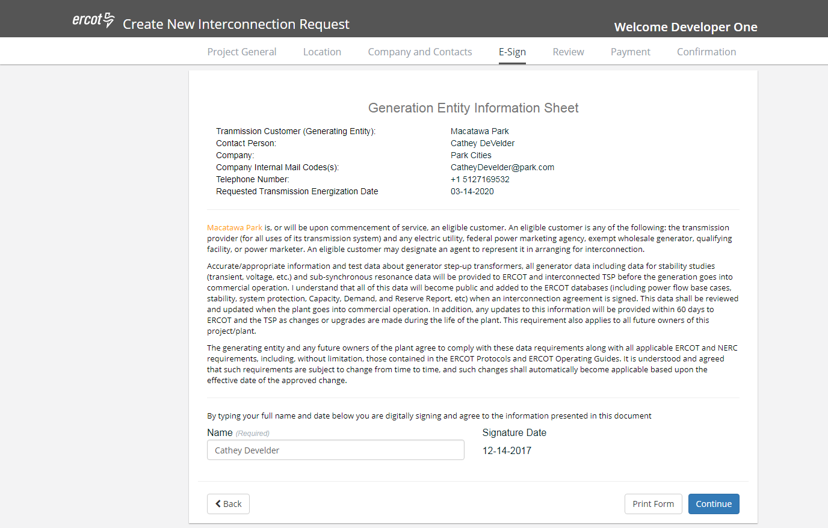
INR Create – E-Sign

Slide 19
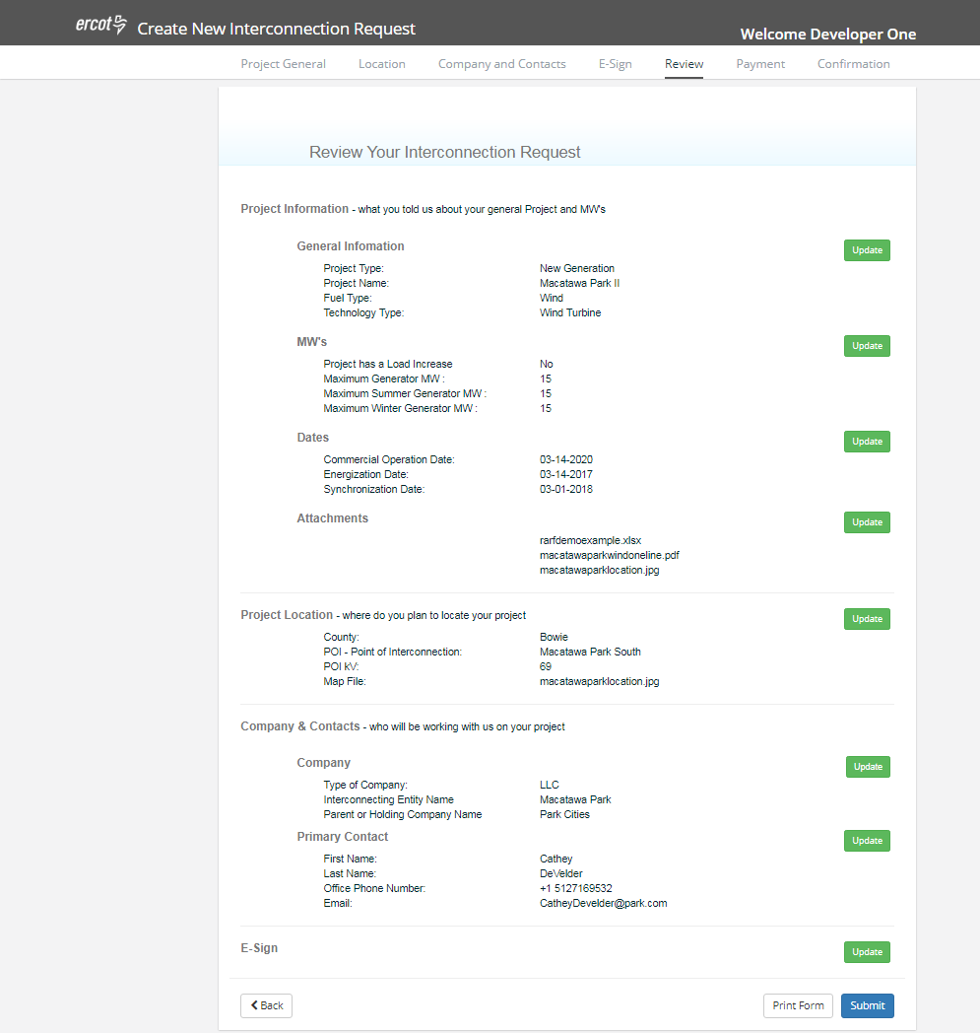
GINR Project – Review

Slide 20
GINR Project
Making updates to an INR
(Change Request)

Slide 21
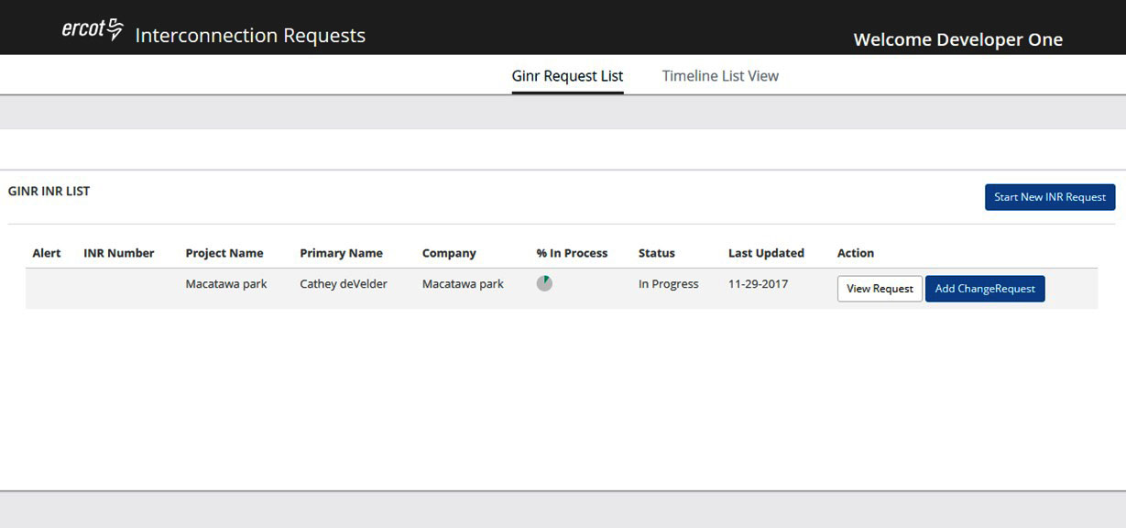
GINR Project – IE Dashboard - Change Request

Slide 22
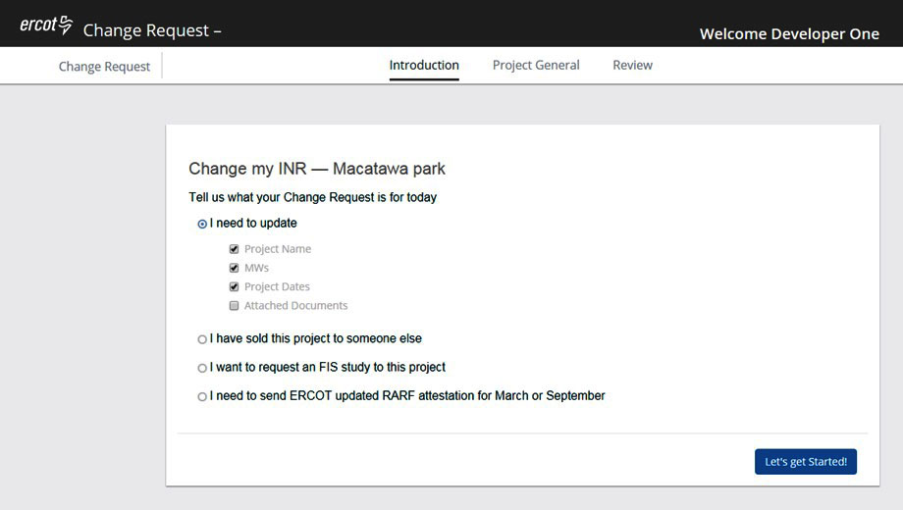
Change Request

Slide 23
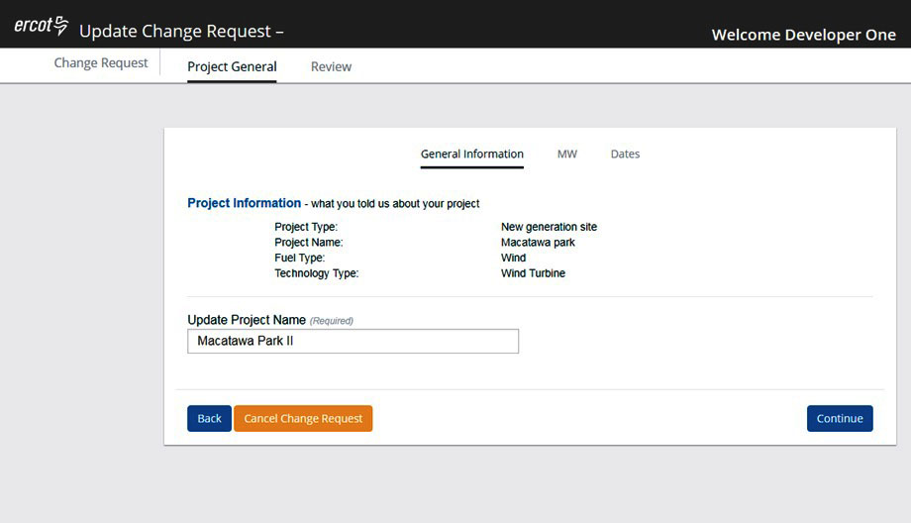
Change Request – General Information

Slide 24
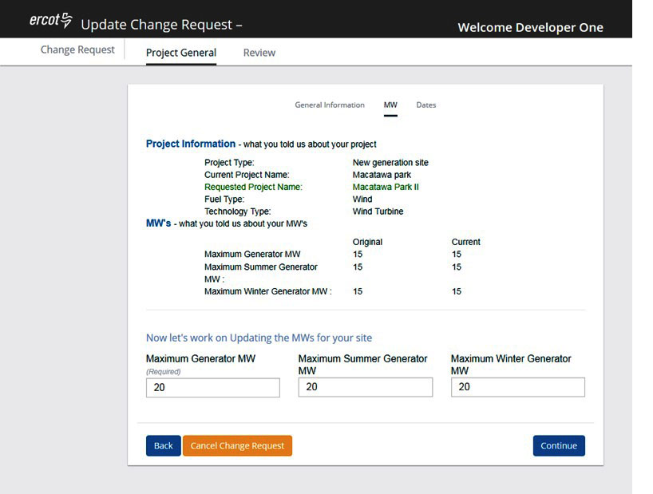

Change Request – MW

Slide 25
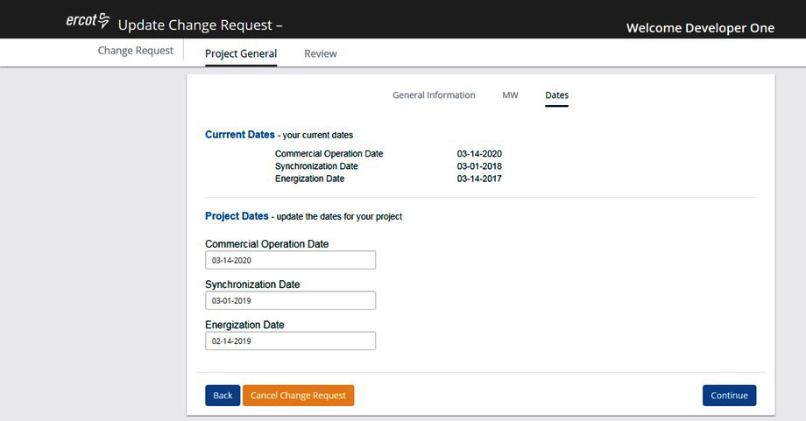
Change Request – Dates

Slide 26
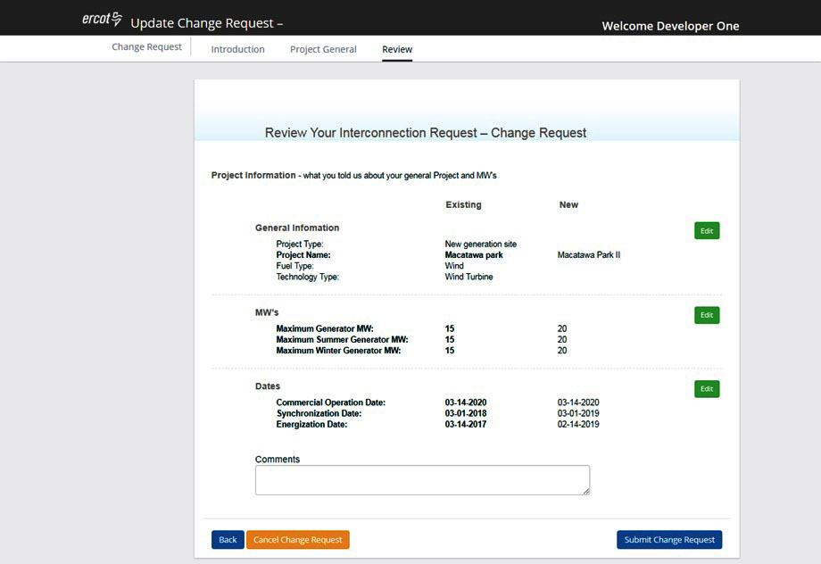
Change Request – Review

Slide 27
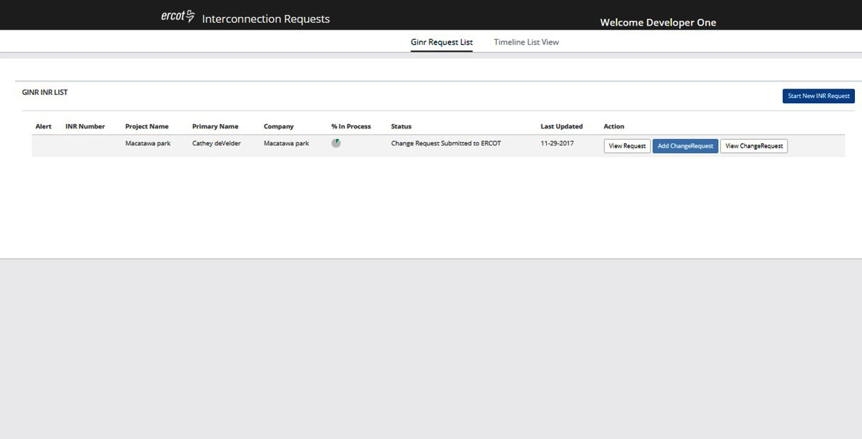
Change Request – IE Dashboard

Slide 28
GINR Project
Transmission Service Provider Usage

Slide 29
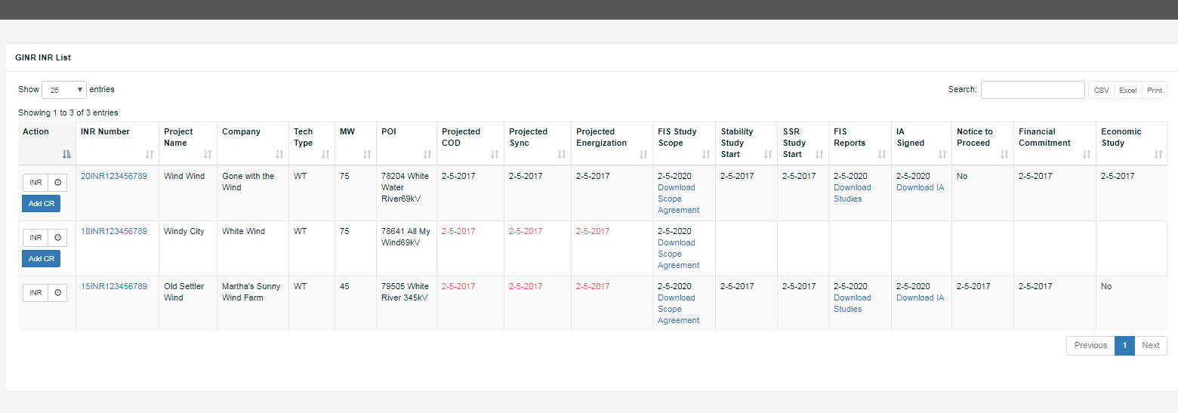
TSP – Dashboard

Slide 30
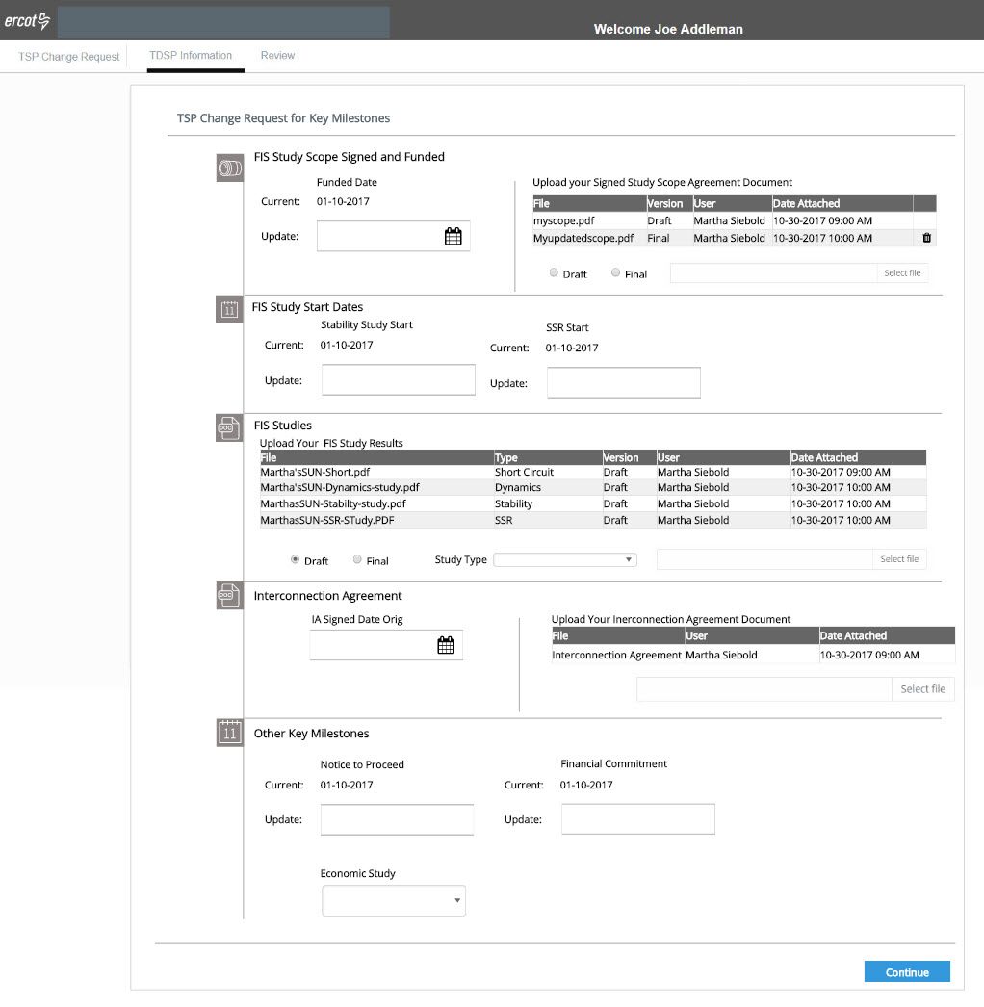
TSP Change Request

Slide 31
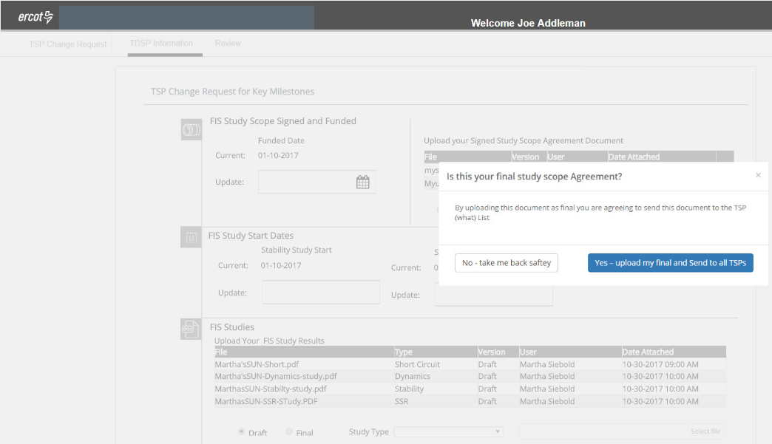
TSP Change Request – Final Document Upload

Slide 32
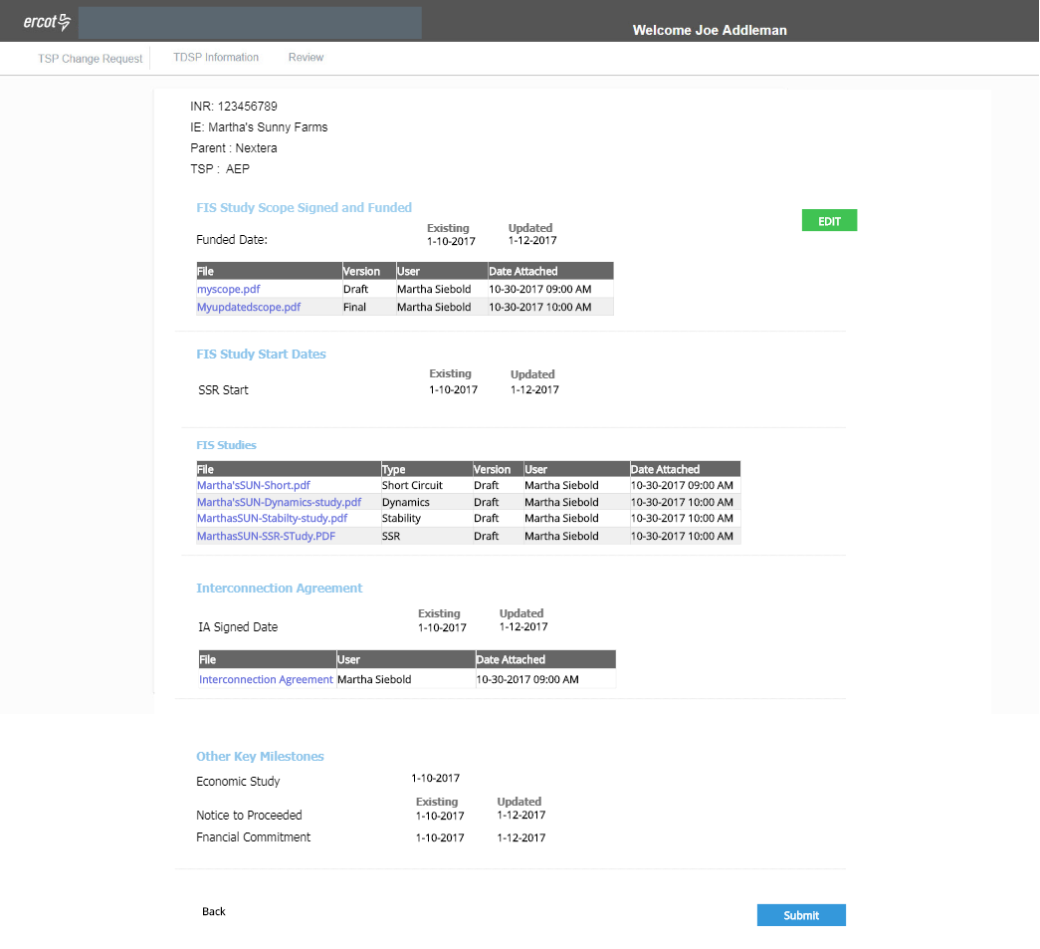
TSP Change Request

Slide 33
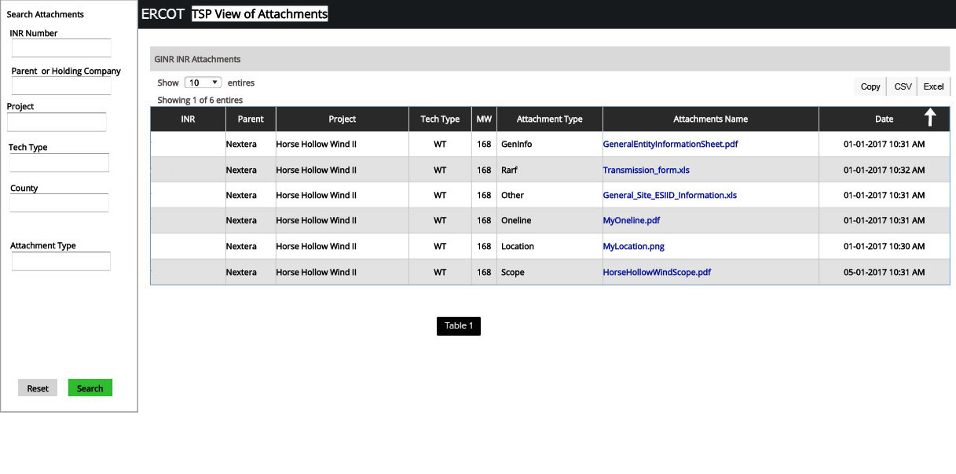
TSP View of Attachments all INR’s

Slide 34
GINR Project Input
Avenues for feedback
  Surveys
  Create focus group
  Usability workshop
If interested in participating contact: Dana O’Neal at dana.Oneal@ercot.com

Slide 35

Q&A

