Slide 1
SMT Update To AMWG
November 2017

Slide 2
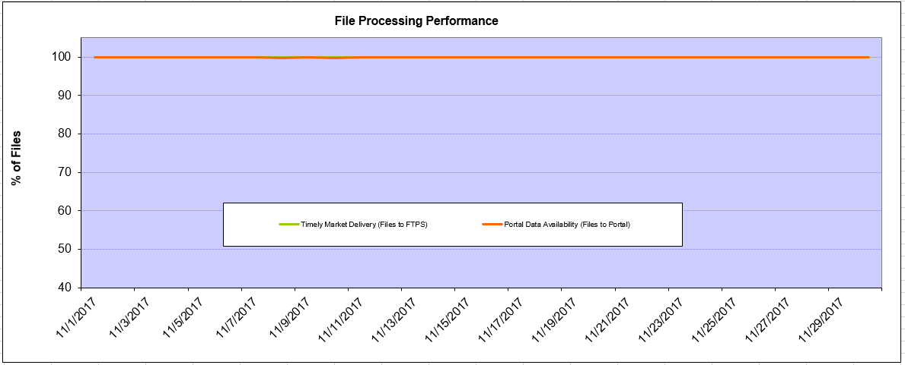
Monthly SMT Data Timelines AMWG CR 2014 002 End to End File Processing Completeness – Nov 2017
% Timely Market Delivery - % of files posted to market (FTPS) by 11:00pm out of # of files received by SMT by 11:00pm.
% Portal Data Availability - % of files loaded to the database for data availability on portal by 6:00am next day for the files received by 11:00pm
A LSE file includes usage data for up to 50,000 ESIIDs.
2

Slide 3
SMT API and FTPS Services Availability – Nov 2017
The service availability is measured as a percentage of number of minutes the service was available out of the total number of minutes in a month, excluding planned outages.
Observed Anomalies:
Mar-Apr 2015: SMT outage and subsequent recovery/catch-up impacted API availability. FTPS was available for most of the part except on 03/21-03/22 for 36 hours.
26 Jul 2015: Services were unavailable for 12 hours due to Flash storage issue
25 Jan 2016: Services were unavailable for 19 hours due to storage configuration issue
07 Mar 2016: API Services were unavailable for 7hours due to Oracle archiver issue.
12 Jul 2017: Due to network Outage FTP & API services are down for 20 minutes. FTPS & API availability is 99.95%.
Notes:
3

Slide 4
SMT Number of Accounts by Type AMWG CR 2014 009 – Nov 2017
Registered Users | ONC | CNP | AEPN | AEPC | TNMP | TOTAL
Active Residential Accounts | 65696 | 29496 | 1903 | 5923 | 4172 | 107190
Active Residential English Accounts | 65467 | 29284 | 1896 | 5796 | 4161 | 106604
Active Residential Spanish Accounts | 229 | 213 | 7 | 127 | 11 | 587
Non Active Residential Accounts | 25699 | 16788 | 1869 | 4225 | 1115 | 49195
Total Residential Accounts | 91395 | 46284 | 3772 | 10148 | 5287 | 156385
TDSP User | 349 | 28 | 10 | 18 | 1 | 406
TDSP Admin | 4 | 4 | 4 | 4 | 3 | 19
Small Business User | 98 | 47 | 1 | 1 | 3 | 150
Small Business Admin | 3121 | 1673 | 91 | 346 | 155 | 5551
Total Agreements (Includes Active and Pending) | 17115 | 3537 | 96 | 312 | 1311 | 22371
Energy Data Agreements (Includes Active and Pending) | 17115 | 3300 | 96 | 312 | 1311 | 22134
Han Device Agreements (Includes Active and Pending) | 0 | 236 | 0 | 0 | 0 | 236
Han Service Agreements (Includes Active and Pending) | 0 | 1 | 0 | 0 | 0 | 1
IN SMT
ESI IDs | 3568221 | 2483105 | 198338 | 868831 | 249667 | 7368162
Meters | 3512057 | 2483020 | 199179 | 869300 | 249081 | 7312637
HAN Devices | 3274 | 4205 | 136 | 269 | 31 | 7915
Acknowledgement | 0 | 0 | 0 | 0 | 0
Pending | 0 | 2 | 0 | 0 | 0
Meter Ready | 4 | 2 | 38 | 93 | 19
Provisioned | 3270 | 4201 | 98 | 176 | 12
HAN Messages (MTD) | 0 | 0 | 0 | 0 | 0 | 0
HAN Messages (YTD) | 201 | 7 | 0 | 0 | 0 | 208
HAN Messages (Cumulative) | 581 | 7412 | 0 | 0 | 0 | 7993
Simple Text Messages | 166 | 2934 | 0 | 0 | 0
Load Control Messages | 165 | 2658 | 0 | 0 | 0
Pricing Messages | 173 | 56 | 0 | 0 | 0
Cancellation Messages | 77 | 1764 | 0 | 0 | 0
Supplemental – (Friends)
Total Agreements | 1927 | 1517 | 82 | 105 | 68 | 3699
Accepted Agreements | 800 | 589 | 36 | 32 | 23 | 1480
Pending Agreements | 2 | 1 | 0 | 1 | 0 | 4
Revoked Agreements | 339 | 296 | 11 | 8 | 7 | 661
Expired Agreements | 746 | 599 | 33 | 64 | 38 | 1480
Terminated Agreements | 40 | 32 | 2 | 0 | 0 | 74
 | TDSPs | REP | Small Business | Regulatory | Third Party
Registered Entities | 5 | 119 | 5364 | 2 | 172
Registered Users | 406 | 862 | 150 | 8 | 26
Registered Admins | 19 | 182 | 5386 | 3 | 161
HAN Messages Sent By | 551 | 7418

Slide 5
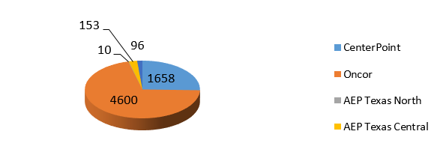
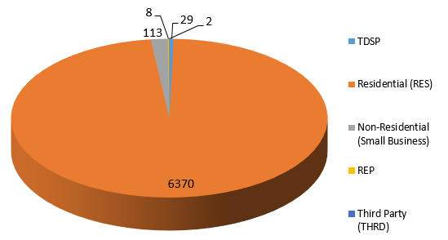
SMT ODR Details – Nov 2017
Total ODR Requests TDSP wise statistics:
Total ODR Requests User type statistics:

