Slide 1
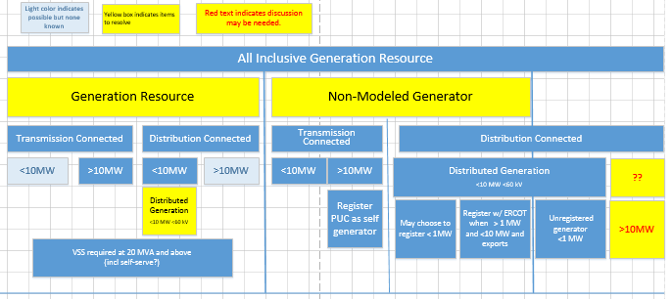
Resource Definition Framework

