Slide 1
Project Update and Summary of
Project Priority List (PPL) Activity
December 14, 2017

Slide 2
Project Update Agenda
Project Portfolio Update p. 3-8
  Recent / Upcoming Project Implementations
  2017 Release Targets
  2018 Release Targets
  2017 Project Spending Forecast
  Revision Request Funding Placeholder Status
  Priority/Rank Options for Revision Requests with Impacts
Appendix
  Project Portfolio Gantt Chart p. 9-16
Location of Project Priority List (PPL): http://www.ercot.com/services/projects/index

Slide 3
Recent / Upcoming Project Implementations
2017 December Release – 12/5/2017-12/7/2017 Complete
  NPRR812 – Alignment of Currently Published Reports
2017 December Retail Release – 12/9/2017-12/10/2017 Complete
  NPRR778 – Modifications to Date Change and Cancellation Evaluation Window
  RMGRR139 – Alignment with NPRR778, Modifications to Date Change and Cancellation Evaluation Window
  EFFECTIVE DATE = 12/11/2017
Note: Projected Go-Live dates are subject to change.
Please watch for market notices as the effective dates approach.

Slide 4
2017 Release Targets – Board Approved NPRRs / SCRs / xGRRs
March 3/7 – 3/9 | May 5/1 – 5/11 | June 6/27 – 6/29 | August 9/11 – 9/13 | October 10/31 – 11/2 | December 12/5 – 12/7
NPRR272 NPRR649 NPRR753 NPRR764 NPRR785 RMGRR134 NPRR790 | SCR790 NPRR746 NPRR786 NPRR792 NOGRR164 PGRR051 RRGRR003 RRGRR006 RRGRR007 RRGRR009 RRGRR010 PGRR046 | NPRR573 NPRR789 NPRR797 NPRR801 NPRR827 NPRR744 | NPRR758 NPRR775 NPRR809(a) PGRR052 PGRR054 | NPRR782 NPRR831(a) NPRR562(a) NPRR808 PGRR056 | NPRR812 NPRR778 RMGRR139
7 | 12 | 6 | 5 | 5 | 3
ü
ü
ü
ü
ü
ü
ü
ü
ü
ü
ü
ü
ü
ü
ü
ü
ü
ü
ü
ü
ü
ü
ü
ü
ü
ü
ü
ü
ü
ü
ü
ü
ü
ü
ü
ü
ü
2/1
6/1
8/1
9/1 & 9/14
12/9 – 12/10 (Retail)
ü
5/8 – NMMS Upgrade
ü
Go-live dates can differ from Protocol effective dates – Please refer to market notices for more details
APPENDIX
Red Text: New additions and target release changes
Strike-Through Text: Previous target release changes
(a), (b), etc. indicates multiple phases
Project Status Codes
NS = Not Started
I = Initiation
P = Planning
E = Execution
H = On Hold
Release targets are subject to change
NPRR562(a) – Procedural changes
NPRR809(a) – Procedural changes
NPRR831(a) – All impacted systems except CRR

Slide 5
2018 Release Targets – Board Approved NPRRs / SCRs / xGRRs
February 2/6 – 2/8 | April 4/3 – 4/5 | May 5/29 – 5/31 | August 8/7 – 8/9 | October 10/23 – 10/25 | December 12/11 – 12/13
NPRR562(b) NPRR776 NPRR830 NPRR683 NPRR743 NPRR760 NPRR800 NPRR810 SCR777 NPRR831(b) | SCR792 NPRR749 NPRR833 | NPRR809(b) SCR791 |  | NPRR768 NPRR817 | NPRR519 NPRR620 NPRR741 NPRR755 PGRR057 SCR789
8 | 1 | 2 | 0 | 2 | 6
NS
E
P
E
E
E
E
E
I
P
NS
NS
NS
E
E
E
E
E
I
CMM Release 1b
CMM Release 1a
January
(Off-cycle)
4/7 – 4/8
(Retail)
6/2 – 6/3
(Retail)
8/11 – 8/12
(Retail)
10/27 – 10/28
(Retail)
12/15 – 12/16
(Retail)
TBD Items (and point at which they became “TBD”)
2014 | 2015 | 2016 | 2017
NPRR664 | None | SCR781 P | NPRR702 P, NPRR519, NPRR620, NPRR741, NPRR755, NPRR829, SCR777, NPRR831(b), NPRR749, NPRR833
Go-live dates can differ from Protocol effective dates – Please refer to market notices for more details
APPENDIX
Red Text: New additions and target release changes
Strike-Through Text: Previous target release changes
(a), (b), etc. indicates multiple phases
Project Status Codes
NS = Not Started
I = Initiation
P = Planning
E = Execution
H = On Hold
Release targets are subject to change
NPRR562(b) – Reporting/posting system changes
NPRR809(b) – Reporting/posting system changes
NPRR831(b) – CRR system changes

Slide 6
2017 Project Spending
2017 PPL Budget = $21.5M
“Potential Demand” represents internal ERCOT projects that have not been fully approved

Slide 7
Revision Request Funding Placeholder Status
In 2017 and 2018, ERCOT forecasted $4.0M for Revision Request work
Yearly Revision Request Spending Forecast Summary
Project Status | 2017 | 2018
YTD Actuals | $2.58M | $0.00M
Approved – In-Flight / Complete | $3.00M | $1.48M
Approved – On Hold | $0.00M | $0.00M
Approved – Not Started | $0.00M | $0.09M
Remaining Funding | $1.00M | $2.43M
Total Allocation | $4.00M | $4.00M
As of 10/31/2017

Slide 8
Priority / Rank Options for Revision Requests with Impacts
Options for…
Revision Request | Description | Priority | Rank | Comments
NPRR819 | Modification of Non-Price Error Resettlement Thresholds and Resettlement Clean-Ups | 2018 | 2110 | Work into the 2018 project plan without disrupting in-flight projects
NPRR841 | Real-Time Adjustments to Day-Ahead Make Whole Payments due to Ancillary Services Infeasibility Charges | 2019 | 2520 | Market input needed on desire to defer implementation of NPRR841 to 2019
NPRR842 | Study Area Load Information | 2018 | 2120 | Market input requested
PPL Rank Information
Next available Rank in Business Strategy = 2110
Next available Rank in Regulatory = 180

Slide 9
Appendix
  11/30/2017 Project Gantt
    In-flight items sorted by Project End Date
    “On Hold” projects listed separately
      None at this time
    “Not Started” items sorted by Project Start Date

Slide 10
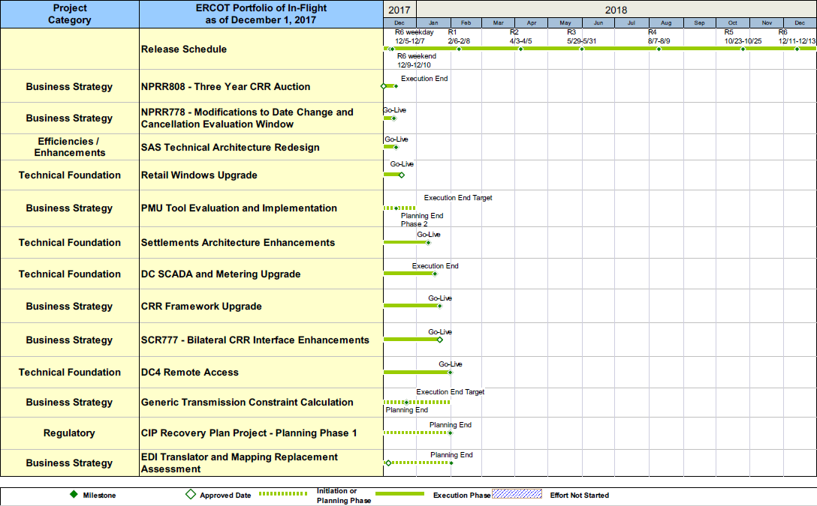
Project Portfolio Status – as of 11/30/2017

Slide 11
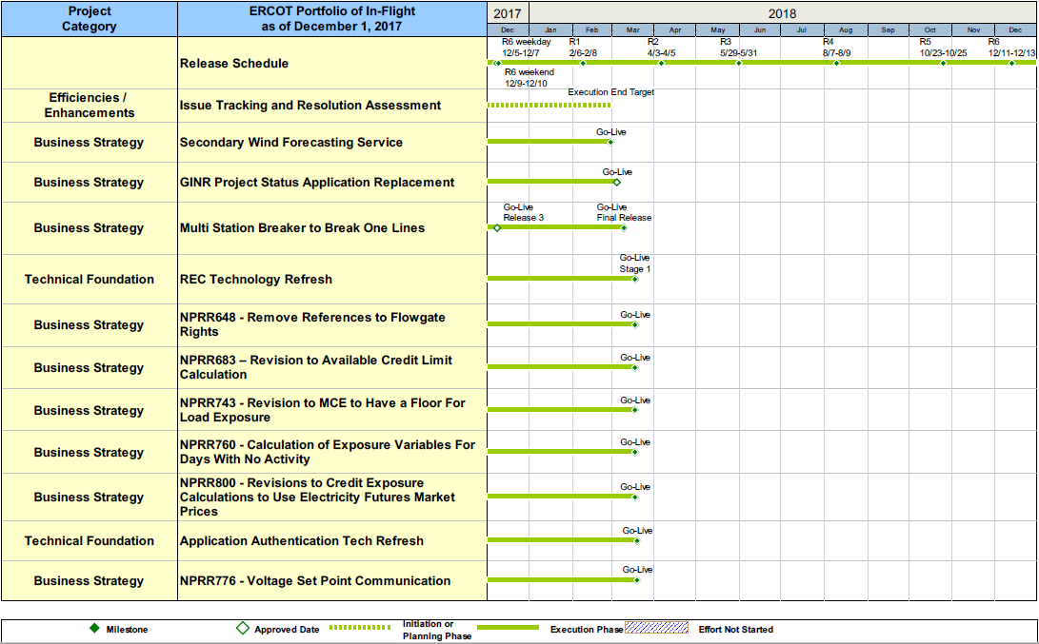
Project Portfolio Status – as of 11/30/2017

Slide 12
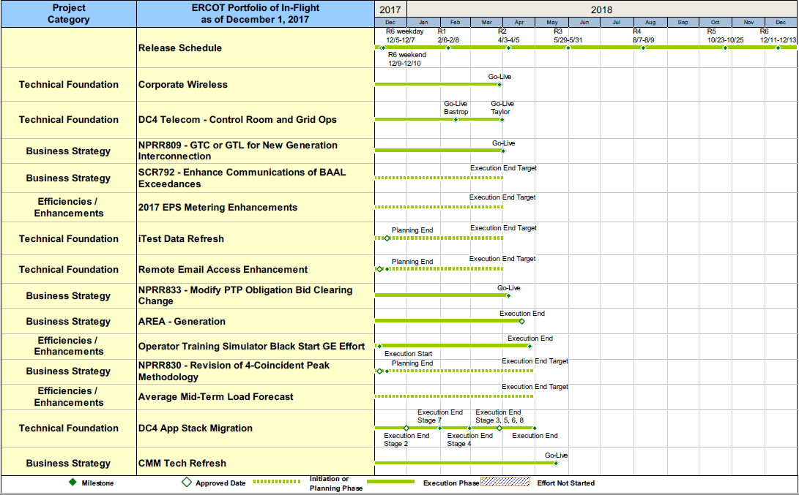
Project Portfolio Status – as of 11/30/2017

Slide 13
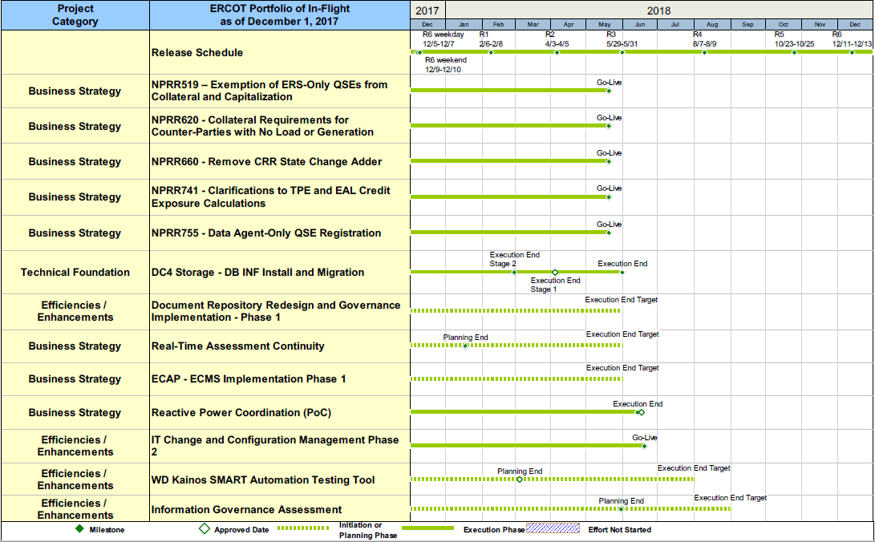
Project Portfolio Status – as of 11/30/2017

Slide 14
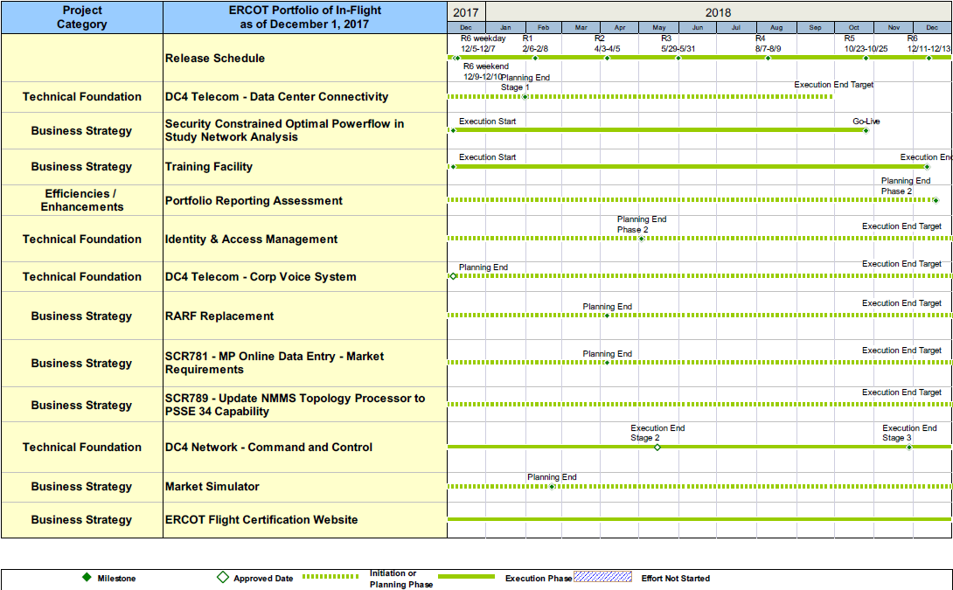
Project Portfolio Status – as of 11/30/2017

Slide 15
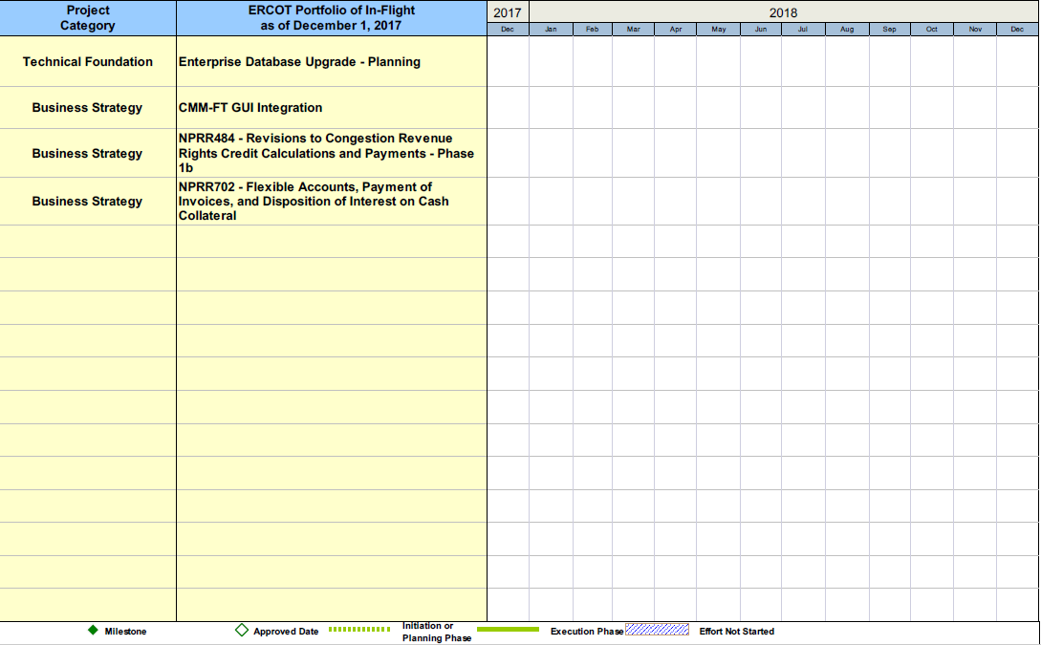
Project Portfolio Status – as of 11/30/2017

Slide 16
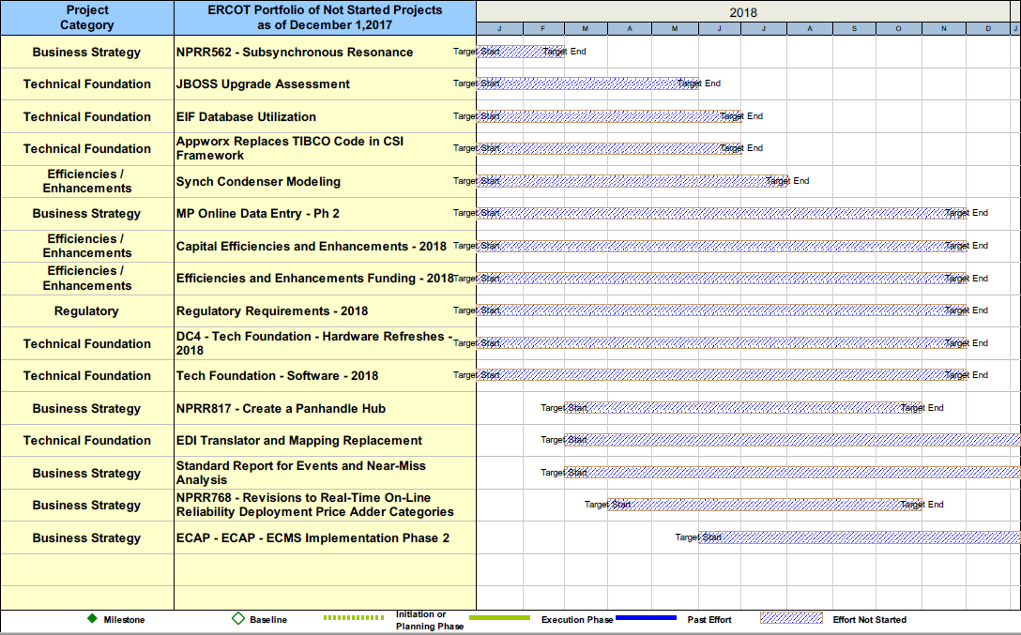
Project Portfolio Status – as of 11/30/2017

