Slide 1
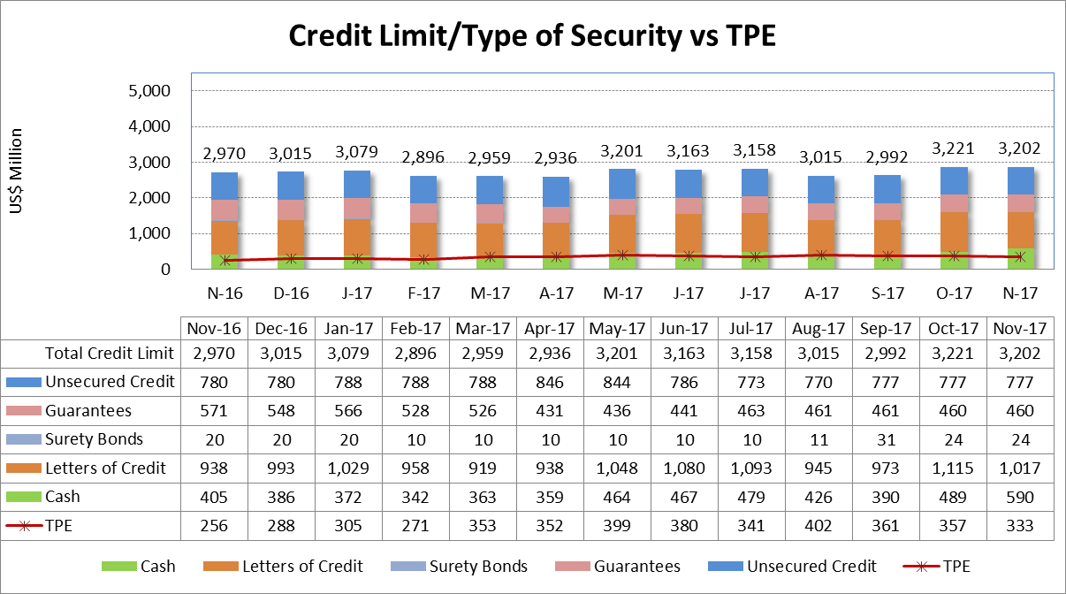
Collateral Breakdown by Type vs. TPE

