Slide 1
Energy Efficiency Forecasting for the December 2017 CDR - Update
Pete Warnken
Manager, Resource Adequacy
December 8, 2017

Slide 2
Energy Efficiency (EE) Forecast Update
Energy efficiency forecast updated based on
New 2018 Long Term Load Forecast
Adjustment for avoided distribution line losses added (gross-up factor increase from 1.02 to 1.08)

Slide 3
Austin Energy’s Cumulative Peak Savings from Energy Efficiency
Amounts reported to ERCOT are shown below
Verified that demand response and rooftop solar contributions have been excluded
Verifying large growth in actual amount for 2017 (244 MW)
Figures already grossed up to account for avoided T&D losses and reserve requirement

Slide 4
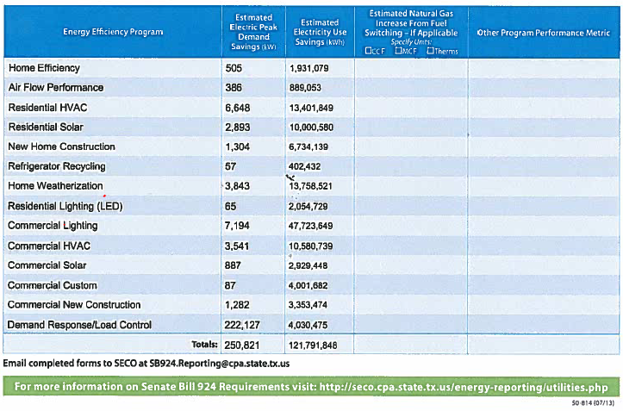
CPS Energy’s 2016 SECO Energy Efficiency Reporting Form – Data Section

