Slide 1
2018 Long-Term Load Forecast
Sarah Moore
Calvin Opheim
Load Forecasting & Analysis
SAWG
December 8, 2017

Slide 2
Outline of Today’s Presentation
Forecasting Framework / Model Data Input
Growth Driver
Normal Weather (P50) Forecast
Impact of 4 CP on Summer Peak
Assumptions and Challenges

Slide 3
Outline of Today’s Presentation
Active Models
ERCOT P50 Forecast
Weather Zone P50 and P90 Forecasts
Questions

Slide 4
Forecasting
Framework

Slide 5
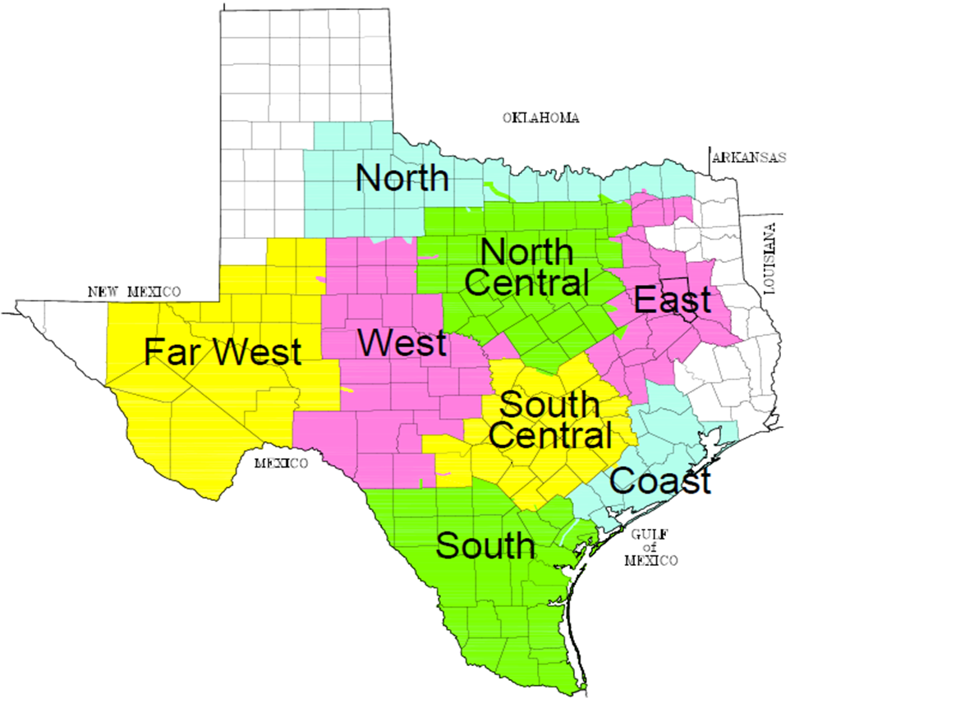
Weather Zones
Two or three weather stations located in each weather zone
Notes:
WEST peak was in July

Slide 6
Load Forecasting Models
Hourly Models
Hourly models were created for each weather zone
Over 48,000¹ hourly observations including load, weather data, and calendar variables (day-of-week, holidays, etc.)
Historical data from January 2012¹ through August 2017 was used to create the models
Unique model for each season
Rationale
Typically use 5¹ years of historical data in model development
Allows for a more recent snapshot of appliance stock, energy efficiency impacts, demand response impacts, price responsive load, etc.
Note [1]: Some models used less observations
Notes:
1 – xxx models only used data from January 2014 through August 2017

Slide 7
Load Forecasting Models – Data Input
Weather Data
Temperature, Temperature Squared, Temperature Cubed
Cooling Degree Days
Heating Degree Days
Cloud Cover
Wind Speed
Dew Point
May also include values from a previous hour(s) or day(s)

Slide 8
Load Forecasting Models – Data Input
Calendar
Month
Day of the week
Holidays
Hour
Interact Hour with Day of the week

Slide 9
Load Forecasting Models – Data Input
Variable Interactions
Interact weather variables with calendar variables
Examples: Temperature with Hour, Dew Point with Hour
Interact multiple weather variables with calendar variables
Example: Temperature with Dew Point and Hour

Slide 10
Growth Driver

Slide 11
Load Forecasting Models – Data Input
Monthly Premise Count by Customer Class
Instead of using economic measures as the driver of future load growth, use the actual number of premises for each customer class
Customer class is determined by the load profile assignment
Three classes
Residential (includes lighting)
Commercial
Industrial
Notes:
Mention history of changing from using purely economic forecast. Historical economic values are subject to change two years after the fact.

Slide 12
Forecasting Premises
Premise Models
Forecasted premise counts are used as the driver of future demand/energy growth in the majority of weather zones
Economic variables were used as input in the premise forecast models
Variables used include population, non-farm employment, and housing stock
Also included error correction term

Slide 13
Forecasting Premises
Monthly Economic Measures
Non-farm employment
Population
Housing stock
Moody’s base scenario was used for economic forecasts
Data Availability
County level
Counties are mapped into a weather zone
Growth Driver in Premise Models

Slide 14
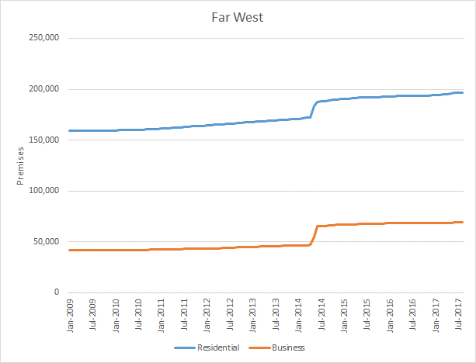
Forecasting Premises - Challenges
Premise counts were increased significantly via opt-in
Forecasting premises is problematic

Slide 15
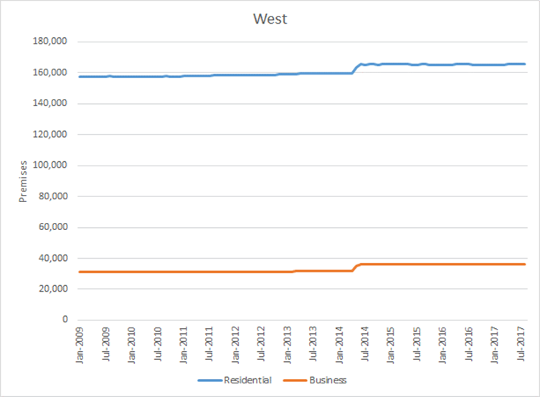
Forecasting Premises - Challenges
Premise counts were increased significantly via opt-in
Forecasting premises is problematic

Slide 16
Forecasting Premises
Premise Models - Exceptions
Unable to forecast premise counts in two weather zones
Impacted by an entity opting-in (Far West and West)
Modeling Solution
These two weather zones required traditional economic variables (non-farm employment and/or housing stock) as the driver of future demand/energy growth in the hourly models

Slide 17
Load Forecasting Models – Data Input
Monthly Economic Data
For the two weather zones without a premise forecast (Far West and West), use economic data (population or non-farm employment) as the driver of future load growth
Moody’s Base Scenario

Slide 18
Normal Weather
(P50) Forecast
Notes:
Comment on not directly temperature based

Slide 19
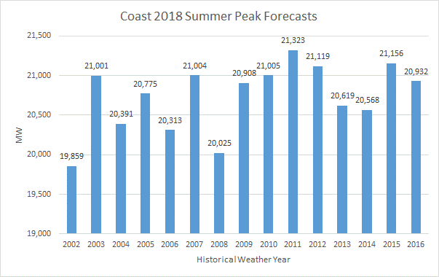
Normal Weather (P50) Forecast
Performed at the Weather Zone Level
Historical weather from calendar years 2002 – 2016 is used as input into each hourly weather zone forecast model

Slide 20
Normal Weather (P50) Forecast
Performed at the Weather Zone Level
Forecasted values are sorted from high to low for using each historical weather year as input
The sorted values are averaged by rank
Example:
Below are the top 5 peak values for Coast for 2018 using 2002 – 2016 historical weather data

Slide 21
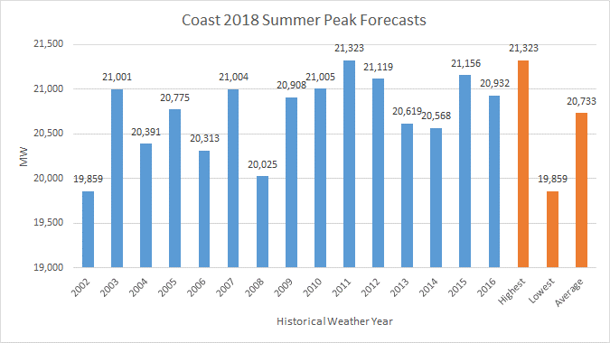
Normal Weather (P50) Forecast
Performed at the Weather Zone Level

Slide 22
Normal Weather (P50) Forecast
Performed at the Weather Zone Level
This process is completed for every weather zone, for each forecasted year (2018 – 2027)
P50 forecasts for each weather zone are found in the Weather Zone Forecasts section of this presentation

Slide 23
Normal Weather (P50) Forecast
ERCOT (P50) Forecast
After the weather zone (P50) hourly load forecasts are completed, the results are mapped into a representative historical calendar by rank
The 2007 calendar was selected. Previously the 2003 calendar was used.
As mentioned last year, we were evaluating changing from using 2003 diversity factors
The 2003 diversity factors are pretty old
Evaluated 2007 through 2016 as these are more recent and have consistent DST months
Of these 2007 had the least amount of diversity between weather zone peaks and ERCOT peak which is consistent with our previous approach

Slide 24
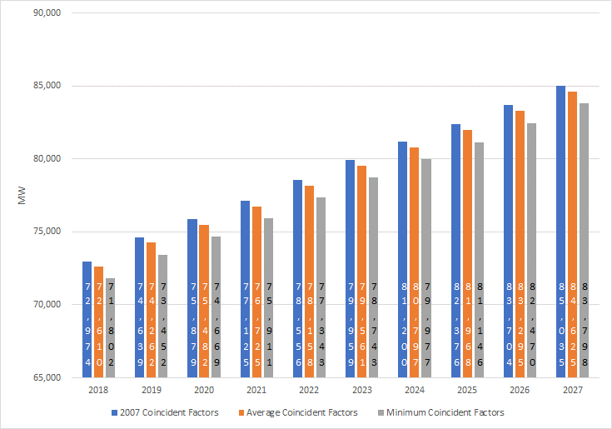
Weather Zone Coincident Peak with ERCOT

Slide 25
4 CP Impacts on Summer Peak

Slide 26
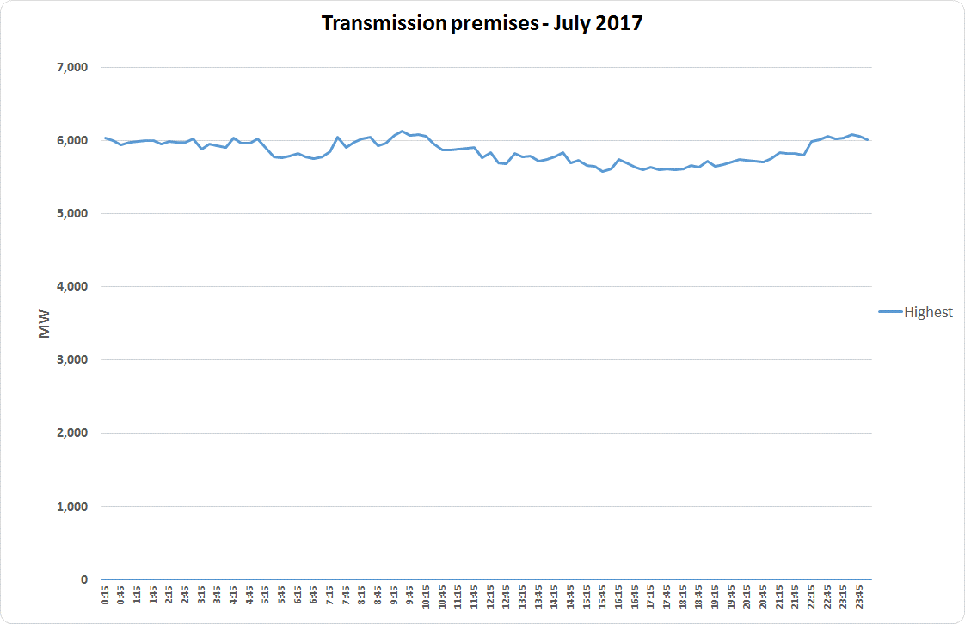
Estimate of 4 CP Impacts

Slide 27
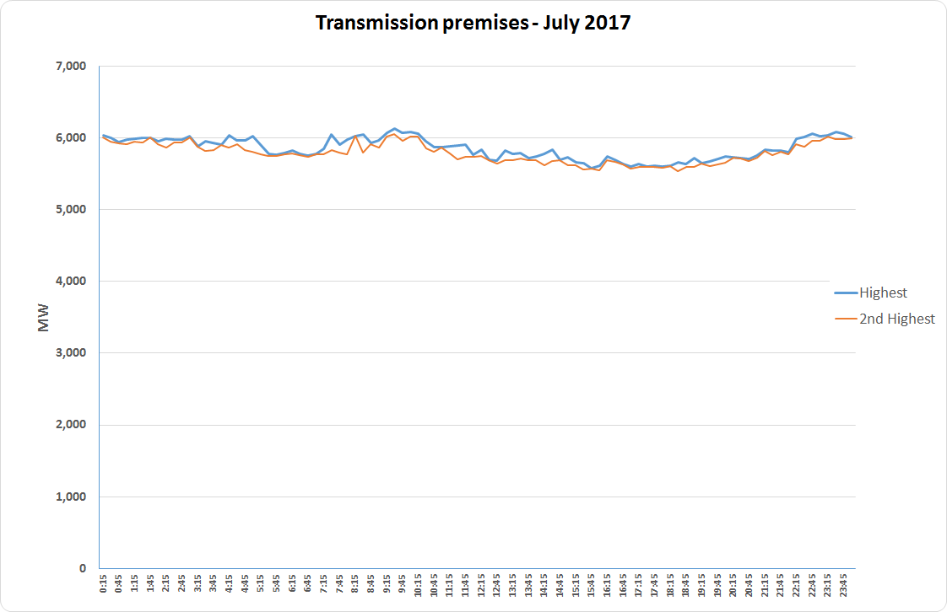
Estimate of 4 CP Impacts

Slide 28
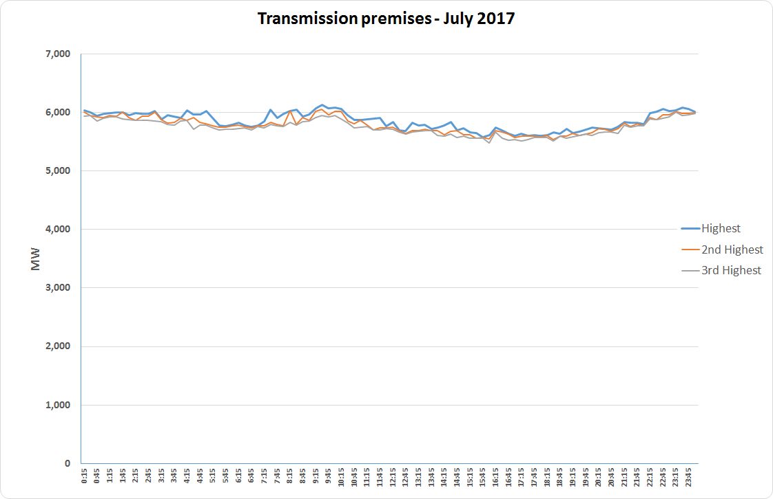
Estimate of 4 CP Impacts

Slide 29
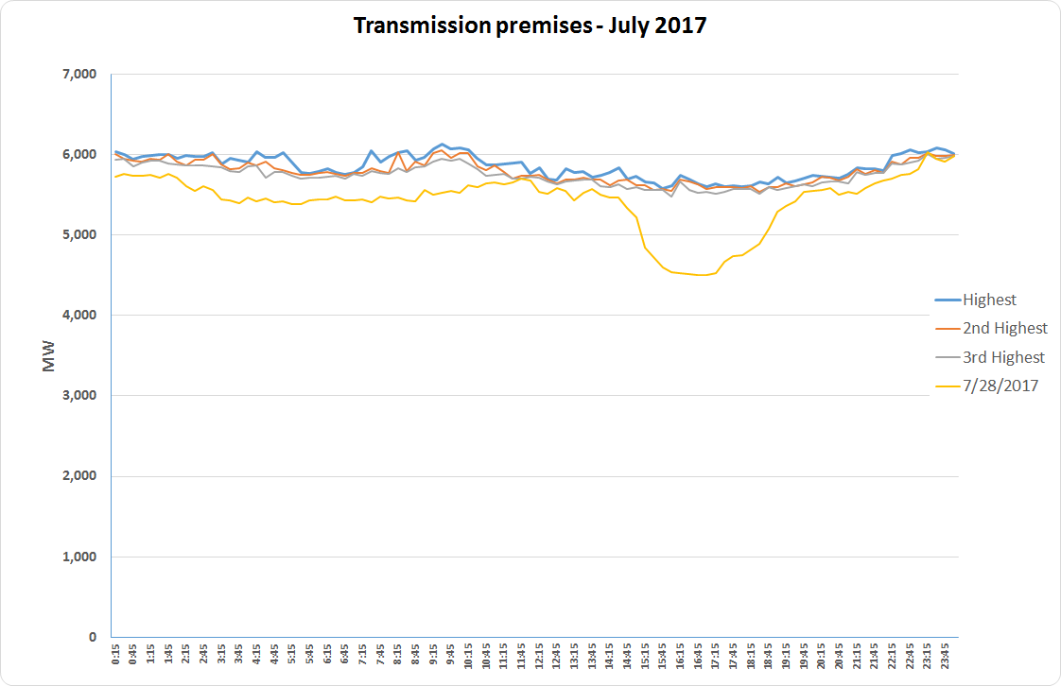
Estimate of 4 CP Impacts

Slide 30
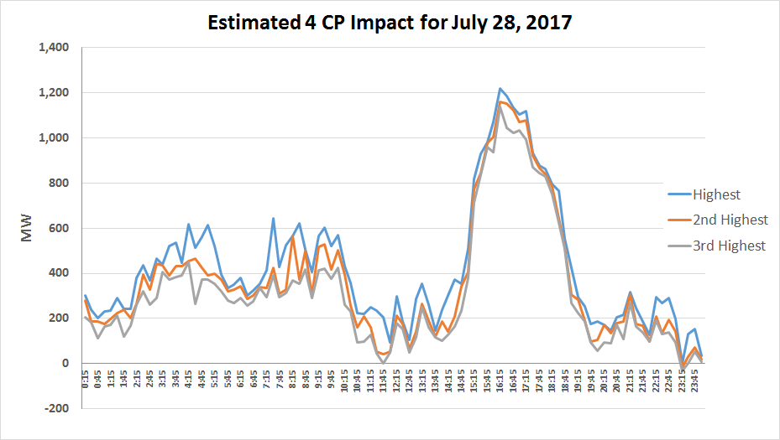
Estimate of 4 CP Impacts

Slide 31
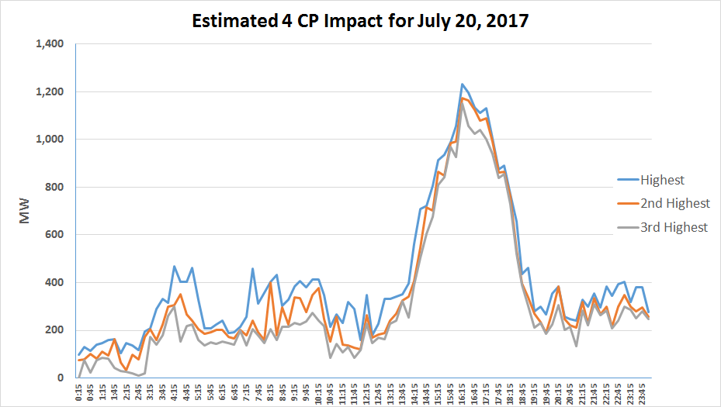
Estimate of 4 CP Impacts

Slide 32
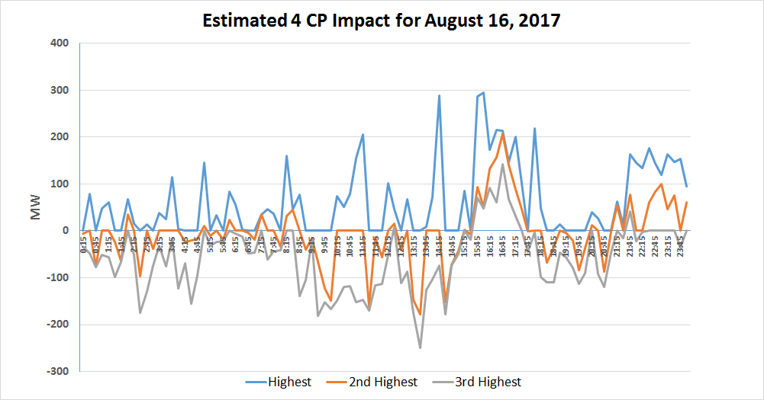
Estimate of 4 CP Impacts

Slide 33
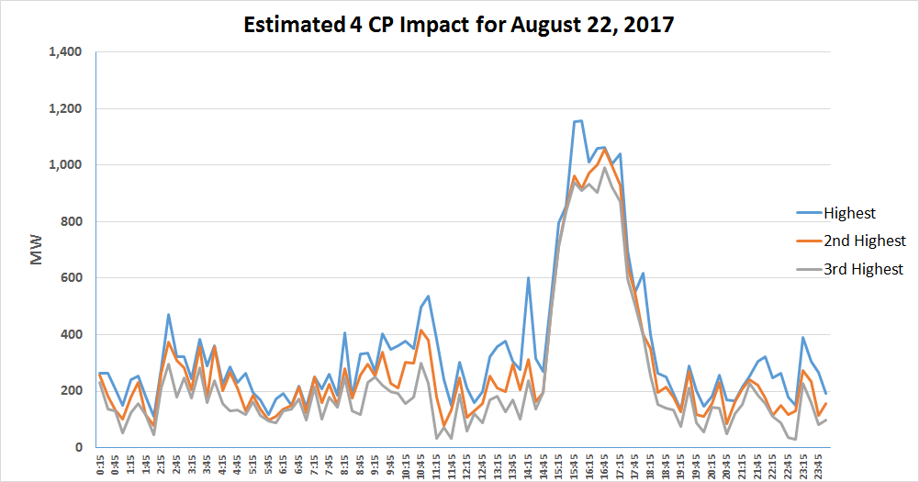
Estimate of 4 CP Impacts

Slide 34
Estimate of 4 CP Impacts – Calculation Details
Data source is the load for transmission premises from settlements (LTRANSTL)
Using this aggregated load, determine the highest MW for each 15-minute time period during each calendar month
Also determine the second and third highest MW for each 15-minute time period during each calendar month
Subtract the load from the summer peak day (7/28/2017) from the highest MW value for each interval
Subtract the load from the summer peak day (7/28/2017) from the second highest MW value for each interval
Subtract the load from the summer peak day (7/28/2017) from the third highest MW value for each interval
These differences approximate the 4 CP impact

Slide 35
Estimate of 4 CP Impacts
This estimate is conservative
Does not include impacts from the NOIEs
Does not include the impacts from other non-transmission (distribution) premises
Both of the above have significant weather sensitive loads which makes the estimate of 4 CP more difficult
Requires a different technique(s) to quantify their 4 CP impact

Slide 36
Assumptions and Challenges

Slide 37
Load Forecasting Assumptions
Current Modeling Framework Assumes:
Inherent levels from the input data for
Appliance stock / energy efficiency
Demand Response, 4 CP Impact, behind-the-meter DG, Price Responsive Load
Electric Vehicles
No increase in territory to be served by ERCOT
Lubbock is not included
No discrete increase for additional larger industrial facilities (except for Freeport)
No incremental adjustments (positive or negative) to the load forecast have been applied for the above

Slide 38
Load Forecasting Challenges
Weather Volatility
Extreme weather events (record heat and cold, drought, flood, etc.) seem to occur fairly frequently
Economic Uncertainty
Accuracy of economic forecasts
Recession has occurred every decade since the 60s
Policy Impacts
Behind the meter DG growth
Energy efficiency growth
Increased price caps
Loads in SCED

Slide 39
Active Models

Slide 40
Models
ERCOT maintains an ensemble of load forecast models
Neural Network models based on a single linear node
Linear Regression model representation of the single linear node Neural Network model
Uses the exact same variables, relationships as the single linear node Neural Network model
Is easier to share the model form with Market Participants (i.e., the variables are easier to interpret than those from the Neural Network model)
Results are very close to the Neural Network model
Neural Network models based on linear and higher order nodes
Models are maintained for daily energy forecasting, hourly energy forecasting, and a combination

Slide 41
ERCOT P50 Forecast

Slide 42
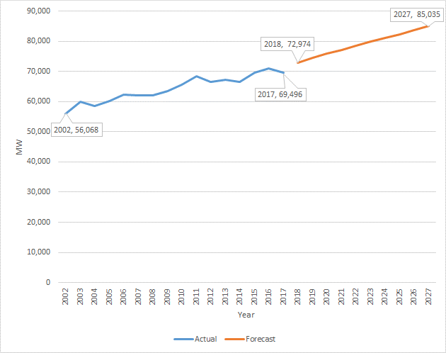
ERCOT Summer Peak Demand

Slide 43
ERCOT Summer Peak Forecast
Notes:
Model error is looking back.

Slide 44
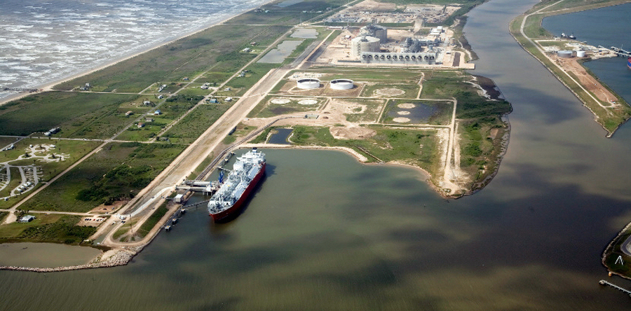
Forecast Adjustments
Freeport LNG Facility
Incremental load of 655 MW was added to the forecast
One train is operational during the 2018 summer peak
Three trains are operational during the 2019 summer peak
This load was
included in the
previous forecast
No reduction in the
facility load was
assumed for 4 CP
and/or high price
intervals

Slide 45
ERCOT Summer Peak Forecast
Forecast begins 1.5% lower than the 2017 long-term load forecast but ends 1.5% higher
Compared to 2017 long-term load forecast
Stronger growth in:
Coast (100 MW – 400 MW higher)
Far West (300 MW – 2,000 MW higher)
South (100 MW – 600 MW higher)
Weaker growth in:
North Central (500 MW lower)
South Central (300 MW – 700 MW lower)
Notes:
Model error is looking back.

Slide 46
ERCOT Annual Energy Forecast
Forecast is 2% to 7% higher than the 2017 long-term load forecast
Notes:
Model error is looking back.

Slide 47
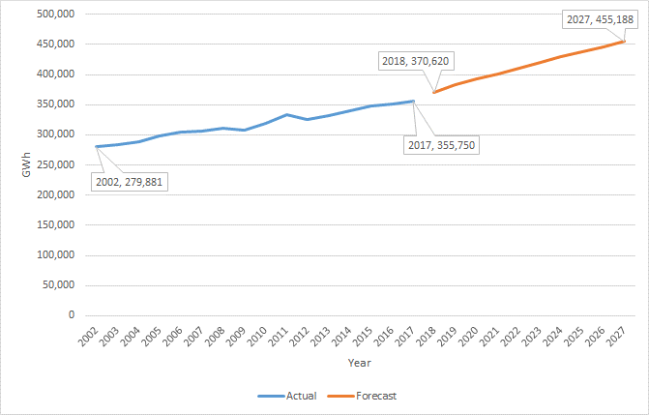
ERCOT Annual Energy

Slide 48
Weather Zone Forecasts

Slide 49
90th Percentile (P90) Forecast
Performed at the Weather Zone Level
Forecasted values are sorted from high to low for using each historical weather year as input
The 90th percentile is calculated for the sorted values
Example:
Below are the top 5 peak values for Coast for 2018 using 2002 – 2016 historical weather data

Slide 50
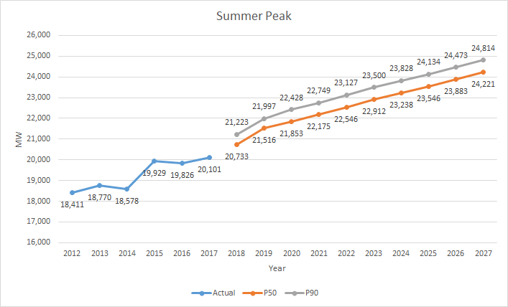
Coast

Slide 51
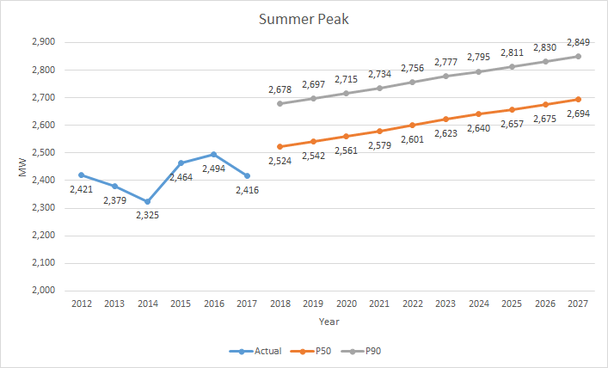
East

Slide 52
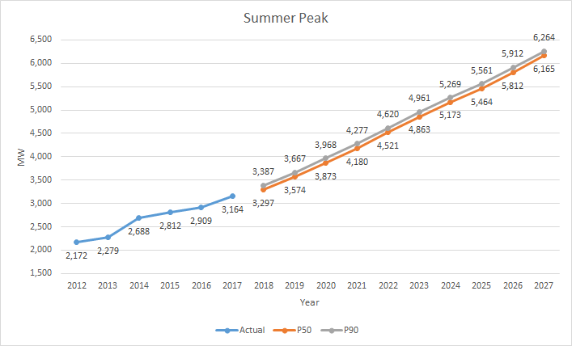
Far West

Slide 53
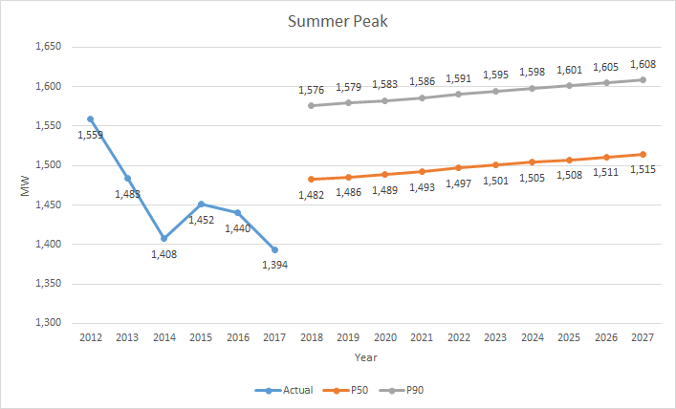
North

Slide 54
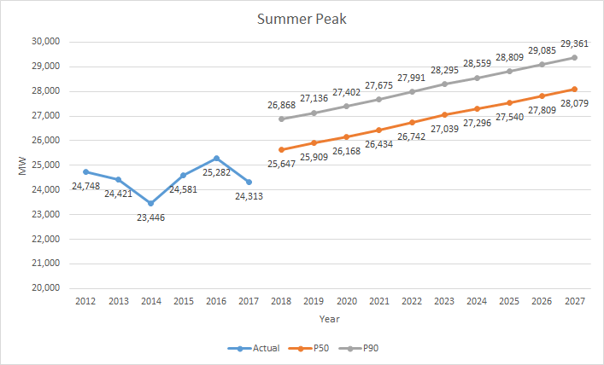
North Central

Slide 55
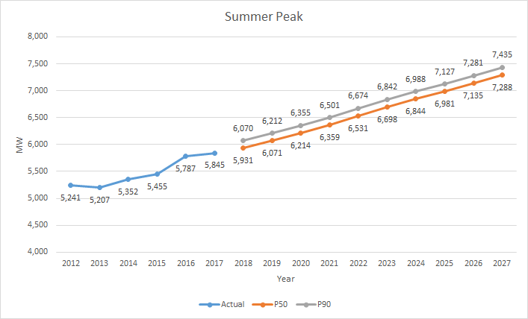
South

Slide 56
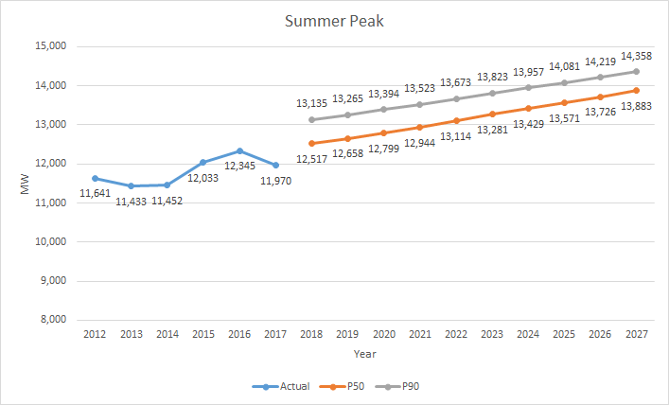
South Central

Slide 57
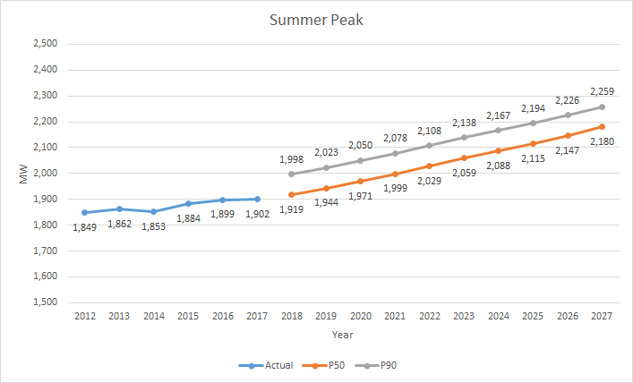
West

Slide 58
Questions?

