Slide 1
Summary of the Current Operating Plan (COP) Submittal Process and Uses
Market Analysis
QMWG
12/4/2017

Slide 2
COP Content
Resource name
For each day and hour in the next seven Operating Days:
  Expected Resource status (ON, OFF, OUT, etc.)
  High and low sustainable and emergency limits (HSL, LSL, HEL, and LEL)
  AS Resource Responsibility capacity for Reg-Up, Reg-Down, RRS, and Non-Spin

Slide 3
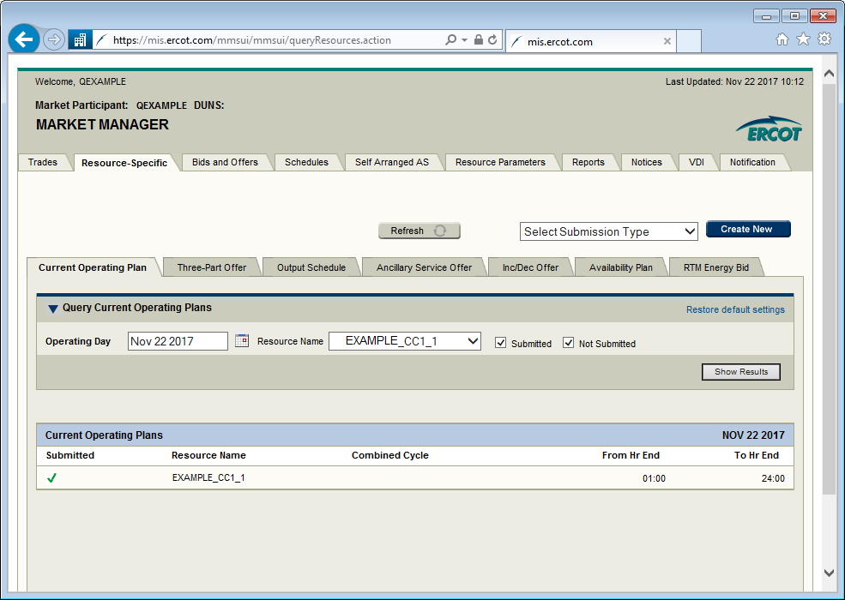
Market Manager Submission

Slide 4
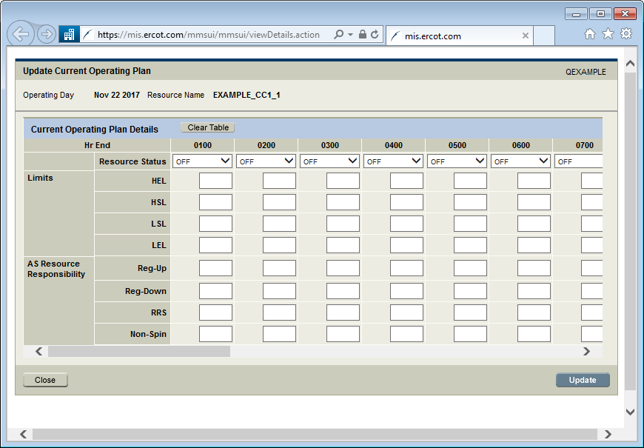
Market Manager Submission

Slide 5
API Submission
QSE can generate and submit the XML messages through an application programming interface (API)
Enables integration of COP submissions into QSE computer systems to increase the efficiency and accuracy of submitting COPs

Slide 6
COP XML Example
<BidSet xmlns="http://www.ercot.com/schema/2007-06/nodal/ews">
<tradingDate>2008-01-01</tradingDate>
<COP>
<startTime>2008-01-01T00:00:00-05:00</startTime>
<endTime>2008-01-02T00:00:00-05:00</endTime>
<marketType>DAM</marketType>
<resource>Resource123</resource>
<ResourceStatus>
<startTime>2008-01-01T00:00:00-05:00</startTime>
<endTime>2008-01-02T00:00:00-05:00</endTime>
<operatingMode>ON</operatingMode>
</ResourceStatus>
<Limits>
<startTime>2008-01-01T00:00:00-05:00</startTime>
<endTime>2008-01-02T00:00:00-05:00</endTime>
<hsl>45.50</hsl>
<lsl>15.14</lsl>
<hel>3.1</hel>
<lel>3.1</lel>
</Limits>
<ASCapacity>
<startTime>2008-01-01T00:00:00-05:00</startTime>
<endTime>2008-01-02T00:00:00-05:00</endTime>
<regUp>3.1</regUp>
<regDown>3.1</regDown>
<rrs>3.1</rrs>
<nonSpin>3.1</nonSpin>
</ASCapacity>
</COP>
</BidSet>

Slide 7
COP References
Protocol Section 3.9, Current Operating Plan (COP)
Business Practice Manual “Current Operating Plan Practices By QSE”
  http://www.ercot.com/mktrules/bpm/index.html
  Communicates to the QSEs, ERCOT’s expectations regarding COP entries based on the usage of the COP data by the various ERCOT market and operations systems.
XML Message Specification
  EIP External Interfaces Specification v1.20I
  http://www.ercot.com/content/wcm/lists/89535/eip_external_interfaces_specification_v1_20I.zip

Slide 8
General COP Requirements and Expectations
Summary from Protocol Section 3.9, Current Operating Plan (COP) and the Business Practice Manual “Current Operating Plan Practices By QSE”
Required from each QSE for each Resource it represents
Reflects expected operating conditions for each Resource for each hour in the next seven Operating Days.
Report changes to the COP for all hours after the Operating Period through the rest of the Operating Day
Should be updated to reflect changes in availability as soon as reasonably practicable, but no later than 60 minutes after the event that caused the change.
The expectation is that the amount or level of uncertainty starts low and increases as the time horizon of the plan is extended.

Slide 9
COP Uses and Snapshot Times
Use | Time of Snapshot or Snapshot Used
RUC | RUC execution time
DAM | DAM execution time
Look Ahead SCED | Look Ahead SCED execution time
SASM | SASM execution time
AS deployment | AS Deployment execution time
AS responsibility check | Top of each hour and 14:30
System conditions displays and reports | Beginning of display or report generation process
Settlements | End of the Adjustment Period snapshot, RUC snapshot, DAM snapshot
System operations future studies | RUC snapshot or study execution time

