Slide 1
Transformer Reactive Power Losses Due to GIC

Slide 2
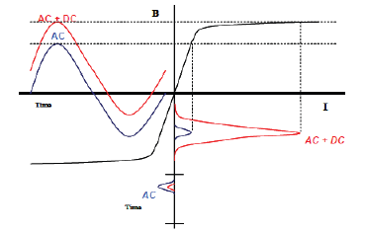
Transformer Saturation and Reactive Power Losses
The DC offset can cause transformer saturation which links to dramatic increase in the transformer excitation current.
Excitation current lags system voltage by 90 degree and therefore associated with reactive power losses
$$Q_{loss}= I_{effective}×k×\frac{V_{H}}{500}$$

Slide 3
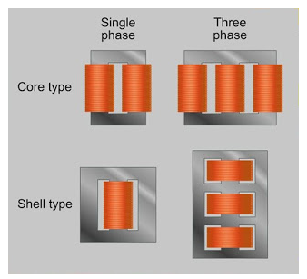
Transformer Core Types

Slide 4
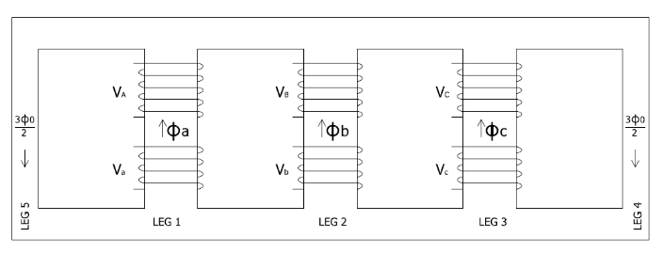
Transformer Core Types
5-Lagged Core
7-Lagged Shell

Slide 5
Default K Factor Values
 | Default K Factor Values
 | PSSE | Powerworld
Three Phase Shell | 0.33 | 0.80
Three Phase Core | N/A | 0.50
Single Phase (Three separate cores) | 1.18 | 1.70
Three Phase, 3-legged , Core | 0.29 | 0.80
Three Phase, 5-legged , Core | 0.66 | 0.80
Three Phase, 7-legged , Core | 0.66 | 0.80
Unknown core, <=200kV | 0.60 | 0.80
Unknown core, >200kV and <= 400kV | 0.60 | 0.80
Unknown core, >400kV | 1.10 | 1.70

Slide 6
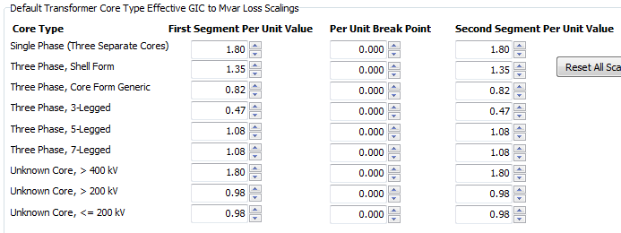
Linear or Multi-Segment

Slide 7
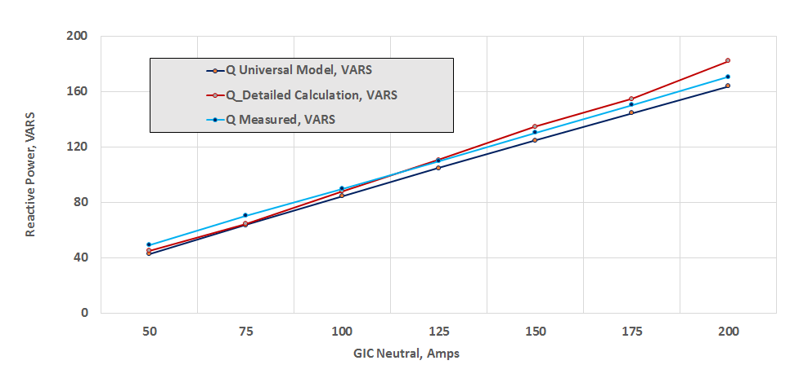
ABB’s Assessment Model

Slide 8
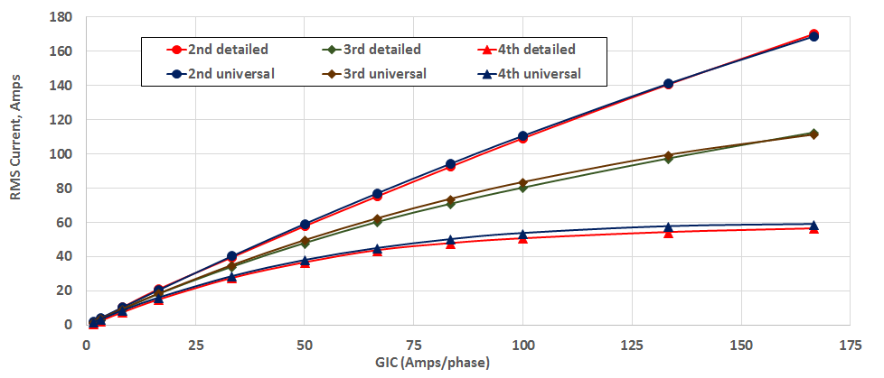
ABB’s Assessment Model
333 MVA, 500 / 230 kV, Single phase Transformer

Slide 9
Approaches for Obtaining k Factor Values
Default values
Request from manufactures
Transformer modeling and simulation (using topologically correct core model)

