Slide 1
FIP + Fuel Adder
VS
Coal Prices
ERCOT
RCWG
Nov 29, 2017

Slide 2
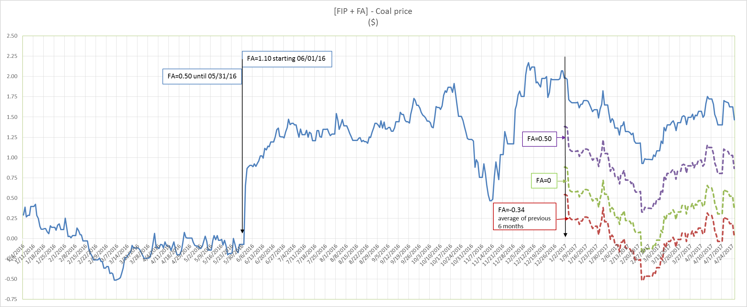
Price Comparison

