Slide 1
ERCOT Transmission Project Planning Process
Jeff Billo
DSWG
November 17, 2017

Slide 2
Genesis of a Transmission Project
Transmission Project
Regional Transmission Plan
Regional Planning Group Review
TSP Internal Studies

Slide 3
Regional Transmission Plan (RTP)
Planning Guide 3.1.4
Annual study completed by December 31
Comprehensive analysis of reliability and economic transmission needs for the ERCOT grid
2017 Scope: 2019, 2020, 2022, 2023 summer peak reliability; 2020 off-peak reliability; 2020, 2023 economic
Case Conditioning
Start with Steady State Working Group base case
Remove projects not approved by RPG
Reliability Analysis
Test case for compliance with NERC TPL-001-4 and PG Section 4
Propose “Corrective Action Plans” for criteria violations
Economic Analysis
Perform 8760-hour production cost analysis to find congestion on system
Study projects that may pass economic benefit test per Protocol 3.11.2
Adjust load forecast per “Bounded Higher Of Methodology” (PG 3.1.7)
Work with TSPs
The RTP combines inputs from economic, cascade, multiple element outage, sensitivity, short circuit, contingency, SCOPF analyses and long lead time assessments.

Slide 4
RPG Review
Protocol 3.11.4 and Planning Guide 3.1.2, 3.1.3, and 3.1.5
Process initiated by project submission to RPG (via ERCOT)
Projects identified through RTP still need to go through RPG review
Four tier classification of projects determines level of review
Case Conditioning
Start with Steady State Working Group or RTP base case
Need Analysis
Test case for reliability and/or economic need per NERC TPL-001-4, Protocol 3.11.2, and/or PG Section 4
Project Alternative Analysis
Study project alternatives
Adjust load forecast per “Bounded Higher Of Methodology” (PG 3.1.7)
Select “best” project based on cost, long-term need, implementation schedule, etc.
Designate TSP(s) to construct project

Slide 5
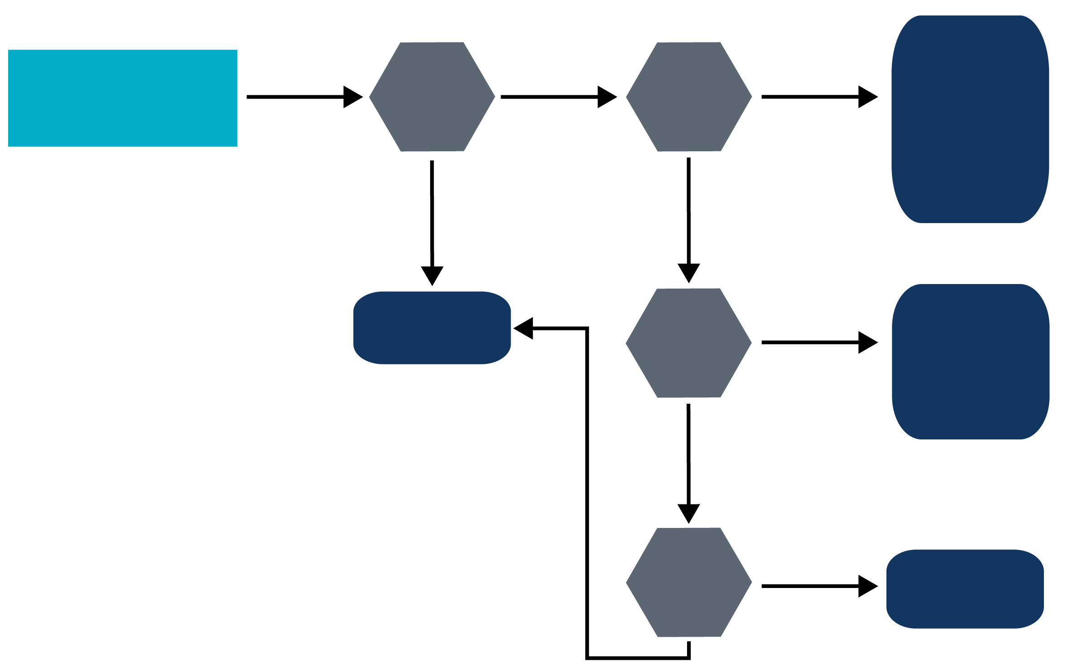
Tier Classification (Per Protocol 3.11.4)
Tier 1
RPG Review and
Comment
ERCOT Independent
Review
ERCOT Board of
Directors Endorsement
Proposed
Project
Is it a
neutral*
project?
>$50
Million
Capital
Cost?
No
Yes
Yes
No
Tier 4
No ERCOT Review
Certificate of
Convenience
and Necessity
required?
Yes
Tier 2
RPG Review and
Comment
ERCOT Independent
Review
*Neutral projects are:
The addition of or upgrades to radial transmission lines; the addition of equipment that does not affect the transfer capability of a line;
Repair and replacement-in-kind projects;
Projects that are directly associated with the interconnection of new generation; and
The addition of static reactive devices.
(Nodal Protocol 3.11.4.4)
No
>$15
Million
Capital
Cost?
No
Tier 3
RPG Review and
Comment
Yes

Slide 6
Transmission Planning Criteria
Reliability
NERC TPL-001-4
ERCOT Planning Guide Section 4
If ERCOT or a Transmission Service Provider (TSP) identify a reliability criteria violation they are required to develop a Correction Action Plan (CAP)
Economic
ERCOT Protocols 3.11.2

Slide 7
Challenges for Non-wires Alternatives
ERCOT/ TSPs only have authority to recommend transmission projects
Project commitment and accountability
Operator dispatch control and visibility
Predictability

Slide 8
Questions?

