Slide 1
Texas Leads the Nation in Cost-Effective Energy Savings Potential
Danielle Sass Byrnett
U.S. Department of Energy
November 14, 2017
Notes:
First time in Plano. I will never forget driving across west Texas --- from New Mexico to San Antonio (and then on to NOLA)…

Slide 2
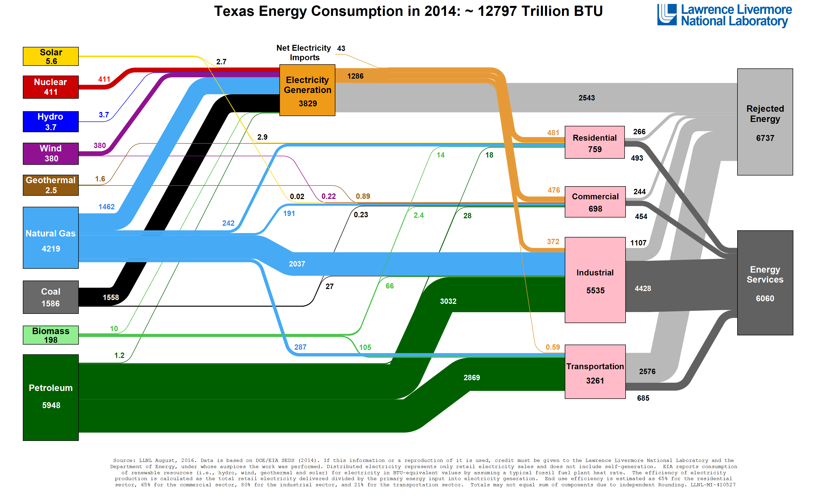
66%
53%
47%
Notes:
The Texas picture is a little better – we ONLY lose 53% of energy we consume. Note that for energy consumed for electric generation, 66% is lost.
End use efficiency for residential and commercial is 65%; and for industrial its 80%

Slide 3
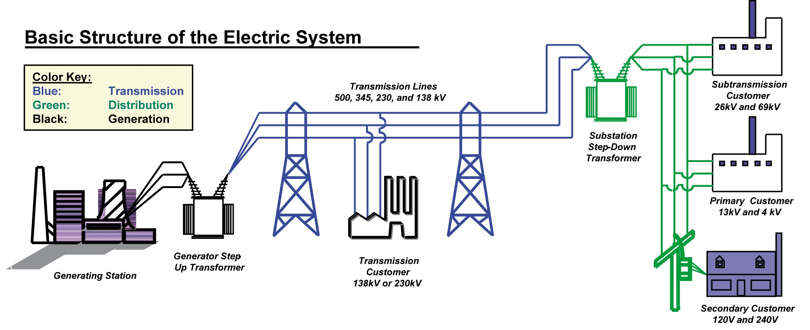
Electric System Losses = EE Multiplier
(44-68%)
Thermal / Conversion
(8%)
T&D
30-50%
Total Efficiency

Slide 4
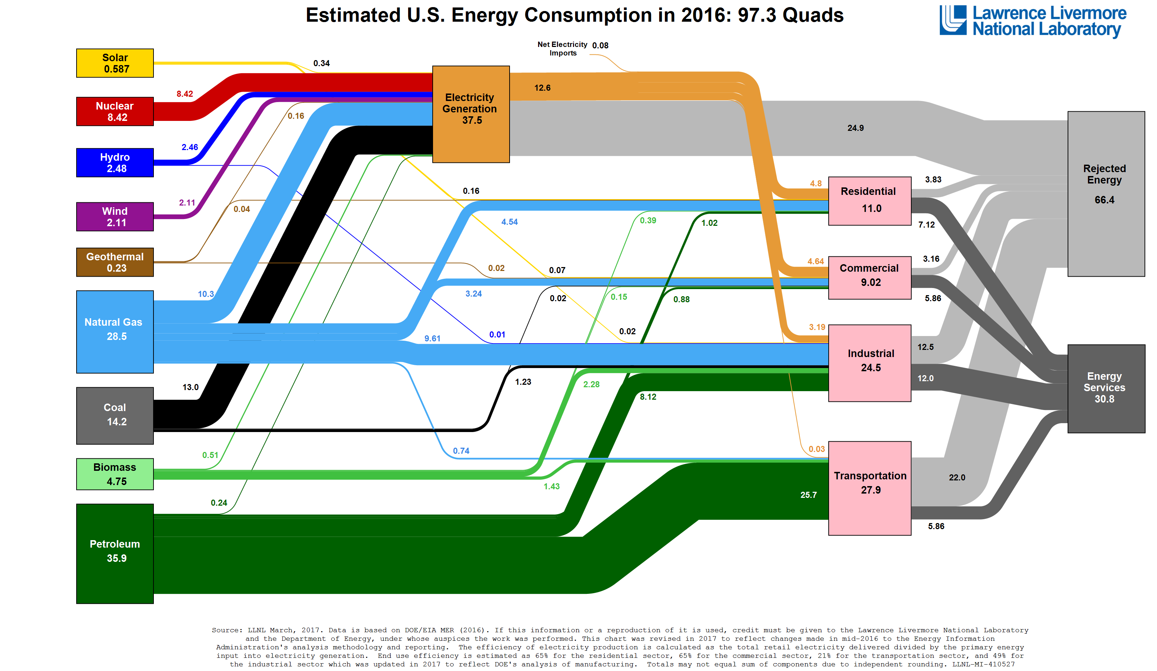
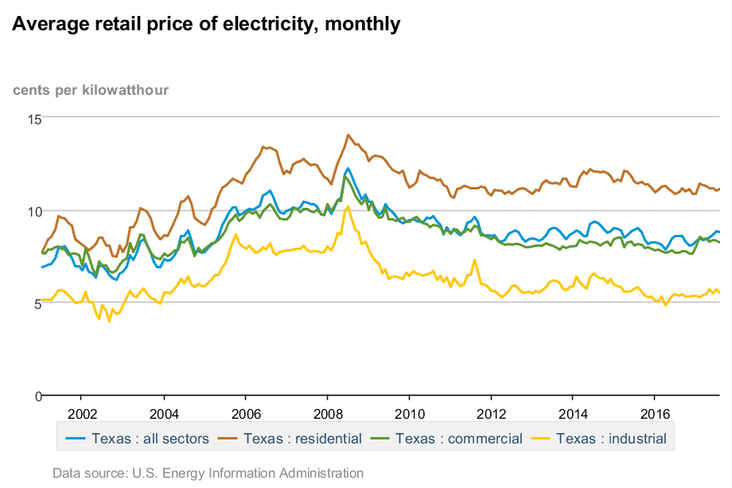
State | All | Resd | Comm | Ind
CA | 17.6 | 19.0 | 17.7 | 14.4
MA | 17.5 | 19.9 | 16.5 | 14.1
NY | 15.8 | 18.6 | 16.0 | 6.2
TX | 8.8 | 11.1 | 8.2 | 5.5
EIA - Electric Power Monthly, August 2017
Notes:
Why so much waste – energy is cheap (all things considered), especially in Texas.
Low, stable electricity prices for decades – counter to CA, MA and NY, which are often held up for model EE initiaitves.

Slide 5
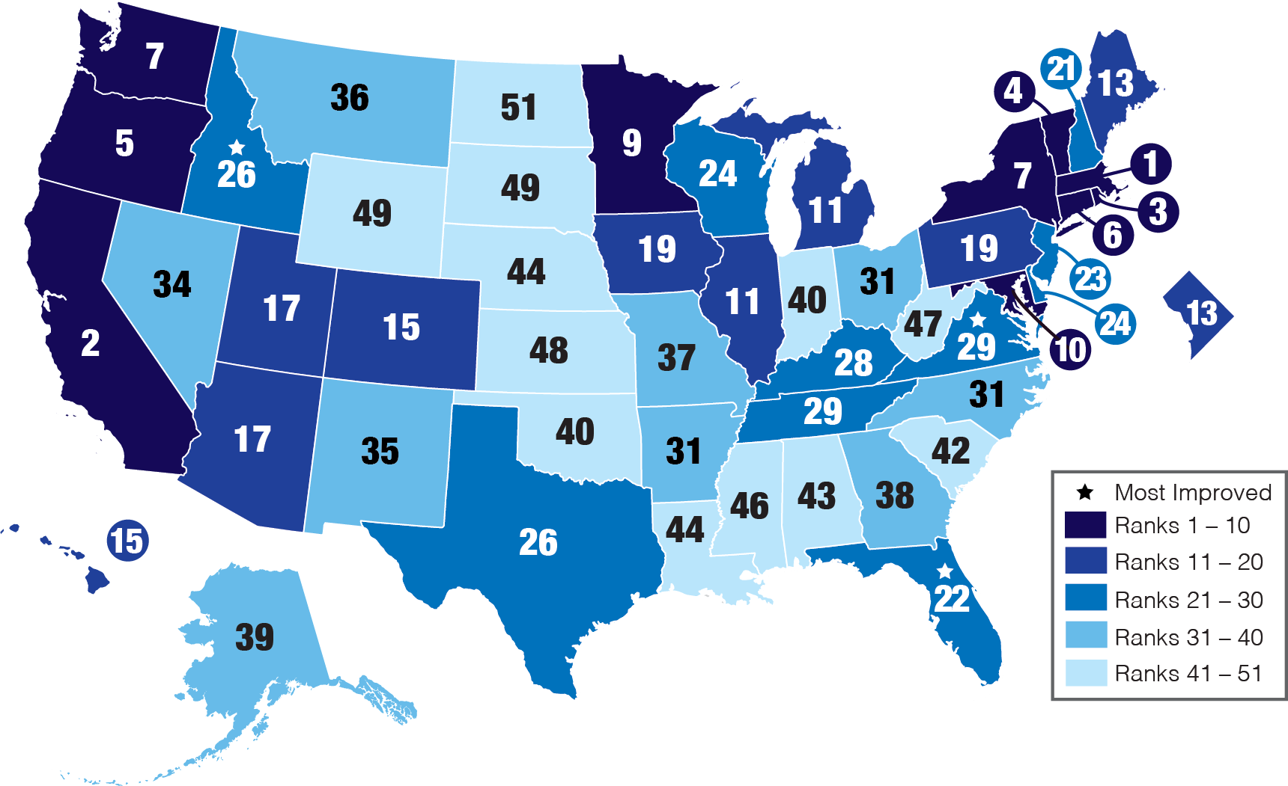
ACEEE State Energy Efficiency Scorecard
2017
Electric EE Programs
State | MWh Savings | % of Sales | Spending (millions) | % of Revenue
CA | 3,909,215 | 1.5% | 1364.1 | 3.5%
MA | 1,569,661 | 3.0% | 538.9 | 6.3%
NY | 1,599,900 | 1.1% | 425.2 | 2.0%
TX | 740,430 | 0.2% | 194.1 | 0.6%
ACEEE 2017 State Scorecard
Notes:
Texas ranks mid pack among states for EE according to ACEEE.
The annual ACEEE study is weighted toward utility EE policies and programs – TX has 19% of CA’s annual MWh savings and spends 14% as much

Slide 6
Capturing Energy Efficiency Savings is Feasible
16 states (1/3) achieving ≥1% annual incremental electricity savings
15 additional states (2/3 combined) achieving ≥0.4%
Top 10 States
State | 2016 net incremental savings, MWh | % of 2016 retail sales
MA | 1,569,661 | 3.00%
RI | 214,329 | 2.85%
VT | 138,318 | 2.52%
WA | 1,358,095 | 1.54%
CA | 3,909,215 | 1.54%
CT | 442,250 | 1.53%
AZ | 1,108,273 | 1.42%
ME | 157,921 | 1.38%
HI | 124,399 | 1.32%
MN | 847,830 | 1.31%
… | … | …
TEXAS | 740,430 | 0.19%
Share of U.S. electricity generation by resource in 2015
ACEEE, 2016
#26
Sources: ACEEE, 2017, The 2017 State Energy Efficiency Scorecard. ACEEE, 2016, The Greatest Energy Story You Haven't Heard.
Notes:
16 states achieved >1% annual electric savings in 2015, with 6 states 1.5-3%.² Many of these states have been running energy efficiency programs for decades and are continuing to cost-effectively increase savings.
2/3 states doing more than double what Texas is.
Energy efficiency potential studies are one part of state planning processes, and DOE sought to understand the resources available to states and utilities.

Slide 7
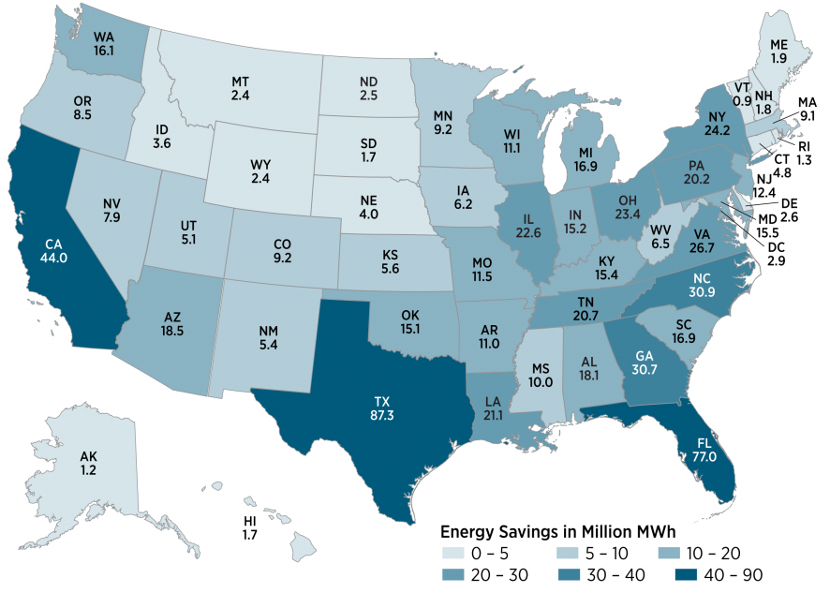
Total Economic Electricity Savings Potential (2016-2035) by State (million MWh)
EPRI: First consistent economic EE potential study across all states: residential, commercial equipment turnover; industrial top down
741 million MWh
National savings: 16%
State-level savings: 12% to 21% per state (TX:18.8%)
26 states with more than 15%
Source: Electric Power Research Institute (EPRI), 2017. State-Level Electric Energy Efficiency Potential Estimates
Notes:
Conservative estimate = .8% vs 1-2.5%
METHODOLOGY SLIDES IN APPENDIX
This dataset serves as:
Comparison for states with existing potential studies
Starting point for states without recent potential studies
Commissioned by DOE, EPRI conducted an update to their 2014 building sector, stock turnover model of economic (TRC) electricity potential savings analysis. At DOE’s request, they disaggregated the results to a state level.
The total national estimate is 741 million MWh of EE economic potential from 2016 to 2035, equivalent to 16% of baseline sales.
This is a conservative estimate (~0.8% annual savings, vs. 1-2.5% average annual savings identified across 2/3 of ~80 state- and utility-specific studies) but valuable in taking a consistent approach for all states --- and particularly helpful to the dozen or so states that haven’t had a potential study performed in the past ~7 years.
As you can see, every state has a large amount of electric EE potential that can be utilized as a cost-effective energy resource. This cost-effective electric potential grows over time as equipment reaches the end of its useful life and is replaced by a cost-effective efficient replacement.
State-level EE potential estimates range across states from 12% (Missouri) to 21% (Florida) in 2035 relative to the adjusted baseline sales – fluctuating based largely on sector composition and climate zone.
26 states show more than 15% savings available cost-effectively between 2016 and 2035 relative to the adjusted baseline sales.
Largest savings correlate to:
Climate
High electricity use
Population
Electricity-intensive manufacturing

Slide 8
2008 Itron Study for PUCT
17.6%

Slide 9
2008 Itron Study for PUCT
23.3%

Slide 10
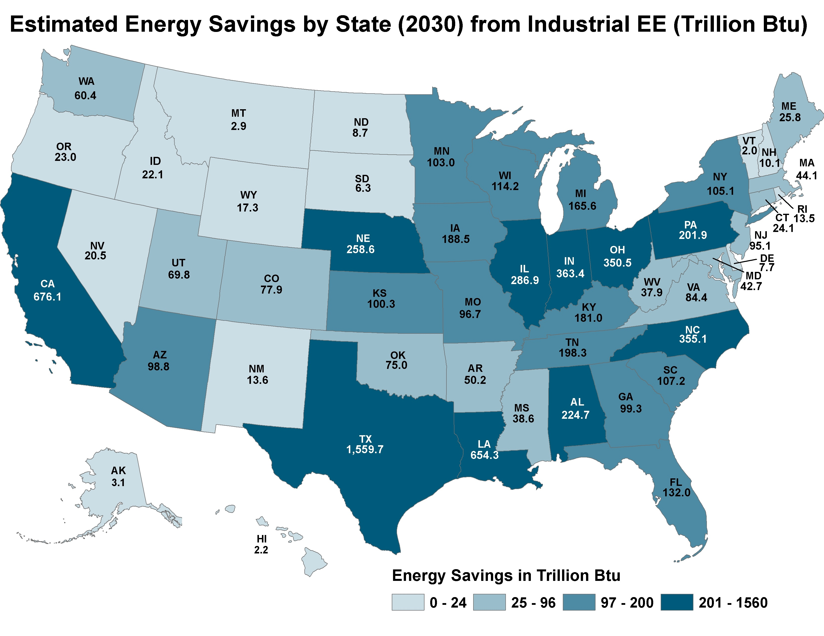
State-Level Economic Industrial Energy Savings Estimates (All Fuels)
Total energy savings:
7,500 trillion Btu
State-level energy savings: 2.2 (VT) to 1,560 (TX) trillion Btu per state
435.8 million MWh electricity savings
Source: DOE, 2017, energy.gov/eere/slsc/Eeopportunities.
Notes:
Aggressive estimate
Industrial sector accounts for largest share of energy consumption in the U.S. at 30%; and double R & C in Texas
There is a large opportunity for capturing energy efficiency potential in the industrial sector
The darkest blue shows the top 10 states in terms of industrial EE potential savings by 2030
Methodology:
Analysis uses historical growth averages for value of shipments to project economic growth out to 2030 for sectors within each state
This projection is combined with energy intensity projections to estimate future state energy consumption for two different scenarios:
The BAU scenario utilizes EIA’s projections in energy efficiency out to 2030; for example, EIA’s industry-wide BAU rate is 1.2%
The second scenario estimates savings by 2030 if each sector were to double their BAU rate of energy efficiency improvement, which would be 2.4% industry-wide (Better Plants = 2.5% reduced energy intensity/year)
Results indicated 435.8 million MWh in electricity savings and 7,500 trillion Btu in total fuel savings could be achieved by 2030
Could be achieved through plan or process efficiency improvements, incl. equipment upgrades or SEM/ISO50001

Slide 11
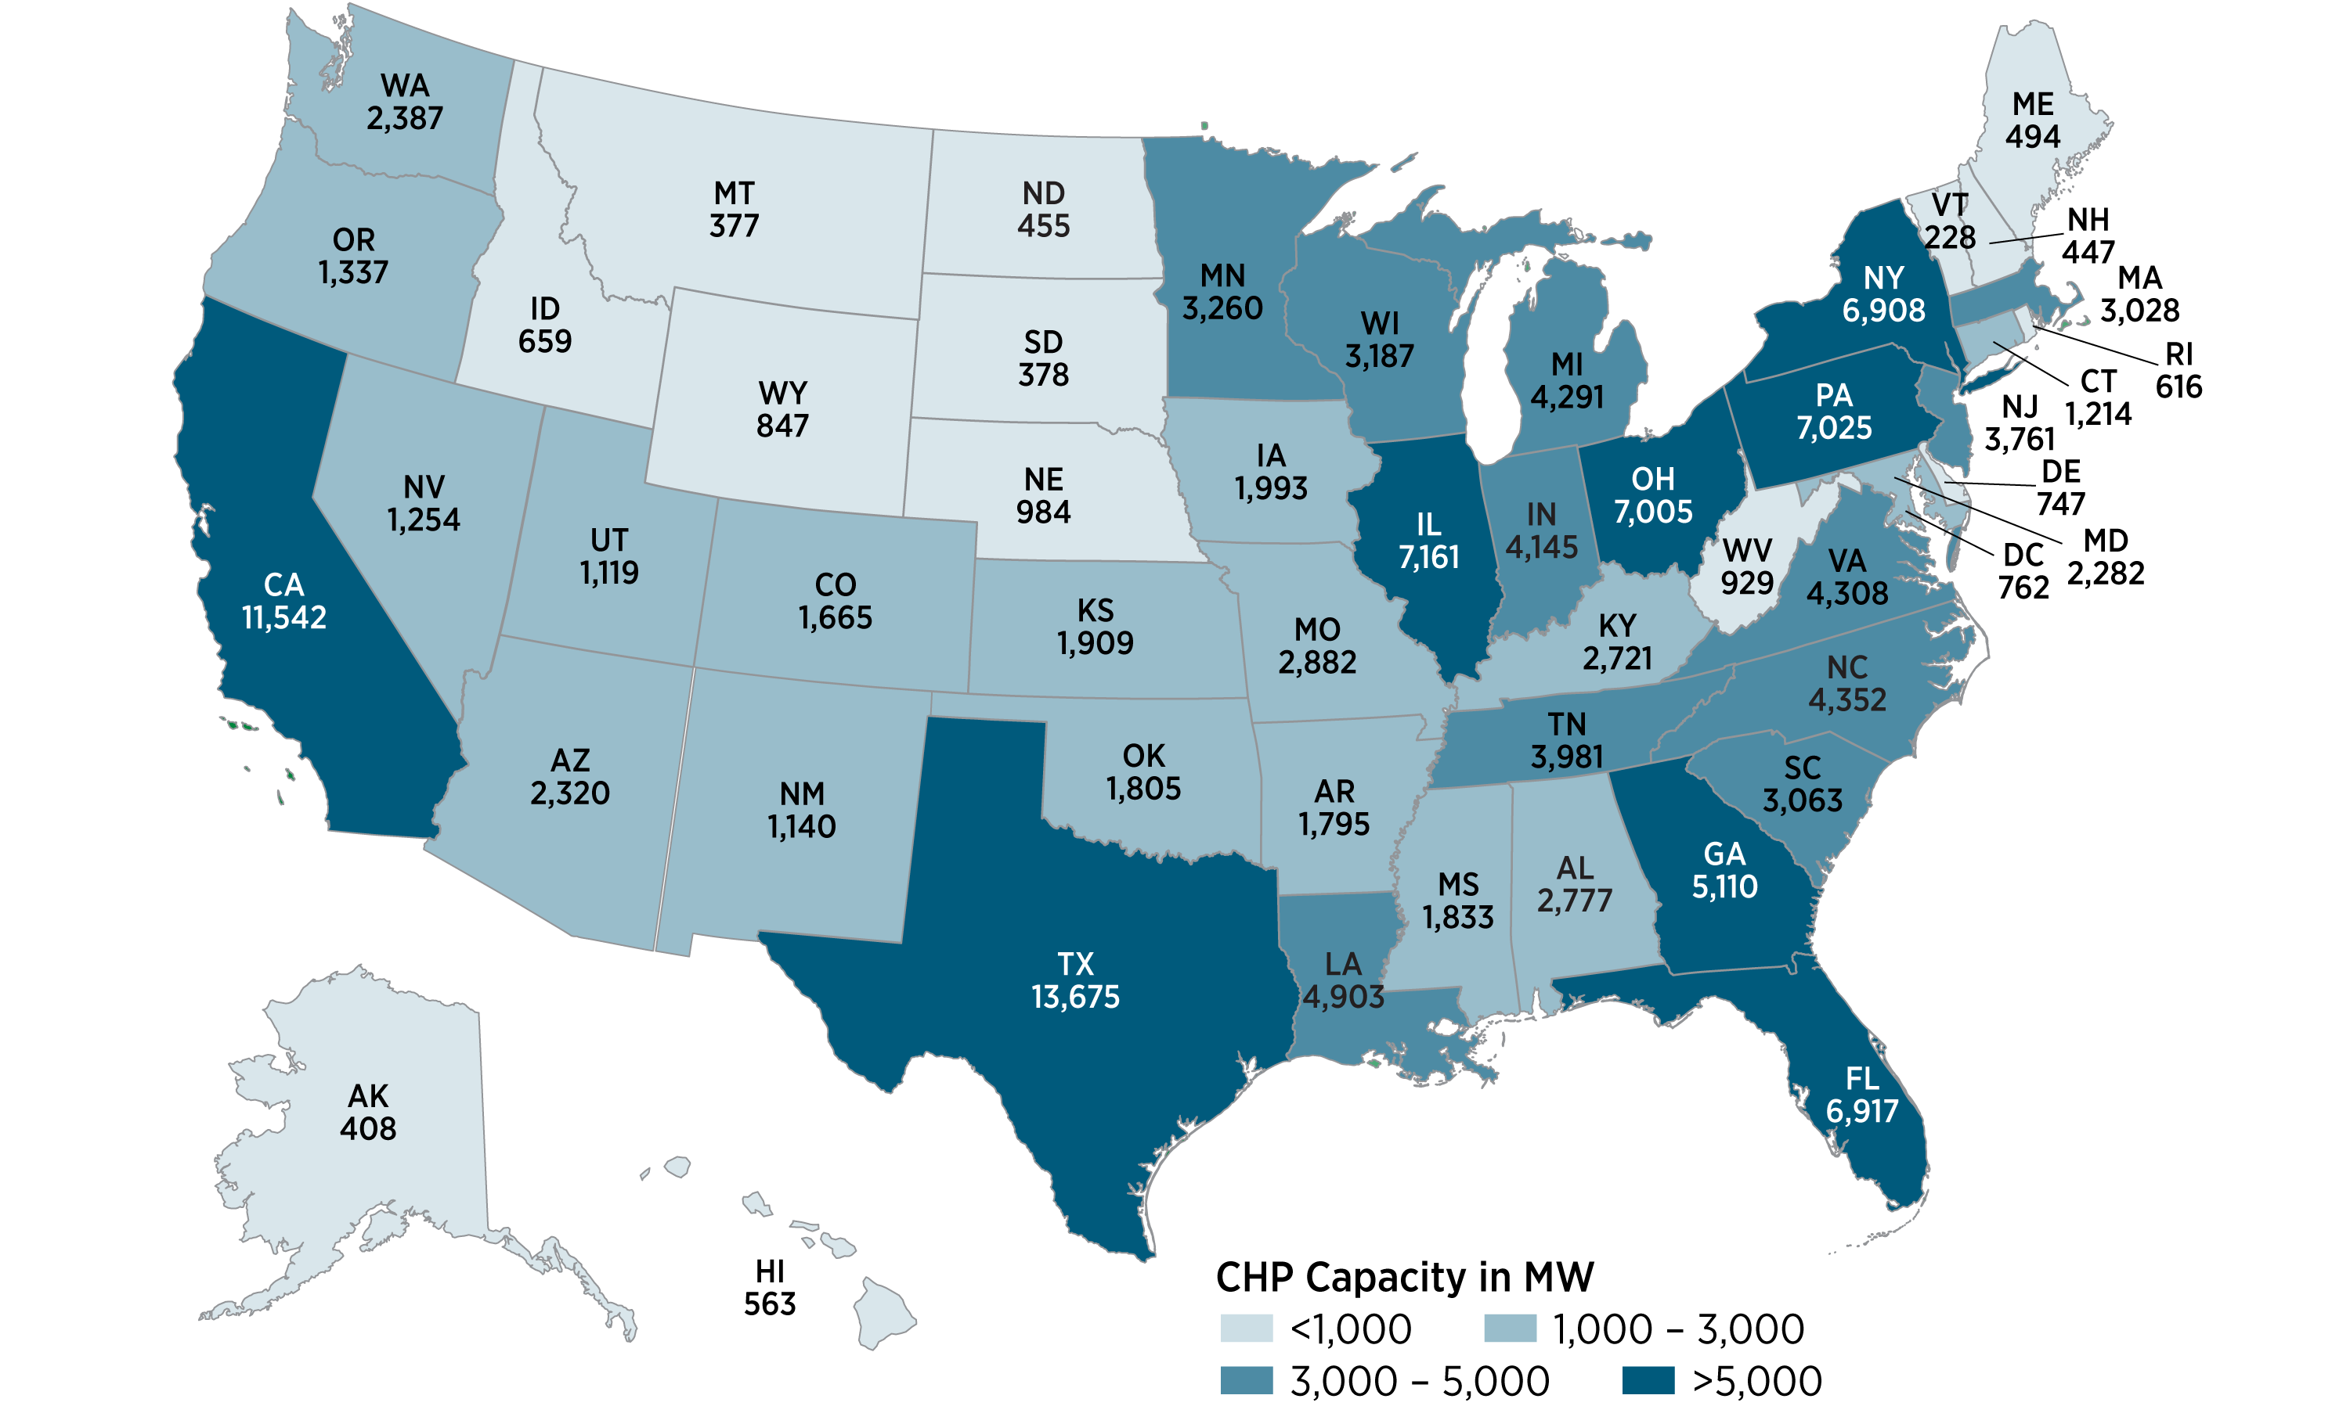
Estimated On-Site Technical Potential by State from Combined Heat and Power (CHP) (MW) Ind. & Comm. Bldgs.
National potential:
148,936 MW
State-level potential: 228 (VT) to 13,675 MW (TX) per state
U.S. DOE, 2016, Combined Heat and Power (CHP) Technical Potential in the United States, http://energy.gov/chp-potential
Notes:
From U.S. DOE, 2016, “Combined Heat and Power (CHP) Technical Potential in the United States”
Technical potential for CHP in U.S. industrial facilities and commercial buildings
Sufficient detail for stakeholders to consider CHP in strategic energy planning and energy efficiency program design
Total U.S. CHP Technical Potential = 240.6 GW at over 291,000 sites
Onsite Potential = 148.9 GW
Export Potential = 91.7 GW
Report includes national summaries and detailed state profiles and tables that include CHP opportunities by:
Sector
Facility type
Size range
(Technical potential is an estimation of the market size for “topping cycle” CHP, waste heat to power CHP (WHP CHP), and district energy CHP when constrained only by technological limits —without regard to economic or market factors)
Top states with high technical potential in both the industrial and commercial sectors include California, Illinois, New York, Ohio, Pennsylvania and Texas. These states have large manufacturing sectors (chemicals and refining in Texas, for example) with high CHP technical potential. They also have large cities with many opportunities for CHP at commercial and multifamily buildings as well as high concentrations of colleges and universities.

Slide 12
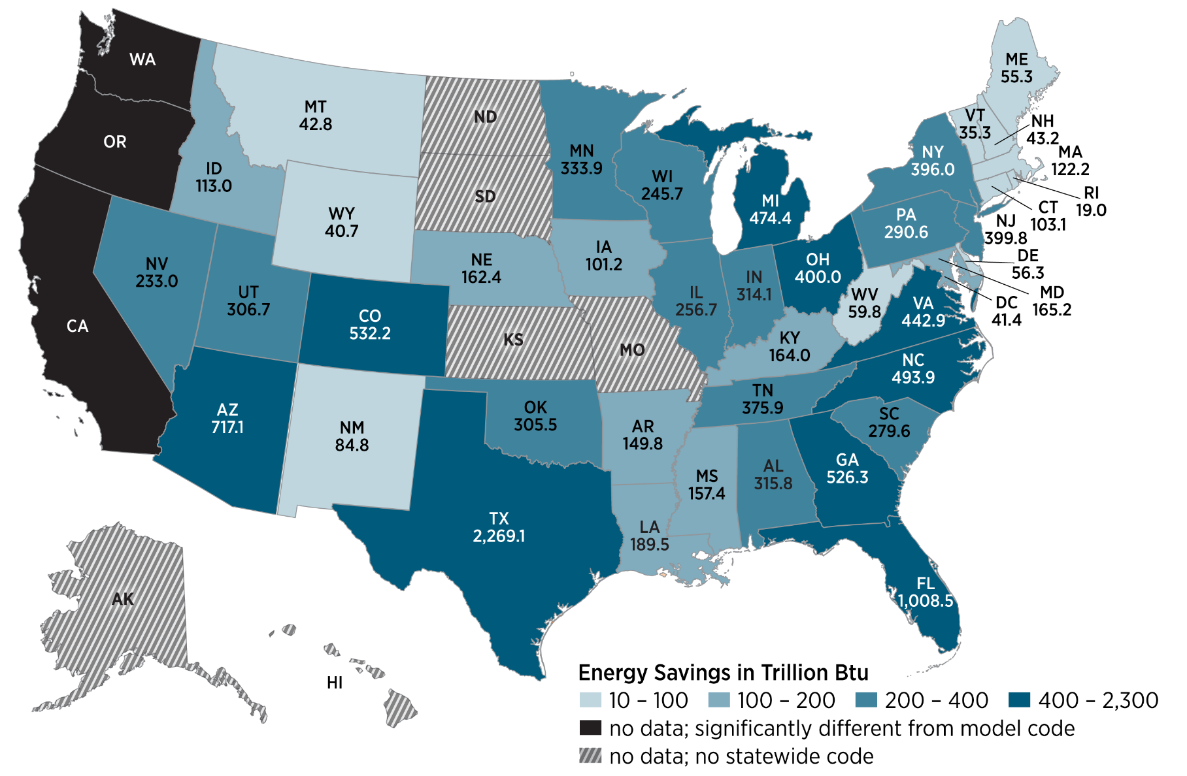
Estimated Achievable Potential Energy Savings by State (2010-2040) Building Energy Codes (Trillion Btu) Res. & Comm. Bldgs.
Total energy savings:
12,824 trillion Btu
State-level energy savings: 19 (RI) to 2,269 (TX) trillion Btu per state
Source: PNNL, 2016. Impacts of Model Building Energy Codes
Notes:
Methodology Highlights:
Residential & commercial buildings
National and state-level perspectives
Annual and cumulative projections (2010-2040)
All three phases of codes:
Development: Code-to-code savings—represents potential savings based on updated model codes [DOE Determination]
Adoption: Future adoption projected based on historical state adoption trends [DOE state adoption tracking]
Compliance: Savings de-rated based on what is achieved in the field [DOE and external studies]
Methodology (continued):
Excludes states without statewide codes (AK, HI, KS, MO, MS),
or that fundamentally differ from the model codes (CA, OR, WA)
Some ‘home rule’ states rely on data from populous jurisdictions as a surrogate for state compliance (AZ, CO, WY)
Residential compliance rates based on recent DOE field studies—commercial based on past DOE and external studies
Incremental savings are scaled by new floor space to calculate statewide and national savings (AEO 2015)
Several metrics reported (site, primary, FFC, cost, and CO₂)
It can be seen that certain states, such as Texas, Florida, and a few others, have much higher total savings than other states reflecting their relatively higher past and projected new floor space construction.
Texas Medium Slow adoption

Slide 13
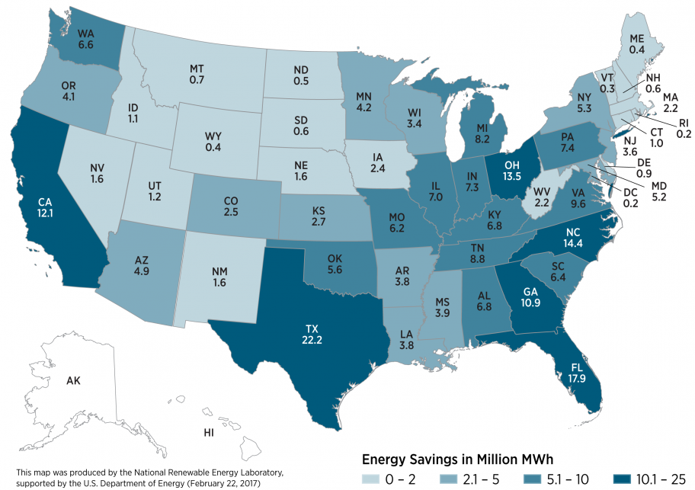

Residential Single-Family Detached Existing Housing: Economic Potential Electricity Savings (2012-2042)
Total electricity savings:
245 million MWh/yr
State-level electricity savings: 0.2 (DC) to 22.2 (TX) million MWh/yr per state
Would also save 4,200 trillion Btu of source energy (24% of consumption)
NREL, 2017. Electric End-Use Energy Efficiency Potential in the U.S. Single-Family Housing Stock, http://www.nrel.gov/docs/fy17osti/65667.pdf
Notes:
Sound bite: “The map shows what savings would result if U.S. homeowners made all cost-effective energy efficient upgrades (based on NPV>0). Energy upgrades include situation-specific combinations of central AC, furnaces, HPs, water heaters, lighting and appliances at the time of replacement, as well as insulating walls, insulating ceilings, and performing air sealing and duct sealing.”
Current report posted focuses on electricity savings. Analysis looked at all fuels.
******** Supplemental Information *********
Map was generated using ResStock, a data-driven tool for modeling the entire U.S. housing stock with unprecedented granularity (millions of simulations on NREL’s supercomputer)
- Results: Actionable analyses and visualizations of U.S. energy efficiency potential
- Leverages: A dozen public and private data sources (e.g. EIA RECS, Census/Housing Survey, Codes, Dept. of Homeland Security data), and DOE’s flagship energy simulation engine (EnergyPlus).
- Acknowledgement: ResStock was developed with support from BTO and other partners. Results on these slides are from a 2016 analysis supported by DOE-BTO and DOE-EPSA.
Economic potential includes electricity savings resulting from all upgrades in single-family detached homes that result in a positive net present value for the home owner, using a 3% real discount rate and 30 year analysis period.
Key assumptions for this analysis are listed below.
Technical and economic potential are presented as annual energy savings rather than cumulative energy savings over a number of years.
Economic potential calculations include net replacement costs at wear out assuming full turnover of the stock of equipment and appliances (over the 30-year analysis period). Cost-effectiveness is evaluated using costs and benefits from the building owner’s perspective rather than a utility or societal perspective.
For NPV calculations, 30 years of future cash flows (utility bill savings, equipment replacement at end of life, and residual value) are brought to the present using a 3% real discount rate.
The packages used to estimate overall economic potential were constructed using NPV as the cost-effectiveness metric.
The same economic calculations are used for both owner-occupied and tenant-occupied homes. For tenant-occupied housing, it is assumed that either the building owner pays the utility bills or rent can be increased by an amount equal to utility bill savings.
State, utility, and local incentives (e.g., rebates) were not included in the economic analysis, due to the large number of unique incentives that exist. The federal income tax credit for residential energy efficiency was included and assumed to be available in future years (capped at $500 per household).
The scope of this analysis is limited in the following ways:
The analysis covers single-family detached housing only. The housing stock characteristics tool developed for ResStock currently is limited to single-family detached housing and excludes all multifamily buildings (including duplexes and townhomes) as well as mobile homes.
House counts and housing characteristics are a snapshot based on circa-2012 data; projections of future construction and changes in housing characteristics were not included in this analysis.
Geographic scope is limited to the 48 contiguous U.S. states and Washington, D.C. Sources of housing characteristics and consumption data (particularly the Residential Energy Consumption Survey) for Alaska, Hawaii, and U.S. territories tend to have low sample sizes, resulting in high uncertainty in the data.

Slide 14
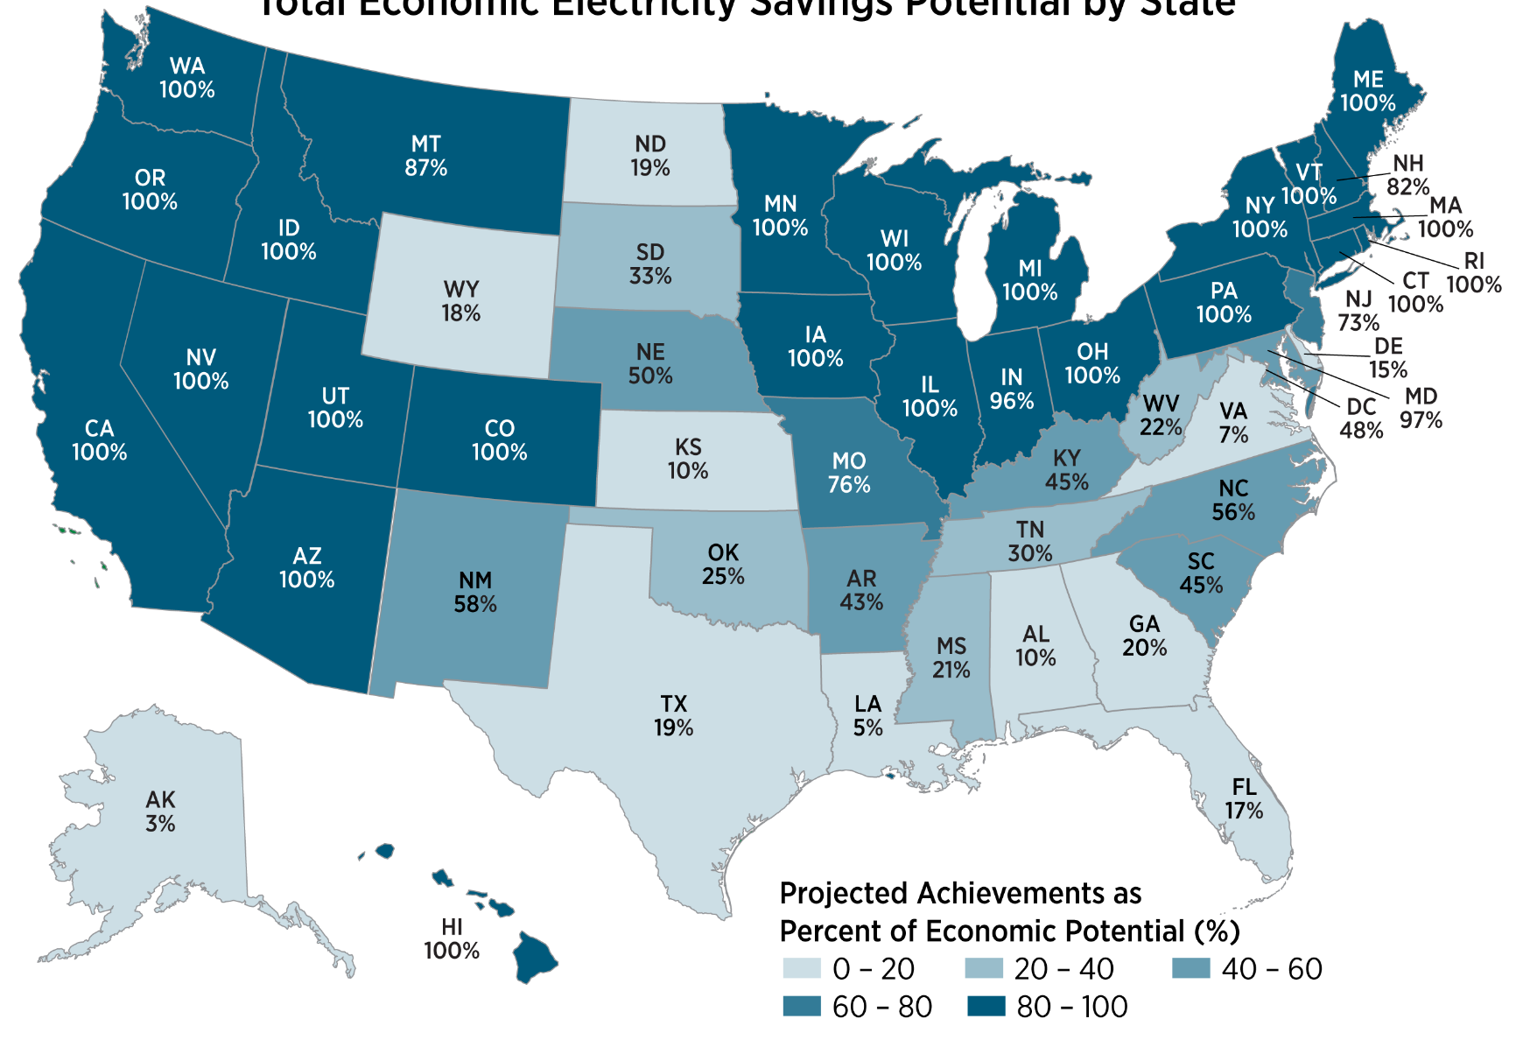
Summary: Texas is Leaving Lots of Cost-Effective Savings on the Table
Electricity Savings that could be Achieved through Continuation of Current Approaches (2016-2035) as Percent of Modeled Economic Potential by State
22 states on track to achieve 100% of modeled* economic savings
20 states on track to achieve <50%
*model excludes behavior-based programs, program efficiency; coarse technology improvement
Source: Electric Power Research Institute (EPRI), 2017. State-Level Electric Energy Efficiency Potential Estimates. Data on savings rates from ACEEE State Scorecard.
Notes:
The potential in each state was compared to the savings that could be achieved if states continue to realize the same average level of annual incremental savings as has been achieved in the past 10 years. (ACEEE State Scorecard data were used for to calculate the historic average annual savings.)
As you can see, >20 states are on track to achieve all* of the modeled savings this model views as cost-effective if they keep doing what they’re doing.
Conversely, 20 states are leaving a LOT of cost-effective savings on the table, as their current activities will get them less than 50% of what’s economic. (10 states <20%. )That means that their residents, businesses, and manufacturers are paying more for their electricity than they need to.
*The number of states achieving 100% points to limitations in the model and methodology (e.g., a lack of modeled energy efficiency opportunities) rather than a lack of likely savings available. The model outputs are determined by input factors including the technologies considered, the cost of those technologies, the avoided costs, and the program administration costs. If policies require higher levels of savings than projected in this study, program administrators might implement new or additional efficiency measures in order to reduce costs and achieve more savings, taking advantage of both technological innovation and cost reduction as well as other energy efficiency savings approaches, including behavioral savings, which are not considered here.

