Slide 1
SMT Update To AMWG
October 2017

Slide 2
Monthly SMT Data Timelines AMWG CR 2014 002 End to End File Processing Completeness – OCT 2017
% Timely Market Delivery - % of files posted to market (FTPS) by 11:00pm out of # of files received by SMT by 11:00pm.
% Portal Data Availability - % of files loaded to the database for data availability on portal by 6:00am next day for the files received by 11:00pm
A LSE file includes usage data for up to 50,000 ESIIDs.
2

Slide 3
SMT API and FTPS Services Availability – OCT 2017
The service availability is measured as a percentage of number of minutes the service was available out of the total number of minutes in a month, excluding planned outages.
Observed Anomalies:
Mar-Apr 2015: SMT outage and subsequent recovery/catch-up impacted API availability. FTPS was available for most of the part except on 03/21-03/22 for 36 hours.
26 Jul 2015: Services were unavailable for 12 hours due to Flash storage issue
25 Jan 2016: Services were unavailable for 19 hours due to storage configuration issue
07 Mar 2016: API Services were unavailable for 7hours due to Oracle archiver issue.
12 Jul 2017: Due to network Outage FTP & API services are down for 20 minutes. FTPS & API availability is 99.95%.
Notes:
3

Slide 4
SMT Number of Accounts by Type AMWG CR 2014 009 – October 2017
Registered Users | ONC | CNP | AEPN | AEPC | TNMP | TOTAL
Active Residential Accounts | 63337 | 29331 | 1907 | 5922 | 3937 | 104434
Active Residential English Accounts | 63117 | 29125 | 1900 | 5795 | 3927 | 103864
Active Residential Spanish Accounts | 220 | 206 | 7 | 127 | 10 | 570
Non Active Residential Accounts | 25099 | 16472 | 1847 | 4171 | 1075 | 48175
Total Residential Accounts | 88436 | 45803 | 3754 | 10093 | 5012 | 152609
TDSP User | 347 | 31 | 10 | 18 | 1 | 407
TDSP Admin | 4 | 4 | 4 | 4 | 3 | 19
Small Business User | 100 | 47 | 1 | 1 | 3 | 152
Small Business Admin | 3094 | 1658 | 89 | 346 | 153 | 5501
Total Agreements (Includes Active and Pending) | 13827 | 3454 | 82 | 268 | 1082 | 18713
Energy Data Agreements (Includes Active and Pending) | 13827 | 3215 | 82 | 268 | 1082 | 18474
Han Device Agreements (Includes Active and Pending) | 0 | 238 | 0 | 0 | 0 | 238
Han Service Agreements (Includes Active and Pending) | 0 | 1 | 0 | 0 | 0 | 1
IN SMT
ESI IDs | 3561785 | 2479354 | 198380 | 867938 | 249355 | 7356812
Meters | 3505138 | 2479261 | 199225 | 868381 | 248788 | 7300793
HAN Devices | 3308 | 4258 | 136 | 270 | 29 | 8001
Acknowledgement | 0 | 0 | 0 | 0 | 0
Pending | 0 | 11 | 0 | 0 | 0
Meter Ready | 5 | 3 | 39 | 90 | 17
Provisioned | 3302 | 4244 | 97 | 180 | 12
HAN Messages (MTD) | 0 | 0 | 0 | 0 | 0 | 0
HAN Messages (YTD) | 197 | 0 | 0 | 0 | 0 | 197
HAN Messages (Cumulative) | 577 | 7405 | 0 | 0 | 0 | 7982
Simple Text Messages | 165 | 2930 | 0 | 0 | 0
Load Control Messages | 163 | 2658 | 0 | 0 | 0
Pricing Messages | 173 | 53 | 0 | 0 | 0
Cancellation Messages | 76 | 1764 | 0 | 0 | 0
Supplemental – (Friends)
Total Agreements | 1907 | 1493 | 82 | 104 | 68 | 3654
Accepted Agreements | 792 | 579 | 36 | 32 | 23 | 1462
Pending Agreements | 3 | 1 | 0 | 0 | 0 | 4
Revoked Agreements | 333 | 284 | 11 | 8 | 7 | 643
Expired Agreements | 740 | 598 | 33 | 64 | 38 | 1473
Terminated Agreements | 39 | 31 | 2 | 0 | 0 | 72
 | TDSPs | REP | Small Business | Regulatory | Third Party
Registered Entities | 5 | 117 | 5318 | 2 | 165
Registered Users | 407 | 873 | 152 | 8 | 25
Registered Admins | 19 | 180 | 5340 | 3 | 151
HAN Messages Sent By | 540 | 7418

Slide 5
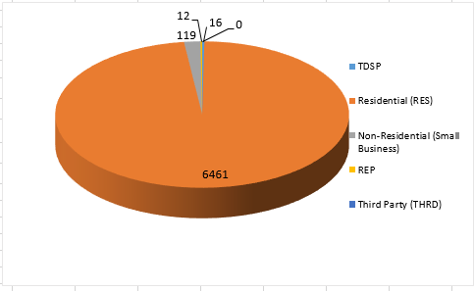
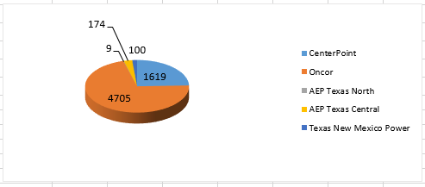
SMT ODR Details – OCT 2017
Total ODR Requests TDSP wise statistics:
Total ODR Requests User type statistics:

