Slide 1
Energy Efficiency Forecasting for the December 2017 CDR
Pete Warnken
Manager, Resource Adequacy
November 10, 2017

Slide 2
Energy Efficiency (EE) Forecast
Main change from May 2017 CDR: include NOIE energy efficiency savings estimates
2016/2017 annual cumulative savings reported to State Energy Conservation Office
10-year annual cumulative savings forecast provided by Austin Energy
The following slide shows the derivation of the energy efficiency forecast with current data; note that the forecast needs to be updated with peak loads from the 2017 Long-Term Load Forecast

Slide 3
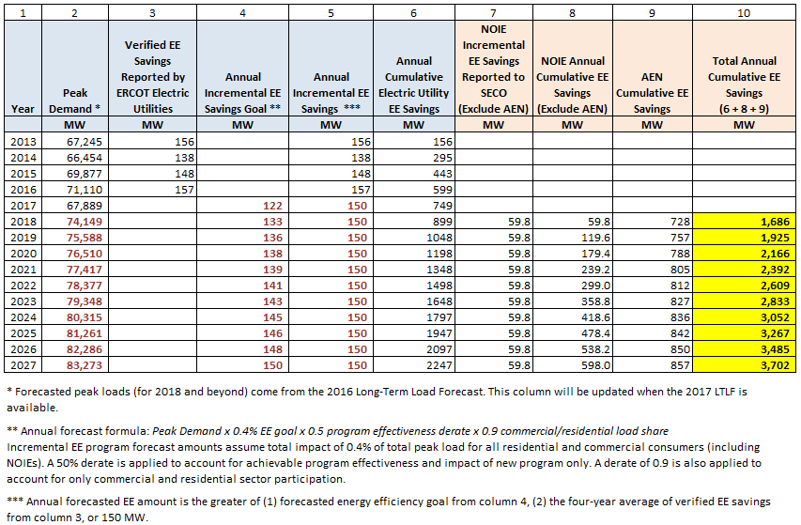
Energy Efficiency Forecast Derivation

