Slide 1
Credit Exposure Update
Spoorthy Papudesi
ERCOT Credit
November 15, 2017

Slide 2
Agenda
Inputs and assumptions
Observations
Exposure distributions
Appendix

Slide 3
Credit Exposure Update
Inputs and Assumptions:
Only Active Counter-Parties are included
Counter-Parties are classified by rating and market activity
TPE and collateral balances used are averages for September and October 2017
Counter-Parties that are subsidiaries of, or guaranteed by, rated entities are given the parent/guarantor’s rating, adjusted down one notch

Slide 4
Credit Exposure Update
Changes from August 2017 * to October 2017 *
Number of active Counter-Parties increased from 213 to 216.
Market-wide TPE slightly increased from 360 million to 362 million.
Excess Collateral decreased from 1,599 million to 1,573 million.
TPE of Load and Generation category as a percentage of Total TPE decreased by 10% while it increased for CRR only category by 6.27%
Relatively higher Real Time prices on October 1st and October 9th
Increase in CRR-related exposure due to Hurricane Harvey
*Numbers presented are averages of Jul-Aug 2017 and Sep-Oct 2017

Slide 5
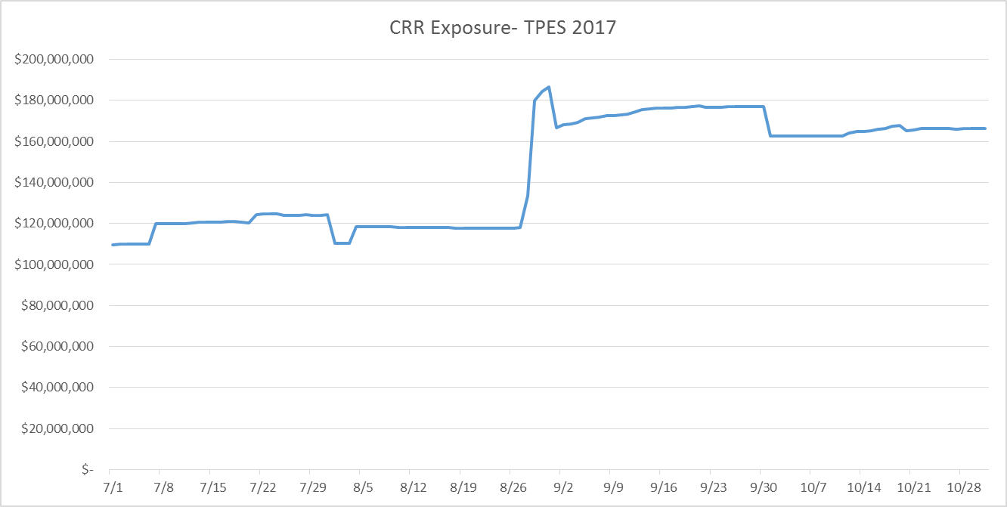
Credit Exposure Update

Slide 6
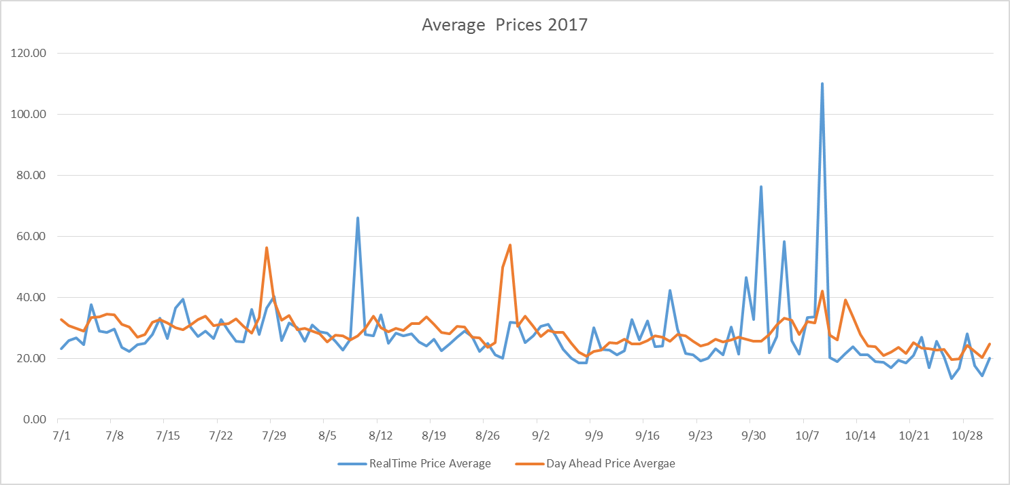
Credit Exposure Update

Slide 7
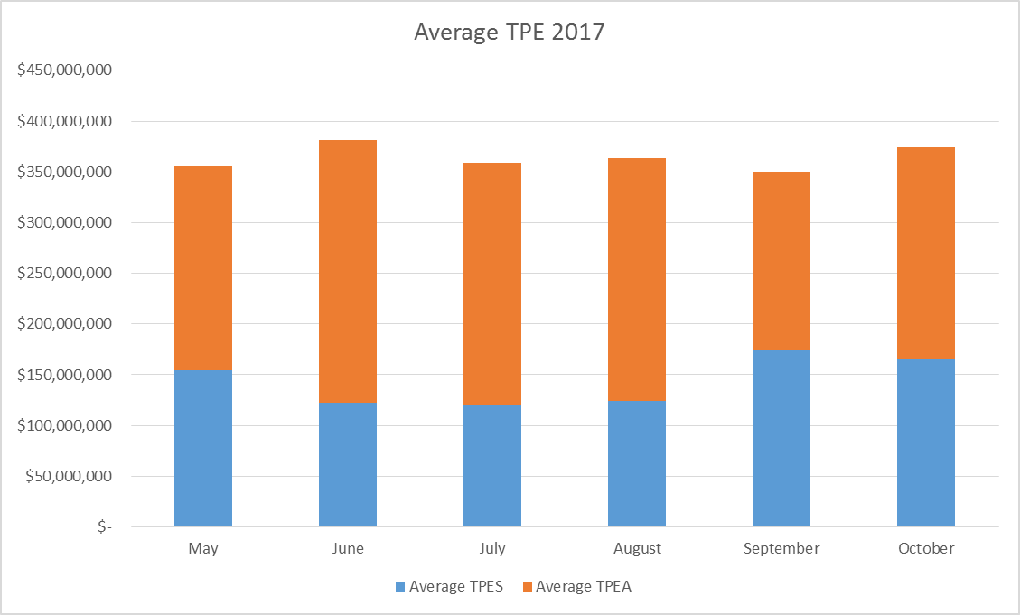
Credit Exposure Update

Slide 8
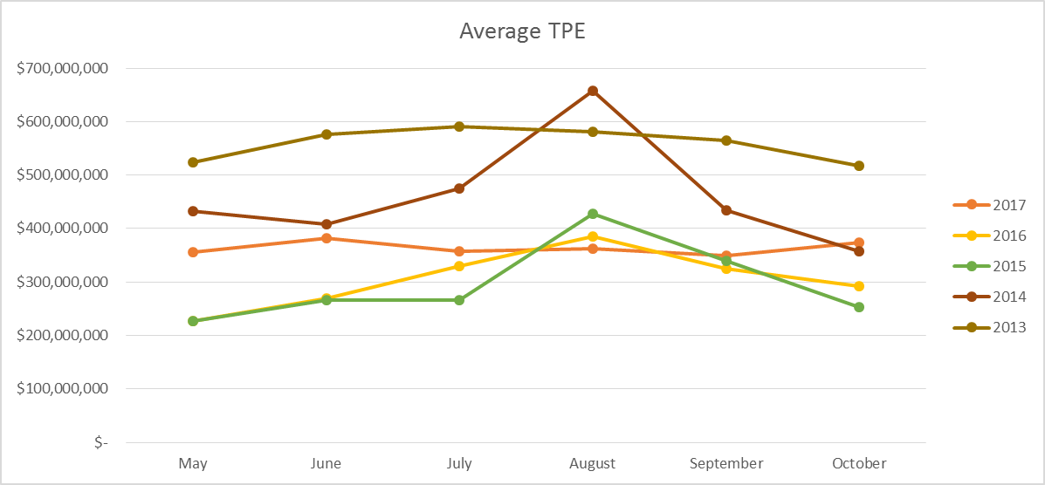
Credit Exposure Update

Slide 9
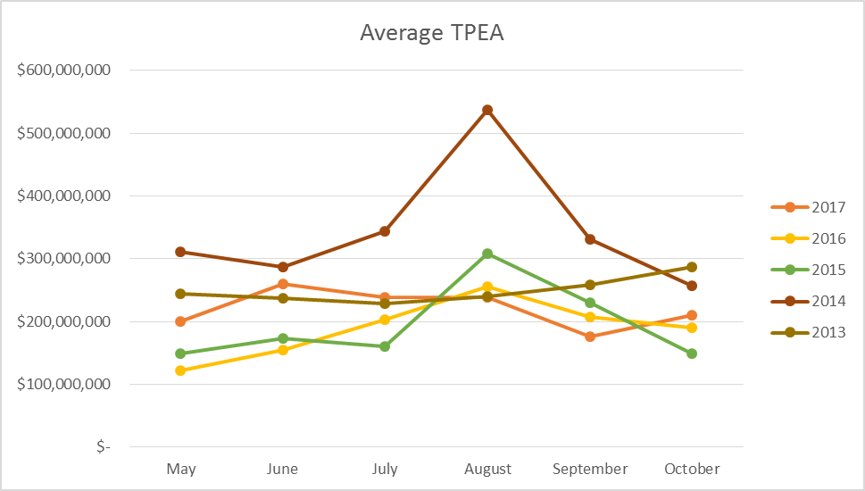
Credit Exposure Update

Slide 10
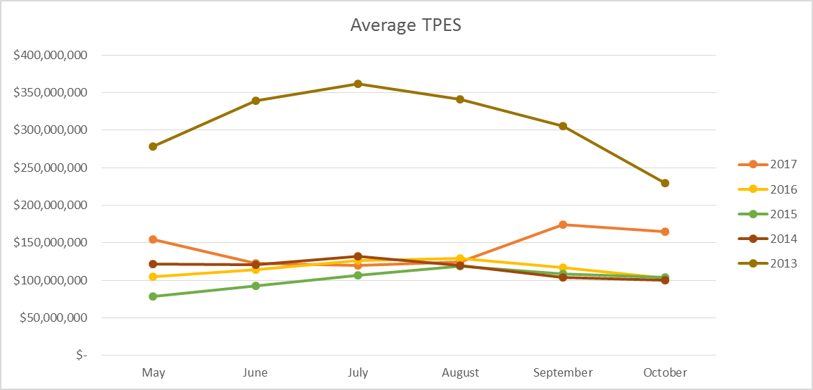
Credit Exposure Update

Slide 11
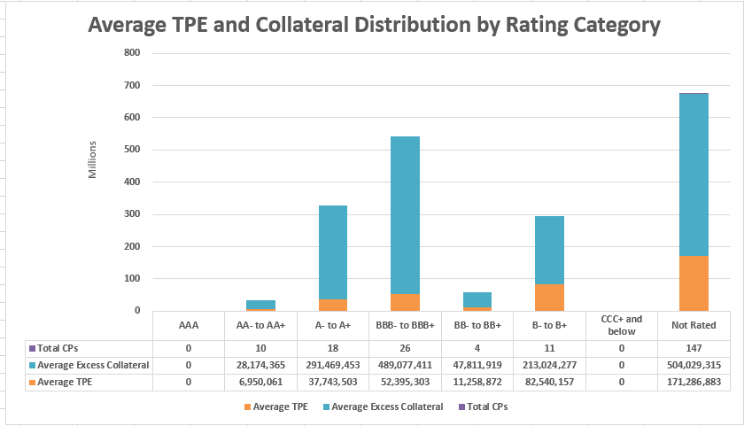
Credit Exposure Update

Slide 12
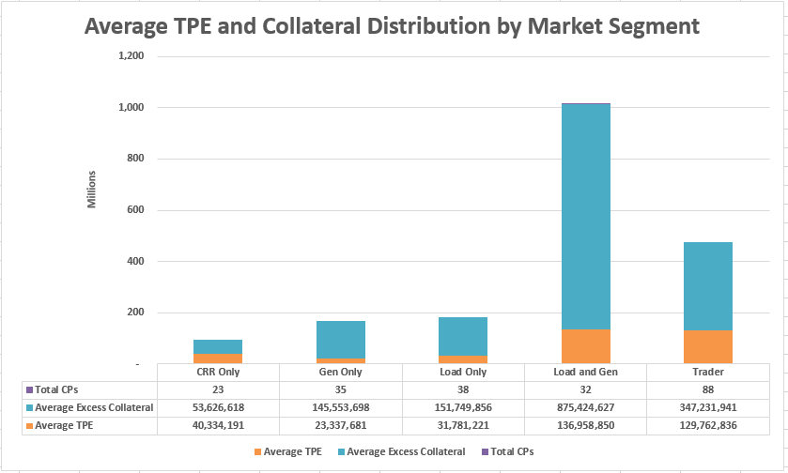
Credit Exposure Update

Slide 13
Credit Exposure Update
Appendix

Slide 14
Credit Exposure Update
Appendix
Summary statistics by market category

Slide 15
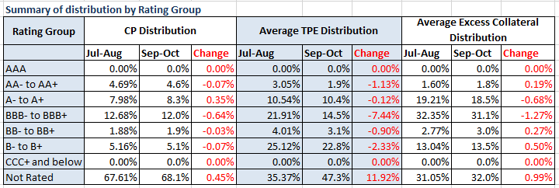
Credit Exposure Update
Summary statistics by rating group

Slide 16
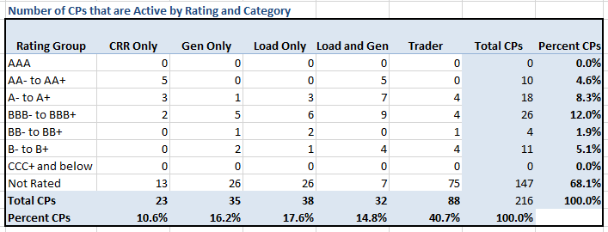
Credit Exposure Update
Active Counter-Parties distribution by rating and category

Slide 17
Credit Exposure Update
Average Total Potential Exposure distribution

Slide 18
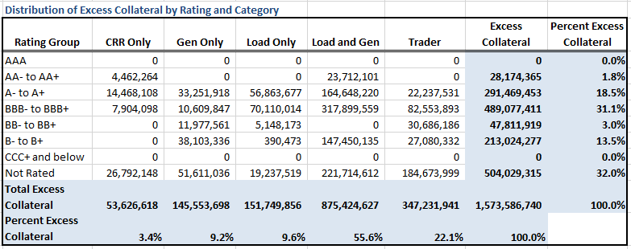
Credit Exposure Update
Average Excess Collateral distribution*
*Excess Collateral is a voluntary disposition by Counterparty

Slide 19
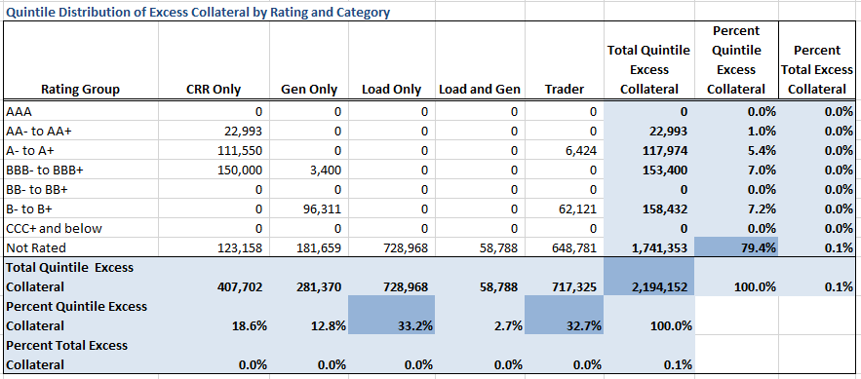
Credit Exposure Update
Average Excess Collateral distribution in the Bottom Quintile*
*Excess Collateral is a voluntary disposition by Counterparty

Slide 20
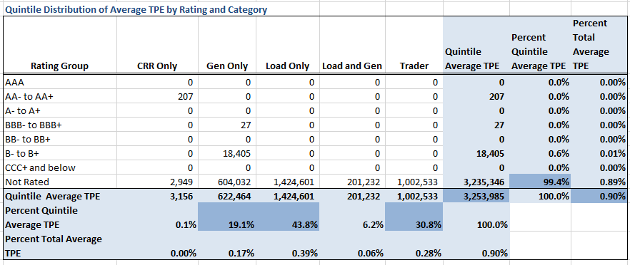
Credit Exposure Update
Average TPE distribution in the Bottom Quintile Based on Excess Collateral

Slide 21
Credit Exposure Update
Questions

