Slide 1
Impact Analysis Process Overview
Troy Anderson
Portfolio Management
11/9/2017

Slide 2
Overview Objectives – Impact Analysis (IA)
What information does the IA include?
How does the IA estimation process work?
What is the typical IA timeline?
What is the purpose of an IA?
1
2
3
4

Slide 3
IA Purpose
1
Serve as the starting point for the project team when the project begins
Provide ERCOT’s Portfolio Management team with data for project spend forecasting and resource planning
Maintain compliance with Section 21 of Protocols
Supply consistent information for approvers
(ERCOT Board of Directors, Market Subcommittees [PRS, TAC, etc.], ERCOT executives)
Estimate ERCOT impacts of a proposed system change at a point in time

Slide 4
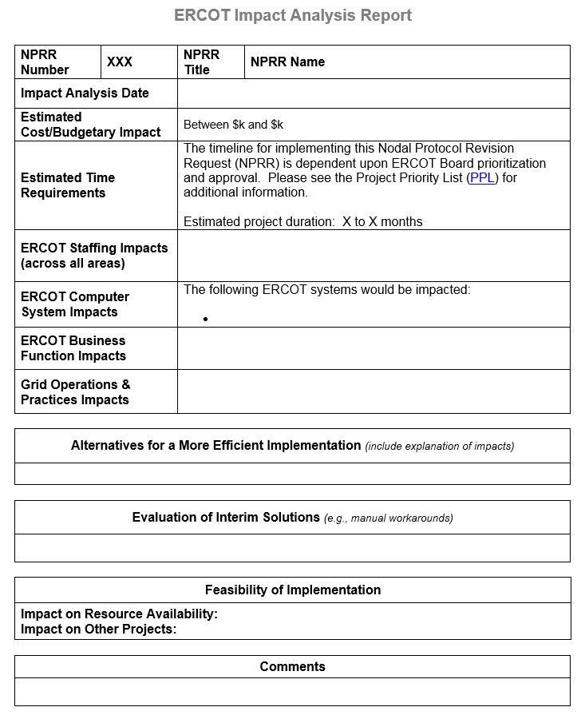
Impact Analysis Information
2
Cost
Duration
Staff
Systems
Process
Other
Comments

Slide 5
IA Estimation – Primary Cost Components
2
IT Infrastructure
Hardware / Software
Storage
ERCOT staff
Licenses
Contractor (if known)
Labor
Vendor

Slide 6
IA Example – Initiation and Planning Labor
2
Sample for illustrative purposes only
Resource names, rates, and systems have been changed to preserve confidentiality
Notes:
Cost will reflect the total amount of the project and including an outside services required. Time– this will also included onboarding of contractor services.

Slide 7
IA Example – Execution and Closing Labor
2
Sample for illustrative purposes only
Resource names, rates, and systems have been changed to preserve confidentiality
Notes:
Vendor cost is covered in the total cost of the IA. Duration also compensates for any Vendor needs.

Slide 8
IA Estimation – Non-Labor Details
2
*
*
*
*
* Infrastructure teams produce these estimates based on target delivery approach from Subject Matter Experts in the business and IT Development areas
Notes:
Desk or operating procedures which require updates based on new or revised language. Language could also cause drive new desk or operating procedures.

Slide 9
IA Summary by Phase and Cost Type
2
Notes:
Costs – reflects the O&M cost for the amount of FTEs required. Time – this will also included onboarding of FTEs. Staff – includes the amount of FTEs impacted and # FTEs required. This also provides the market with hour breakdown of FTE assignment details.

Slide 10
IA Estimation – Other Items Noted on IA
2
Project Duration
Estimate of time from project start (“Initiation”) through project completion
Systems Impacted
List of primary systems impacted by change
Does not include time in stakeholder process
Actual project duration may vary based on dependencies with other projects or bundling of related changes into a single project
Individual core systems (EMS, MMS, NMMS, OS, CRR, CMM, S&B, etc.)
“BI & Data Analytics” (various reporting tools)
“Data Access & Transparency” (MIS, MPIM, web services)
“Data and Information Products” (CDR, replication, extracts, report postings)

Slide 11
IA Estimation – Other Items Considered
2
Business Process Impacts
Revisions to operating or desk procedures
ERCOT Staffing Impacts
Incremental impact on ERCOT headcount
Amount of increase/decrease in labor to ERCOT staff
Expressed in portions of an FTE (0.1 FTE, 0.5 FTE, etc.)
Expressed in whole numbers (0 FTE, 1 FTE, etc.)
2 pieces of information provided
Will be zero if the labor can be absorbed with existing staff

Slide 12
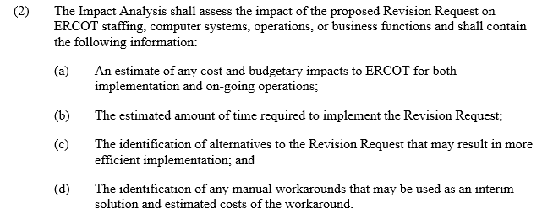
IA Estimation – Other Items Considered
2
Other Sections on IA Template
“Alternatives for a More Efficient Implementation”
“Evaluation of Interim Solutions”
“Feasibility of Implementation”
These may be candidates for deletion from the IA template because the “Cost” and “Comments” sections are typically used to outline additional information relating to alternatives or interim solutions
Section 21.4.6 (2)
12

Slide 13
Data Collection and Review Process
3
Process Start
Triage
Core systems teams determine likely delivery approach
Impact Analysis
As needed, follow-up meetings are held to re-evaluate impacts and address design questions
Portfolio Management reaches out to key internal constituents to begin the IA process
Labor and other cost estimates are gathered by Portfolio Management for inclusion in the IA
Weekly meeting to kick off the IA estimation process
Upon business owner approval, draft IA goes to weekly executive review meeting for review and posting to ERCOT.com
PRS approves Revision Request language
Draft IA is reviewed by business owner
Business owner explains change to representatives of other areas who may be impacted
Outreach to vendors (where applicable)
Downstream system teams assess their impacts based on delivery approach
Infrastructure team assesses impacts based on delivery approach
Notes:
Note: This is the first time some of the teams have seen this language. This is due to most of them do not attend market meetings.

Slide 14
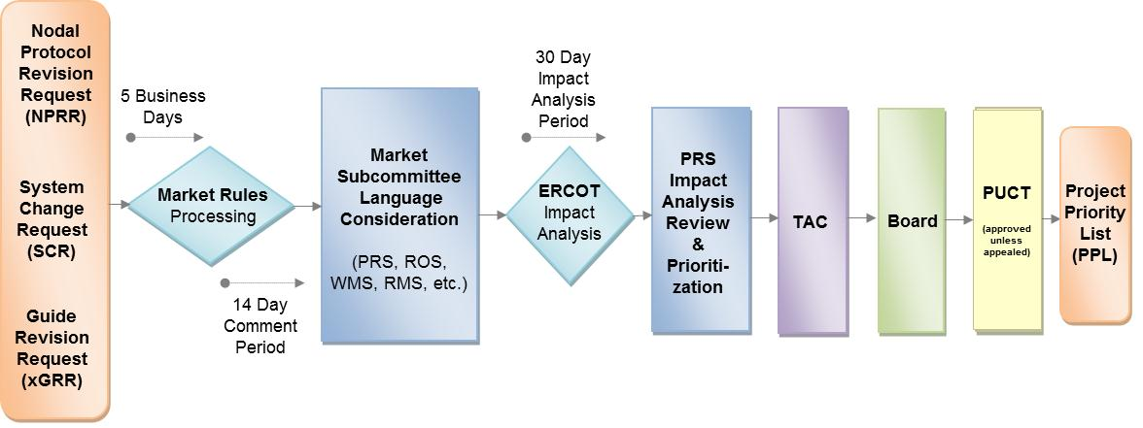
Revision Request Process Timeline
4
28 days to produce IA (sometimes 21 or 35 days)
Day 0
Day 4
Days 5-20
Day 21
Day 28
PRS approval
Triage
Estimation & review process
Materials mailing
PRS review

Slide 15
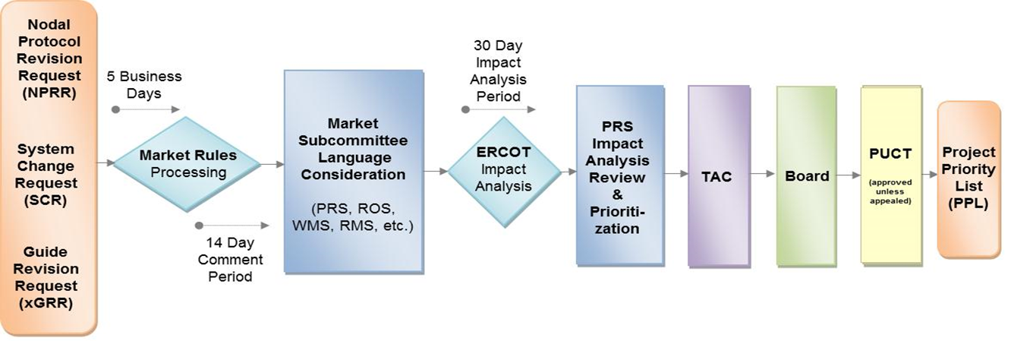
ERCOT-Submitted Process Timeline
4
Draft Revision Request
ERCOT Management Review
ERCOT Management Review
Impact
Analysis
Section 21.4.1 (5) requires ERCOT to post an initial Impact Analysis with any ERCOT-sponsored Revision Request

Slide 16
Closing Comments
1
Complexity and confidence in our proposed design are key factors in determining the IA cost estimate range
ERCOT uses this process to estimate the cost of all our internal projects
IAs are high-level estimates based on many assumptions
A significant number of ERCOT staff members participate in the IA process
Questions?

Slide 17
Bonus Information: Project Lifecycle
Project Phases
Project
Management
Initiation
Planning
Execution
Closing
Approval
Approval
Approval
Development
Testing
Go-Live
Stabilization
Project Implementation
Budget and Timeline Finalized
Portfolio Review Gating Approvals
ERCOT employs a phased project approach to accomplish the successful implementation of each project effort. The individual phases of a project represent a specific set of activities to be accomplished before moving on to a subsequent phase with particular documents and deliverables being required before a project is approved to move onto the next phase of the project lifecycle. The request by the project team to move to the next phase is called “gating”. Gating requests are considered by a team of ERCOT executives, directors and managers who oversee the ERCOT project portfolio and balance priority, resource availability, cash flow impact and related dependencies across the portfolio of initiatives.

