Slide 1
PDCWG Report to ROS
Chair: Percy Galliguez, Brazos Electric Power Cooperative, Inc.
Vice Chair: Lei Ye, Austin Energy
ROS
November 2nd, 2017

Slide 2
Report Overview & Notes
Report Overview
  Meeting Minutes
  BAL-001-TRE-1 FMEs & IMFR
    3 FMEs in the month of September
    One FME activated hydro generation resource RRS providers.
    IMFR=1022.32MW/0.1Hz(2.683 times the required IMFR, 381MW/0.1Hz)
  Frequency Control Report

Slide 3
Meeting Minutes
PDCWG Meeting 9/13/17
  Southern Cross DC Tie Transmission Project(ERCOT and Pattern Development Presentations)
  AS Methodology for 2018(ERCOT)
  Regulation & Frequency Control Reports
  MOD-026-1 Discussion(Close to submission)
    NOGRR Proposal/Review Status
  BAL-001-TRE-001 Discussion
    Combined Cycle Steam Governor Deadband R6.2
    Power Augmentation for Chillers

Slide 4
Frequency Measurable Events Performance

Slide 5
Frequency Measurable Events
There was 3 FMEs in September
  9/1/2017 16:56:08
    Loss of 456 MW
    Interconnection Frequency Response: 1014 MW/0.1Hz
    8 of 39(2 of 31 RRS Providers) Evaluated Generation Resources had less than 75% of their expected Initial Primary Frequency Response.
    5 of 39(1 of 31 RRS Providers) Evaluated Generation Resources had less than 75% of their expected Sustained Primary Frequency Response.
  9/1/2017 21:41:48
    Loss of 1204 MW(Nadir=59.762Hz)
    Interconnection Frequency Response: 1433 MW/0.1Hz
    6 of 45(1 of 21 RRS Providers) Evaluated Generation Resources had less than 75% of their expected Initial Primary Frequency Response.
    4 of 45(0 of 21 RRS Providers) Evaluated Generation Resources had less than 75% of their expected Sustained Primary Frequency Response.

Slide 6
Frequency Measurable Events
  9/15/2017 17:50:47
    Loss of 812 MW
    Interconnection Frequency Response: 855 MW/0.1Hz
    8 of 47(0 of 17 RRS Providers) Evaluated Generation Resources had less than 75% of their expected Initial Primary Frequency Response.
    5 of 47(0 of 17 RRS Providers) Evaluated Generation Resources had less than 75% of their expected Sustained Primary Frequency Response.

Slide 7
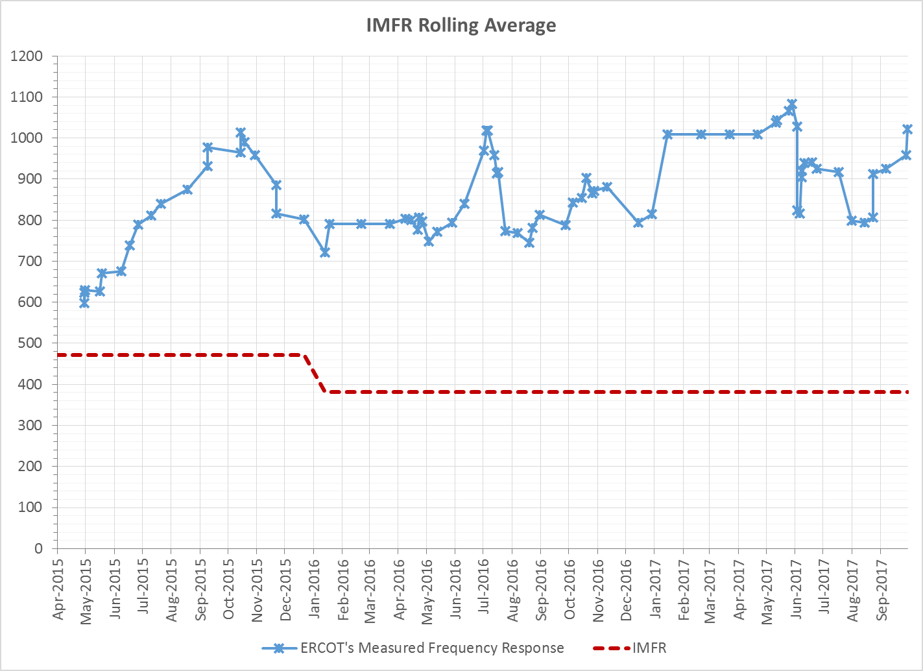
Interconnection Minimum Frequency Response (IMFR) Performance
IMFR Performance currently 1022.32 MW/0.1Hz

Slide 8
Frequency Control Report
September 2017

Slide 9
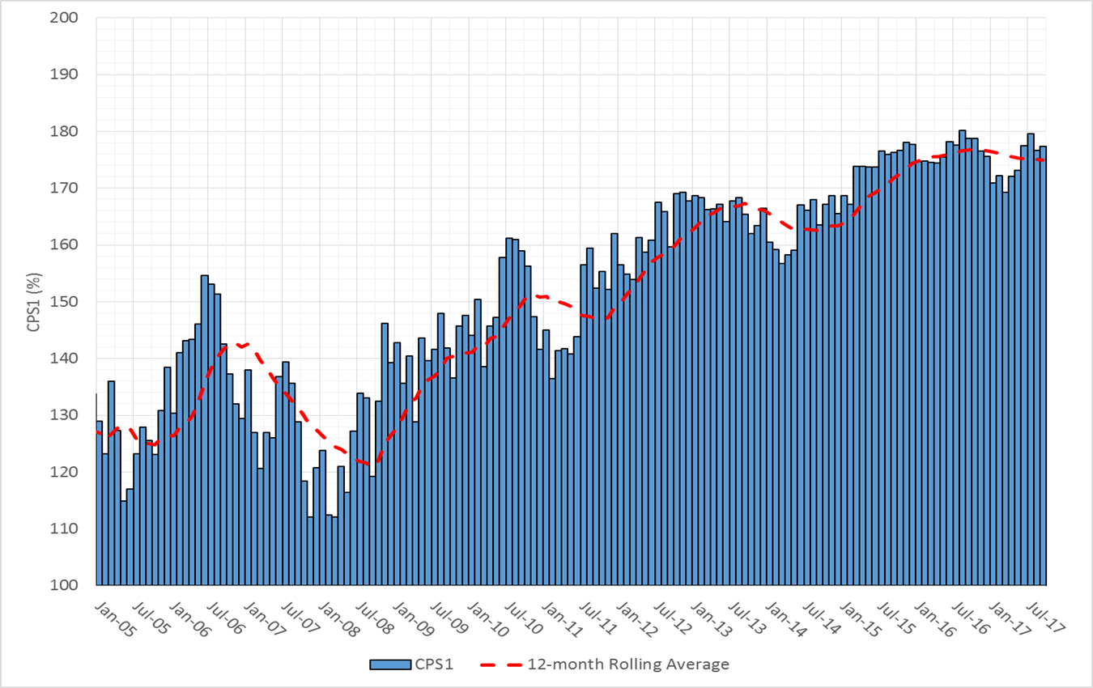

CPS1 Performance

Slide 10
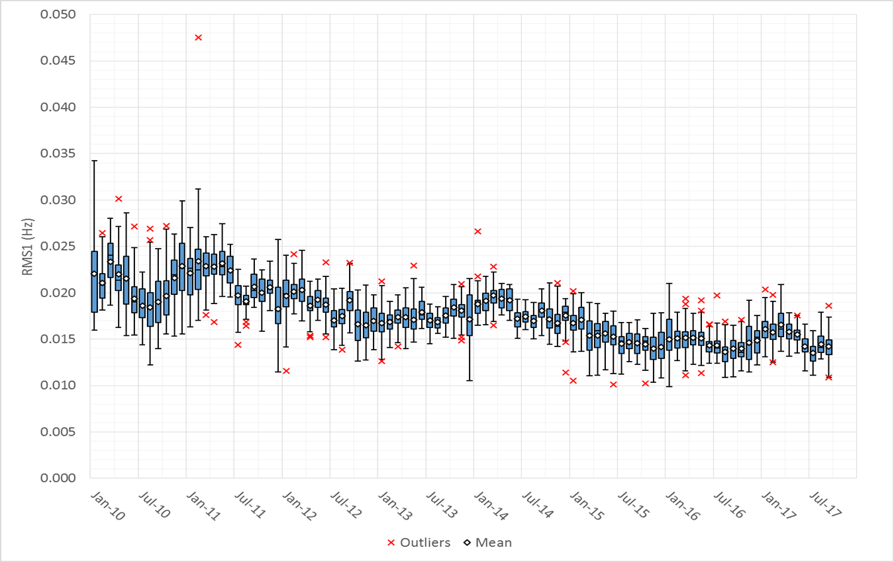
RMS1 Performance of ERCOT Frequency

Slide 11
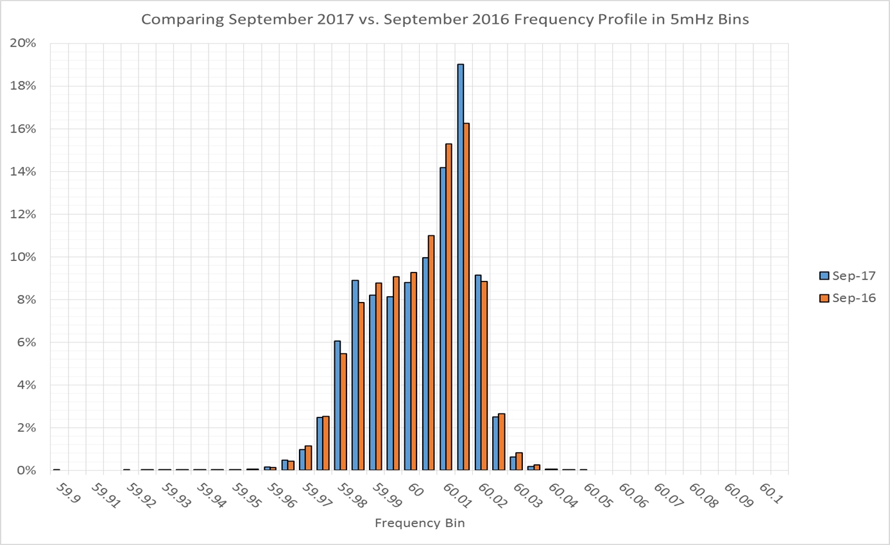
Frequency Profile Analysis

Slide 12
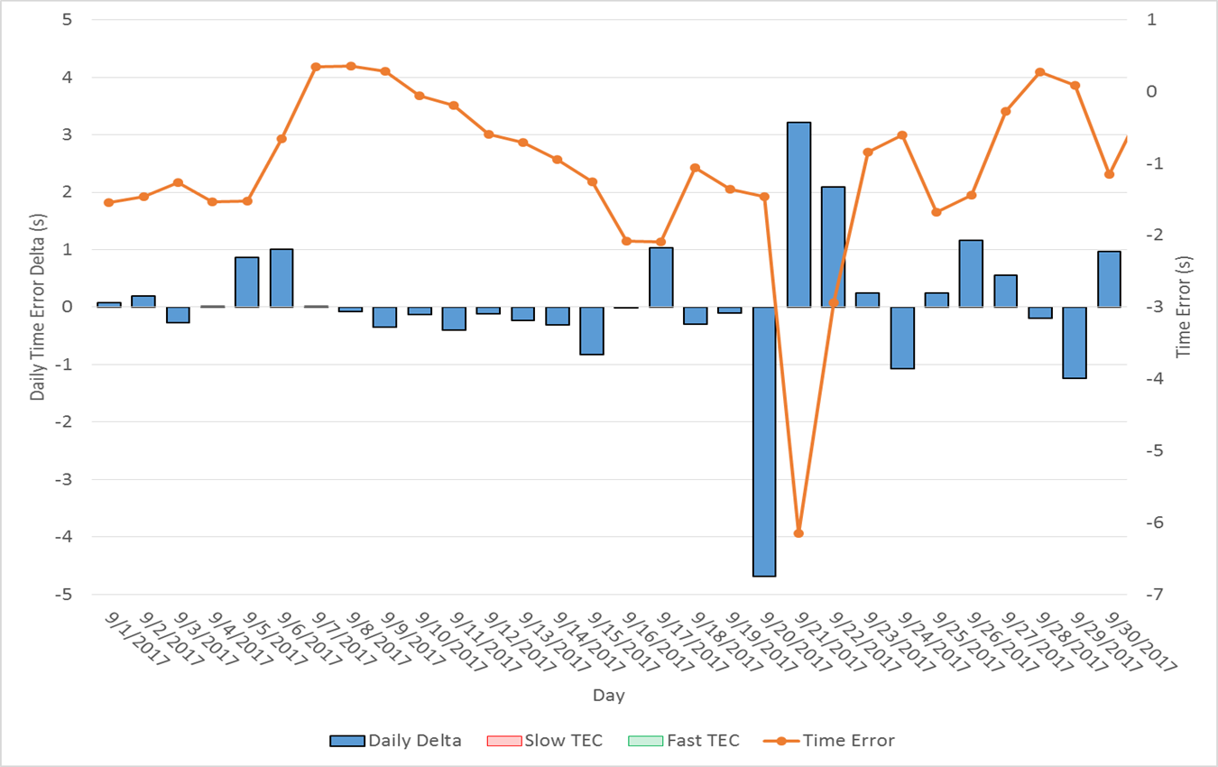
Time Error Corrections
There were no Time Error Corrections (TEC) in September

Slide 13
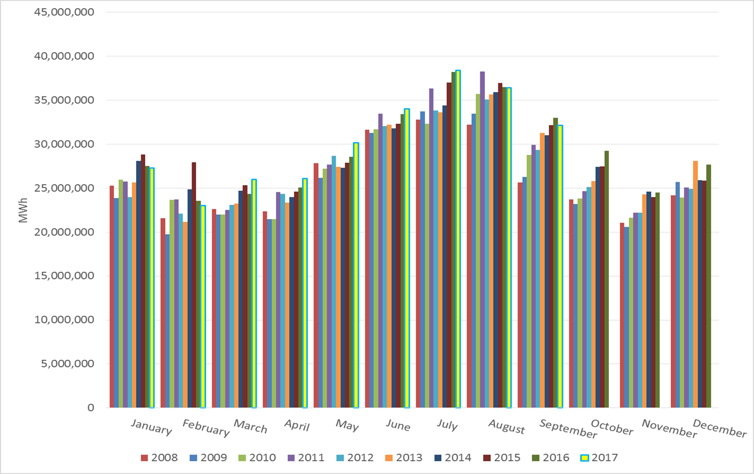
ERCOT Total Energy

Slide 14
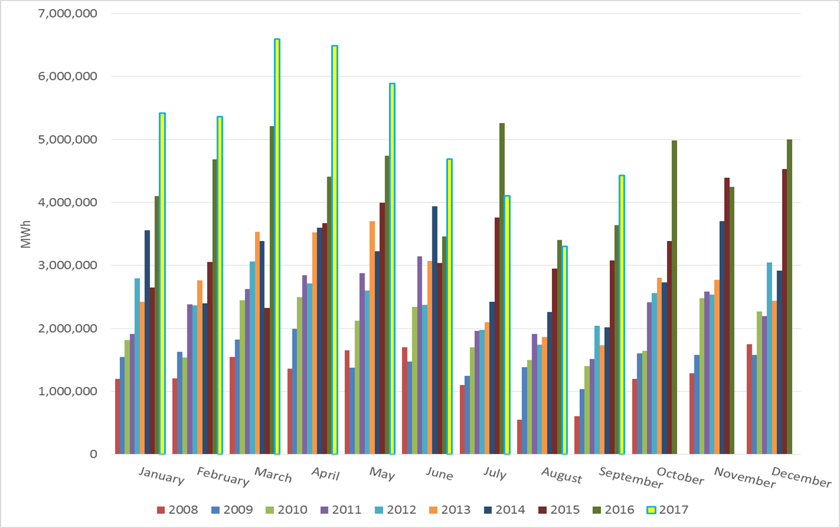
ERCOT Total Energy from Wind Generation

Slide 15
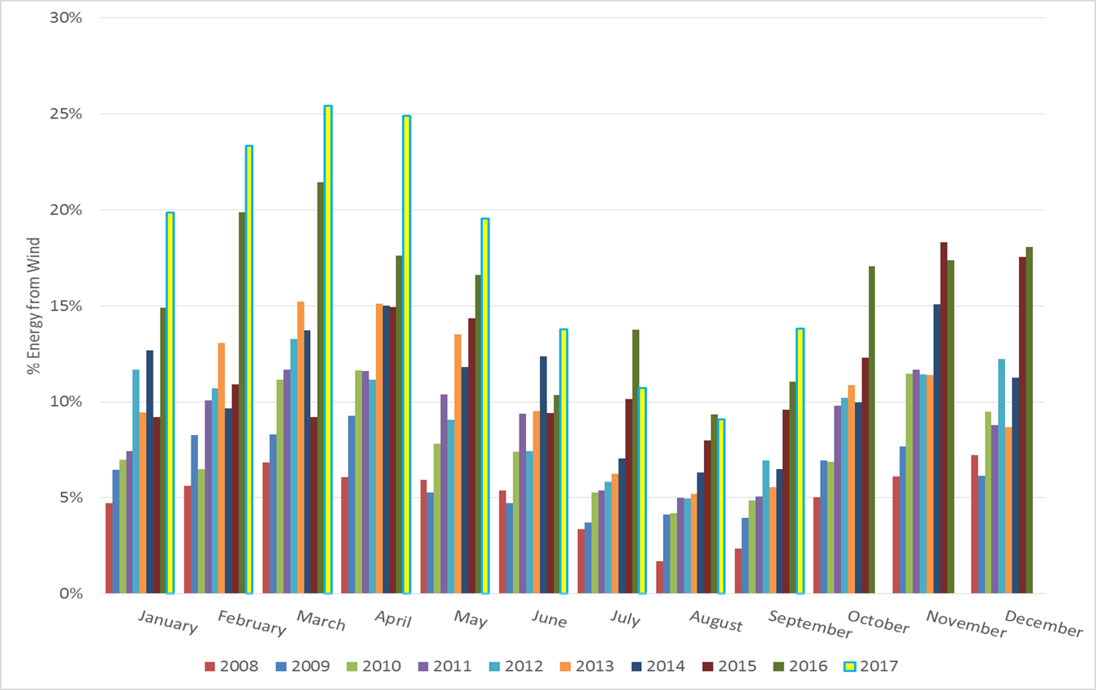
ERCOT % Energy from Wind Generation

Slide 16
Questions?

