Slide 1
GBY5 RMR Final Costs
Nov 1, 2017

Slide 2
Budget Totals and Avoided Costs from Cancellation
Notes:
February 2017 and cancellation budgets include settled actuals but do not include Incentive Factor.
Avoided Costs calculated by comparing Cancellation Budget with Feb-17 Budget

Slide 3
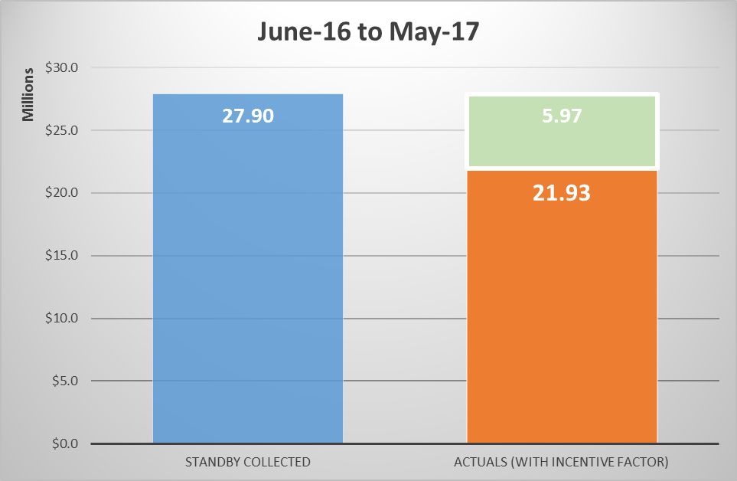
Standby Collected v Actual Costs
Final Settlements
Paid back to Load

Slide 4
RMR Cost Update
Questions

Slide 5
Appendix

Slide 6
Additional Relevant Information

Slide 7
Timeline for Completing True-Up Settlements
May 1, 2017: Oct 25, 2017
May 31, 2017: Nov 24, 2017

