Slide 1
Wind Turbine Power Curve Improvements

Slide 2
Overview
Wind Turbine Technology Evolution
Performance Trends
Power Curves and Capacity factor improvements
Next Steps

Slide 3
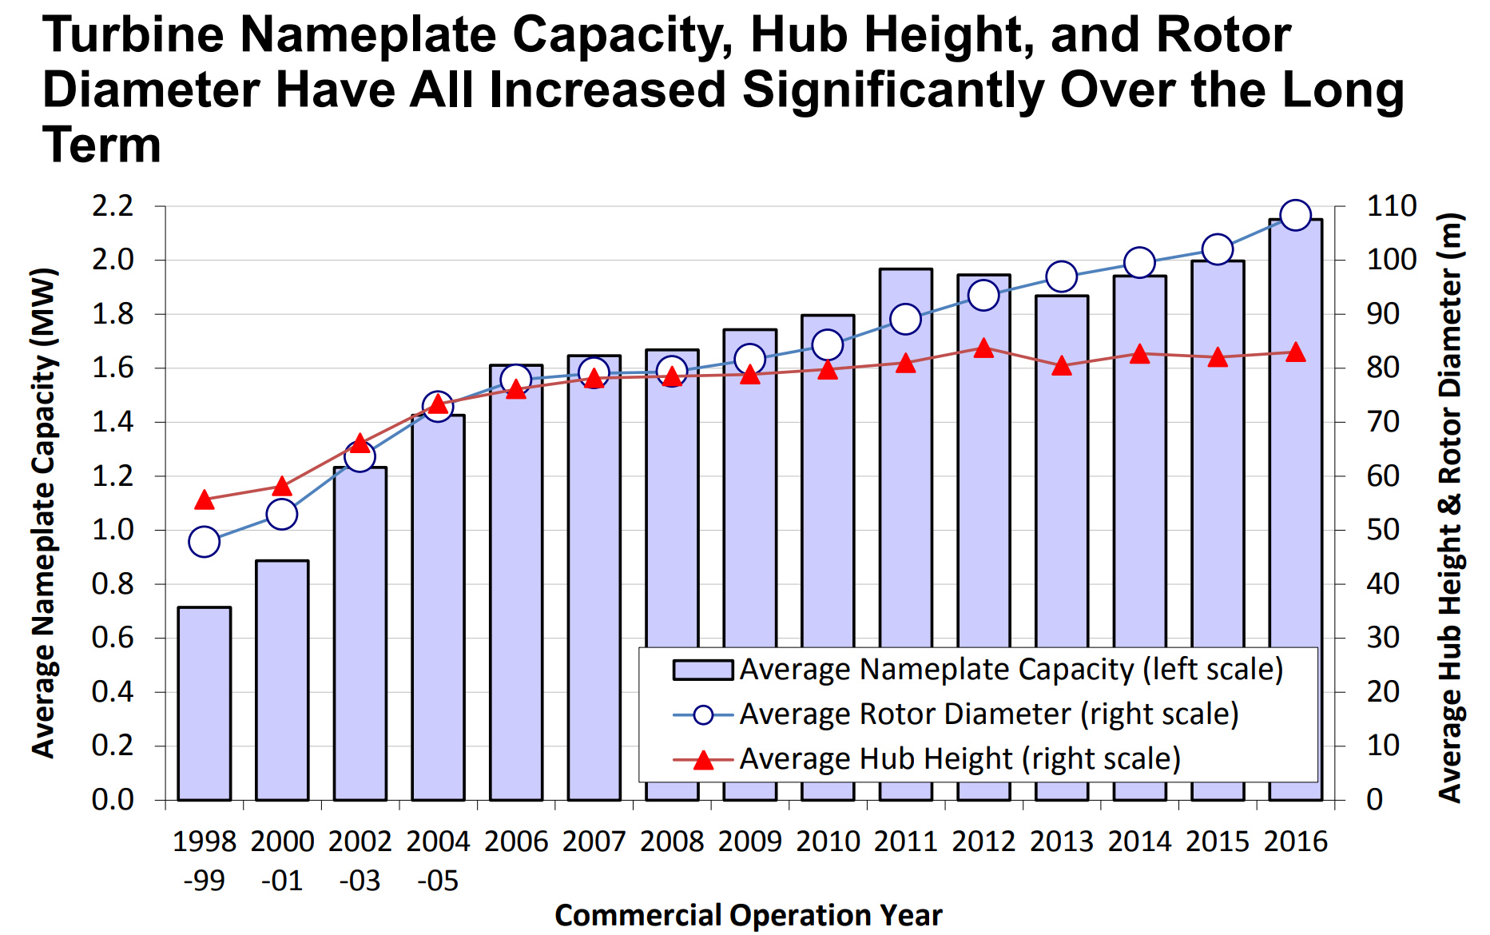
Wind Turbine Technology Evolution

Slide 4
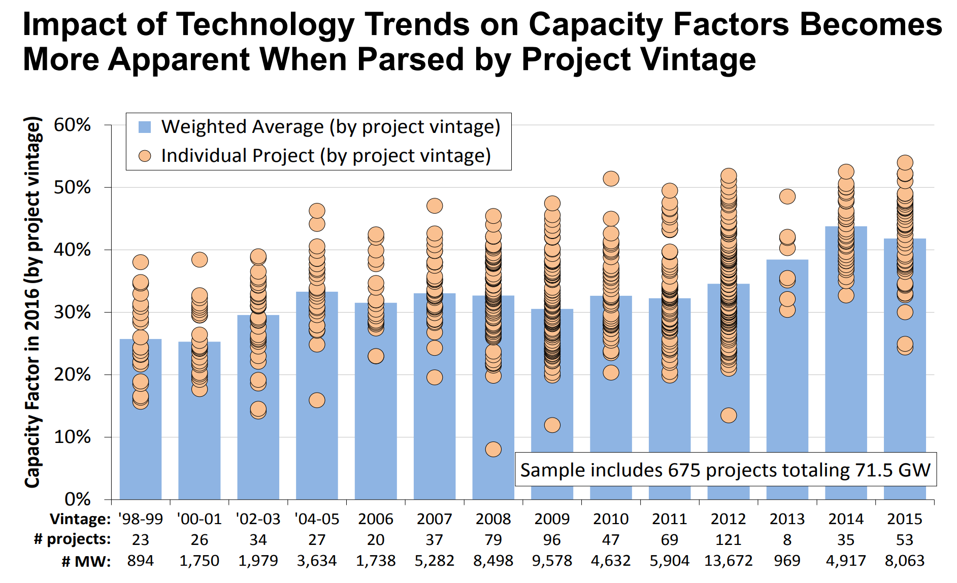
Performance Trends

Slide 5
Power Curve & Capacity Factors
Wind Turbine technology is constantly evolving –
Power curve of a wind turbine depicts the relationship between output power and hub height wind speed and is an important characteristic of the turbine. It essentially captures the wind turbine performance.
The wind turbine power curve models are used to estimate the capacity factors. As technology improves power curves have been observed to improve with steep slopes.
IEC class 1 turbines are not expected to be deployed for future projects. IEC class 2 & 3 turbines are expected to be used for projects that will commercialize in the near future.

Slide 6
Power Curve Comparison
For ease of visualization only the class II turbine power curves are compared most of the sites currently in ERCOT are actually being built with Class II turbines.

Slide 7
Average Energy Comparison from 2011 to 2017
The above graph demonstrates the energy produced by a normalized wind farm in any given year. It can be seen that because of the improvements in turbine technology current wind farms produce more energy than they did in 2011.

Slide 8
Next Steps
This is a work in progress.
Locational data still needs to be synthesized and synced to queue projects to better understand power curve variations.
Apex welcomes questions and feedback on this initiative.
Swaraj Jammalamadaka
Apex Clean Energy, Inc.
swaraj.jammalamadaka@apexcleanenergy.com | www.apexcleanenergy.com

