Slide 1
2017 Annual Validation
Update
PWG
10.25.2017

Slide 2
Annual Validation 2017
Annual Validation for 2017 is complete. All TDSPs have met the 99% threshold.
Thank you for your hard work and cooperation with this effort.\!

Slide 3
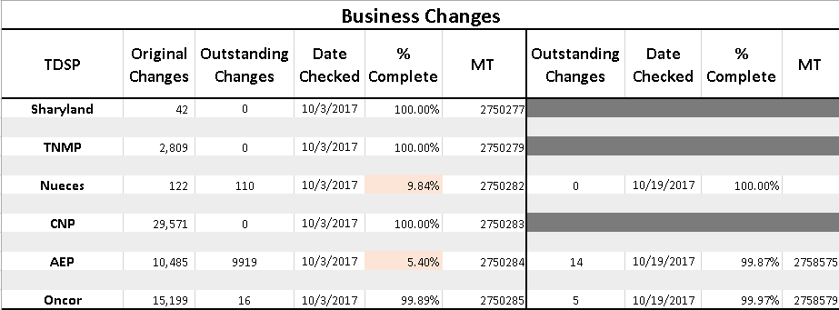
Business Check

Slide 4
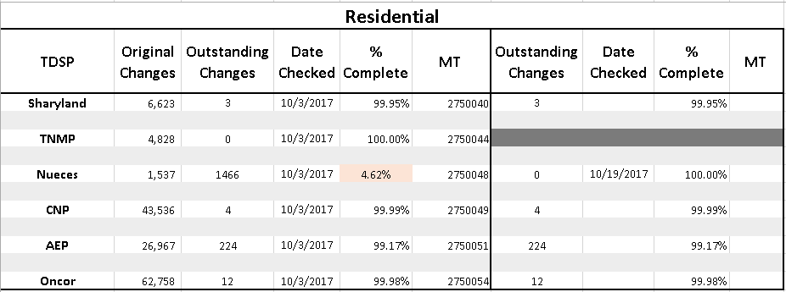
Residential Check

Slide 5
2017 Annual Validation Update
May 31, 2017
TDSPs should be submitting 814-20s for Residential and Business Changes
ERCOT will review database for expected changes on 10/02/2017
ERCOT plans on investigating more thoroughly CNP’s request when we upgrade to SAS grid (more storage)

Slide 6
2017 Annual Validation Task List
 |  | Date Completed
Due Date* | 2017 Residential Annual Validation Task List | ERCOT | AEP | CNP | ONCOR | SHRY McAllen | SHRY | TNMP | Nueces
03/30/2017 | ERCOT to provide list of ESI IDs to TDSPs | NM | 2666782 | 2666785 | 2666787 | 2666794 | 2666793 | 2666792 | 2666789
04/10/2017 | TDSPs to provide finalized list of ESI IDs to ERCOT |  | 4/5/2017 | 4/3/2017 | 4/7/2017 | 4/11/2017 | 4/11/2017 | 4/6/2017 | 4/18/2017
04/15/2017 | Market Notice announcing lists are available to CR of record | BB
04/15/2017 | TDSPs to begin submitting 814_20 transactions
09/30/2017 | TDSPs to complete submissions of all 814_20 transactions
10/02/2017 | ERCOT completes review of expected database changes
Due Date* | 2017 Business Annual Validation Task List
03/30/2017 | ERCOT to provide list of ESI IDs to TDSPs | NM | 2666782 | 2666785 | 2666787 | 2666793 |  | 2666792 | 2666789
03/30/2017 | ERCOT Provides Qtr Validation Lists to TDSPs (BUS Only) | BB | 2666812 | 2666820 | 2666829 | 2666847 |  | 2666836
04/10/2017 | TDSPs to provide finalized list of ESI IDs to ERCOT |  | 4/5/2017 | 4/4/2017 | 4/7/2017 | 4/11/2017 |  | 4/6/2017 | 4/18/2017
04/15/2017 | Market Notice announcing lists are available to CR of record | BB
04/15/2017 | TDSPs to begin submitting 814_20 transactions
09/30/2017 | TDSPs to complete submissions of all 814_20 transactions
09/30/2016 | Complete Quarterly Validations | BB | 4/12/2017 |  |  | 4/17/2017 |  | 4/20/2017
10/02/2017 | ERCOT to review database for expected changes |  | MT | MT | MT | MT | MT | MT | MT
10/02/2017 | All TDSPs have submitted at least 99% of changes
11/02/2016 | Initial Weather Responsiveness Report Produced
01/02/2016 | Weather Responsiveness Overdue Report Produced
Monthly | Continue Overdue Reporting Until All Complete
* If the date falls on a weekend or holiday, please use the following business day as deadline. |  |  |  |  |  |  |  |  | Update:4/24/2017

Slide 7
Summary of RES Changes by Weather Zone
Annual Validation 2017
 | RESHI to RESLO |  |  |  |  |  |  |  | RESLO to RESHI
 | AMS Count |  |  |  | NIDR COUNT |  |  |  | AMS Count |  |  |  | NIDR COUNT
 | AV 2017 | AV 2016 | AV 2015 |  | AV 2017 | AV 2016 | AV 2015 |  | AV 2017 | AV 2016 | AV 2015 |  | AV 2017 | AV 2016 | AV 2015
Coast | 30,205 | 14,274 | 18,885 |  | 57 | 75 | 143 |  | 17,113 | 25,006 | 67,636 |  | 86 | 81 | 120
East | 3,424 | 7,092 | 572 |  | 231 | 147 | 156 |  | 1,465 | 2,759 | 5,323 |  | 78 | 120 | 166
Far West | 2,052 | 2,430 |  |  | 3,282 | 488 | 517 |  | 3,302 | 4,396 | 4,517 |  | 754 | 1,728 | 3,873
North Central | 30,935 | 33,645 | 308 |  | 1,989 | 1,147 | 1,822 |  | 15,711 | 42,451 | 70,977 |  | 927 | 1,049 | 1,668
North | 2,039 | 3,541 | 103 |  | 167 | 93 | 140 |  | 1,168 | 2,278 | 3,760 |  | 76 | 128 | 198
South Central | 3,064 | 2,957 | 1 |  | 31 | 23 | 26 |  | 822 | 2,012 | 1,927 |  | 13 | 16 | 23
South | 16,593 | 14,293 | 11,254 |  | 1,609 | 609 | 551 |  | 3,255 | 9,670 | 14,008 |  | 926 | 409 | 496
West | 2,973 | 2,611 | 558 |  | 512 | 281 | 874 |  | 1,025 | 1,887 | 3,500 |  | 229 | 158 | 94
Total Changes | 91,285 | 80,843 | 31,681 |  | 7,878 | 2,863 | 4,229 |  | 43,861 | 90,459 | 171,648 |  | 3,089 | 3,689 | 6,638
 |  |  |  |  |  |  | Percent Changes- Annual Validation 2017
 |  |  |  |  |  |  |  |  | AMS | NIDR | Total
 |  |  |  |  |  |  | Total Changes |  | 135,146 | 10,967 | 146,113
 |  |  |  |  |  |  | Total RES ESI IDS in 2017 Population |  | 6,139,971 | 258,009 | 6,397,980
 |  |  |  |  |  |  | Percent Change |  | 2.20% | 4.25% | 2.28%

Slide 8
Residential Count Summary
Annual Validation 2017
 | RESHI to RESLO |  |  |  | RESLO to RESHI |  |  |  | TOTAL Changes by TDSP
 | AMS Count | NIDR COUNT | Total |  | AMS Count | NIDR COUNT | Total |  | AMS Count | NIDR COUNT | Total
CNP | 27,771 | 2 | 27,773 |  | 15,734 | 29 | 15,763 |  | 43,505 | 31 | 43,536
Sharyland |  | 4,486 | 4,486 |  |  | 1,124 | 1,124 |  | - | 5,610 | 5,610
Sharyland McAllen |  | 762 | 762 |  |  | 251 | 251 |  | - | 1,013 | 1,013
Nueces |  | 833 | 833 |  |  | 704 | 704 |  | - | 1,537 | 1,537
Oncor | 29,500 | 1,619 | 31,119 |  | 20,737 | 902 | 21,639 |  | 50,237 | 2,521 | 52,758
TNMP | 2,593 | 155 | 2,748 |  | 1,974 | 106 | 2,080 |  | 4,567 | 261 | 4,828
AEP C | 19,072 | 16 | 19,088 |  | 4,194 | 7 | 4,201 |  | 23,266 | 23 | 23,289
AEP N | 2,349 | 5 | 2,354 |  | 1,322 | 2 | 1,324 |  | 3,671 | 7 | 3,678
Total Changes | 81,285 | 7,878 | 89,163 |  | 43,961 | 3,125 | 47,086 |  | 125,246 | 11,003 | 136,249
 |  |  |  |  | Total RES ESIIDS in 2017 Population |  |  |  | 6,139,971 | 244,162 | 6,384,133
 |  |  |  |  | Percent Change |  |  |  | 2.04% | 4.51% | 2.13%

Slide 9
2017 BUS Annual Validation Yearly Compare
ANNUAL VALIDATION BUSINESS CHANGES
 |  | 2014 | 2015 | 2016 | 2017
Current Profile | New Profile
BUSHIDG | BUSMEDDG |  | 3 |  | 1
BUSHILF | BUSLOLF | 966 | 889 | 566 | 966
BUSHILF | BUSMEDLF | 5,833 | 4,261 | 3,326 | 4,975
BUSHIPV | BUSLOPV
BUSHIPV | BUSMEDPV | 6 | 5 | 3 | 6
BUSLODG | BUSMEDDG | 1
BUSHIWD | BUSLOWD |  |  |  | 1
BUSHIWD | BUSMEDWD | 1 |  |  | 1
BUSLOLF | BUSHILF | 1,002 | 946 | 825 | 1,789
BUSLOLF | BUSMEDLF | 13,273 | 11,008 | 8,516 | 13,498
BUSLOPV | BUSMEDPV | 11 | 10 | 7 | 21
BUSLOPV | BUSHIPV |  |  |  | 1
BUSLOWD | BUSMEDWD | 1 |  | 2 | 1
BUSMEDDG | BUSHIDG | 1 |  |  | 1
BUSMEDDG | BUSLODG |  |  |  | 1
BUSMEDLF | BUSHILF | 8,591 | 8,194 | 6,577 | 11,187
BUSMEDLF | BUSLOLF | 27,718 | 21,219 | 15,729 | 28,371
BUSMEDPV | BUSHIPV | 9 | 4 | 2 | 5
BUSMEDPV | BUSLOPV | 27 | 24 | 31 | 48
BUSMEDWD | BUSLOWD | 5 | 3 | 1 | 6
BUSMEDWD | BUSHIWD |  |  | 1 | 1
BUSNODEM | BUSHILF | 77 | 95 | 46 | 124
BUSNODEM | BUSLOLF | 516 | 1,045 | 616 | 948
BUSNODEM | BUSMEDLF | 121 | 125 | 85 | 145
BUSNODPV | BUSLOPV | 1
BUSNODWD | BUSLOWD
 | Total Changes | 58,160 | 47,831 | 36,333 | 62,097
 | BUS ESIIDs in Population | 1,049,322 | 1,080,440 | 1,100,838 | 1,097,506
 | Percent Change | 5.5% | 4.4% | 3.3% | 5.7%

Slide 10
2017 BUS Annual Validation by TDSP
Annual Validation-Business Breakdown by TDSP
 | 2014 |  |  | 2015 |  |  | 2016 |  |  | 2017
TDSP | COUNT | PERCENT |  | COUNT | PERCENT |  | COUNT | PERCENT |  | COUNT | PERCENT
Center Point | 27,241 | 46.84% |  | 21,090 | 44.09% |  | 15,937 | 43.86% |  | 29,571 | 47.62%
Sharyland-McAllen |  | 0.00% |  | 42 | 0.09% |  | 28 | 0.08% |  | 42 | 0.07%
Nueces |  | 0.00% |  | 136 | 0.28% |  | 53 | 0.15% |  | 122 | 0.20%
Sharyland |  | 0.00% |  | 2,951 | 6.17% |  | 2,445 | 6.73% |  | 3,869 | 6.23%
Oncor | 18,593 | 31.97% |  | 12,456 | 26.04% |  | 9,943 | 27.37% |  | 15,199 | 24.48%
TNMP | 954 | 1.64% |  | 2,219 | 4.64% |  | 1,294 | 3.56% |  | 2,809 | 4.52%
AEP Central | 8,823 | 15.17% |  | 6,724 | 14.06% |  | 5,084 | 13.99% |  | 8,233 | 13.26%
AEP North | 2,549 | 4.38% |  | 2,213 | 4.63% |  | 1,549 | 4.26% |  | 2,252 | 3.63%
Total Changes | 58,160 |  |  | 47,831 |  |  | 36,333 |  |  | 62,097

