Slide 1
WETT Bearkat Area Transmission Improvements project-ERCOT Independent Review Scope
October 19, 2017

Slide 2
Overview
Wind Energy Transmission Texas (WETT) submitted Bearkat Area Transmission Improvements project for Regional Planning Group review. This is a Tier 1 project that is estimated to cost $ 69.87 million.
Proposed for 2021
Address generator interconnection issues in Bearkat Area
Reliability Issues
Voltage Instability
Thermal Overloads
Provide exit strategy for WETT proposed Remedial Action Scheme (RAS)
Improve generator get-a-way capacity at Bearkat
Economic Benefit

Slide 3
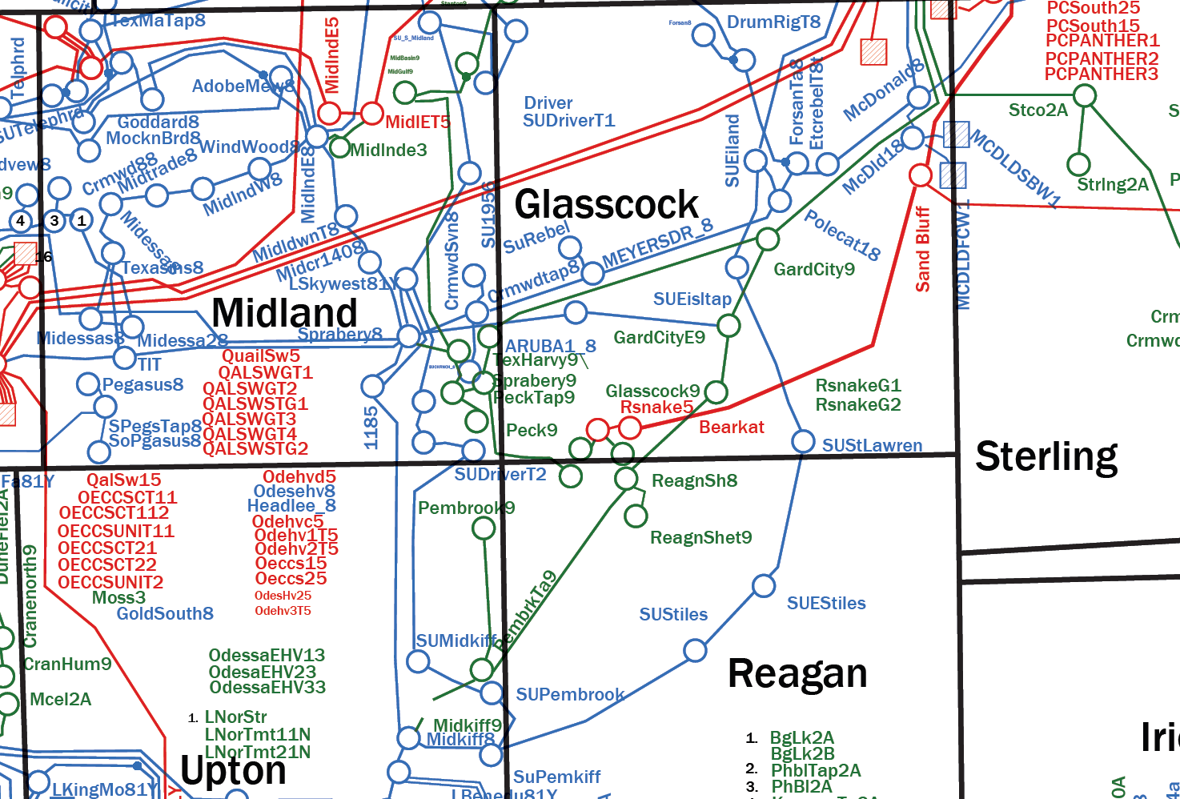
Overview

Slide 4
BearKat Area Generators
Project Name | Projected COD | Capacity | Signed Interconnect Agreement | Planning Guide Section 6.9
RATTLESNAKE DEN WIND PHASE 1 G1 | In-Service | 104 | Yes | Yes
RATTLESNAKE DEN WIND PHASE 1 G2 | In-Service | 103 | Yes | Yes
NBOHR(BearKat Wind A) | 12/29/2017 | 197 | Yes | Yes
Edmondson Ranch Wind | 05/07/2018 | 293 | No | No
Kontiki Wind | 04/01/2019 | 500 | No | No
BearKat Wind B | 04/15/2019 | 163 | Yes | Yes

Slide 5
Study Assumptions
Dynamic Study Case
Constructed from latest DWG 2020 HWLL Flat Start case finalized March 2017
Study Region will consist of Far-West and West Weather Zones
Generator additions that meet Planning Guide Section 6.9 criteria in study region at time of study will be added to the case.
Transmission Projects expected to be in-service within the study region by 2022 at the time of the study will be added to the case
Criteria: NERC TPL and ERCOT Planning Guides

Slide 6
Study Assumptions
Production Cost Study Case
Constructed from 17 RTP 2023 Production Cost Model
Study Region will consist of Far-West and West Weather Zones
Generator additions that meet Planning Guide Section 6.9 criteria in study region at time of study will be added to the case.
Transmission Projects expected to be in-service within the study region by 2022 at the time of the study will be added to the case

Slide 7
Study Procedure
Scenarios to be evaluated:
Study Cases
Sensitivities based on PG Section 3.1.3(4):
Generator additions with Signed Generation Interconnection Agreements (SGIA) but that DO NOT meet Planning Guide Section 6.9 criteria in study region at time of study will be added to the case
Economic Assessment of Alternatives

Slide 8
Deliverables
Tentative Timeline
Final EIR update to RPG – December 2017
EIR recommendation to TAC – January/February 2018
BOD Endorsement – February 2018

Slide 9
?
Stakeholder Comments Also Welcomed to Prabhu Gnanam:
ggnanam@ercot.com

