Slide 1
Generation Observations
Jeff Billo
October 19, 2017

Slide 2
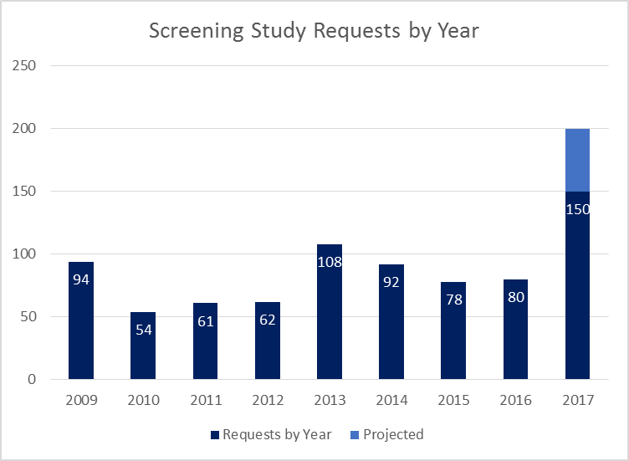
Increase in Generation Interconnection Requests in 2017
Through September

Slide 3
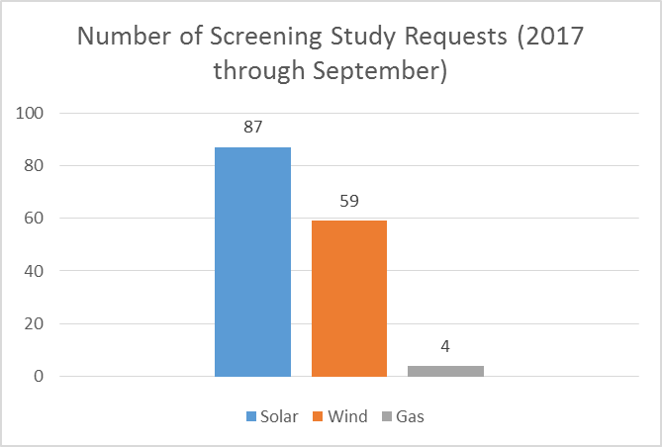
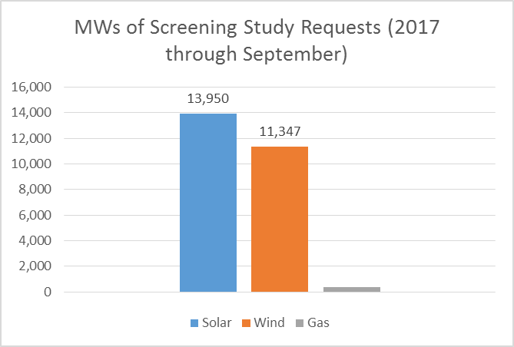
What Are These 2017 Requests?

Slide 4
What is the History of Previous Requests?

Slide 5
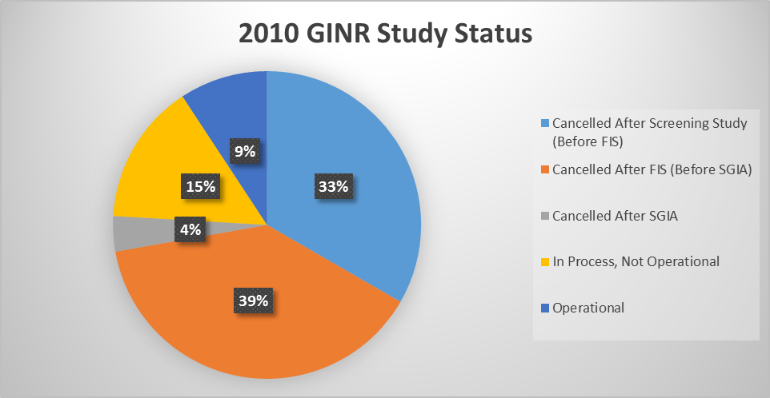
What is the History of Previous Requests?

Slide 6
What is the History of Previous Requests?

Slide 7
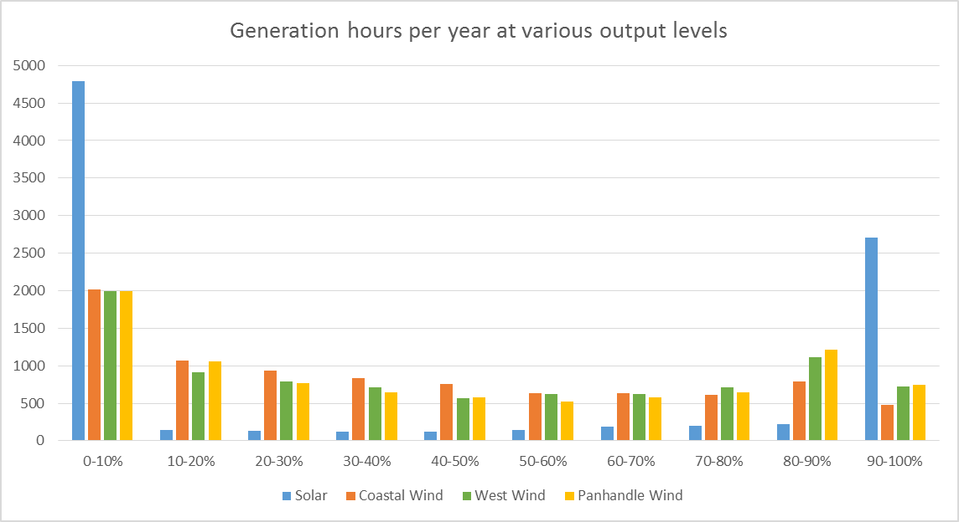
Solar vs. Wind Profiles

Slide 8
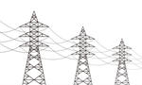
Solar vs. Wind Curtailment Economics
100 MW Capacity
90 MW Limit
0.4% Annual Energy Curtailment
100 MW Capacity
90 MW Limit
7.6% Annual Energy Curtailment

Slide 9
Solar vs. Wind Curtailment Economics
Generation Weighted Prices - 2016
Technology | $ / MWh
Combined Cycle (GT>90MW) | 24.6
Coal / Lignite | 24.0
Nuclear | 21.5
Wind | 16.2
Solar PV | 32.0
Gas Steam | 35.1-53.5
Source: IMM Report to the ERCOT Board, April 2017: http://www.ercot.com/content/wcm/key_documents_lists/103986/6_IMM_Report.pdf

Slide 10
Questions?

