Slide 1
SMT Update To AMWG
September 2017

Slide 2
Monthly SMT Data Timelines AMWG CR 2014 002 End to End File Processing Completeness – SEP 2017
% Timely Market Delivery - % of files posted to market (FTPS) by 11:00pm out of # of files received by SMT by 11:00pm.
% Portal Data Availability - % of files loaded to the database for data availability on portal by 6:00am next day for the files received by 11:00pm
A LSE file includes usage data for up to 50,000 ESIIDs.
2

Slide 3
SMT API and FTPS Services Availability – SEP 2017
The service availability is measured as a percentage of number of minutes the service was available out of the total number of minutes in a month, excluding planned outages.
Observed Anomalies:
Mar-Apr 2015: SMT outage and subsequent recovery/catch-up impacted API availability. FTPS was available for most of the part except on 03/21-03/22 for 36 hours.
26 Jul 2015: Services were unavailable for 12 hours due to Flash storage issue
25 Jan 2016: Services were unavailable for 19 hours due to storage configuration issue
07 Mar 2016: API Services were unavailable for 7hours due to Oracle archiver issue.
12 Jul 2017: Due to network Outage FTP & API services are down for 20 minutes. FTPS & API availability is 99.95%.
Notes:
3

Slide 4
SMT Number of Accounts by Type AMWG CR 2014 009 – September 2017
Registered Users | ONC | CNP | AEPN | AEPC | TNMP | TOTAL
Active Residential Accounts | 61715 | 28969 | 1904 | 5805 | 3825 | 102218
Active Residential English Accounts | 61503 | 28769 | 1897 | 5683 | 3816 | 101668
Active Residential Spanish Accounts | 212 | 200 | 7 | 122 | 9 | 550
Non Active Residential Accounts | 24702 | 16257 | 1837 | 4114 | 1054 | 47485
Total Residential Accounts | 86417 | 45226 | 3741 | 9919 | 4879 | 149703
TDSP User | 347 | 31 | 10 | 18 | 1 | 407
TDSP Admin | 4 | 4 | 4 | 4 | 3 | 19
Small Business User | 97 | 47 | 1 | 2 | 3 | 150
Small Business Admin | 3060 | 1644 | 88 | 339 | 151 | 5443
Total Agreements (Includes Active and Pending) | 13632 | 3391 | 77 | 238 | 995 | 18333
Energy Data Agreements (Includes Active and Pending) | 13632 | 3150 | 77 | 238 | 995 | 18092
Han Device Agreements (Includes Active and Pending) | 0 | 240 | 0 | 0 | 0 | 240
Han Service Agreements (Includes Active and Pending) | 0 | 1 | 0 | 0 | 0 | 1
IN SMT
ESI IDs | 3557032 | 2474886 | 198269 | 867475 | 248887 | 7346549
Meters | 3499736 | 2475930 | 199084 | 867893 | 248332 | 7290975
HAN Devices | 3341 | 4312 | 136 | 271 | 29 | 8089
Acknowledgement | 0 | 0 | 0 | 0 | 0
Pending | 0 | 0 | 0 | 0 | 0
Meter Ready | 5 | 13 | 40 | 92 | 17
Provisioned | 3336 | 4289 | 96 | 179 | 12
HAN Messages (MTD) | 0 | 0 | 0 | 0 | 0 | 0
HAN Messages (YTD) | 195 | 0 | 0 | 0 | 0 | 195
HAN Messages (Cumulative) | 575 | 7405 | 0 | 0 | 0 | 7980
Simple Text Messages | 165 | 2930 | 0 | 0 | 0
Load Control Messages | 163 | 2658 | 0 | 0 | 0
Pricing Messages | 171 | 53 | 0 | 0 | 0
Cancellation Messages | 76 | 1764 | 0 | 0 | 0
Supplemental – (Friends)
Total Agreements | 1896 | 1488 | 82 | 104 | 68 | 3638
Accepted Agreements | 790 | 576 | 36 | 32 | 23 | 1457
Pending Agreements | 2 | 0 | 0 | 1 | 0 | 3
Revoked Agreements | 331 | 284 | 11 | 8 | 7 | 641
Expired Agreements | 734 | 597 | 33 | 63 | 38 | 1465
Terminated Agreements | 39 | 31 | 2 | 0 | 0 | 72
 | TDSPs | REP | Small Business | Regulatory | Third Party
Registered Entities | 5 | 117 | 5260 | 2 | 158
Registered Users | 407 | 865 | 150 | 8 | 25
Registered Admins | 19 | 179 | 5282 | 3 | 144
HAN Messages Sent By | 538 | 7418

Slide 5
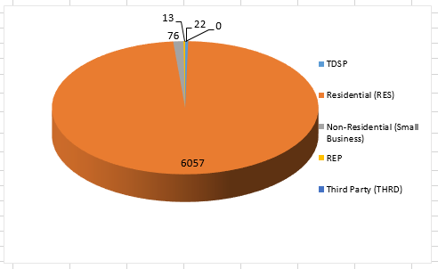
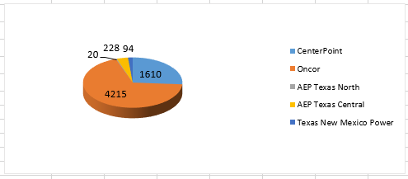
SMT ODR Details – SEP 2017
Total ODR Requests TDSP wise statistics:
Total ODR Requests User type statistics:

