Slide 1
Settlement Update
Austin Rosel
ERCOT
October 11, 2017

Slide 2
Agenda
2017 R5 Settlement Implementations
Effective October 31 - November 2, 2017
NPRR782 – Settlement of Infeasible Ancillary Services Due to Transmission Constraints

Slide 3
NPRR782
Introduces a charge for infeasible Ancillary Services. A QSE with infeasible Ancillary Services will be charged the Day-Ahead Market clearing price for the infeasible amount, regardless of whether the responsibility was awarded, self-arranged, or traded and regardless of whether a Supplemental Ancillary Service Market was executed.
Example for Reg-Up:

Slide 4
NPRR782
Charges for infeasible Ancillary Services will be credited to the total cost of Ancillary Services that is ultimately allocated on an Hourly Load Ratio Share Basis. Currently, the cost of infeasible Ancillary Services is directly assigned to the QSE with the infeasible amounts and only if the amount is replaced in a SASM.
Example for Reg-Up:

Slide 5
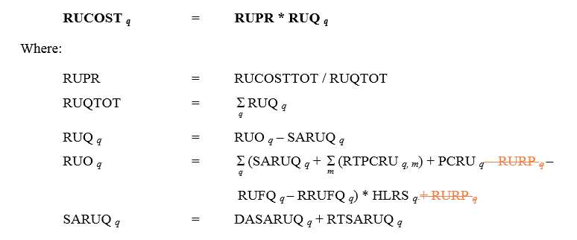
NPRR782

Slide 6
NPRR782
A 30 day Market Notice (with a correction) has been sent out, a 10 day Market Notice will also be sent.
M-D092917-01 Implementation Details for NPRR782
M-D092917-02 Additional Implementation Details for NPRR782

Slide 7
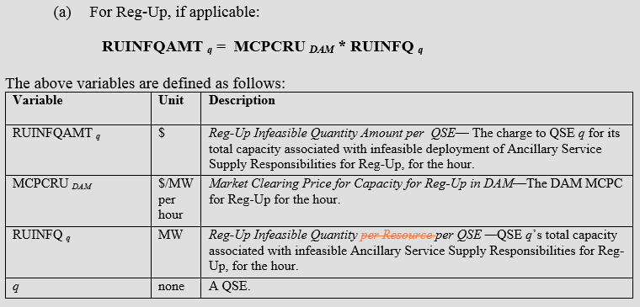
NPRR840
A related NPRR, NPRR840 Implementation of Infeasible Ancillary Service Protocol Revisions, is recommended for approval at the October Board of Directors meeting. This NPRR removes a requirement for the ERCOT Operator to notify the QSE about infeasible Ancillary Services with a two hour advance notice.
This NPRR also clarifies that the billing determinants for infeasible MW are QSE level billing determinants, not Resource Level Billing Determinants.

