Slide 1
Market Impacts of Deploying Offline Non-Spin versus RUCing the Offline Non-Spin Resource for Local Congestion
Market Analysis
QMWG
10/09/2017

Slide 2
Market Impacts of Non-Spin Deployment vs RUC
What are the differences in market impact between:
Deploying Offline Non-Spin
RUCing the Offline Non-Spin Resource and replacing the Non-Spin
This presentation considers deployments for resolving local congestion only, not for capacity, PRC, or voltage

Slide 3
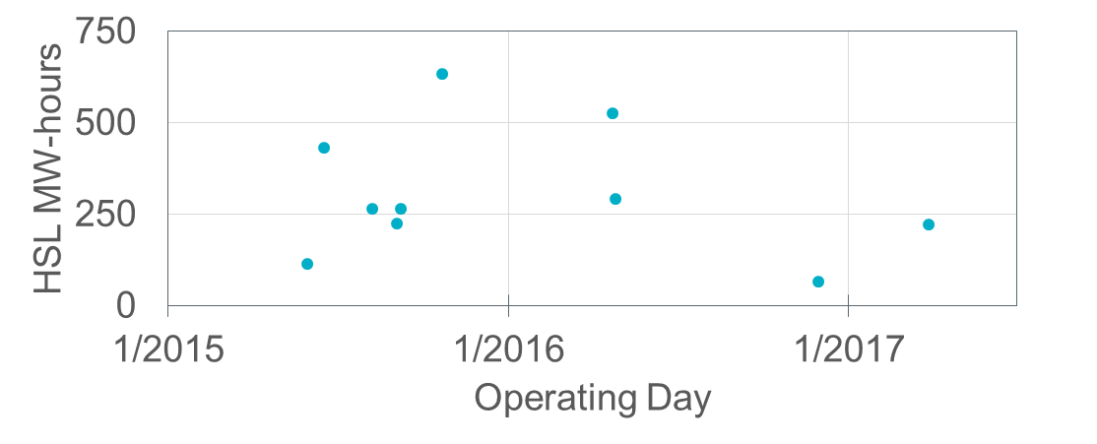
History of Non-Spin Deployment 2015 – August 2017
Metric | All Deployments* | Deployments for Congestion
Resource-Operating Days | 36 | 12
Unique Operating Days | 25 | 10
Unique Resources | 17 | 9
Resource-hours | 132 | 47
HSL MW-hours | 10,600 | 3,050
* All values in this presentation except for this column are for Non-Spin deployments for local congestion only. No deployments for capacity/PRC or voltage are included.

Slide 4
Offer Floors
The RUC offer floor is $1,500/MWh whereas Offline Non-Spin does not have an offer floor
This difference does not affect the market results if either of these is true:
The resource is mitigated
Unless the Offline Non-Spin Resource’s EOC is below its MOC
The resource is not dispatched above LSL
If both of the above are false, deploying Offline Non-Spin will have a larger price suppression effect if the resource’s EOC is below the RUC offer floor.
About 50% of Resource-hours were mitigated
About 34% of Resource-hours were dispatched at LSL
About 73% of Resource-hours were either mitigated or dispatched at LSL

Slide 5
Price Adders
The Real-Time On-Line Reliability Deployment Price Adder includes RUC-Committed Resources unless the QSE has opted out
No price adder if the QSE opts out
RUCed Resources’ LSL is relaxed in calculation of RTORDPA
Deployed Offline Non-Spin becomes ON and its LSL is not relaxed
About 16 Resource-hours (34%) were at LSL
Highest system lambda while dispatched at LSL was about $74/MWh
12 SCED intervals (out of about 560) had system lambda > $50/MWh
Given this observation and that a typical LSL for a Resource providing Non-spin is relatively small, price adders would likely have been negligible
Real-Time On-Line and Off-line Reserve Price Adders
Both deployed Non-Spin and RUCed Resources are included in RTOLCAP
Offline Non-Spin is included in RTOFFCAP

Slide 6
Duration and Timing
Non-Spin deployments may be recalled at any time whereas RUC commitments are for full hours
About 4 additional Resource-hours (10%) would have been committed if RUCed instead of deployed as Non-Spin
RUC commitments may require Operators to take action further in advance rather than waiting for the conditions to occur in real-time

Slide 7
Make-Whole and Non-Spin Replacement
Non-Spin deployments are not eligible for make-whole payments
RUCed resources are eligible for make-whole payments
RUCing the Offline Non-Spin Resource may result in the Non-Spin capacity being replaced, whereas deploying the Offline Non-Spin Resource does not.
Replacement by moving the responsibility to another Resource, AS Trade, or SASM

