Slide 1
Project Update and Summary of
Project Priority List (PPL) Activity
October 12, 2017

Slide 2
Project Update Agenda
Project Portfolio Update p. 3-9
  Recent / Upcoming Project Implementations
  2017 Release Targets
  2018 Release Targets
  2017 Project Spending Forecast
  Revision Request Funding Placeholder Status
  Priority/Rank Options for Revision Requests with Impacts
Appendix
  Project Portfolio Gantt Chart p. 10-18
Location of Project Priority List (PPL): http://www.ercot.com/services/projects/index

Slide 3
Recent / Upcoming Project Implementations
2017 August Release – 9/11/2017-9/13/2017 Complete
  NPRR758 – Improved Transparency for Outages Potentially Having a High Economic Impact
  NPRR775 – Enhanced Implementation of Limits for Fast Responding Regulation Service
2017 October Release – 10/31/2017-11/2/2017 In Flight
  NPRR778 – Modifications to Date Change and Cancellation Eval. Window
  NPRR782 – Settlement of Infeasible A/S Due to Transmission Constraints
  NPRR831(a) – Inclusion of Private Use Networks in Load Zone Price Calcs
    All impacted systems except CRR
Note: Projected Go-Live dates are subject to change.
Please watch for market notices as the effective dates approach.

Slide 4
2017 Release Targets – Board Approved NPRRs / SCRs / xGRRs
March 3/7 – 3/9 | May 5/1 – 5/11 | June 6/27 – 6/29 | August 9/11 – 9/13 | October 10/31 – 11/2 | December 12/5 – 12/7
NPRR272 NPRR649 NPRR753 NPRR764 NPRR785 RMGRR134 NPRR790 | SCR790 NPRR746 NPRR786 NPRR792 NOGRR164 PGRR051 RRGRR003 RRGRR006 RRGRR007 RRGRR009 RRGRR010 PGRR046 | NPRR573 NPRR789 NPRR797 NPRR801 NPRR827 NPRR744 | NPRR758 NPRR775 NPRR809(a) PGRR052 PGRR054 | NPRR778 NPRR782 NPRR808 NPRR810 NPRR831(a) NPRR562(a) NPRR808 PGRR056 | NPRR562 NPRR810 NPRR812
7 | 12 | 6 | 5 | 6 | 2
ü
ü
ü
ü
ü
ü
ü
ü
ü
ü
ü
ü
ü
ü
ü
ü
ü
ü
ü
ü
ü
ü
ü
ü
ü
ü
ü
ü
ü
E
E
E
E
E
2/1
6/1
8/1
9/1 & 9/14
12/9 – 12/10 (Retail)
ü
5/8 – NMMS Upgrade
ü
TBD Items (and point at which they became “TBD”)
2014 | 2015 | 2016 | 2017
NPRR664 | None | SCR781 P | NPRR702 P, PGRR057, NPRR519, NPRR620, NPRR741, NPRR755, SCR789 H, SCR792
Go-live dates can differ from Protocol effective dates – Please refer to market notices for more details
APPENDIX
Red Text: New additions and target release changes
Strike-Through Text: Previous target release changes
(a), (b), etc. indicates multiple phases
Project Status Codes
NS = Not Started
I = Initiation
P = Planning
E = Execution
H = On Hold
Release targets are subject to change
NPRR562(a) – Procedural changes
NPRR809(a) – Procedural changes
NPRR831(a) – All impacted systems except CRR

Slide 5
2018 Release Targets – Board Approved NPRRs / SCRs / xGRRs
February 2/6 – 2/8 | April 4/3 – 4/5 | May 5/29 – 5/31 | August 8/7 – 8/9 | October 10/23 – 10/25 | December 12/11 – 12/13
NPRR562(b) NPRR776 NPRR830 NPRR683 NPRR743 NPRR760 NPRR800 NPRR833 SCR777 NPRR831(b) | SCR792 | NPRR749 NPRR809(b) |  |  | PGRR057
10 | 1 | 2 | 0 | 0 | 1
NS
E
NS
E
E
E
E
P
E
E
NS
NS
P
E
CMM Release 1a
January
(Off-cycle)
Dates TBD
(Retail)
Dates TBD
(Retail)
Dates TBD
(Retail)
Dates TBD
(Retail)
Dates TBD
(Retail)
Go-live dates can differ from Protocol effective dates – Please refer to market notices for more details
APPENDIX
Red Text: New additions and target release changes
Strike-Through Text: Previous target release changes
(a), (b), etc. indicates multiple phases
Project Status Codes
NS = Not Started
I = Initiation
P = Planning
E = Execution
H = On Hold
Release targets are subject to change
NPRR562(b) – Reporting/posting system changes
NPRR809(b) – Reporting/posting system changes
NPRR831(b) – CRR system changes

Slide 6
2017 Project Spending
2017 PPL Budget = $21.5M
“Potential Demand” represents internal ERCOT projects that have not been fully approved

Slide 7
Revision Request Funding Placeholder Status
In 2017 and 2018, ERCOT forecasted $4.0M for Revision Request work
Yearly Revision Request Spending Forecast Summary
Project Status | 2017 | 2018
YTD Actuals | $1.83M | $0.00M
Approved – In-Flight / Complete | $2.86M | $0.96M
Approved – On Hold | $0.00M | $0.00M
Approved – Not Started | $0.05M | $0.32M
Remaining Funding | $1.09M | $2.72M
Total Allocation | $4.00M | $4.00M
As of 8/31/2017

Slide 8
Priority / Rank Options for Revision Requests with Impacts
Options for…
Revision Request | Description | Priority | Rank | Comments
None
PPL Rank Information
Next available Rank in Business Strategy = 2110
Next available Rank in Regulatory = 170

Slide 9
Appendix
  9/30/2017 Project Gantt
    In-flight items sorted by Project End Date
    “On Hold” projects listed separately
      None at this time
    “Not Started” items sorted by Project Start Date

Slide 10
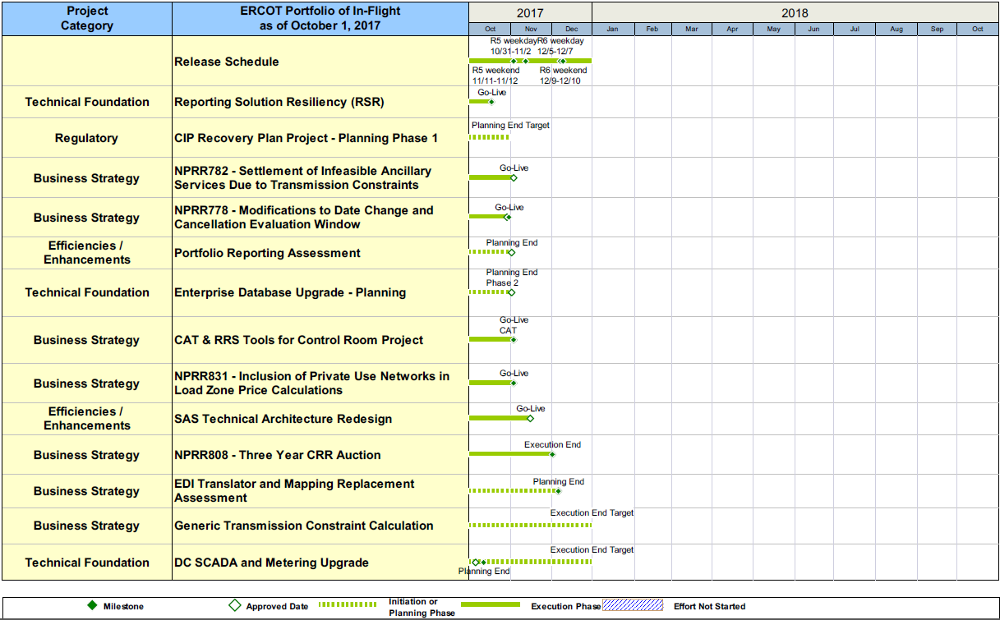
Project Portfolio Status – as of 9/30/2017

Slide 11
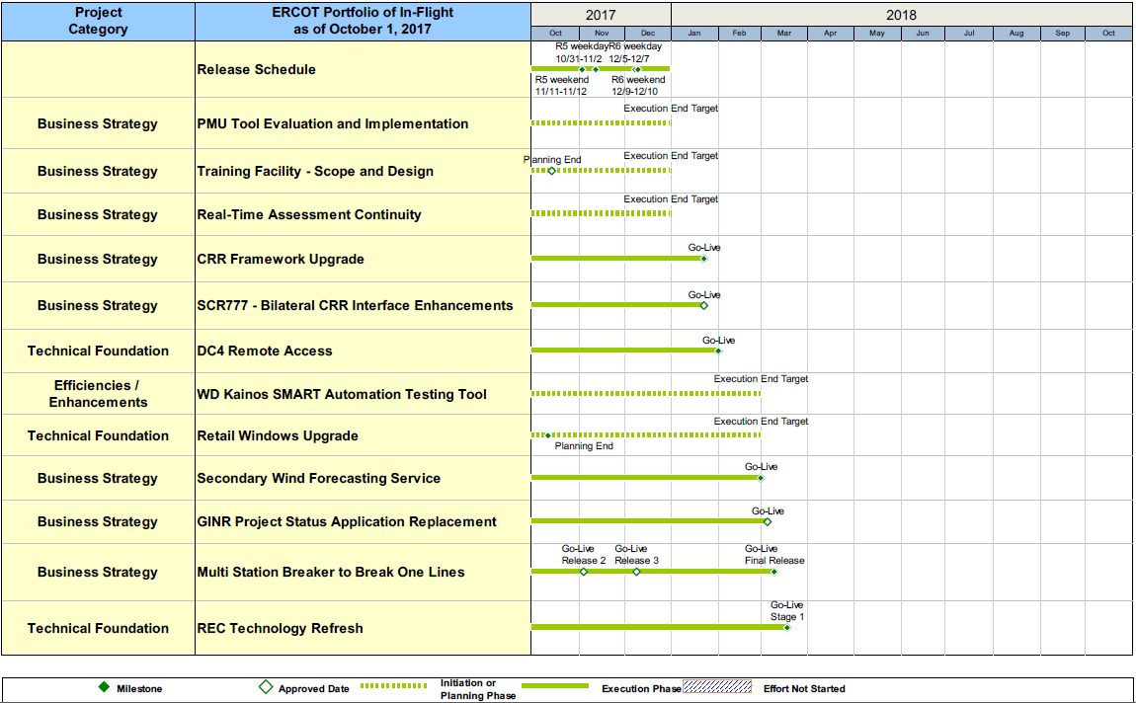
Project Portfolio Status – as of 9/30/2017

Slide 12
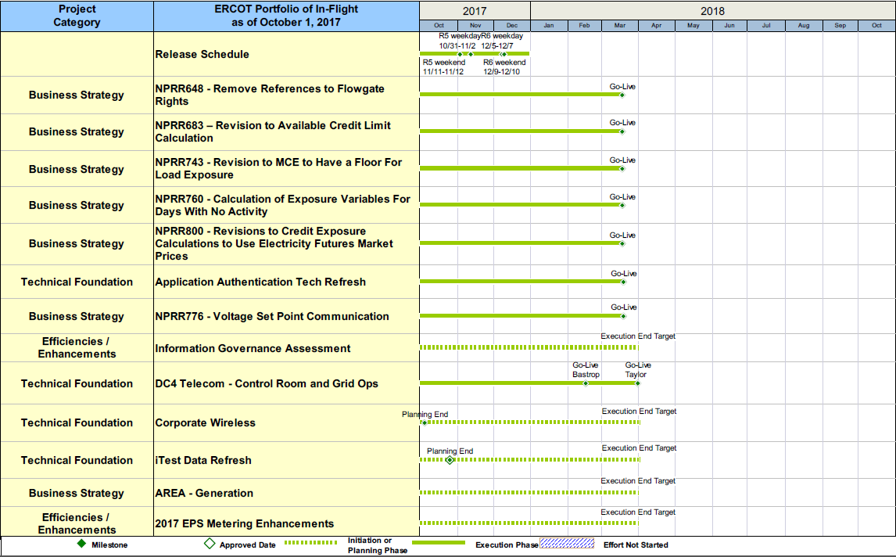
Project Portfolio Status – as of 9/30/2017

Slide 13
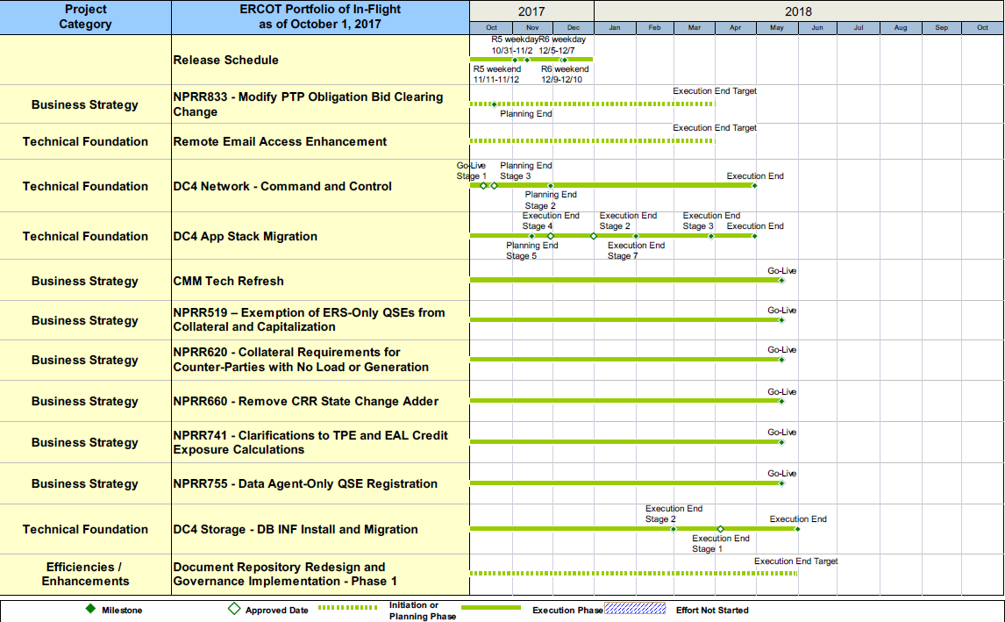
Project Portfolio Status – as of 9/30/2017

Slide 14
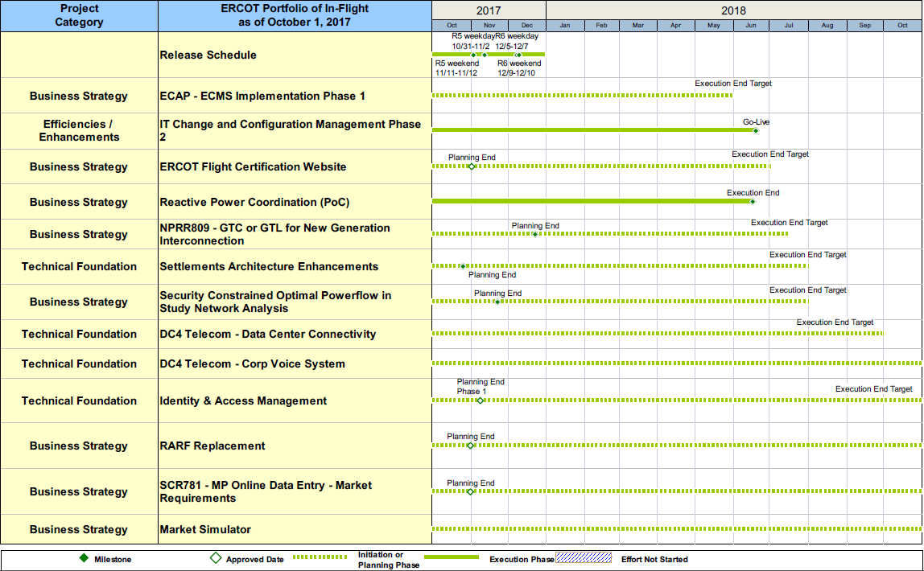
Project Portfolio Status – as of 9/30/2017

Slide 15
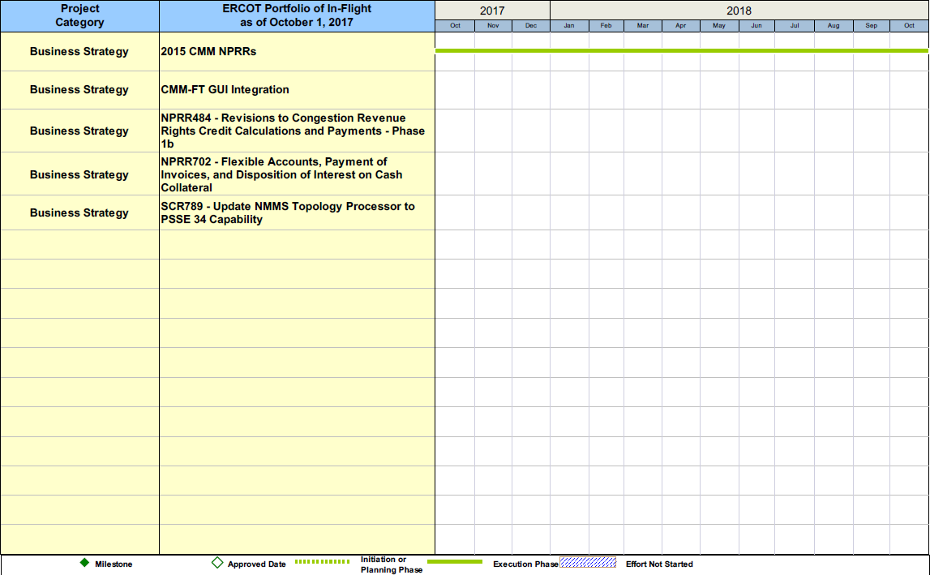
Project Portfolio Status – as of 9/30/2017

Slide 16
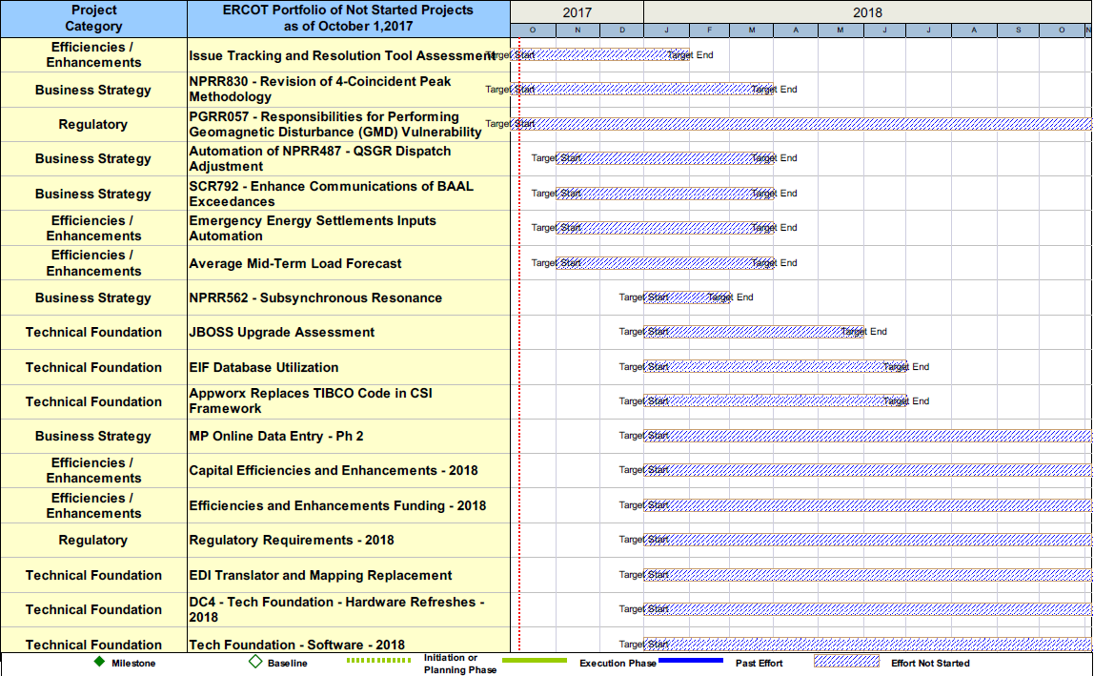
Project Portfolio Status – as of 9/30/2017

Slide 17
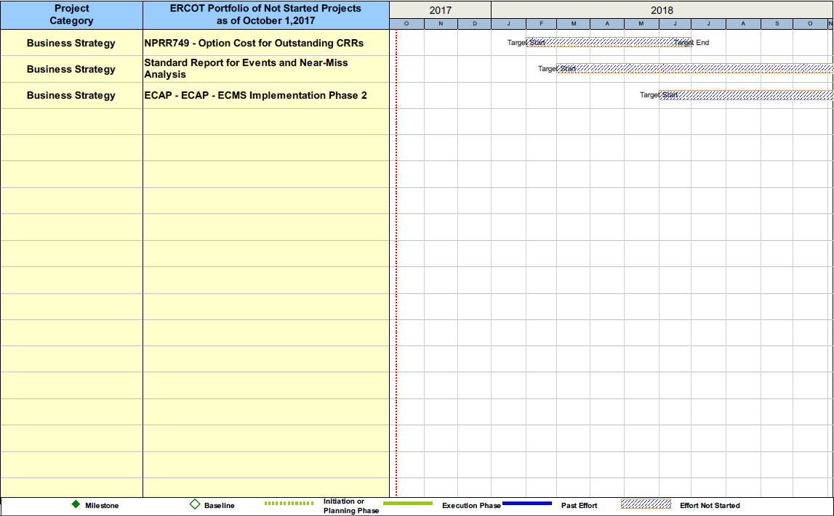
Project Portfolio Status – as of 9/30/2017

