Slide 1
ERCOT Retail Market Training Task Force
Update to RMS
Tuesday, October 10th, 2017

Slide 2
Retail Training Instructor Led Classes - 2017
Final instructor led training for 2017 –
REVISED Schedule*
WebEx also available
HOUSTON CenterPoint
Retail 101 - Tues, December 5th 9:00 – 4:00
Inadvertent Gain Training – Wed, Dec 6th 9:00 – 4:00
*tentative – dependent on RMS schedule for December

Slide 3
Retail Training Curriculum
Retail 101 – High level overview of the ERCOT Retail Market…
History of the Texas competitive electricity market
Roles of Market Participants – ERCOT, REPs, TDSPs, PUCT
Market Rules
Retail Transactions
Impacts of Advanced Metering technology
Market data transparency
Inadvertent Gain and Loss Training - a closer look at the IAG/IAL market process…
Fundamentals of the established market process including rescissions
Facilitated discussion of best practices
End to end demo of the MarkeTrak subtypes
IGL market reporting

Slide 4
Retail Training Instructor Led Classes – Proposed for 2018
Proposed Schedule for Retail Training - 2018
AUSTIN | FEBRUARY | WebEx Only
Tue | January 30th | RETAIL 101 | 9:00 – 4:00
Wed | January 31st | INADVERTENT GAIN TRAINING | 9:00 – 3:30
DALLAS | MAY | Oncor Offices
Tue | May 1st | RETAIL 101 | 9:00 – 4:00
Wed | May 2nd | TxSET TRAINING | 9:00 – 4:00
HOUSTON | SEPTEMBER | CenterPoint Offices
Tue | September 25th | RETAIL 101 | 9:00 – 4:00
Wed | September 26th | TxSET TRAINING | 9:00 – 4:00

Slide 5
MarkeTrak On-line Training Modules - Series COMPLETE!
Marketrak Overview
Switch Hold Removal
Cancel With/Without Approvals
Inadvertent Gains/Losses & Rescissions
Usage and Billing
Other D2D Subtypes
Bulk Insert
MarkeTrak Admin Functionality
Data Extract Variances (DEV) LSE Subtypes
Data Extract Variances (DEV) Non-LSE Subtypes
Emails and Notifications
Reporting – Background & GUI

Slide 6
MarkeTrak On-line Module Training via ERCOT Learning Management System
How many market participants have viewed the Online training modules*?
Which segment of the market do the viewers represent?
There have been 136 users YTD. Top modules viewed are Overview, Inadvertent Gain, and Cancel w/ Approval.
*Training taken via ERCOT LMS. Does not include training taken outside the LMS

Slide 7
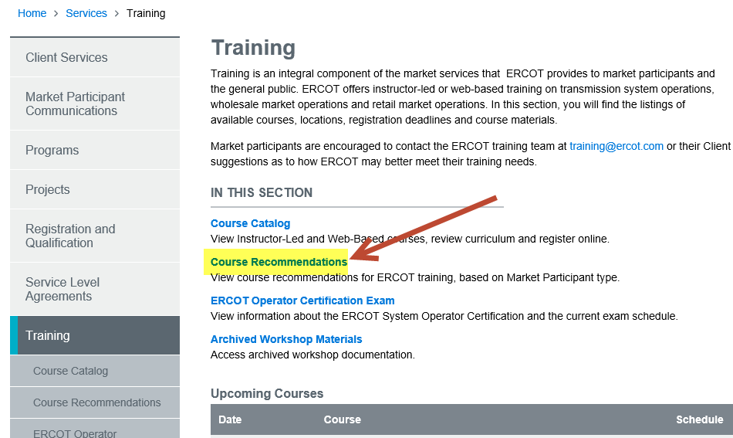
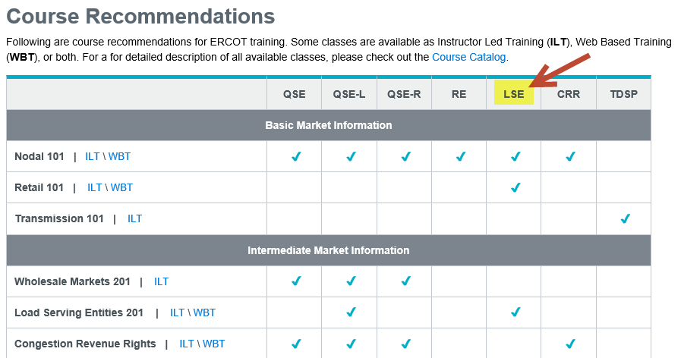
ERCOT Learning Management System – New Feature
The Training page of the ERCOT website has added a new page of Course Recommendations where you can view recommended courses for each Market Participant type.

Slide 8
MarkeTrak On-line Training Module Series
How do I register for Training?
Go to the ERCOT Training Website at http://www.ercot.com/services/training/
Select the course you are interested in attending
On the ‘Schedule/Registration’ tab, select the ‘enroll online’ link under ‘Registration’ to register for the course.
If you find the course is not listed under the Web-based training…
Go to ERCOT Training Website as shown above
Select the ‘ERCOT Learning Management System’ (LMS) link in the upper right hand corner under RELATED CONTENT
If necessary, set up a log on
Once in LMS, follow drop downs for ‘web-based training’ and ‘retail market’. Available modules will appear
Select ‘start course’
Note! Most modules are able to be completed in less than 30 minutes.

Slide 9
Please join us for our Next RMTTF Meeting
November 2nd, 2017
9:30 AM
ERCOT MET Center

Slide 10
Thank you!

