Slide 1
Summary of GIC Model Development @ 09/28/2017
Presentation to PGDTF
Qiuli Yu and Leslie Williams
ERCOT
September 28, 2017

Slide 2
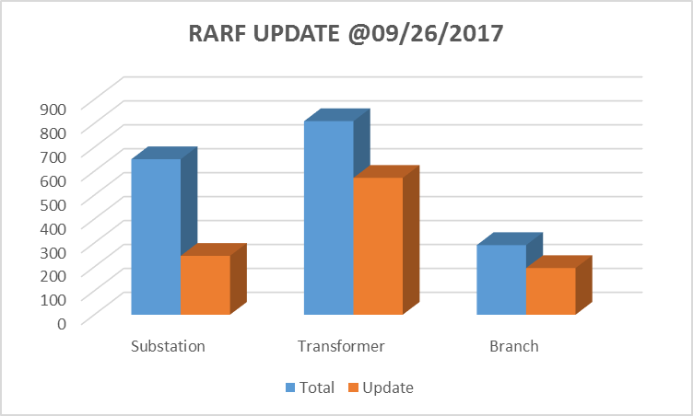
RARF Update On September 26 of 2017
 | Total | Update | Percent
Substation | 650 | 293 | 45%
Transformer | 804 | 635 | 79%
Branch | 290 | 218 | 75%

Slide 3
TSPs GIC Data Correction Update On September 26 of 2017
TSP | Status
 | Bus-Substation mapping Errors | Substation Duplicates
GPLMPA | √ | √
TAEN | √
TAEPTC | Incomplete | √
TBPUB | Just have contact information
TBREC | Incomplete | √
TBTU | Not Received | √
TCPSE | √
TDME | Not Received | √
TEXLATSP | Incomplete
TGSEC | Incomplete
TLCRA | √ | √
TLSTR | √
TONCOR | Incomplete | √
TRAYBN | Incomplete
TSLND1 | √
TSTEC | √
TTNMP | Not Received
Duplicate substation numbers
Bus-Substation Mapping missing
Buses of Transformers are not in the same substation
Around 40 Transformers have the issue

Slide 4
Next Step During GIC Model Development
In the next step, ERCOT will focus on
Resolve substation number duplicates again
Complete bus-substation mapping again
Transformer table integration – use transformer data from TSPs and REs to replace default data
Expected efforts from TSPs
ERCOT will send requests to related TSPs asking data completion/correction
TSPs correct the data issues and submit GIC input update in timely manner

