Slide 1
2018 System Change Roadmap
David Forfia
Director Enterprise Architecture
& IT Transformation

Slide 2
Agenda
  ERCOT Roadmap Process
  IT to IT Retail Market Technology Roadmap WebEx Timing
  2018 Technology Project Forecast – ERCOT NAESB Upgrade

Slide 3
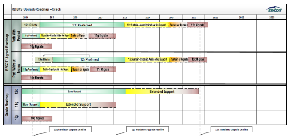
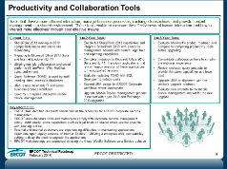
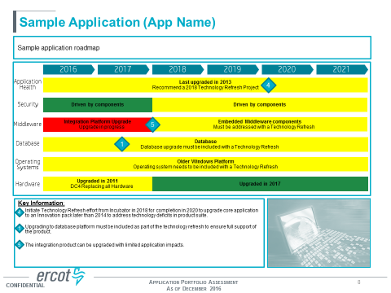
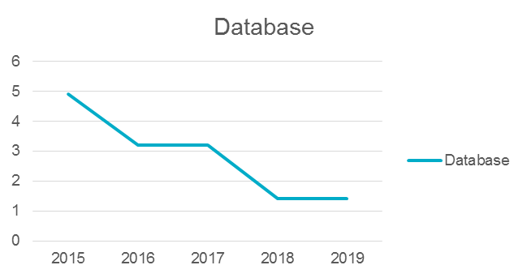
Planning Drives the Investment
Tech Foundation Roadmaps
are completed annually (1st Quarter) and
reviewed and accepted by the ARB
Applications are assessed against the roadmaps
bi-annually (1Q/3Q) and as needed for the
Board Deep Dive
Forecasting the need for projects on the project
incubator to address the trends using the
Tech Foundation process

Slide 4
Technical Health Project Strategy
Continuous Application Maintenance
  Maintain the Application in conjunction with Business projects
    Delivers business and application value at the same time
    Reduces the overall cost by combining development and testing cycles
    Keeps the application healthy as a matter of normal project processes thru incremental improvements
Application Technology Refresh Project
  Charter an “Application Refresh” project to address the overall Application System
    Addresses the system technology as a whole
    Biggest IT return for the investment
    Biggest business operational improvement for the investment
    Schedule strategically when there is limited planned business projects
Platform Refresh Project
  Charter a “Platform Refresh” project to address the platform across all applications
    Targets a single application component across the portfolio
    Least improvement to the overall health
    Least IT return for the investment
    Least Business return for the investment and delay
    Difficult to strategically schedule around other projects due to scope of impact

Slide 5
IT to IT Technical Roadmap Webex
Continue working groups as projects on normal timeline for project releases
Proposing Scheduling in 3Q2017
Specific audience is IT Staff at the Market Participants
  ERCOT Technical upgrades potentially have impacts on Market Participants
  Market participant upgrades potentially have impacts on ERCOT
Focusing on ERCOT Technical Roadmaps 2017 - 2022
SAMPLE

Slide 6
2018 Project Forecast – ERCOT NAESB Upgrade
ERCOT needs to upgrade the NAESB Application Suite
  Targeted for a late 2018 or early 2019 release
Impacts
  Does not require participants to complete an upgrade
  Requires Market Testing and should be in budget request for 2018
Benefits
  Enables Participants capable of using enhanced encryption while supporting current encryption
  Enables RMS to choose upgrade to a version of the NAESB standard above 1.7 when the committee determines the need.

Slide 7
Questions ?
Additional Questions ?

