Slide 1
SCED Limit Calculation
Matthew Young/Jian Chen
9/15/2017

Slide 2
Problem Overview
When the MW limit for a transmission constraint is calculated, there is a possibility for abnormally low limit results if the flow over the constrained equipment is very small. Resulting in the constraint binding at an unrealistic MW limit.

Slide 3
Current SCED Limit Calculation (Constant Power Factor)
The SCED MW limit of the active constraint is calculated by EMS.
The real and reactive flows are used to calculate the current power factor.
The power factor is presumed to remain constant from one SCED run to the next.
The power factor is then applied to the MVA limit to get the MW limit.
$${MW}_{limit}={MVA}_{limit}∗\left(\frac{{MW}_{flow}}{\sqrt{{MW}_{flow}^{2}+{MVAR}_{flow}^{2}}}\right)$$

Slide 4
Existing problem
When calculating the PF, if P << Q, the resulting MW limit can be very low in relation to the actual equipment rating.

Slide 5
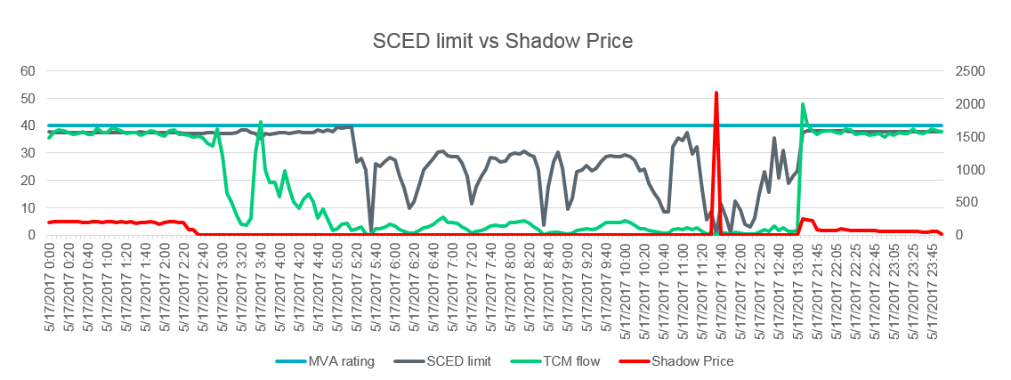
Impact to SCED
As a result, a very low MW limit could be sent to SCED, causing a high shadow price in SCED dispatch.
SZEPCMN8: HLD_FMR1 on 5/17/2017

Slide 6
Review of similar events
Since Jan.1 2012, there have been 11 similar events, when MW limits dropped below 20% of MVA ratings and caused high shadow prices (>$1000) in SCED.
Date |  | Contingency | Constraint | Daily Limit Min | Max SP with Low Lim | Binding with Low Limit
6/14/2012 |  | XLOB58 | NLARSW_PS1 | 38.9 | $3,500.00 | 2
8/23/2012 |  | XLOB58 | NLARSW_PS1 | 49.4 | $1,855.25 | 1
12/9/2012 |  | XVE2R89 | PAUL_69-1 | 4.8 | $2,800.00 | 1
12/28/2012 |  | BASE CASE | SNYDR_FMR1 | 6.2 | $1,111.72 | 1
2/21/2013 |  | SAJORIO5 | RIOHONDO_345L | 1.2 | $3,500.00 | 8
5/19/2015 |  | SCRDLOF9 | POS_SHAN_1 | 0.3 | $2,800.00 | 1
5/3/2017 |  | SKLELOY8 | LOYOLA_69_1 | 0.9 | $3,500.00 | 2
5/14/2017 |  | SSCLWF28 | NVKSW_FMR1 | 7.7 | $3,500.00 | 1
5/17/2017 |  | SZEPCMN8 | HLD_FMR1 | 0.2 | $2,165.75 | 1
5/28/2017 |  | XFTS89 | PIGTAP_SOLSTI1_1 | 0.3 | $3,500.00 | 1
7/21/2017 |  | XFTS89 | PIGTAP_SOLSTI1_1 | 1.4 | $3,500.00 | 1

Slide 7
Alternative Method
One alternative method to calculate the SCED MW limit is based on the assumption that the change in reactive power through the constrained equipment will be small and can be ignored.
$${MW}_{limit}=\sqrt{{MVA}_{limit}^{2}−{MVAR}_{flow}^{2}}$$
As shown in the above equation, this method would run into problems when reactive flow is higher than equipment rating. To prevent this from happening, a hybrid-method is suggested:
$$If {MVA}_{flow}<{MVA}_{limit} : {MW}_{limit}=\sqrt{{MVA}_{limit}^{2}−{MVAR}_{flow}^{2}}$$
$$If {MVA}_{flow}>{MVA}_{limit} : {MW}_{limit}={MVA}_{limit}∗\left(\frac{{MW}_{flow}}{\sqrt{{MW}_{flow}^{2}+{MVAR}_{flow}^{2}}}\right)$$

Slide 8
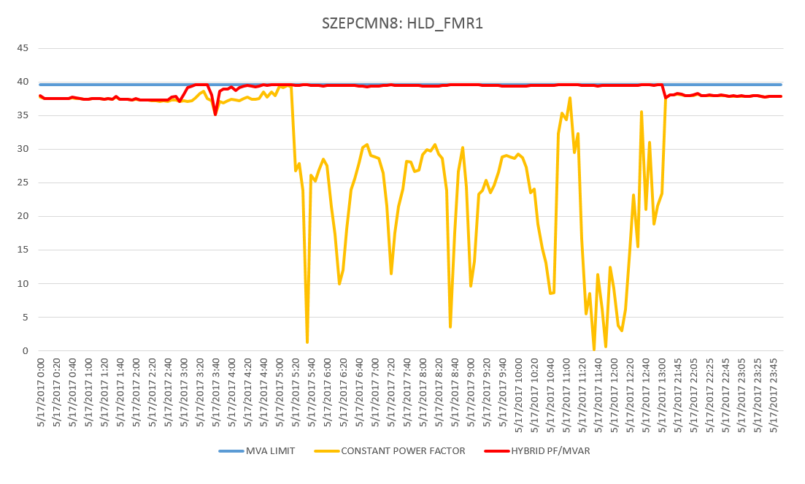
Method Comparisons

Slide 9
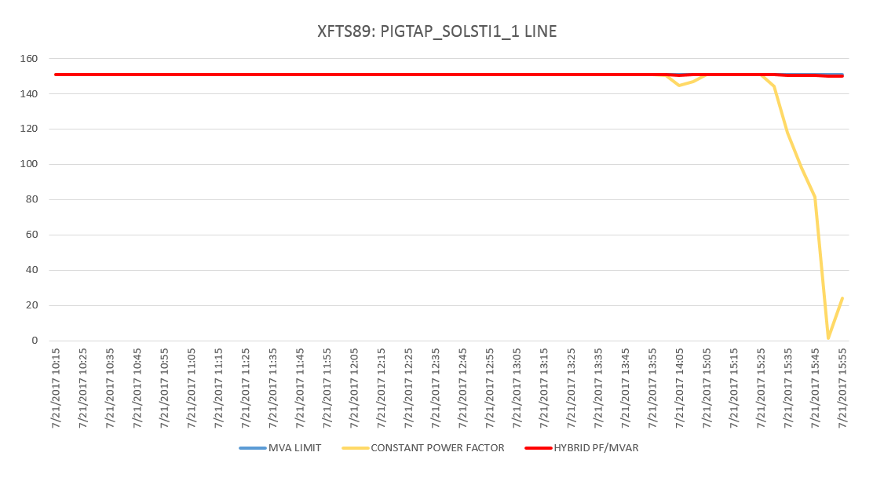
Method Comparisons

Slide 10
Method Comparisons
Test with all active constraints from July, 2017.
Total of 16,718 SCED constraint intervals are tested.
MW limit/MVA rating | Constant Power Factor | Hybrid PF/MVAR
80%~100% | 16623 | 16718
60~80% | 49 | 0
40~60% | 23 | 0
20~40% | 12 | 0
0~20% | 11 | 0

Slide 11
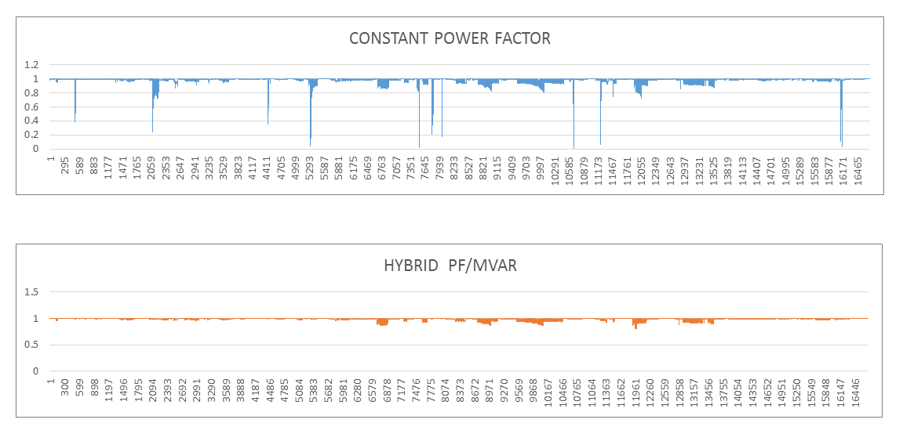
Method Comparisons

Slide 12
Conclusion
Constant Power Factor Method
Unrealistic MW limits could be sent to SCED when the power factor of a constraint is very low.
Based off of historical data, there were few of these events since Jan.1, 2012, with minimal impact to the market.
Hybrid PF/MVAR Method
Could present the opportunity for some MVA limit overshoot.
While a possible solution to unrealistic MW limits, would affect all constraints going forward.

