Slide 1
Project Update and Summary of
Project Priority List (PPL) Activity
September 14, 2017

Slide 2
Project Update Agenda
Project Portfolio Update p. 3-9
  Recent / Upcoming Project Implementations
  2017 Release Targets
  2018 Release Targets
  2017 Project Spending Forecast
  Revision Request Funding Placeholder Status
  RARF Replacement Project Update
  Priority/Rank Options for Revision Requests with Impacts
Appendix
  Project Portfolio Gantt Chart p. 10-18
Location of Project Priority List (PPL): http://www.ercot.com/services/projects/index

Slide 3
Recent / Upcoming Project Implementations
2017 August Release – 9/11/2017-9/13/2017 In Flight
  NPRR758 – Improved Transparency for Outages Potentially Having a High Economic Impact
  NPRR775 – Enhanced Implementation of Limits for Fast Responding Regulation Service
2017 October Release – 10/31/2017-11/2/2017 In Flight
  NPRR778 – Modifications to Date Change and Cancellation Eval. Window
  NPRR782 – Settlement of Infeasible A/S Due to Transmission Constraints
  NPRR808 – Three Year CRR Auction
  NPRR810 – Applicability of RMR Incentive Factor on Reservation and Transportation Costs Associated with Firm Fuel Supplies
  NPRR831(a) – Inclusion of Private Use Networks in Load Zone Price Calcs
    All impacted systems except CRR
Note: Projected Go-Live dates are subject to change.
Please watch for market notices as the effective dates approach.

Slide 4
2017 Release Targets – Board Approved NPRRs / SCRs / xGRRs
March 3/7 – 3/9 | May 5/1 – 5/11 | June 6/27 – 6/29 | August 9/11 – 9/13 | October 10/31 – 11/2 | December 12/5 – 12/7
NPRR272 NPRR649 NPRR753 NPRR764 NPRR785 RMGRR134 NPRR790 | SCR790 NPRR746 NPRR786 NPRR792 NOGRR164 PGRR051 RRGRR003 RRGRR006 RRGRR007 RRGRR009 RRGRR010 PGRR046 | NPRR573 NPRR789 NPRR797 NPRR801 NPRR827 NPRR744 | NPRR758 NPRR775 NPRR809 PGRR052 PGRR054 | NPRR778 NPRR782 NPRR808 NPRR810 NPRR831(a) | NPRR562 NPRR812 SCR789
7 | 12 | 6 | 5 | 5 | 2
ü
ü
ü
ü
ü
ü
ü
ü
ü
ü
ü
ü
ü
ü
ü
ü
ü
ü
ü
ü
ü
ü
ü
ü
E
E
ü
ü
ü
E
E
E
E
E
NS
E
2/1
6/1
8/1
11/11 – 11/12 (Retail)
12/9 – 12/10 (Retail)
ü
5/8 – NMMS Upgrade
ü
TBD Items (and point at which they became “TBD”)
2014 | 2015 | 2016 | 2017
NPRR664 | None | SCR781 P | NPRR702 P, PGRR057, NPRR519, NPRR620, NPRR741, NPRR755, NPRR833, SCR789 H, SCR792
Go-live dates can differ from Protocol effective dates – Please refer to market notices for more details
APPENDIX
Red Text: New additions and target release changes
Strike-Through Text: Previous target release changes
(a), (b), etc. indicates multiple phases
Project Status Codes
NS = Not Started
I = Initiation
P = Planning
E = Execution
H = On Hold
Release targets are subject to change
NPRR831(a) – All impacted systems except CRR

Slide 5
2018 Release Targets – Board Approved NPRRs / SCRs / xGRRs
March Dates TBD | May Dates TBD | June Dates TBD | August Dates TBD | October Dates TBD | December Dates TBD
NPRR776 NPRR830 NPRR683 NPRR743 NPRR760 NPRR800 NPRR833 SCR777 NPRR831(b) |  | NPRR749
9 | 0 | 1 | 0 | 0 | 0
P
NS
E
E
E
E
I
E
E
NS
CMM Release 1a
January
(Off-cycle)
Dates TBD
(Retail)
Dates TBD
(Retail)
Dates TBD
(Retail)
Dates TBD
(Retail)
Dates TBD
(Retail)
Go-live dates can differ from Protocol effective dates – Please refer to market notices for more details
APPENDIX
Red Text: New additions and target release changes
Strike-Through Text: Previous target release changes
(a), (b), etc. indicates multiple phases
Project Status Codes
NS = Not Started
I = Initiation
P = Planning
E = Execution
H = On Hold
Release targets are subject to change
NPRR831(b) – CRR system changes

Slide 6
2017 Project Spending
2017 PPL Budget = $20.5M
“Potential Demand” represents internal ERCOT projects that have not been fully approved

Slide 7
Revision Request Funding Placeholder Status
In 2017 and 2018, ERCOT forecasted $4.0M for Revision Request work
Yearly Revision Request Spending Forecast Summary
Project Status | 2017 | 2018
YTD Actuals | $1.34M | $0.00M
Approved – In-Flight / Complete | $2.36M | $0.96M
Approved – On Hold | $0.00M | $0.00M
Approved – Not Started | $0.09M | $0.32M
Remaining Funding | $1.55M | $2.72M
Total Allocation | $4.00M | $4.00M
As of 7/31/2017

Slide 8
PR106-01 RARF Replacement
Project Update
Project Overview
  This project will replace the Resource Asset Registration Form (RARF) with a new web based application. Market Participants will have the ability to submit, review, and make online changes to Resource Registration data.
  .
Status
Project is still in the planning phase
  Requirements gathering has been slowed down while planning activities get reordered.
  Planning activities are being reordered to ensure activities are sequenced correctly, staffed appropriately and setup to adequately engage MPs on solution requirements
    ERCOT has been gathering and evaluating MP feedback on their overall user experience in working with ERCOT systems. (26 interviews conducted)
    This feedback has been helpful and is being considered as we start to look at the business requirements for this project.
Project was originally due to gate out of planning by the end of October, however we expect a change control to come forth before then with a modified schedule.
Therefore…
Replacing the current RARF spreadsheet and improving the overall process for users remains a HIGH priority for ERCOT.
Ensuring it is built with modern technology, UX principles and a scalable architecture is equally important.
Having a process in place to solicit Market Participant input is a pre-requisite to finalizing business requirements and drafting user stories
Therefore, more time is needed to get these foundational principles, processes, and resources defined before we can update our schedule.
We will provide an update on schedule at the November PRS meeting.
Notes:
Schedule slide instructions:
Project Overview; add a brief description of the project so someone reviewing the deck will understand what the project is implementing.
If the names in the header do not fit on one line with the current font size, make the size smaller. Use the same method for the Project number and name. If this does not fix the issue, use your best judgment to reformat the header and include the necessary information.
Complete the box above for major project milestones – refer to the milestones presented on phase gating slide, and include additional milestones as needed
Report the status of each milestone using the dropdown box in the embedded table above. Double click and then use the drop down list to select the status. Make sure to click out of cell, so the drop down arrow does not appear on the slide.
Address any schedule variances, risks or issues, as well as anything ahead of schedule, in the commentary box. Things to consider:
Are you on or off schedule? Why?
Are there critical path activities that are potentially at risk?
If the project gets a rebaseline, the old dates do not have to be included.

Slide 9
Priority / Rank Options for Revision Requests with Impacts
Options for…
Revision Request | Description | Priority | Rank | Comments
NPRR815 | Revise the Limitation of Load Resources Providing Responsive Reserve (RRS) Service | 2018 | 2070 | Revised Impact Analysis posted Work into the 2018 project plan without disrupting in-flight projects
NPRR817 | Create a Panhandle Hub | 2018 | 2080 | Revised Impact Analysis posted Work into the 2018 project plan without disrupting in-flight projects
NPRR825 | Require ERCOT to Issue a DC Tie Curtailment Notice Prior to Curtailing any DC Tie Load | 2018 | 2090 | Work into the 2018 project plan without disrupting in-flight projects
SCR791 | Correction of 60-day SCED GRD Disclosure Report | 2018 | 2100 | Work into the 2018 project plan without disrupting in-flight projects
PPL Rank Information
Next available Rank in Business Strategy = 2070
Next available Rank in Regulatory = 170

Slide 10
Appendix
  8/31/2017 Project Gantt
    In-flight items sorted by Project End Date
    “On Hold” projects listed separately
      None at this time
    “Not Started” items sorted by Project Start Date

Slide 11
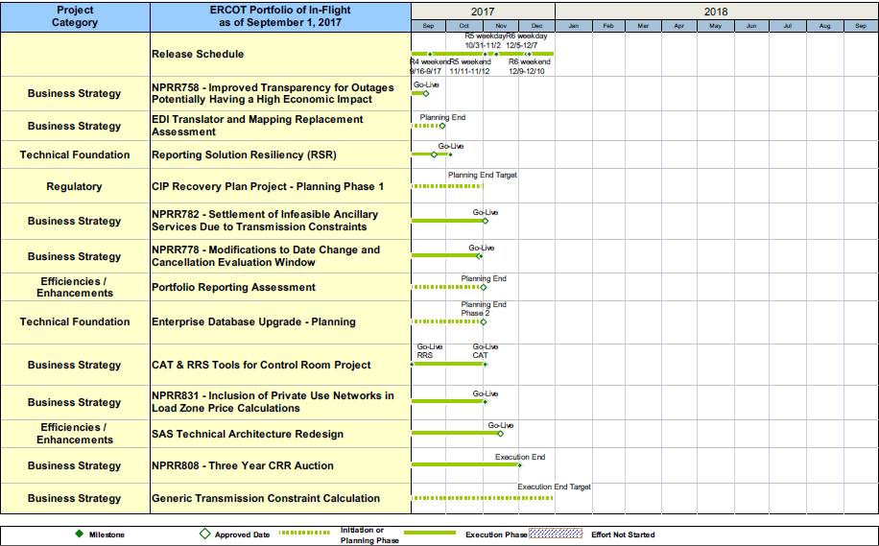
Project Portfolio Status – as of 8/31/2017

Slide 12
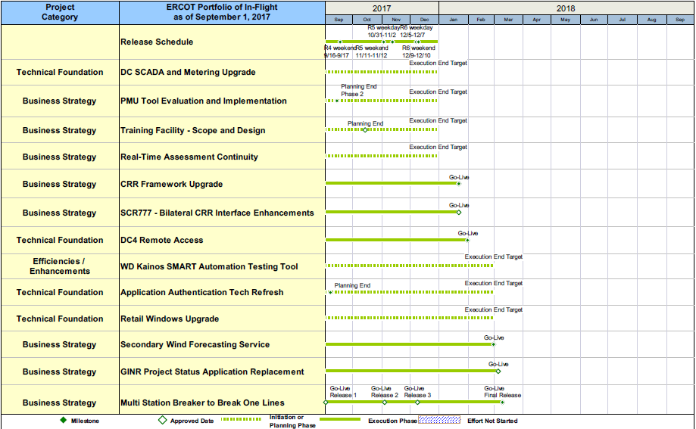
Project Portfolio Status – as of 8/31/2017

Slide 13
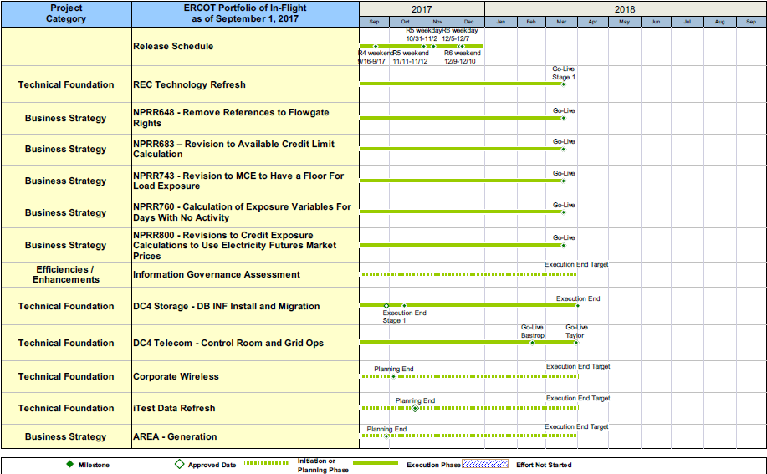
Project Portfolio Status – as of 8/31/2017

Slide 14
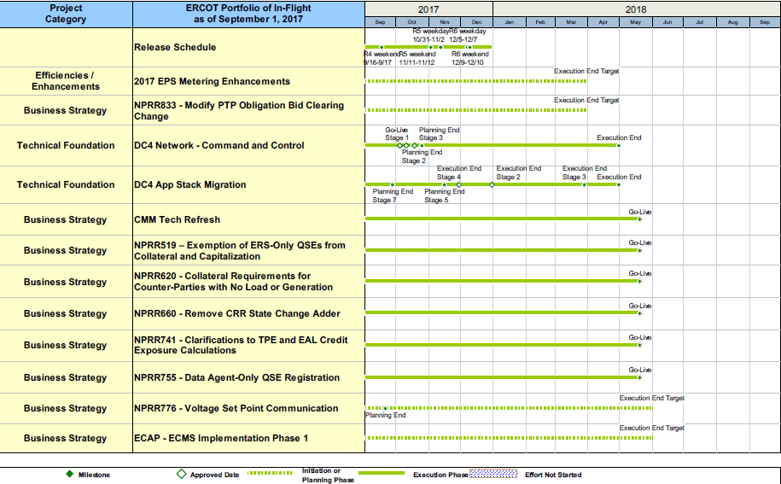
Project Portfolio Status – as of 8/31/2017

Slide 15
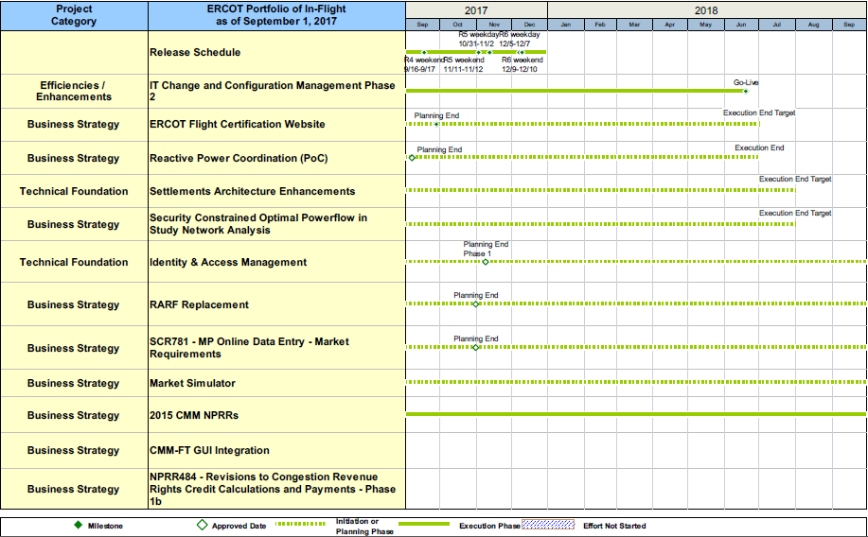
Project Portfolio Status – as of 8/31/2017

Slide 16
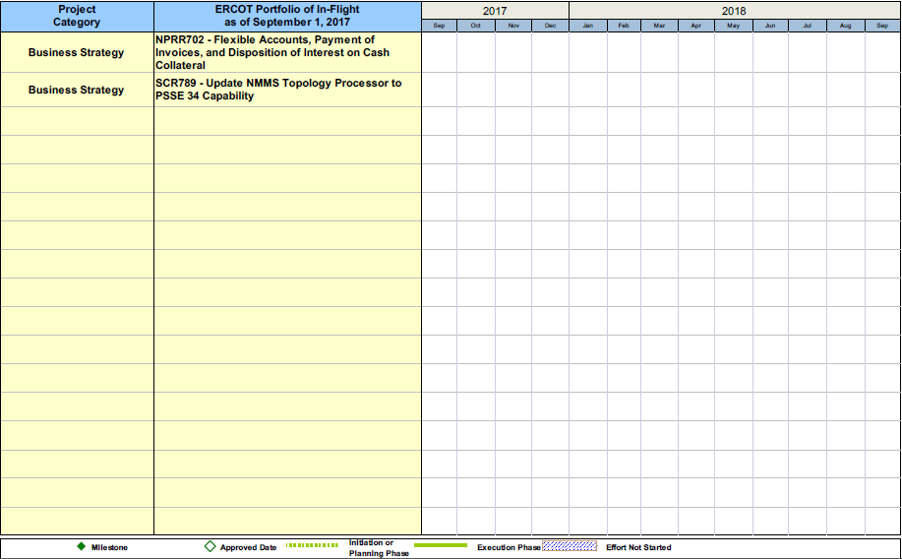
Project Portfolio Status – as of 8/31/2017

Slide 17
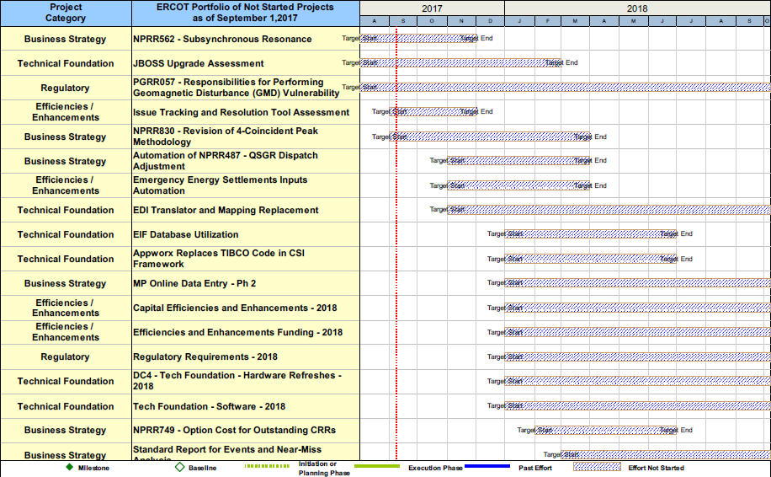
Project Portfolio Status – as of 8/31/2017

Slide 18
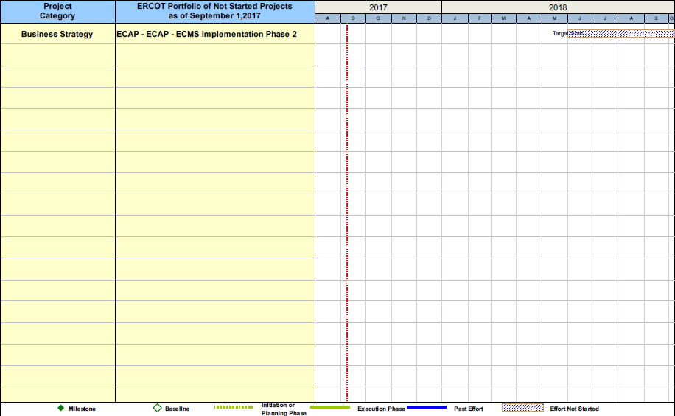
Project Portfolio Status – as of 8/31/2017

