Slide 1
CRR Deration and NPRR821
PRS
09/14/2017

Slide 2
Introduction
Deration and how it works
Eliminating deration
Options around eliminating deration
Alternatives proposed by LCRA – Focus on the PTP price instead

Slide 3
Deration
CRR deration was introduced as a market mitigation measure for a particular gaming strategy
CRR deration directly assigns reduced payments to specific CRRs that have impacts on oversold transmission elements
CRRs are only subject to deration if they involve a Resource Node
CRR payments incorporate a quantity called Hedge Value which limits derations to keep payments in line with proxy fuel costs at the Source or Sink
Unlike short-payments, derations are never refunded
Both derations and short-payments can cause a payment mismatch for entities converting the hedge to RT -> $ paid for CRRs ≠ $ charged for DAM PTPs

Slide 4
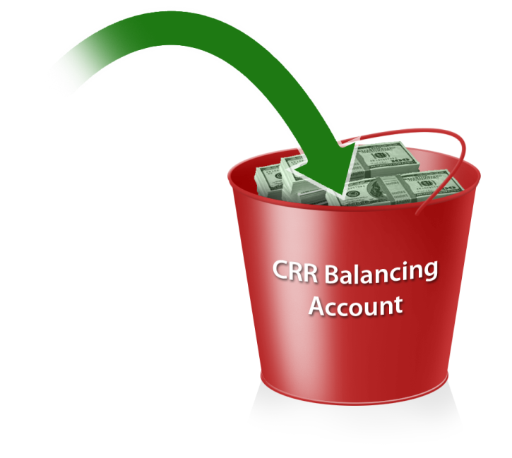
DAM Congestion Rent
If there is not enough congestion rent collected for the hour to pay all of the CRRs (after deration has occurred), all CRRAHs are charged a pro-rated shortfall charge to cover the difference.
At the end of the month, if there are funds in the Balancing Account they are used to refund shortfall charges to CRRAHs.
Occurs hourly
Charges for Energy Bids
Charges for PTP Obligation Bids
Payments for Energy Offers
Payments for PTP Obligation Bids
Payment due to CRRAHs
Congestion Rent

Slide 5
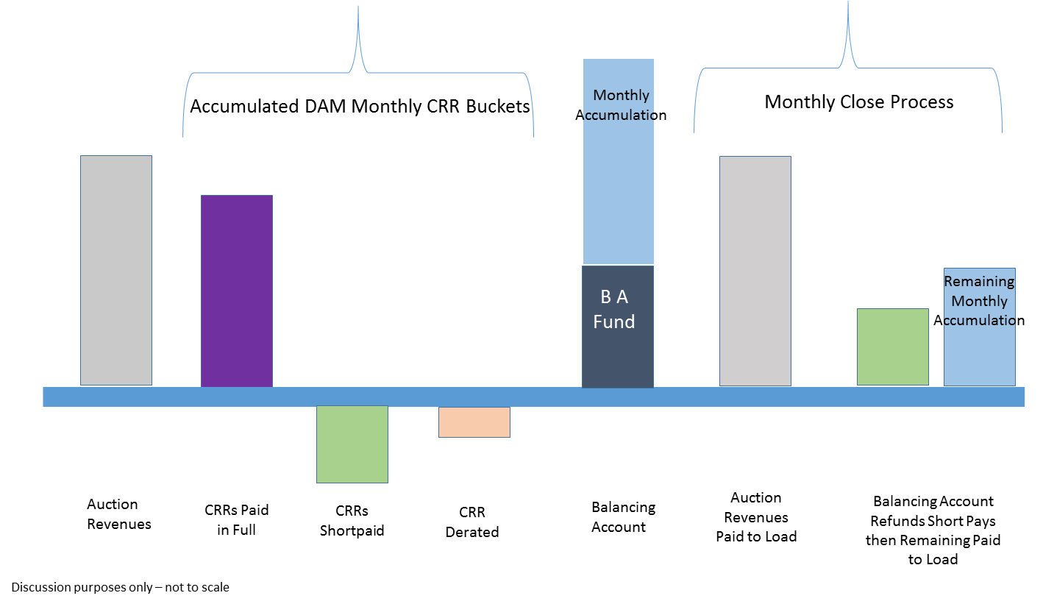
Current Monthly Timeline

Slide 6
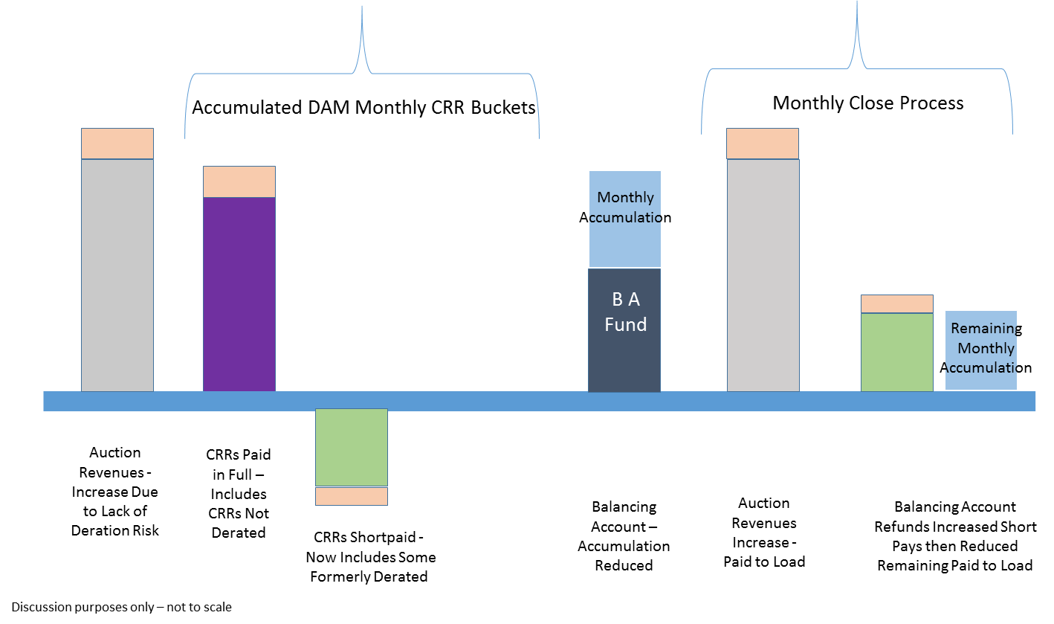
No Deration Monthly Timeline

Slide 7
Interaction Among Markets – Ideal Conditions
The value of CRRs are based on the estimate of the expected congestion costs on the purchase path.
The net amount paid for CRR ownership in auctions should converge to the net amount received in DAM by CRRAHs for their CRR.
The net amount paid for PTPs in DAM should converge to the net amount received in RT by QSEs for their PTPs.
DA prices are based on the estimate of expected RT energy costs. In long run, the DASPP and RTSPP should converge.
Under ideal conditions (markets converged)
CRR Auction Revenue = DAM CRR payout = DAM congestion rent = RT congestion rent (complete hedging)
DAM SPP = RT SPP
CRR+DAM+RT settlements = settling everything in RT

Slide 8
NPRR821 Options
Original (DC Energy) - Eliminates deration, CRRs receive full target payment
Potential impacts-
Auction revenues are expected to increase due to CRRs having a higher value in the DAM. Increases cost of CRRs and increases payout to load of auction revenue.
Less excess Congestion Rent credited to Balancing Account due to increased CRR payout. This will tend to reduce the monthly load payout from the Balancing Account.
Increased chance of shortfall charges to CRRAHs, and less Congestion Rent increases chances of some shortfall charges not being refunded.
DC Energy comments - Eliminates deration with a ‘circuit breaker’ to temporarily reduce CRRs sold in the monthly auction if the Balancing Account balance drops to zero.
Additional impacts when ‘circuit breaker’ enacted, due to less CRRs sold:
Auction revenues reduced.
More excess Congestion Rent available for credit to the Balancing Account, blunting the effects listed above for original proposal.

Slide 9
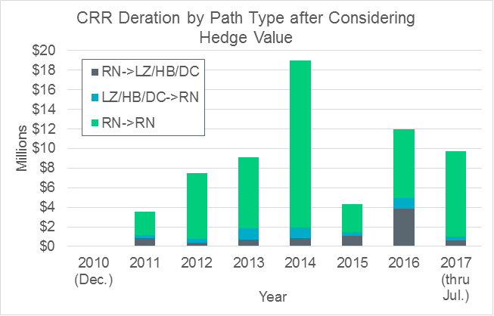
NPRR821 Options
Joint Commenters – removes Resource Node ->Load Zone/Hub as a path that can be derated
Scaled back version of original with similar but greatly reduced impacts
Morgan Stanley comments – all CRRs subject to deration, not just those involving Resource Nodes; eliminates Hedge Value limitation on derations; and removes the Balancing Account fund.
Potential impacts-
Auction Revenues decrease as CRRs have lower value in DAM. Decreases costs of CRRs and decreases payout to load of auction revenue.
More excess Congestion Rent credited to Balancing Account due to decreased CRR payout. This will tend to increase the monthly load payout from the Balancing Account.
Virtually eliminates shortfall charges

Slide 10
QSE PTP Obligations in DAM
Mechanism for hedging congestion costs in RT:
Purchase a DAM PTP Obligation bid based on the DAM locational price difference.*
Get paid (or charged) based on the RT locational price difference.*
Net revenue from PTP Obligation bids is credited to DAM congestion rent.
Net RT payments funded via Real-Time Revenue Neutrality Allocation, if insufficient RT congestion rent is collected.
*Note that NOIEs can essentially purchase RT Options

Slide 11
NPRR821 Options PTP Focus Instead of Deration
LCRA Option 1 and Option 2 both reduce the cost of DAM PTP Obligations, but differ on the circumstances.
Option 1 reduces the PTP cost if a QSE is linked to a CRRAH that owns a derated CRR on the path.
Option 2 reduces the PTP cost if any derated CRR exists on the path.
CRR full payment
PTP original cost
CRR derated payment
PTP reduced cost

Slide 12
NPRR821 Options PTP Focus Instead of Deration
LCRA Option 1
Auction revenues are unlikely to be impacted because CRRs are still derated
Less excess Congestion Rent will be credited to Balancing Account due to decreased PTP revenue. This will tend to reduce the monthly load payout.
Increased chance of shortfall due to the reduction in Congestion Rent collected.
LCRA Option 2
Same impacts but increased magnitude due to the increase in eligible PTPs.

Slide 13
Specific ERCOT Concerns Surrounding Alternatives
The option to adjust the PTP treatment favors price-taking behavior in the DAM over price sensitive bids and offers.
This will crowd-out certain types of participation.
Removes any incentive to place offers in the DAM that are reflective of real-time behavior. Regardless of the magnitude of a negative price for a particular resource an entity will not have an incentive to react.
The outcome creates an inequity and has efficiency concerns. The DAM was not intended to favor price-taking behavior over price sensitive bids and offers.
The option to eliminate balancing account and de-rate everyone is a paradigm change and should not be moved forward without additional thought about the consequences.

Slide 14
Appendix

Slide 15
CRR Auction Revenue
CRR Auction and Auction Revenues
All revenues distributed on load ratio share basis depending on whether the CRR source and sink belong to the same 2003 Congestion Management Zone or not.

Slide 16
Impact of Removing the CRR Deration Process
Post Rolling CRR Balancing Account

Slide 17
Impact of Removing the CRR Deration Process
Post Rolling CRR Balancing Account

Slide 18
Deration by Path Type

Slide 19
Deration

