Slide 1
ERCOT’s Response to ERS Capacity from ERS Generators Self-Deploying during Pricing Events
Mark Patterson
Manager, ERCOT Demand Integration

Slide 2
ERS Generator Response during Pricing Event and near 4CP Day
ERS Generator fleet obligation ≈ 310 MWs
ERS generators that deploy only for emergencies/ERCOT instruction have a total ERS Obligation ≈ 14 MWs (not included in this analysis).
ERS generators that also deploy outside of emergencies have a total ERS Obligation ≈ 296 MWs
November 29th was the largest price response by ESI-IDs on real-time pricing or block and index in 2016. This should provide a worst case scenario for the ERS fleet responding to prices.
August 2nd was chosen because it was both a pricing event and near 4CP day

Slide 3
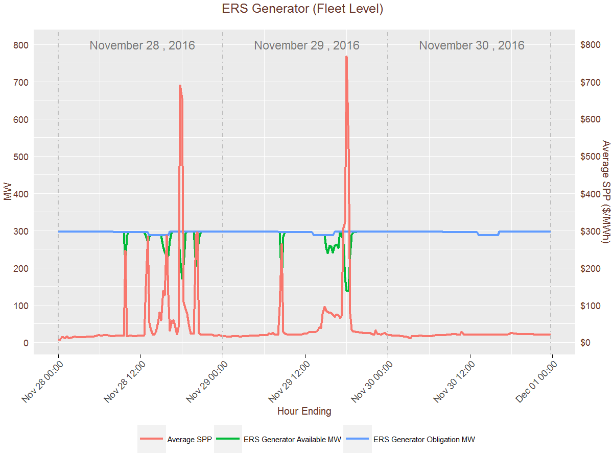

Slide 4
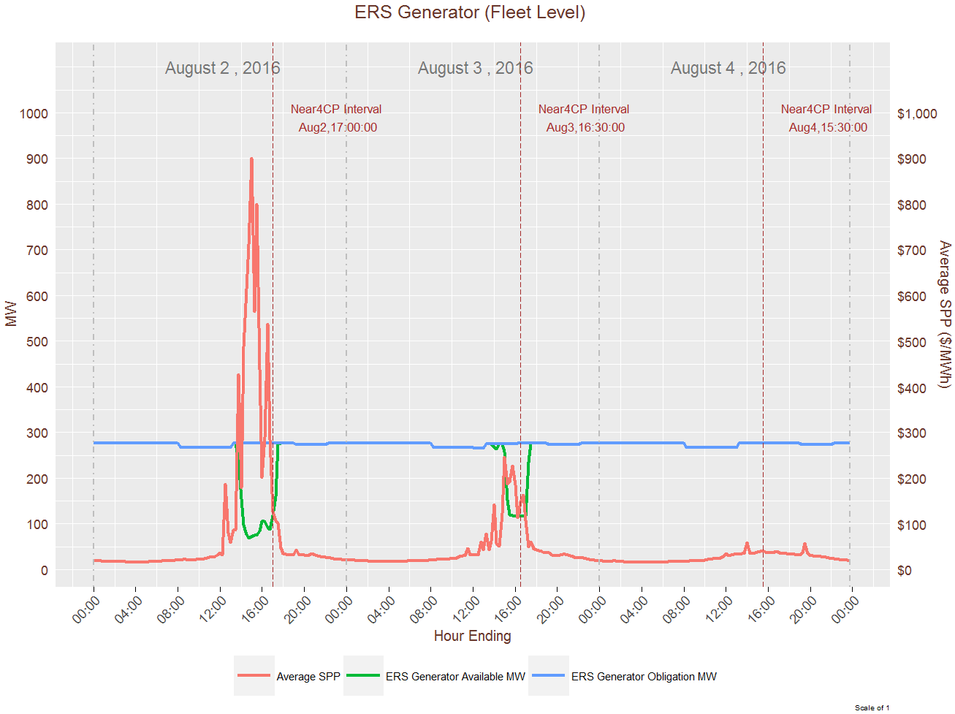

Slide 5
WMS Request to ERCOT
Bring back suggestions for resolving the issue of ERS Generators self-deploying during pricing events.

Slide 6
Capacity from ERS Generators
Capacity Reserved for ERS*
Total Output Capacity from ERS Generator
Injection Capacity
Self–Serve Capacity
* Only Capacity Reserved for ERS is obligated to provide ERS and therefore ERS payments are based on this capacity’s ability to meet its availability and performance criteria

Slide 7
Clawback Suggestion for Capacity Reserved For ERS
Capacity Reserved for ERS
3 year Transition Period
1st Year – 1/3 of any revenue received from ERCOT for energy payments* will be clawed back from the ERS Payment, not to exceed total ERS payment for the ERS Contract Period.
2nd Year – 2/3 of any revenue received from ERCOT for energy payments* will be clawed back from the ERS Payment, not to exceed total ERS payment for the ERS Contract Period.
3rd Year and after – 100% of revenue received from ERCOT for energy payments* will be clawed back from the ERS Payment, not to exceed total ERS payment for the ERS Contract Period.
* Energy payments are exclusive of energy when deployed for ERCOT instructed events (emergency and test) and properly scheduled self-tests

Slide 8
Clawback Suggestion for Capacity Reserved For ERS
The clawback of the ERS Payment based will be applied at the ERS Resource level and not at the QSE portfolio level. In addition the clawback will not be applied to only ERS Time periods in which the energy payments were realized.
For ERS Generators co-located with an ERS Load and opting for joint evaluation the ERS payment for both the ERS Generator and ERS Load will be available for clawback.
If known in time for the ERS RFP any money clawed back will be carried forward to remaining Standard Contract Terms remaining in the ERS Program Year.

Slide 9
Clawback Suggestion for Capacity Reserved For ERS
Even with the clawback of the ERS Payment the ERS Generator will retain its ERS obligation throughout the ERS Standard Contract Term.

