Slide 1
SMT Update To AMWG
AUGUST 2017

Slide 2
Monthly SMT Data Timelines AMWG CR 2014 002 End to End File Processing Completeness – AUG 2017
% Timely Market Delivery - % of files posted to market (FTPS) by 11:00pm out of # of files received by SMT by 11:00pm.
% Portal Data Availability - % of files loaded to the database for data availability on portal by 6:00am next day for the files received by 11:00pm
* A LSE file includes usage data for up to 50,000 ESIIDs.
2

Slide 3
SMT API and FTPS Services Availability – AUG 2017
The service availability is measured as a percentage of number of minutes the service was available out of the total number of minutes in a month, excluding planned outages.
Observed Anomalies:
Mar-Apr 2015: SMT outage and subsequent recovery/catch-up impacted API availability. FTPS was available for most of the part except on 03/21-03/22 for 36 hours.
26 Jul 2015: Services were unavailable for 12 hours due to Flash storage issue
25 Jan 2016: Services were unavailable for 19 hours due to storage configuration issue
07 Mar 2016: API Services were unavailable for 7hours due to Oracle archiver issue.
12 Jul 2017: Due to network Outage FTP & API services are down for 20 minutes. FTPS & API availability is 99.95%.
Notes:
3

Slide 4
SMT Number of Accounts by Type AMWG CR 2014 009 – August 2017
Registered Users | ONC | CNP | AEPN | AEPC | TNMP | TOTAL
Active Residential Accounts | 60542 | 28732 | 1908 | 5771 | 3742 | 100695
Active Residential English Accounts | 60334 | 28529 | 1901 | 5652 | 3733 | 100149
Active Residential Spanish Accounts | 208 | 203 | 7 | 119 | 9 | 546
Non Active Residential Accounts | 24126 | 15896 | 1815 | 4022 | 1014 | 46412
Total Residential Accounts | 84668 | 44628 | 3723 | 9793 | 4756 | 147107
TDSP User | 361 | 30 | 10 | 18 | 1 | 420
TDSP Admin | 4 | 4 | 4 | 4 | 3 | 19
Small Business User | 96 | 47 | 1 | 1 | 3 | 148
Small Business Admin | 3022 | 1630 | 88 | 330 | 150 | 5382
Total Agreements (Includes Active and Pending) | 13232 | 3300 | 66 | 214 | 888 | 17700
Energy Data Agreements (Includes Active and Pending) | 13232 | 3058 | 66 | 214 | 888 | 17458
Han Device Agreements (Includes Active and Pending) | 0 | 241 | 0 | 0 | 0 | 241
Han Service Agreements (Includes Active and Pending) | 0 | 1 | 0 | 0 | 0 | 1
IN SMT
ESI IDs | 3552831 | 2474713 | 198193 | 870312 | 248425 | 7344474
Meters | 3494820 | 2474631 | 199005 | 870718 | 247940 | 7287114
HAN Devices | 3391 | 4362 | 137 | 276 | 29 | 8195
Acknowledgement | 0 | 0 | 0 | 0 | 0
Pending | 0 | 10 | 0 | 0 | 0
Meter Ready | 7 | 1 | 40 | 96 | 17
Provisioned | 3384 | 4351 | 97 | 180 | 12
HAN Messages (MTD) | 0 | 0 | 0 | 0 | 0 | 0
HAN Messages (YTD) | 172 | 0 | 0 | 0 | 0 | 172
HAN Messages (Cumulative) | 552 | 7405 | 0 | 0 | 0 | 7957
Simple Text Messages | 160 | 2930 | 0 | 0 | 0
Load Control Messages | 158 | 2658 | 0 | 0 | 0
Pricing Messages | 158 | 53 | 0 | 0 | 0
Cancellation Messages | 76 | 1764 | 0 | 0 | 0
Supplemental – (Friends)
Total Agreements | 1888 | 1475 | 82 | 102 | 67 | 3614
Accepted Agreements | 789 | 571 | 36 | 31 | 23 | 1450
Pending Agreements | 2 | 1 | 0 | 0 | 0 | 3
Revoked Agreements | 327 | 283 | 11 | 8 | 6 | 635
Expired Agreements | 731 | 589 | 33 | 63 | 38 | 1454
Terminated Agreements | 39 | 31 | 2 | 0 | 0 | 72
 | TDSPs | REP | Small Business | Regulatory | Third Party
Registered Entities | 5 | 117 | 5200 | 2 | 156
Registered Users | 420 | 856 | 148 | 8 | 25
Registered Admins | 19 | 177 | 5220 | 3 | 144
HAN Messages Sent By | 515 | 7418

Slide 5
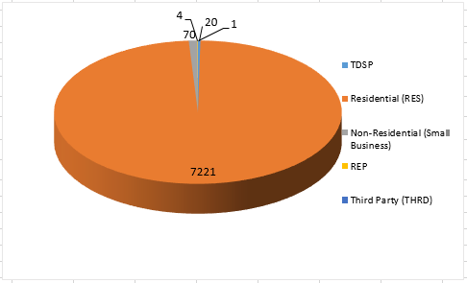
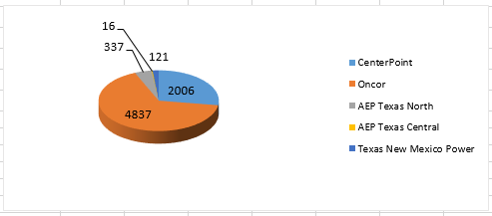
SMT ODR Details – AUG 2017
Total ODR Requests TDSP wise statistics:
Total ODR Requests User type statistics:

