Slide 1
Southern Cross Transmission LLC
Owner/Operator of a Merchant DC Tie
Registration Options Discussion
September 7, 2017
Ted Hailu
Director, Client Services
ERCOT

Slide 2
Table of Contents
PUCT Project 46304 Order, Directive #1 on SCT – Registration
Current ERCOT DC Ties
  Overview
  Glossary of terms
  ERCOT / SPP example
DC Tie Operators and TSPs in ERCOT
SCT Merchant DC Tie
SCT Registration Options

Slide 3
PUCT Project 46304 Order, Directive #1 on SCT – Registration
“ERCOT shall (a) determine the appropriate market participation category for Southern Cross Transmission LLC and for any other entity associated with the Southern Cross DC tie for which a new market-participant category may be appropriate (creating new ones if necessary), (b) implement the modifications to the standard-form market-participant agreement and its protocols, bylaws, operating guides, and systems required for Southern Cross Transmission's and any other entity's participation, and (c) determine the appropriate market segment for Southern Cross Transmission and any other entity.”
  For Southern Cross Transmission LLC (SCT) and any other entity associated with the DC Tie:
    Determine the appropriate Market Participant (MP) category and create a new category if necessary
    Determine appropriate market segment
    Implement required modifications to Protocols, Operating Guides, systems, Standard Form MP Agreement, Bylaws

Slide 4
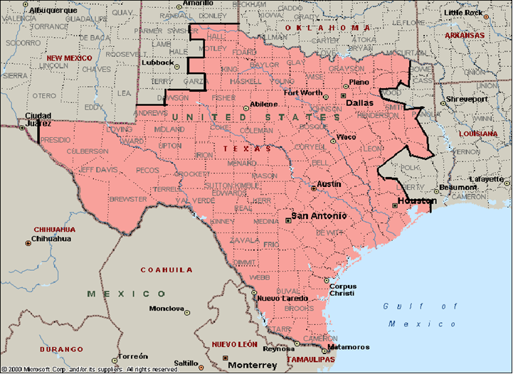
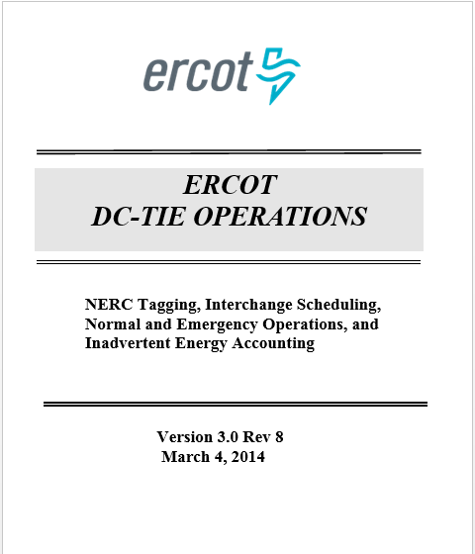
Current ERCOT DC Ties overview
ERCOT - SPP (North, East)
ERCOT - Mexico (CENACE) (South, Laredo, Railroad)
DC-E
600 MW
DC-N
220MW
DC Tie | Operator
North | AEP
East | AEP
South | AEP
Laredo | AEP
Railroad | Sharyland
DC-S
36 MW
DC-L
100 MW
DC-R
300 MW

Slide 5
Current ERCOT DC Ties – Glossary of Terms (NERC/NASEB)
DC Tie Equipment
NERC functions/definitions
PUCT / Protocols function/definitions
Element - device
Transmission Element - device part of ERCOT Transmission Grid
Bulk Electric System - Element >100kV
Transmission Facility - >60kV, DCTie
Facility - set of BES equipment
Related company registrations
NERC registration
ERCOT registration
Transmission Owner
Transmission Service Provider
under jurisdiction of PUCT
Transmission Operator
Transmission Planner
Transmission Service Provider

Slide 6
Current ERCOT DC Ties – Glossary of Terms (NERC/NAESB)
Transmission Customer
  Customer that executes a Transmission Service agreement or receives Transmission Service
    Generator Owner, Load-Serving Entity, Purchasing-Selling Entity
Transmission Service
  Services provided to the Transmission Customer by the Transmission Service Provider to move energy from a Point of Receipt (Source) to a Point of Delivery (Sink)
    Firm - Long-Term…………. One year or longer
    Firm - Short-Term………… Monthly, Weekly, Daily
    Non-Firm………………….. Monthly, Weekly, Daily, Hourly
Transmission Service Provider (TSP)
  Administers the transmission tariff and provides Transmission Service to Transmission Customers under applicable Transmission Service agreements

Slide 7
Current ERCOT DC Ties – Glossary of Terms (NERC/NAESB)
Purchasing-Selling Entity (PSE)
  Entity that purchases or sells, and takes title to, energy, capacity, and Interconnected Operations Services
Open Access Transmission Tariff (OATT)
  Transmission tariff accepted by FERC requiring the TSP to provide non-discriminatory service
Electronic Tag (e-Tag)
  Electronic request for the movement of energy over a prescribed physical path, for a given duration, for given energy profile
Balancing Authority
  Responsible entity that integrates resource plans ahead of time, maintains Demand and resource balance within a Balancing Authority Area, and supports Interconnection frequency in real time.

Slide 8
Current ERCOT DC Ties – ERCOT/SPP Example
DC Ties are Transmission Facilities (>60 kV)
  Owned / Operated by TSPs under PUCT jurisdiction
Balancing Authorities (BAs) & TSPs on scheduling path have approval authority (ERCOT / SPP)
  DC Tie Operators manage flow based on approved Net Interchange Schedules
Two steps of Interchange Scheduling
    Reservation: Transmission Service Requests submitted on SPP’s OASIS (OATI webOASIS)
    Scheduling: NERC e-tags submitted via OATI (WebTrans)

Slide 9
Current ERCOT DC Ties – ERCOT/SPP Example
Purchasing-Selling Entities (PSEs) schedule imports and exports
  Must be QSEs if scheduling across ERCOT DC Ties
Exports and imports are treated as Loads and Resources, respectively, in the Protocols
  ERCOT develops COP for DC Tie Resource
  Approved schedules used as meter reads
Deviation between actual flow and schedules considered Inadvertent Energy

Slide 10
Current ERCOT DC Ties – ERCOT/SPP Example
OATI
System
Schedules
TSP approved
Schedules
submitted
OATI NERC TSPs
ERCOT
SPP
Sharyland (not NERC TSP)
AEP (not NERC TSP)
OATI NERC PSE QSEs
Schedules
BA approved
OATI NERC BAs
ERCOT
SPP
Cenace (not NERC BA)
DC Tie Operator physically manages net power flow
DC Tie Operator
SHARYLAND TO
Railroad
(DC_R)
AEP DC TIE
North
DC_N
AEP DC TIE
East
DC_E
AEP TO
EaglePass
(DC_S)
AEP TO
Laredo (DC_L)

Slide 11
DC Tie operators and TSPs in ERCOT
DC Tie Operators are TSPs in ERCOT protocols
TDSP
Distribution Operations
Transmission Operations
DC Tie Operator
Retail Operations
etc…
CRRAH
RE
LSE
QSE

Slide 12
DC Tie operators and TSPs in ERCOT
Current ERCOT DC Tie Operators are TSPs
  Have TSP-level access to Systems / Data
  More than what’s needed for DC Tie Operation
Systems | ERCOT TSP With DC Tie Operations | DC Tie Operator
EMMS | Telemetry | Telemetry for DC Tie
NMMS | Modeling Access to full CIM Model | Modeling for DC Tie Bus
Outage Scheduler | Outage Coordination (Access to all Resource & Transmission outages) | Outage Coordination Future topic for PUCT directive #4
Real Time Operation | 7x24 turret phone line Verbal Dispatch Instructions TO hot line calls | 7x24 turret phone line Verbal Dispatch Instructions
Planning | Planning Models, Studies, Planning Working Groups… | Planning Models? Studies? Planning Working Groups? Future topic for PUCT directive #5 and #6

Slide 13
DC Tie operators and TSPs in ERCOT
Systems | ERCOT TSP With DC Tie | DC Tie Operator
Metering | TDSP-read, EPS meters | EPS meter at DC Tie Used for inadvertent energy accounting
Market Information System (MIS) | Unredacted CIM Models Outage Reports WAN Invoices DC Tie Schedules (for all DC Ties) - billing determinants for transmission service | N/A N/A WAN Invoices DC Tie Schedules (for all DC Ties) – billing determinants for transmission service
OATI (Scheduling – WebTrans) | Net Interchange Schedules | Net Interchange Schedules
Communication | Wide Area Network (WAN) | Wide Area Network (WAN)

Slide 14
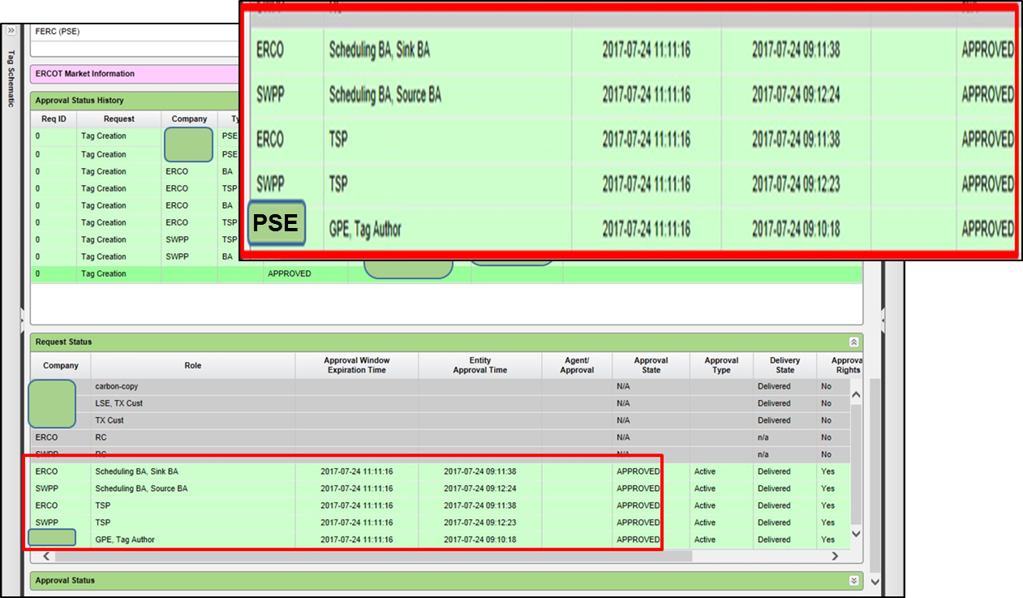
DC Tie operators and TSPs in ERCOT
OATI (WebTrans) – ERCOT (NERC BA/TSP) view

Slide 15
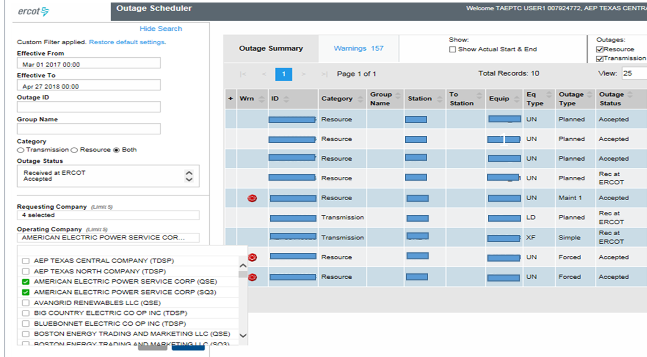
DC Tie operators and TSPs in ERCOT
Outage Scheduler – ERCOT TSP view
  Access to Transmission and Resource Outages

Slide 16
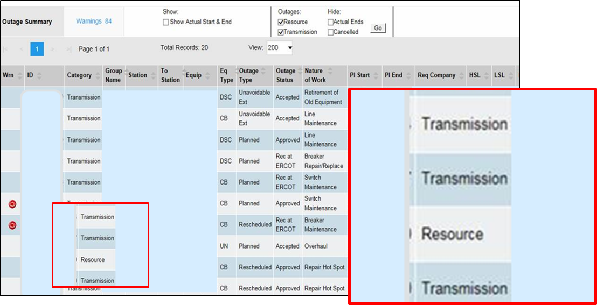
DC Tie operators and TSPs in ERCOT
Outage Scheduler – QSE view
  Resource and Transmission outages for facilities owned/operated by Resource Entity

Slide 17
SCT Merchant DC Tie
But this DC Tie is different …
DC-SCT
2000 MW

Slide 18
SCT Overview
FERC approved OATT for SCT
NERC Registration
NAESB Registration
TBD- Tariff Administrator
OASIS reservation processes (NERC TSP)
ERCOT Interconnect
ERCOT BA
ERCOT TSP
Eastern
Interconnect
TBD BA
TBD TSP
TX/LA Border Converter Station
400 mile DC Line
Eastern Interconnect Converter Station
2,000 MW Capacity
PSEs schedule power with
approved eTags/schedules
(ERCOT, SCT, TBD)
SCT- DC Tie Operator
Certified operator(s) at SCT to reliably flow net interchange of approved schedules (NERC TO, TOP)

Slide 19
SCT Merchant DC Tie
SCT DC Tie consists of a 400 mile HVDC line between two NERC Balancing Authorities
  ERCOT and BA in the Eastern Interconnection
  SCT will probably be a NERC TSP
    DC Tie Operator (ERCOT Market Participant)
    HVDC line Operator
    Tariff Administrator (FERC-approved OATT)
      Reservations: Transmission Service Requests
        Capacity to be sold in open season solicitations
        Capacity not sold in solicitations or released by capacity holders to be made available via OASIS
      Scheduling: Approval rights for DC Tie Schedules

Slide 20
SCT Registration Options
SCT as a “DC Tie Operator” under ERCOT’s DC Tie Operating Procedures will:
  Presumably need to have at least some TSP-like responsibilities with respect to its DC Tie
    Modeling, Outage coordination, Communication, Dispatch Instructions, Planning
  NOT have TSP responsibilities related to Transmission Facilities other than its DC Tie
    Retail, Load Profiling, Distribution, Metering, etc..
  Need access to systems and data limited to operation of the DC Tie
    Would require significantly less access than full TSP-level access

Slide 21
SCT Registration Options
 | System Impacts | Data Access | Protocol Changes
Use existing MP category: Transmission Service Provider | None SCT with full TSP responsibilities and access to systems | Full TSP access | Limited to definition changes
New MP Category: DC Tie Operator | Potentially significant SCT’s responsibilities delineated and integrated into applicable systems | Limited access | Create new Market Participant and requirements to define roles and responsibilities

Slide 22
Confidentiality Concern
To administer its OATT, SCT will need to see each e-Tag ahead of real time. E-Tag includes QSE-specific DC Tie schedule information.
This information is commercially sensitive and probably confidential
  Protocols Section 1.3.1.1(1)(u) requires confidential treatment of DC Tie schedule information used by TSPs for export-fee billing under Section 9.17.2
  SCT would have this information in real-time
Need to ensure SCT is prohibited from disclosing and from sharing with competitive affiliates in ERCOT
Limit on duration of confidentiality may be appropriate

Slide 23
SCT Registration Options
Many questions are yet to be answered...
Agreements with other ISO/RTO Directive #2
Economic dispatch Directive #7
Congestion Management Directive #6
Ancillary Services (AS)
  AS requirements, Ramping, MSSC: Directive #3, #9
  Allocation of AS requirements Directive #9
  Primary Frequency Response (PFR) Directive #8
  Voltage Support Service (VSS) Directive #8
Planning Models Directive #5
Outage Coordination Directive #4
Price Formation Directive #10
etc…

Slide 24
SCT Registration Options
The resolution of questions yet to be answered may:
  Add to SCT’s responsibilities as a DC Tie Operator
  Modify data / access / system requirements
  Additional responsibilities may
    Add to responsibilities of SCT as registered
    Require registration under additional MP categories
Next steps:
  ERCOT will listen to feedback in this workshop
  ERCOT will work with SCT to develop appropriate revisions requests (NPRR, NOGRR, etc.)
  November PRS target

Slide 25

Questions

