Slide 1
Summary of GIC Model Development @ 08/24/2017
Presentation to PGDTF
Qiuli Yu and Leslie Williams
ERCOT
August 24, 2017

Slide 2
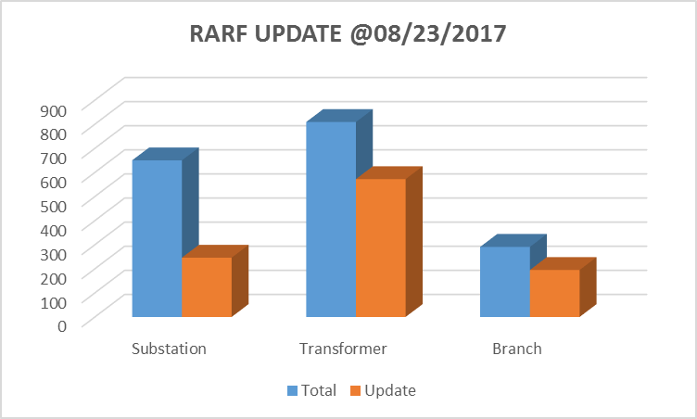
RARF Update On August 23 of 2017
 | Total | Update | Percent
Substation | 650 | 246 | 38%
Transformer | 809 | 572 | 71%
Branch | 291 | 195 | 67%

Slide 3
TSPs GIC Data Update On August 23 of 2017
Duplicate substation numbers
31 substations (owned by 7 TSPs) have duplicate substation numbers (89 records)
5 TSPs have corrected the issue
Till 08/23/2017, 5 substations have duplicate substation numbers (10 records)
Bus-Substation Mapping missing
Total 7296 buses, in which there are 6154 buses owned by TSPs
In 6154 TSPs’ buses, 984 buses are missing substations
ERCOT will send out the list of 984 buses (probably beginning of next week)
Buses of Transformers are not in the same substation
44 Transformers have the issue
ERCOT will send out the list of these transformers (probably beginning of next week)

Slide 4
Next Step During GIC Model Development
In the first step, ERCOT focus on
Substation table development
Bus-substation mapping completion
Other tables (transformer, branch, and fixed shunt) -- Default
For the next step, ERCOT will focus on
Transformer table integration – use transformer data from TSPs and REs to replace default data
Branch table integration – use branch data from TSPs and REs to replace default data
Expected efforts from TSPs
ERCOT will review transformer and branch data from all TSPs
ERCOT will contact TSPs if finding any transformer and branch data issues
TSPs correct the data issues timely

