Slide 1
PDCWG Report to ROS
Chair: Percy Galliguez, Brazos Electric Power Cooperative, Inc.
Vice Chair: Lei Ye, Austin Energy
ROS
September 7th, 2017

Slide 2
Report Overview & Notes
Report Overview
  Meeting Minutes
  BAL-001-TRE-1 FMEs & IMFR
    2 FME in the month of July
    3 FMEs evaluated from month of June
    IMFR=793.85MW/0.1Hz
  Frequency Control Report

Slide 3
Meeting Minutes
PDCWG Meeting 8/9/17
  NPRR 828 Discussion
  Regulation & Frequency Control Reports
  NPRR835 Discussion
  MOD-026-1 & MOD-027-1 Discussion
    NOGRR Proposal/Review Status
  BAL-001-TRE-01 Subcommittee Discussion
    Combined Cycle Steam Unit
  Five FMEs Evaluated-July 2 and 26 and June on June 16, 19 and 27.
Notes:
NPRR828-Informed PDCWG of ROS discussion and NPRR passing ROS vote.
NPRR835-Explanation on why there was an existing limit due to pilot, lack of voltage support and concern for resources swinging back and forth. If fully deployed and exhausted, recharging will be needed and one full hour of regulation service may not be available. ERCOT has monitored the current performance and have not seen any failure to provide the required regulation when deployed. Three PDCWG members, CPS, NRG and EON expressed no objection to NPRR with one member, EDF, abstaining for support. With ERCOT monitoring performance, there is no criteria for regulation performance similar to other resources such as GREDP available to the market. As a separate effort in another NPRR, ERCOT can look at a measurable criteria of performance for these resources that would be appropriate for this type of resource since GREDP is not applicable for measurement. The maximum amount of regulation up/down has not been determined with respect to it’s impact to frequency control performance or other resources but will be determined through AS Methodology.
MOD-026 and NOGRR effort still on going with discussion needed on data submission required by ERCOT.
BAL-001-TRE-01 Subcommittee Discussion-Joel Firestone did not attend August PDCWG meeting, although, TexasRE David Penney, mentioned TexasRE will be hosting an open technical conference on September 14 which will include discussions/recommendations to discuss Combined Cycle Steam Unit droop as well as other topics of concern by market participants especially PDCWG members.

Slide 4
Frequency Measurable Events Performance

Slide 5
Frequency Measurable Events
There was 2 FMEs in July
  7/2/2017 00:19:38
    Loss of 596 MW
    Interconnection Frequency Response:
    5 of 41 Evaluated Generation Resources had less than 75% of their expected Initial Primary Frequency Response.
    6 of 41 Evaluated Generation Resources had less than 75% of their expected Sustained Primary Frequency Response.
  7/26/2017 14:30:42
    Loss of 702 MW
    Interconnection Frequency Response:
    6 of 49 Evaluated Generation Resources had less than 75% of their expected Initial Primary Frequency Response.
    7 of 49 Evaluated Generation Resources had less than 75% of their expected Sustained Primary Frequency Response.

Slide 6
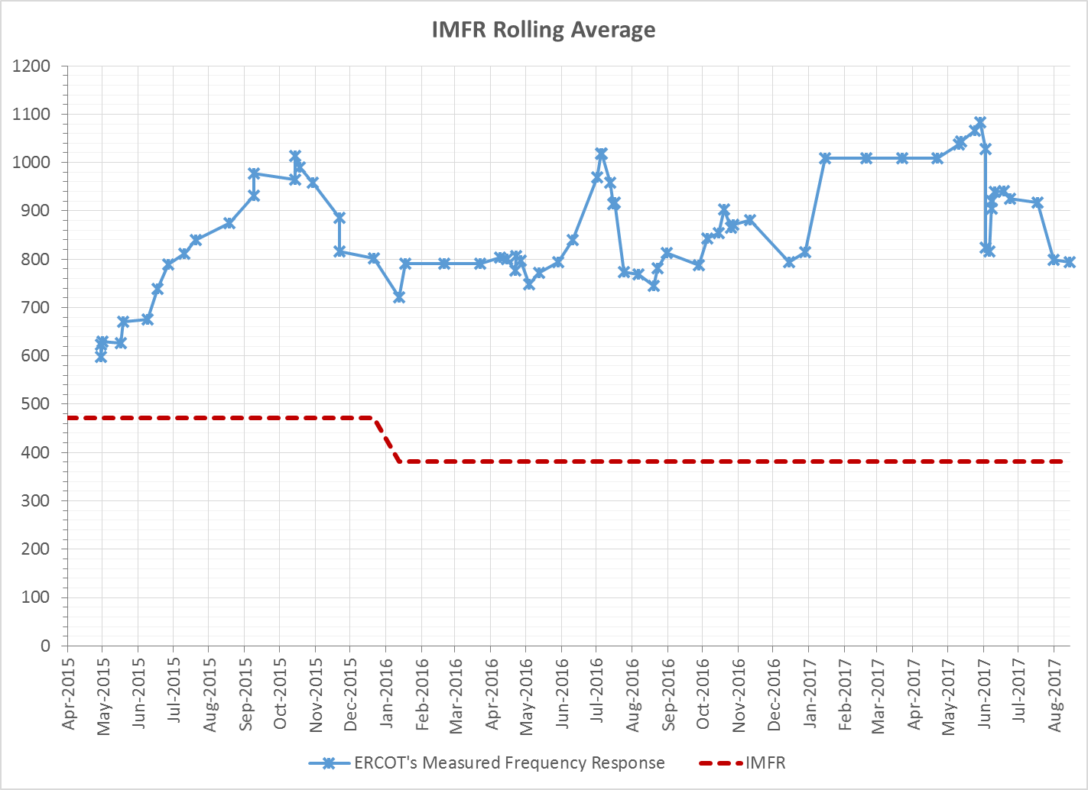
Interconnection Minimum Frequency Response (IMFR) Performance
IMFR Performance currently 793.85 MW/0.1Hz

Slide 7
Frequency Control Report
July 2017

Slide 8
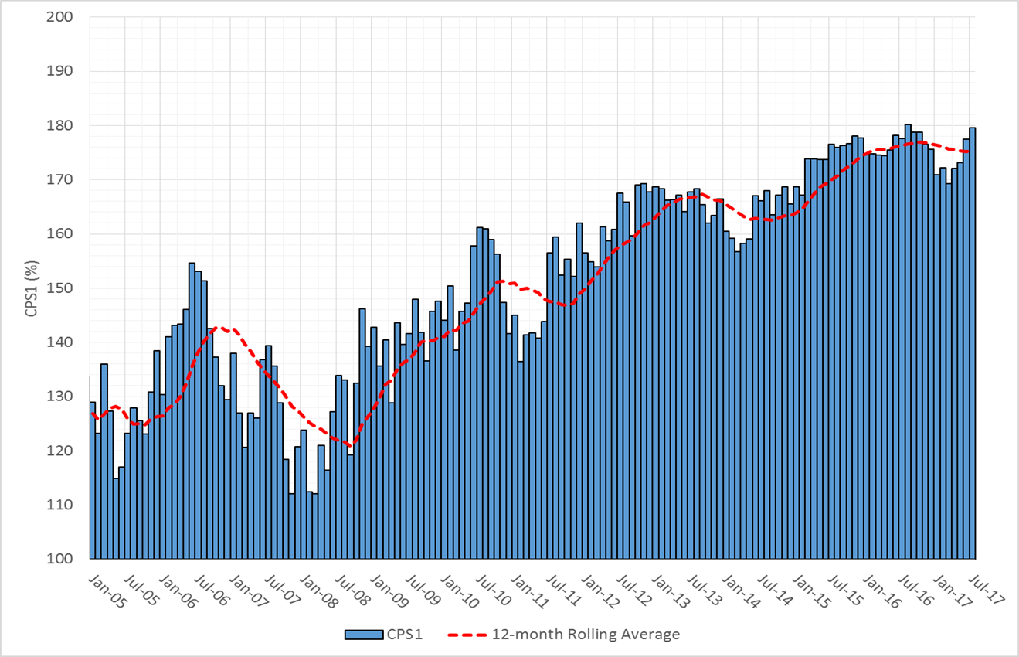
CPS1 Performance

Slide 9
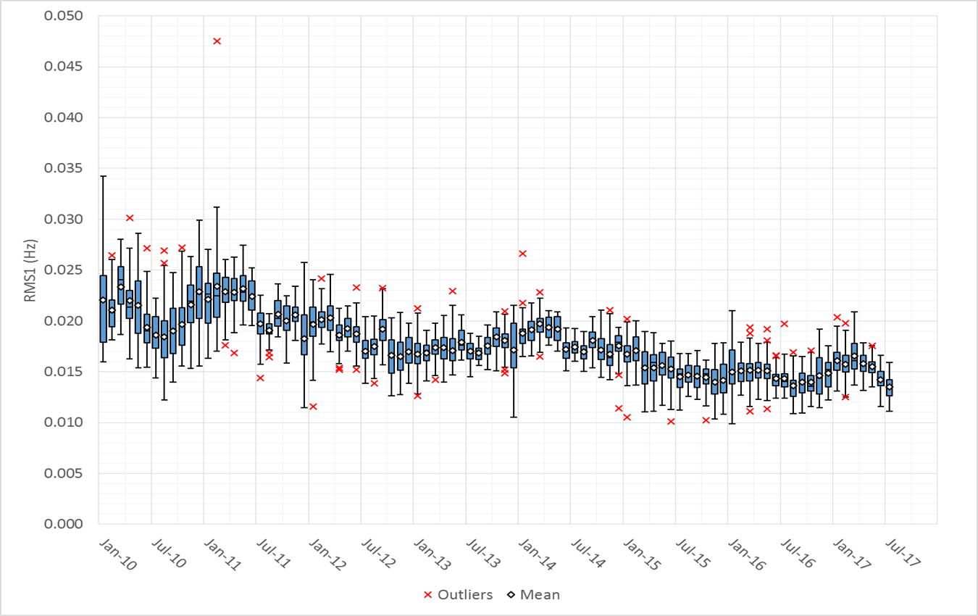
RMS1 Performance of ERCOT Frequency

Slide 10
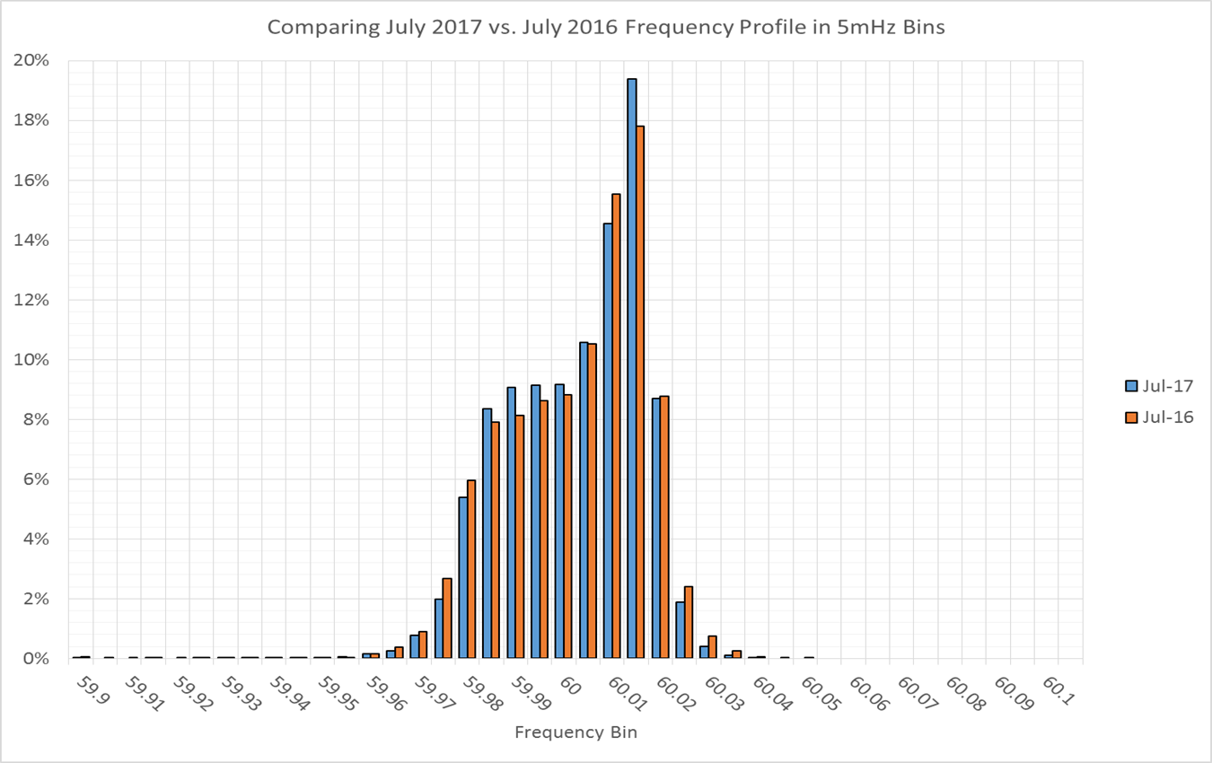
Frequency Profile Analysis

Slide 11
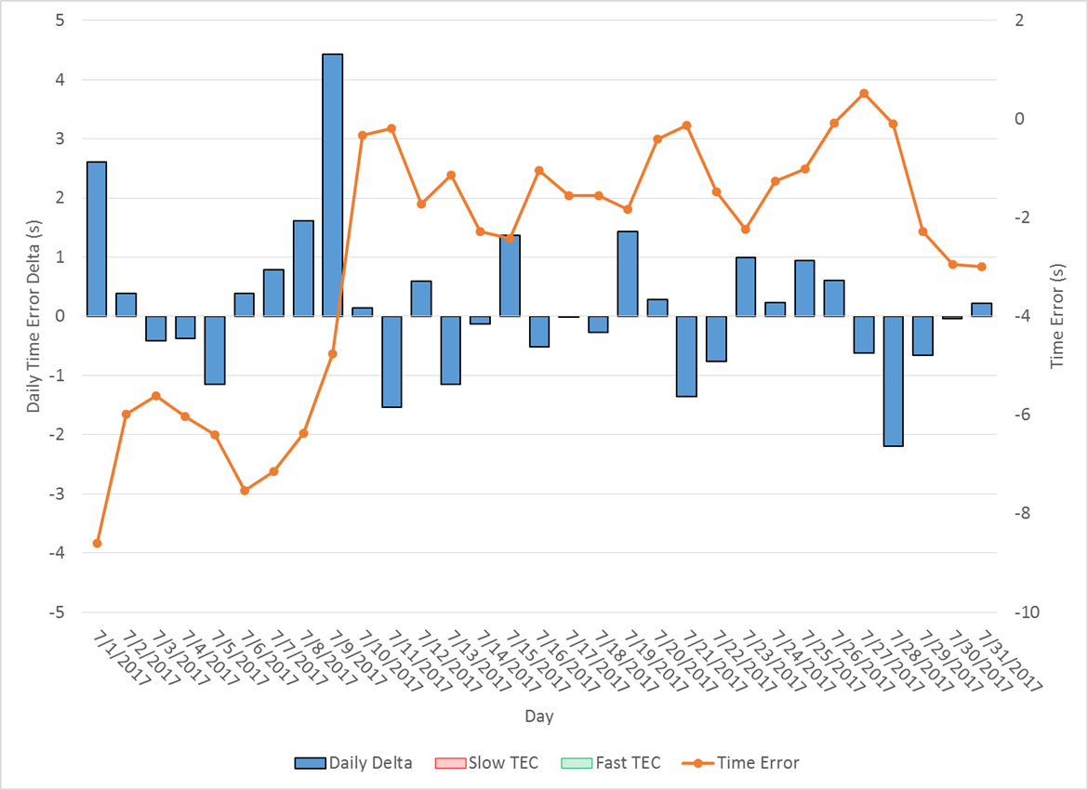
Time Error Corrections
There were no Time Error Corrections (TEC) in July

Slide 12
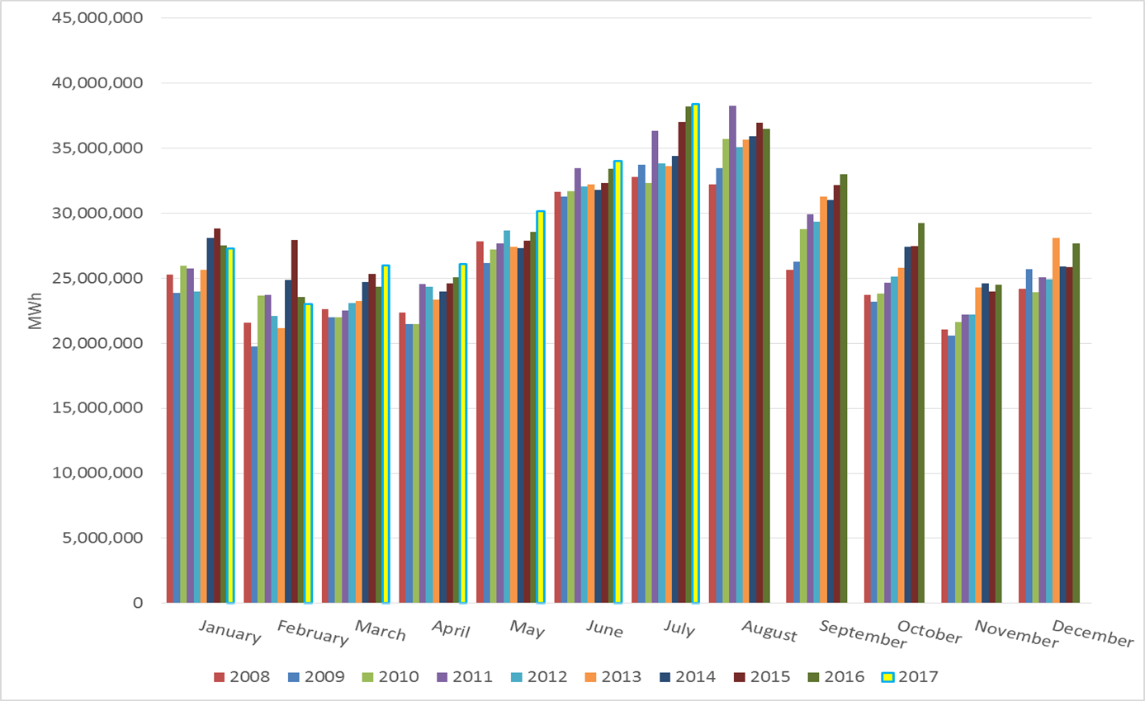
ERCOT Total Energy

Slide 13
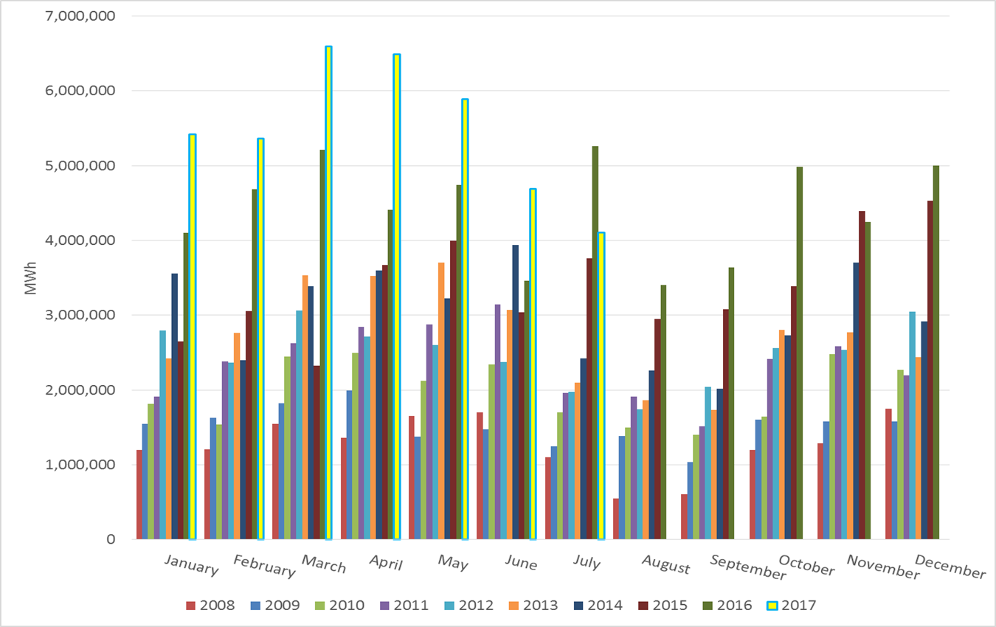
ERCOT Total Energy from Wind Generation

Slide 14
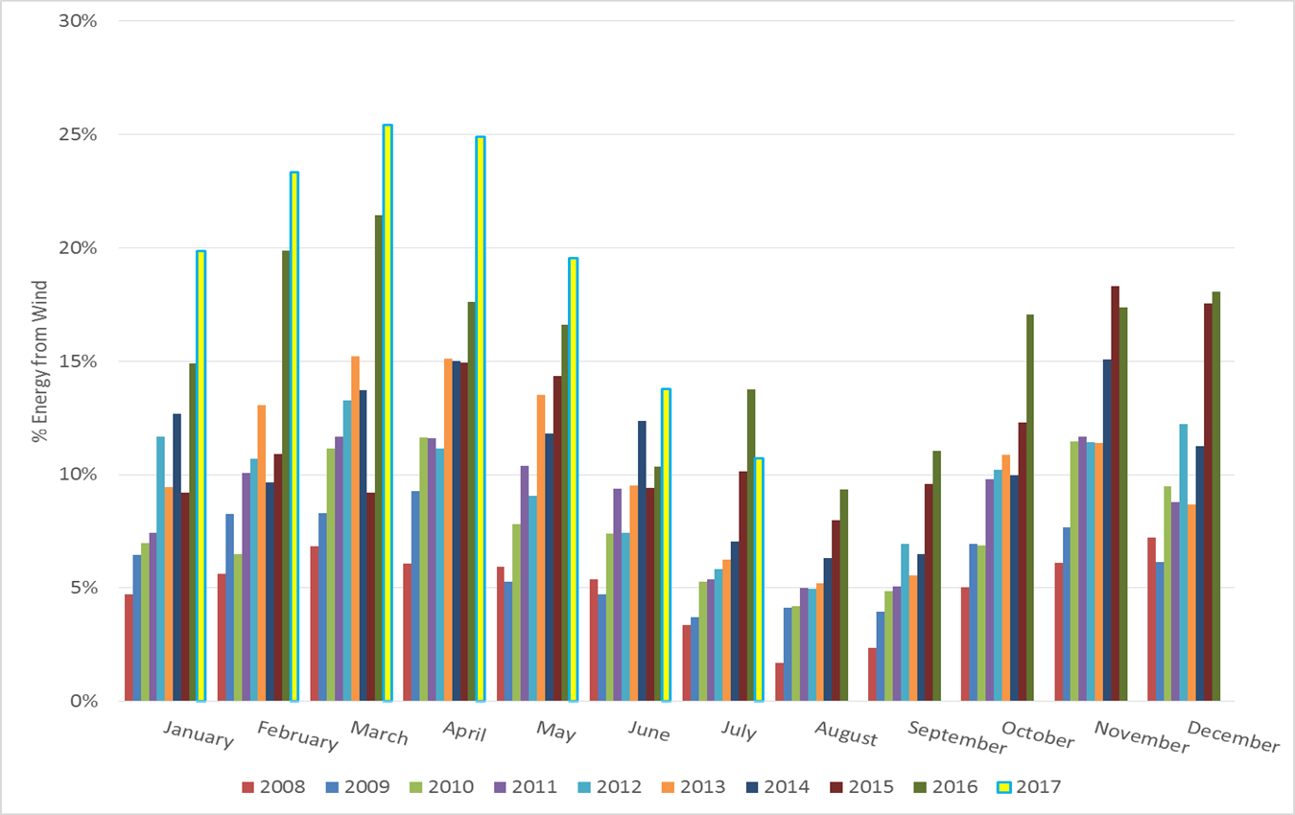
ERCOT % Energy from Wind Generation

Slide 15
Frequency Measurable Events Evaluated
There was 2 FMEs in July
  7/2/2017 00:19:38
    2 of 23 RRS Evaluated Generation Resources had less than 75% of their expected Initial Primary Frequency Response.
    4 of 23 RRS Evaluated Generation Resources had less than 75% of their expected Sustained Primary Frequency Response.
  7/26/2017 14:30:42
    2 of 20 RRS Evaluated Generation Resources had less than 75% of their expected Initial Primary Frequency Response.
    1 of 20 RRS Evaluated Generation Resources had less than 75% of their expected Sustained Primary Frequency Response.

Slide 16
Frequency Measurable Events Evaluated(Cont’d)
There 3 FMEs evaluated in June
  6/16/2017 16:14:23
    9 of 23 RRS Evaluated Generation Resources had less than 75% of their expected Initial Primary Frequency Response.
    8 of 23 Evaluated Generation Resources had less than 75% of their expected Sustained Primary Frequency Response.
    Note 4 resources were JOU.
  6/19/2017 9:10:19
    3 of 22 RRS Evaluated Generation Resources had less than 75% of their expected Initial Primary Frequency Response.
    2 of 22 RRS Evaluated Generation Resources had less than 75% of their expected Sustained Primary Frequency Response.
  6/27/2017 15:50:36
    5 of 29 RRS Evaluated Generation Resources had less than 75% of their expected Initial Primary Frequency Response.
    6 of 29 RRS Evaluated Generation Resources had less than 75% of their expected Sustained Primary Frequency Response.
    Note 4 resources were JOU.

Slide 17
Questions?

