Slide 1
GBY5 RMR Cost Update
WMS
Sep 6, 2017

Slide 2
Budget Totals and Avoided Costs from Cancellation
Notes:
February 2017 and cancellation budgets include settled actuals but do not include Incentive Factor.
Avoided Costs by comparing to Feb-17 Budget

Slide 3
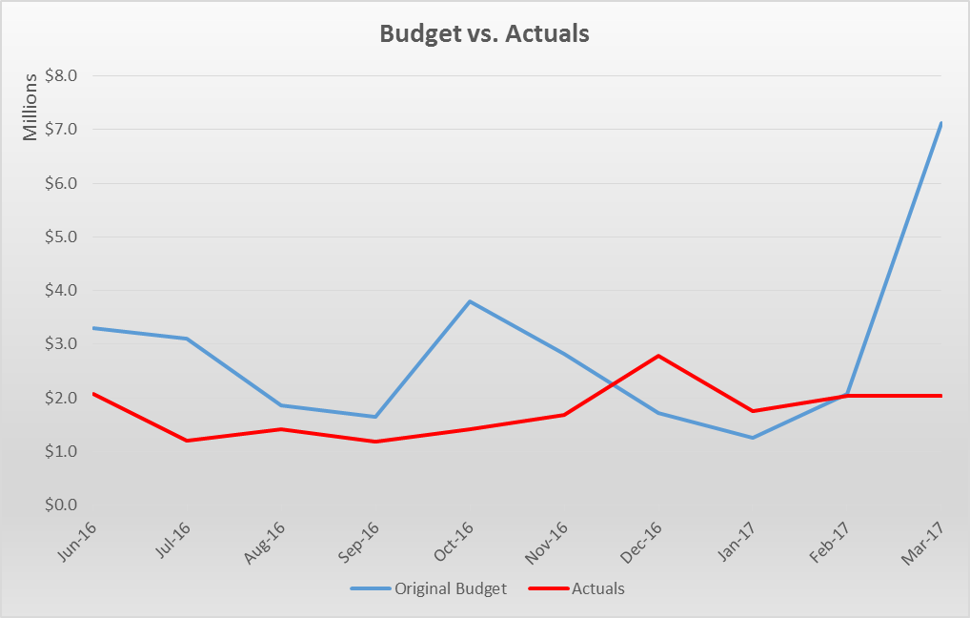
Budgeted and Actual Costs
Actuals settled through March 2017
Note: Budgets exclude Incentive Factor.

Slide 4
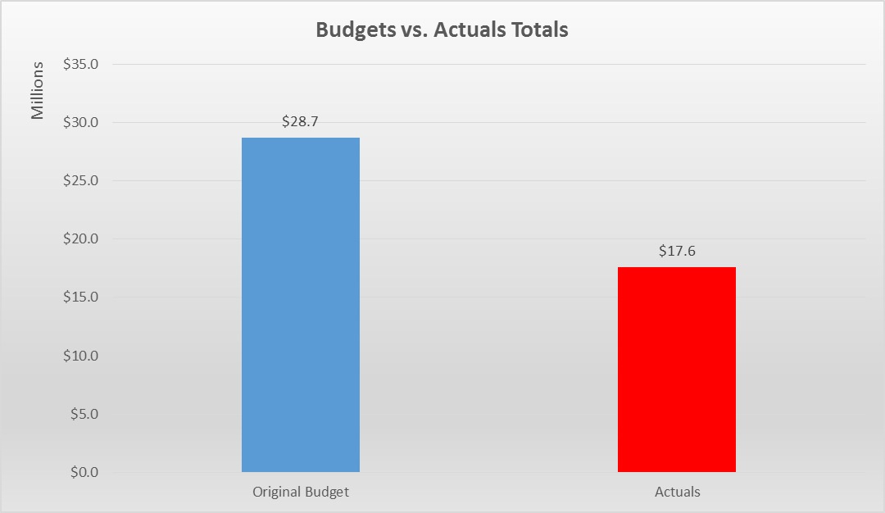
Budgeted and Actual Costs Totals
Budgets and actuals, June 2016 – March 2017
Note: Budgets exclude Incentive Factor.

Slide 5
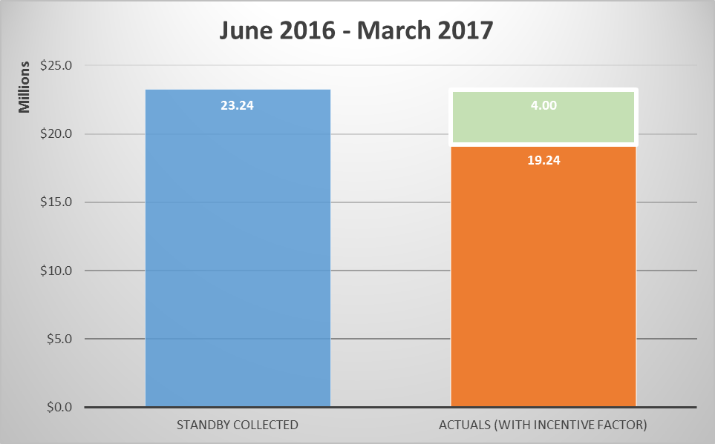
Standby Collected v Actual Costs
Actuals settled through March 2017
Paid back to Load

Slide 6
Standby Collected v Actual Costs
Estimates for full term of RMR Agreement
Paid back
to Load
Based on:
1. Actuals for Jun-16 to Mar-17
2. Initial GBY5 cost submissions for Apr-17 to May-17.

Slide 7
RMR Cost Update
Questions

