Slide 1
2018 LTSA Workshop
August 2017
RPG Meeting
Notes:
Welcome to

Slide 2
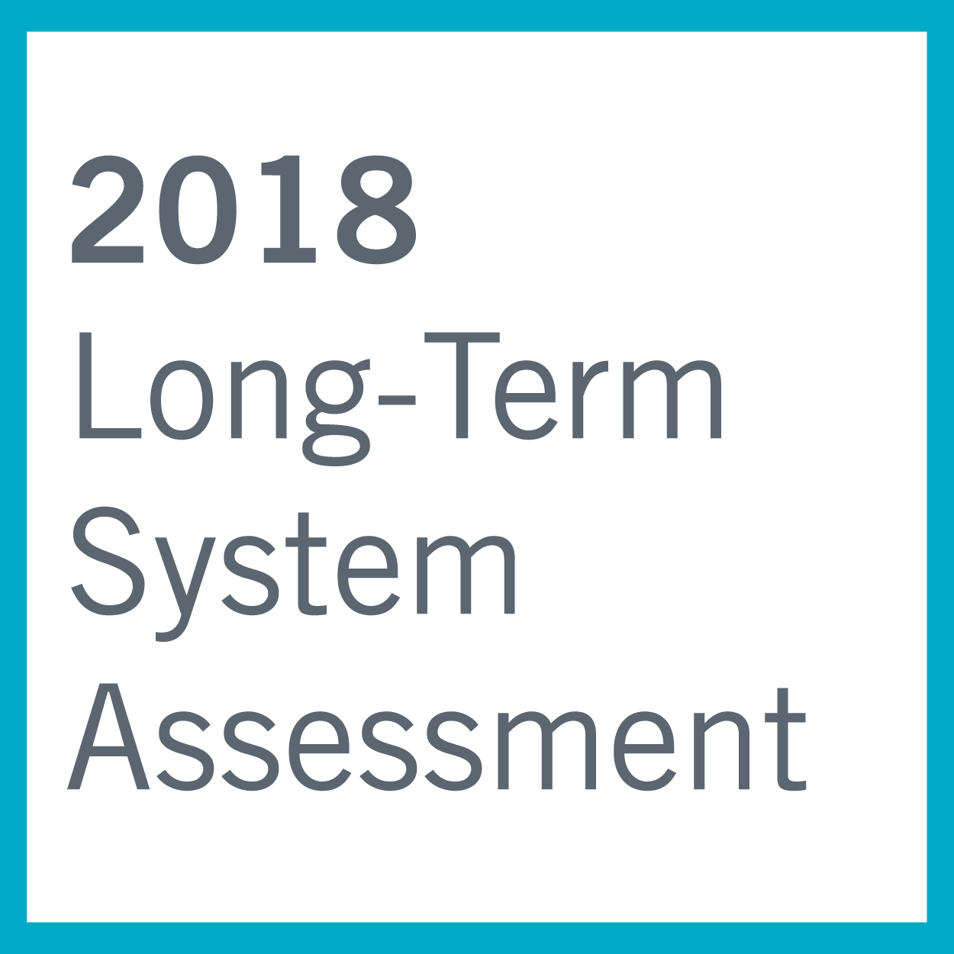
Agenda
2018 LTSA Scenario Descriptions
Next steps

Slide 3
2018 LTSA Scenarios
Current Trends (CT)
High Renewable and Distributed PV Growth (HRG)
High Economic Growth (HEG)
High Renewable Costs (HRC)
Bonus: Emerging Technology (ET)

Slide 4
2018 LTSA Scenario Summary
Category | Assumption | Scenario 1 | Scenario 2 | Scenario 3 | Scenario 4 | Scenario 5
General | Scenario Name | Current Trends | High Renewable and Distributed PV Penetration | High Economic Growth | High Renewable Costs | Emerging Technology
Load | System Load Growth | Average | Same as Current Trends | High | Same as Current Trends | Same as Current Trends
 | LNG export additions | Known | Same as Current Trends | High | Same as Current Trends | Same as Current Trends
Policy | Environmental Regs | Ozone, SO2 (NAAQs) | Same as Current Trends | Same as Current Trends | Same as Current Trends | Same as Current Trends
 | Emission Cost | Low | Medium | Same as Current Trends | Same as Current Trends | Same as Current Trends
 | Renewable incentives | Medium | High | Same as Current Trends | Low | Same as Current Trends
 | DC Tie additions | Add known DC tie | Same as Current Trends | Same as Current Trends | Same as Current Trends | Same as Current Trends
End Use | Distributed PV | Low | High | Medium | Lower than Current Trends | High - EV with Storage
 | EE Growth | Low | High | Same as Current Trends | Same as Current Trends | Same as Current Trends
 | DR Growth | Medium | Same as Current Trends | Same as Current Trends | Low | Low
Renewables | Capital cost | Medium | Low | Low | High | Low cost storage
 | Annual Cap. Limitation | Medium | High | Same as Current Trends | Low | Same as Current Trends
Fuel Prices | NG price forecast | 2017 HOG | Same as Current Trends | Medium | Same as Current Trends | Same as Current Trends

Slide 5
1. Scenario: Current Trends
Economic Growth
1.3 % annual net of all factors affecting the system
Industrial growth in Houston area
Oil and gas and mid-stream development in west Texas area continues at moderate pace
Average GDP growth in line with long-term average
LNG growth based on permits existing
Average weather assumptions used
Technology
No breakthroughs – steady modest cost improvements
Only known potential DC tie (Southern Cross) added in the East
Government policy/mandate
No reserve margin set for ERCOT
Maintain energy-only market
Economic retirements continues based on economics
Environmental Regulation
Ozone, SO2 (NAAQs)- Implementing Current Regulations through 2025, SO2 non-attainment area
Low emission cost on SO2, NOx, CO2
10$/ton Carbon throughout study horizon
End-Use
Energy efficiency spending rises slowly to a rate of .25%/year
Distributed generation increases to 2.5 GW by 2033
Moderate increase in Demand Response
Alternative Generation
Renewable incentives expire as scheduled (2022)
Increase in investment then slow to declining in rate of increase after 2022
Limit capacity addition to 3000 MW wind and 1500 MW of solar annually
Use Lazard assumptions for Storage
Natural Gas Price
2017 High Oil & Gas Production case from the 2017 EIA AEO

Slide 6
2. Scenario: High Renewable and Distributed PV Penetration
Economic Growth
1.3 % annual net of all factors affecting the system
Industrial growth in Houston area
Oil and gas and mid-stream development in west Texas area continues at moderate pace
Average GDP growth in line with long-term average
LNG growth based on permits existing
Average weather assumptions used
Technology
No breakthroughs – steady modest cost improvements
Only known potential DC tie (Southern Cross) added in the East
Government policy/mandate
No reserve margin set for ERCOT
Maintain energy-only market
Economic retirements continues based on economics
Environmental Regulation
Ozone, SO2 (NAAQs)- Implementing Current Regulations through 2025, SO2 non-attainment area
Low emission cost on SO2, NOx, CO2
20$-40$/ton Carbon throughout study horizon
End-Use
Energy efficiency spending rises to a rate of 1%/year due to more aggressive building codes
Distributed generation increases to 18 GW by 2033
Moderate increase in Demand Response
Alternative Generation
Renewable incentives continue through the study horizon
Increase in investment then slow to declining in rate of increase after 2022
Increase capacity addition to value greater than Current Trends
Natural Gas Price
2017 High Oil Production case from the 2017 EIA AEO

Slide 7
3. Scenario: High Economic Growth
Economic Growth
1.8 % annual net of all factors affecting the system
Higher Industrial growth in Houston area (Gulf coast block load additions of 200 MW every 5 years)
Oil and gas and mid-stream development in west Texas area picks up steam (at 1000 MW by 2018)
Average GDP growth in line with long-term average
LNG growth continues (4th train at Freeport, New terminal in Corpus Christi (500 MW) and Brownsville area (800 MW)
Technology
No breakthroughs – steady modest cost improvements
Only known potential DC tie (Southern Cross) added in the East
Government policy/mandate
No reserve margin set for ERCOT
Maintain energy-only market
Economic retirements continues based on economics
Environmental Regulation
Ozone, SO2 (NAAQs)- Implementing Current Regulations through 2025, SO2 non-attainment area
Low emission cost on SO2, NOx, CO2
10$/ton Carbon throughout study horizon
End-Use
Energy efficiency spending rises slowly to a rate of .25%/year
Distributed generation increases to 3 GW by 2033 (slightly higher than Current Trends)
Moderate increase in Demand Response
Alternative Generation
Renewable incentives expire as scheduled (2022)
Lower capital cost than Current Trends
Limit capacity addition to lower than Current Trends
Use Lazard assumptions for Storage
Natural Gas Price
Higher than Current Trends
Average of 2017 Ref and HOG case from the 2017 EIA AEO

Slide 8
4. Scenario: High Renewable Costs
Economic Growth
1.3 % annual net of all factors affecting the system
Industrial growth in Houston area
Oil and gas and mid-stream development in west Texas area continues at moderate pace
Average GDP growth in line with long-term average
LNG growth based on permits existing
Average weather assumptions used
Technology
No breakthroughs – steady modest cost improvements
Only known potential DC tie (Southern Cross) added in the East
Government policy/mandate
No reserve margin set for ERCOT
Maintain energy-only market
Economic retirements continues based on economics
Environmental Regulation
Ozone, SO2 (NAAQs)- Implementing Current Regulations through 2025, SO2 non-attainment area
Low emission cost on SO2, NOx, CO2
10$/ton Carbon throughout study horizon
End-Use
Energy efficiency spending rises slowly to a rate of .25%/year
Distributed generation lower than Current Trends
Moderate increase in Demand Response
Alternative Generation
Renewable incentives expire sooner than Current Trends
Capital costs higher than Current Trends; especially for Solar based on a potential import tariff
Limit capacity addition to 3000 MW wind and 1500 MW of solar annually
Natural Gas Price
2017 High Oil Production case from the 2017 EIA AEO

Slide 9
5. Scenario: Emerging Technology
Economic Growth
1.3 % annual net of all factors affecting the system
Industrial growth in Houston area
Oil and gas and mid-stream development in west Texas area continues at moderate pace
Average GDP growth in line with long-term average
LNG growth based on permits existing
Average weather assumptions used
Technology
EV penetration of 3 million vehicles on Texas roads by 2033. Some with vehicle to grid enabled
Second-life EV batteries installed in residential locations
Only known potential DC tie (Southern Cross) added in the East
Environmental Regulation
Ozone, SO2 (NAAQs)- Implementing Current Regulations through 2025, SO2 non-attainment area
Low emission cost on SO2, NOx, CO2
10$/ton Carbon throughout study horizon
Government policy/mandate
No reserve margin set for ERCOT
Maintain energy-only market
Economic retirements continues based on economics
End-Use
Energy efficiency spending rises slowly to a rate of .25%/year
Distributed generation increases greater than Current Trends by 2033
Moderate increase in Demand Response
Alternative Generation
Renewable incentives expire as scheduled (2022)
Increase in storage, some co-located with renewable generation
Increase in investment then slow to declining in rate of increase after 2022
Limit capacity addition to 3000 MW wind and 1500 MW of solar annually
Use Lazard assumptions for Storage
Natural Gas Price
2017 High Oil Production case from the 2017 EIA AEO

Slide 10
2018 LTSA: The process
Scenario Development
• Review trends and
forecasts
• Seek feedback from
participants about key
drivers and scenarios
for LTSA
Load forecasting
• Develop 8760-hour
load forecasts for each
scenario with normal
weather assumptions
Generation Expansion
• Identify amount of
generation added and
retired by technology
based on scenario
description
• Finalize scenario
descriptions and
assumptions for
current LTSA
• Develop 90th percentile
summer peak forecast
for each scenario
• Identify potential sites
for new generation
Transmission Analysis
• Build start cases based
on the LTSA Scope and
scenario descriptions
• Perform reliability
analysis
• Perform economic
analysis
• Identify transmission
projects to address
economic and reliability
needs

Slide 11
2018 LTSA Schedule
Task | Date
Draft LTSA Scope | March 2017
LTSA Workshop #1 | May 2017 RPG Meeting
LTSA Workshop #2 | June 2017 RPG Meeting
Finalize scenarios | August 2017 RPG Meeting
Current Trends Gen expansion and Load forecasting complete | 4th Quarter 2017
Current Trends transmission basecase ready | 4th Quarter 2017
Gen expansion and Load forecasting complete | 1st Quarter 2018
Transmission Expansion Complete | 2nd Quarter 2018

Slide 12
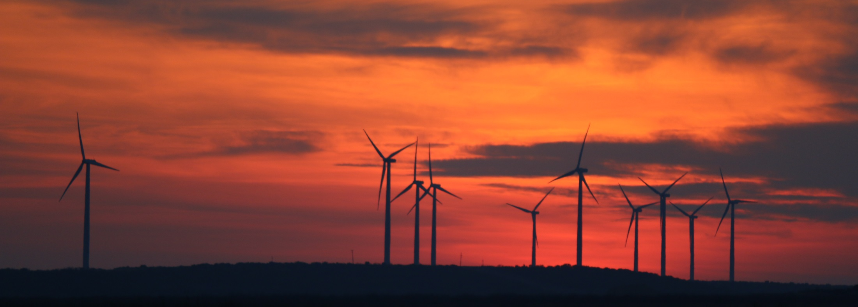
Next steps
Current Trends Generation Expansion and Load Forecasting

Slide 13
Questions
Sandeep Borkar
Sandeep.Borkar@ercot.com
512.248.6642
Doug Murray
Douglas.Murray@ercot.com
512.248.6908
?

