Slide 1
NERC 2017 Long Term Reliability Assessment Update
&
Weather-based Load Shape Weighting Proposal for Reserve Margin Studies
Pete Warnken
August 18, 2017

Slide 2
2017 NERC LTRA Update

Slide 3
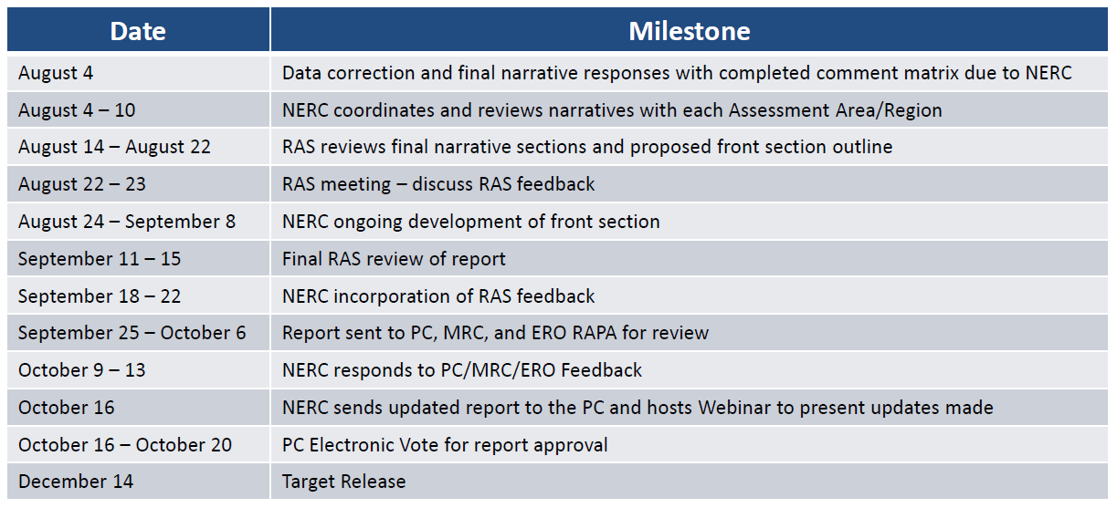
NERC 2017 LTRA Status Update
Latest Preparation Schedule

Slide 4
2016 LTRA Summary Data Table
Aggregate PUN capacity forecast
DC Tie Net Flows to Mexico
Comparable to CDR Planned
Projects not included in Tier 1, but have completed Screening Studies
Existing & Net Transfers plus Tier 1
Anticipated Resources plus Tier 2 Resources and planned mothballs, minus Unconfirmed Retirements

Slide 5
May 2017 CDR Reserve Margin Comparison
Main differences due to:
  Unit status changes after CDR release
    Planned solar and wind project deferrals (-230 MW for 2018)
    Unit retirements (-71 MW)
    Summer rated capacity changes for several existing units (cumulative impact, approx. -50 MW)
  Treatment of DC Tie capacity (-97 MW in 2018)
Note that the cutoff date for including resources in a given year is July 15, whereas the date for the CDR report is June 1

Slide 6
Weather-based Load Shape Weighting Proposal

Slide 7
Methodology Summary
Weather Risk Measure
  Occurrences of consecutive days per year with temps greater than 100°F for DFW, Houston, and Austin (1950-2016), resulting in three data series
  Apply regional load weights to three data series and sum into composite risk score [0 ≤ x ≤ 36.3]
Determine risk score frequencies
  Create histogram with bin range from 0 to 37
  Calculate normalized relative frequencies [0 ≤ x% ≤ 1]

Slide 8
Methodology Summary
Outlier detection using Quartile Fence Method
  Determine breakpoints for “mild” and “extreme” outliers based on relative frequencies
Assign probabilities to each frequency based on risk ranges
  No Risk, Low Risk, Moderate Risk, High Risk (mild outliers), Extremely High Risk (extreme outliers)

Slide 9
Methodology Summary
Load Profile Probability Assignment
  Assign a probability to each load profile based on its composite risk score
  Normalize probabilities based on the load profiles used

Slide 10
Sample Calculation Results
Walk-through of Calculations

Slide 11
How Does Changing Sample Size Affect Results?
Conducted analysis for years 1980-2016
Normalized probability weights are less variable:

Slide 12
Reserve Margin Impact
As a test, replaced original weather-year probability weights used for Jan. 2015 PUCT’s Reserve Margin analysis with values based on the proposed approach
  RM Study: assumed 1% probability of occurrence for 2011 and other annual probabilities set to 9.9%

