Slide 1
SMT Update To AMWG
JULY 2017

Slide 2
Monthly SMT Data Timelines AMWG CR 2014 002 End to End File Processing Completeness – JUL 2017
% Timely Market Delivery - % of files posted to market (FTPS) by 11:00pm out of # of files received by SMT by 11:00pm.
% Portal Data Availability - % of files loaded to the database for data availability on portal by 6:00am next day for the files received by 11:00pm
A LSE file includes usage data for up to 50,000 ESIIDs.
2

Slide 3
SMT API and FTPS Services Availability – JUL 2017
The service availability is measured as a percentage of number of minutes the service was available out of the total number of minutes in a month, excluding planned outages.
Observed Anomalies:
Mar-Apr 2015: SMT outage and subsequent recovery/catch-up impacted API availability. FTPS was available for most of the part except on 03/21-03/22 for 36 hours.
26 Jul 2015: Services were unavailable for 12 hours due to Flash storage issue
25 Jan 2016: Services were unavailable for 19 hours due to storage configuration issue
07 Mar 2016: API Services were unavailable for 7hours due to Oracle archiver issue.
12 Jul 2017: SMT NAESB, FTP and API services were unavailable for a brief period of 23 min due to a network issue.
Notes:
3

Slide 4
SMT Number of Accounts by Type AMWG CR 2014 009 – JUL 2017
Registered Users | ONC | CNP | AEPN | AEPC | TNMP | TOTAL
Active Residential Accounts | 58717 | 28223 | 1904 | 5625 | 3660 | 98129
Active Residential English Accounts | 58514 | 28032 | 1898 | 5506 | 3651 | 97601
Active Residential Spanish Accounts | 203 | 191 | 6 | 119 | 9 | 528
Non Active Residential Accounts | 23444 | 15575 | 1794 | 3968 | 977 | 45311
Total Residential Accounts | 82161 | 43798 | 3698 | 9593 | 4637 | 143440
TDSP User | 326 | 31 | 10 | 18 | 1 | 386
TDSP Admin | 4 | 4 | 4 | 4 | 3 | 19
Small Business User | 96 | 46 | 1 | 1 | 4 | 148
Small Business Admin | 2985 | 1609 | 86 | 323 | 148 | 5312
Total Agreements (Includes Active and Pending) | 10792 | 2984 | 63 | 205 | 867 | 14911
Energy Data Agreements (Includes Active and Pending) | 10792 | 2741 | 63 | 205 | 867 | 14668
Han Device Agreements (Includes Active and Pending) | 0 | 242 | 0 | 0 | 0 | 242
Han Service Agreements (Includes Active and Pending) | 0 | 1 | 0 | 0 | 0 | 1
IN SMT
ESI IDs | 3546527 | 2469342 | 198069 | 869392 | 247879 | 7331209
Meters | 3487666 | 2469264 | 198877 | 869767 | 247405 | 7272979
HAN Devices | 3446 | 4409 | 138 | 280 | 29 | 8302
Acknowledgement | 0 | 0 | 0 | 0 | 0
Pending | 0 | 8 | 0 | 0 | 0
Meter Ready | 3 | 3 | 41 | 101 | 17
Provisioned | 3443 | 4398 | 97 | 179 | 12
HAN Messages (MTD) | 0 | 0 | 0 | 0 | 0 | 0
HAN Messages (YTD) | 116 | 0 | 0 | 0 | 0 | 116
HAN Messages (Cumulative) | 496 | 7405 | 0 | 0 | 0 | 7901
Simple Text Messages | 157 | 2930 | 0 | 0 | 0
Load Control Messages | 140 | 2658 | 0 | 0 | 0
Pricing Messages | 127 | 53 | 0 | 0 | 0
Cancellation Messages | 72 | 1764 | 0 | 0 | 0
Supplemental – (Friends)
Total Agreements | 1876 | 1463 | 82 | 100 | 65 | 3586
Accepted Agreements | 787 | 566 | 37 | 30 | 22 | 1442
Pending Agreements | 4 | 1 | 0 | 2 | 0 | 7
Revoked Agreements | 324 | 283 | 10 | 8 | 6 | 631
Expired Agreements | 723 | 582 | 33 | 60 | 37 | 1435
Terminated Agreements | 38 | 31 | 2 | 0 | 0 | 71
 | TDSPs | REP | Small Business | Regulatory | Third Party
Registered Entities | 5 | 116 | 5131 | 2 | 154
Registered Users | 386 | 840 | 148 | 8 | 25
Registered Admins | 19 | 175 | 5151 | 3 | 143
HAN Messages Sent By | 459 | 7418

Slide 5
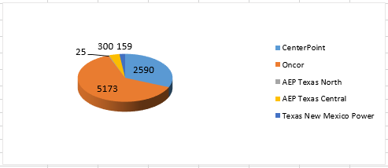
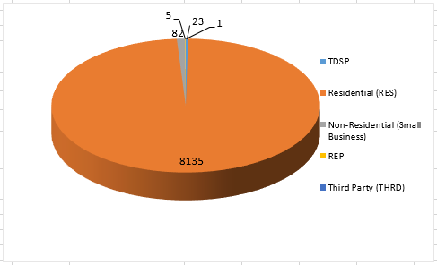
SMT ODR Details – JUL 2017
Total ODR Requests TDSP wise statistics:
Total ODR Requests User type statistics:

