Slide 1
Project Update and Summary of
Project Priority List (PPL) Activity
August 11, 2017

Slide 2
Project Update Agenda
Project Portfolio Update p. 3-9
  Recent / Upcoming Project Implementations
  2017 Release Targets
  2018 Release Targets
  2017 Project Spending Forecast
  Revision Request Funding Placeholder Status
  RARF Replacement Project Update
  Priority/Rank Options for Revision Requests with Impacts
Appendix
  Project Portfolio Gantt Chart p. 10-18
Location of Project Priority List (PPL): http://www.ercot.com/services/projects/index

Slide 3
Recent / Upcoming Project Implementations
August 1 Go-Lives Complete
  NPRR809 – GTC or GTL for New Generation Interconnection
  PGRR052 – Stability Assessment for Interconnecting Generation
  PGRR054 – Stability Limits in the Full Interconnect Study
2017 August Release – 8/29/2017-8/31/2017 In Flight
  NPRR758 – Improved Transparency for Outages Potentially Having a High Economic Impact
  NPRR775 – Enhanced Implementation of Limits for Fast Responding Regulation Service
Note: Projected Go-Live dates are subject to change.
Please watch for market notices as the effective dates approach.

Slide 4
2017 Release Targets – Board Approved NPRRs / SCRs / xGRRs
March 3/7 – 3/9 | May 5/1 – 5/11 | June 6/27 – 6/29 | August 8/29 – 8/31 | October 10/31 – 11/2 | December 12/5 – 12/7
NPRR272 NPRR649 NPRR753 NPRR764 NPRR785 RMGRR134 NPRR790 | SCR790 NPRR746 NPRR786 NPRR792 NOGRR164 PGRR051 RRGRR003 RRGRR006 RRGRR007 RRGRR009 RRGRR010 PGRR046 | NPRR573 NPRR789 NPRR797 NPRR801 NPRR827 NPRR744 | NPRR758 NPRR775 NPRR809 PGRR052 PGRR054 | NPRR778 NPRR782 NPRR808 NPRR810 NPRR812 NPRR831(a) | NPRR562 NPRR812 SCR789
7 | 12 | 6 | 5 | 5 | 3
ü
ü
ü
ü
ü
ü
ü
ü
ü
ü
ü
ü
ü
ü
ü
ü
ü
ü
ü
ü
ü
ü
ü
ü
E
E
E
E
E
E
E
P
E
E
NS
NS
I
2/1
6/1
8/1
11/11 – 11/12 (Retail)
12/9 – 12/10 (Retail)
ü
5/8 – NMMS Upgrade
ü
TBD Items (and point at which they became “TBD”)
2014 | 2015 | 2016 | 2017
NPRR664 | None | SCR781 P | NPRR702 P, PGRR057, NPRR519, NPRR620, NPRR741, NPRR755, NPRR833, SCR792
Go-live dates can differ from Protocol effective dates – Please refer to market notices for more details
APPENDIX
Red Text: New additions and target release changes
Strike-Through Text: Previous target release changes
(a), (b), etc. indicates multiple phases
Project Status Codes
NS = Not Started
I = Initiation
P = Planning
E = Execution
H = On Hold
Release targets are subject to change
NPRR831(a) – All impacted systems except CRR

Slide 5
2018 Release Targets – Board Approved NPRRs / SCRs / xGRRs
March Dates TBD | May Dates TBD | June Dates TBD | August Dates TBD | October Dates TBD | December Dates TBD
NPRR776 NPRR830 NPRR683 NPRR743 NPRR760 NPRR800 SCR777 NPRR831(b) | NPRR519 NPRR620 NPRR683 NPRR741 NPRR743 NPRR755 NPRR760 NPRR800 | NPRR749
8 | 0 | 1 | 0 | 0 | 0
I
NS
E
E
E
E
E
E
NS
CMM Release 1a
January
(Off-cycle)
Dates TBD
(Retail)
Dates TBD
(Retail)
Dates TBD
(Retail)
Dates TBD
(Retail)
Dates TBD
(Retail)
Go-live dates can differ from Protocol effective dates – Please refer to market notices for more details
APPENDIX
Red Text: New additions and target release changes
Strike-Through Text: Previous target release changes
(a), (b), etc. indicates multiple phases
Project Status Codes
NS = Not Started
I = Initiation
P = Planning
E = Execution
H = On Hold
Release targets are subject to change
NPRR831(b) – CRR system changes

Slide 6
2017 Project Spending
2017 PPL Budget = $20.5M
“Potential Demand” represents internal ERCOT projects that have not been fully approved

Slide 7
Revision Request Funding Placeholder Status
In 2017, ERCOT forecasted $4.0M for Revision Request work
Yearly Revision Request Spending Forecast Summary
Project Status | 2017
YTD Actuals | $1.34M
Approved – In-Flight / Complete | $2.36M
Approved – On Hold | $0.00M
Approved – Not Started | $0.09M
Remaining Funding | $1.55M
Total Allocation | $4.00M
As of 6/30/2017
Doesn’t include items approved at 8/8/2017 Board of Directors meeting

Slide 8
RARF Replacement Project Update
Project was taken off hold on 4/26/2017
Currently in the planning phase
  Extensive analysis is being performed on viable solutions in conjunction with SCR781 Market Requirements
  Internal data analysis is underway
  Requirements gathering slightly behind schedule but alternatives are being assessed on how we can streamline the requirements definition process
Target to gate to Execution late October 2017
To be discussed at Generation Interconnection Process workshop on 8/30/2017 (see 8/2/2017 Market Notice)
Project manager available to provide in-person status at September PRS meeting
Note: Projected Go-Live dates are subject to change.
Please watch for market notices as the effective dates approach.

Slide 9
Priority / Rank Options for Revision Requests with Impacts
Options for…
Revision Request | Description | Priority | Rank | Comments
NPRR817 | Create a Panhandle Hub | 2018 | 2100 | Work into the 2018 project plan without disrupting in-flight projects
NPRR815 | Revise the Limitation of Load Resources Providing Responsive Reserve (RRS) Service | 2018 | 2110 | Work into the 2018 project plan without disrupting in-flight projects ERCOT is considering an alternate approach to reduce the estimated project cost
NPRR829 | Incorporate Real-Time Non-Modeled Telemetered Net Generation by Load Zone into the Estimate of RTL | 2019 | 2510 | Defer until after in-flight CMM Upgrade project Consider working into a later release of that project
SCR791 | Correction of 60-day SCED GRD Disclosure Report | TBD | TBD | Additional time requested to complete IA IA expected in time for September PRS meeting
PPL Rank Information
Next available Rank in Business Strategy = 2070
Next available Rank in Regulatory = 170

Slide 10
Appendix
  7/31/2017 Project Gantt
    In-flight items sorted by Project End Date
    “On Hold” projects listed separately
      None at this time
    “Not Started” items sorted by Project Start Date

Slide 11
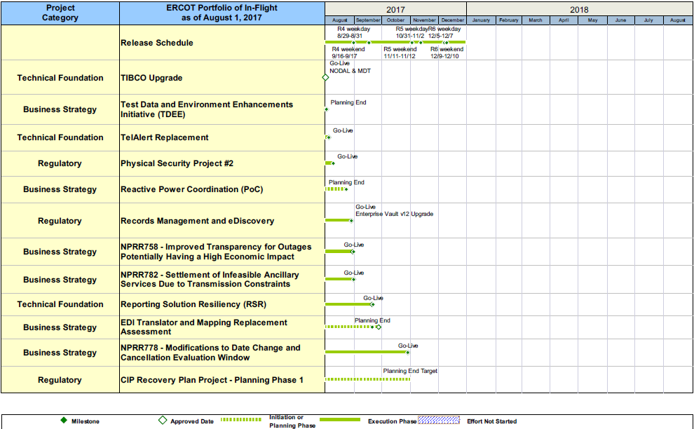
Project Portfolio Status – as of 7/31/2017

Slide 12
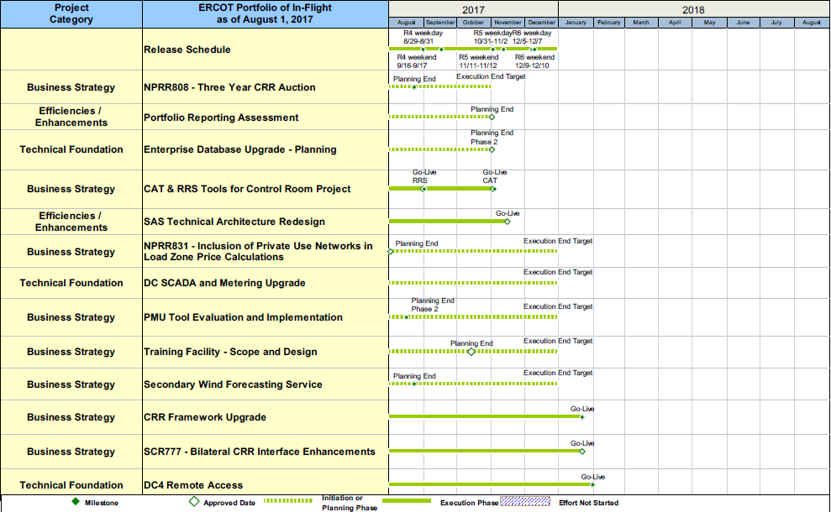
Project Portfolio Status – as of 7/31/2017

Slide 13
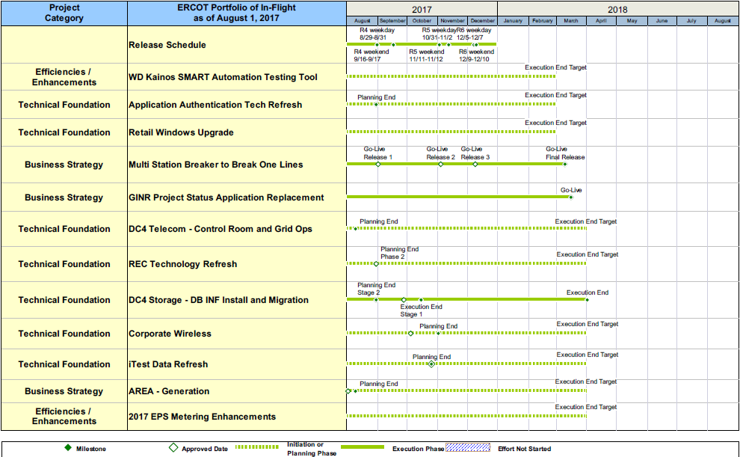
Project Portfolio Status – as of 7/31/2017

Slide 14
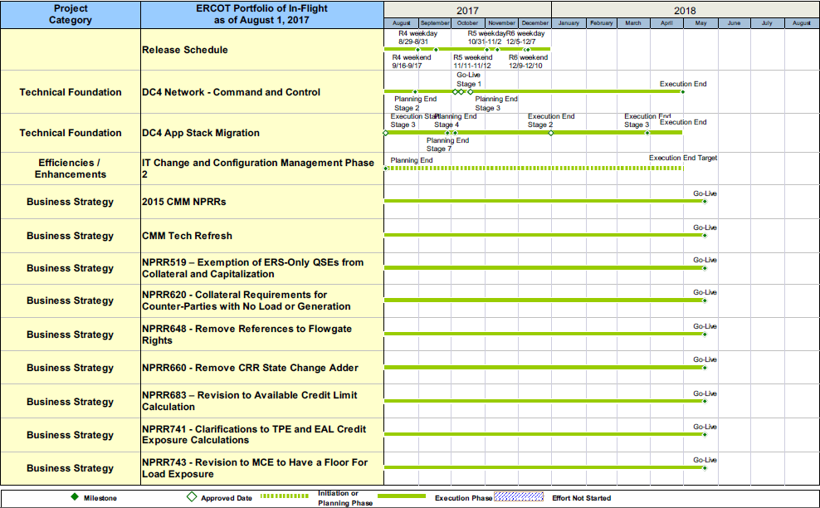
Project Portfolio Status – as of 7/31/2017

Slide 15
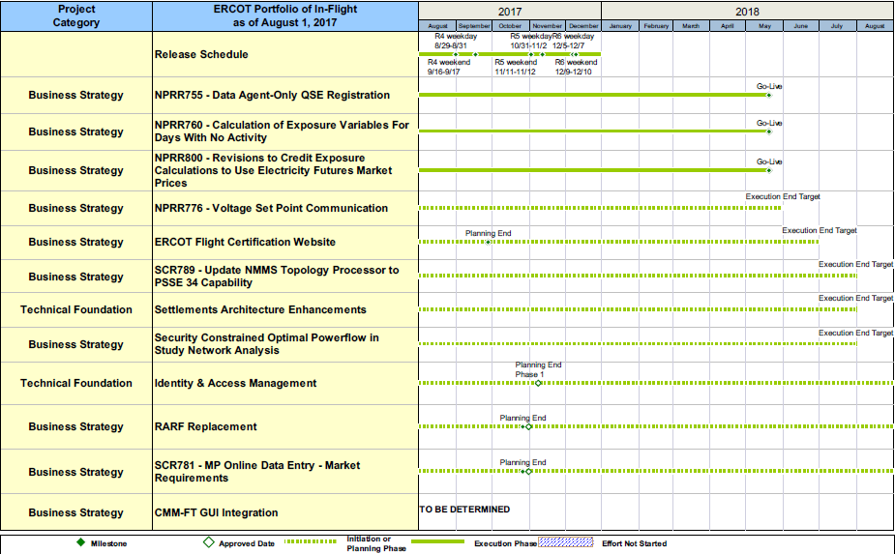
Project Portfolio Status – as of 7/31/2017

Slide 16
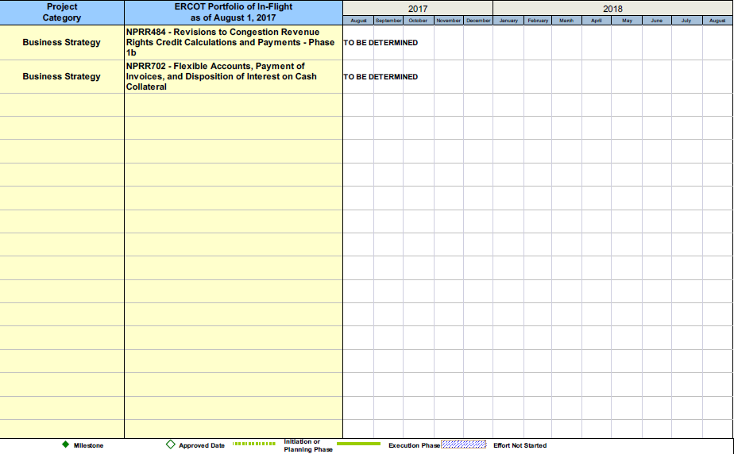
Project Portfolio Status – as of 7/31/2017

Slide 17
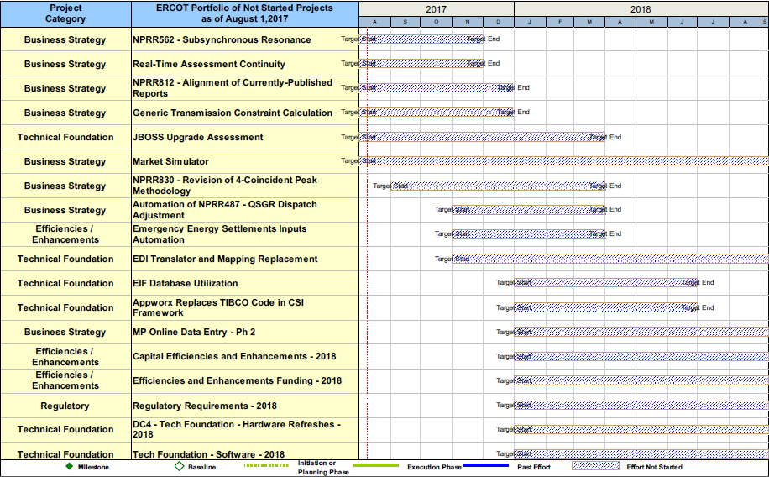
Project Portfolio Status – as of 7/31/2017

Slide 18
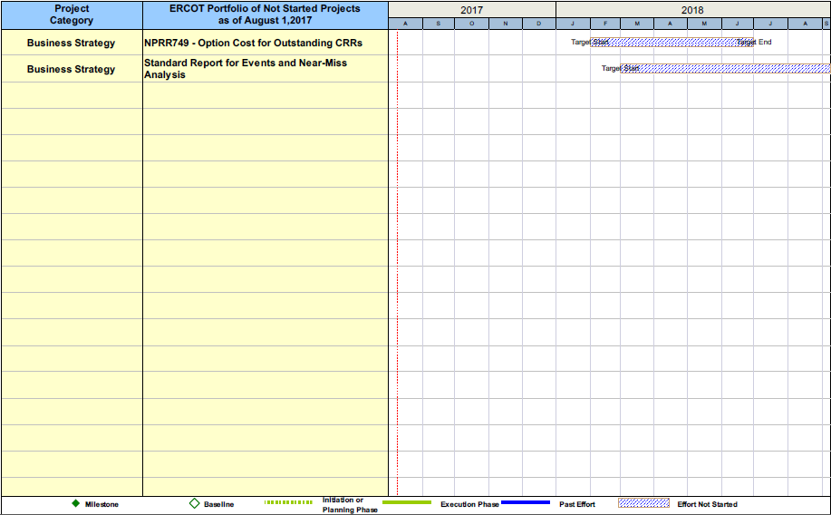
Project Portfolio Status – as of 7/31/2017

