Slide 1
Credit Exposure Update
Spoorthy Papudesi
ERCOT Credit
August 16, 2017

Slide 2
Agenda
Inputs and assumptions
Exposure and collateral distributions
Observations

Slide 3
Credit Exposure Update
Inputs and Assumptions:
Only Active Counter-Parties are included
Counter-Parties are classified by rating and market activity
TPE and collateral balances used are averages for May and June 2017
Counter-Parties that are subsidiaries of, or guaranteed by, rated entities are given the parent/guarantor’s rating, adjusted down one notch

Slide 4
Credit Exposure Update
Changes from April 2017 * to June 2017 *
No Significant Change from the last reporting date
Number of active Counter-Parties has decreased from 205 to 204.
Market-wide TPE has increased from 320 million to 365 million.
Excess Collateral has increased from1,462 million to 1,566 million.
TPE of Load and Gen category as a percentage of Total TPE has increased by 5.5% while the TPE of Trader category has decreased by 5.5%.
The Excess Collateral of Load and Gen category as a percentage of Total Excess Collateral decreased by 5.5% while Traders increased by 4.5%.
*Numbers presented are averages of Mar-Apr 2017 and May-Jun 2017

Slide 5
Credit Exposure Update
Summary statistics by market category

Slide 6
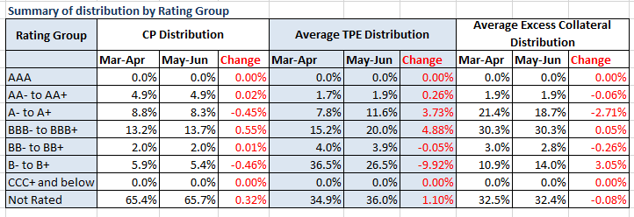
Credit Exposure Update
Summary statistics by rating group

Slide 7
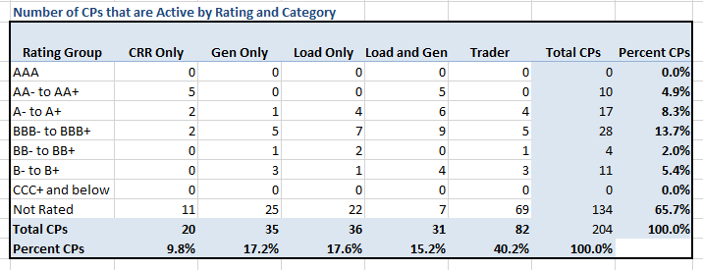
Credit Exposure Update
Active Counter-Parties distribution by rating and category

Slide 8
Credit Exposure Update
Average Total Potential Exposure distribution

Slide 9
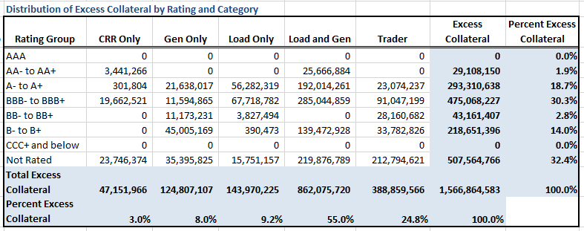
Credit Exposure Update
Average Excess Collateral distribution*
*Excess Collateral is a voluntary disposition by Counterparty

Slide 10
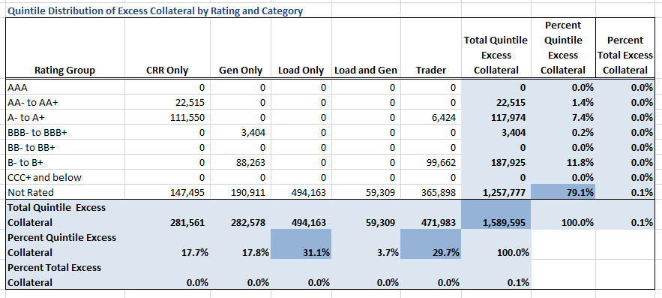
Credit Exposure Update
Average Excess Collateral distribution in the Bottom Quintile*
*Excess Collateral is a voluntary disposition by Counterparty

Slide 11
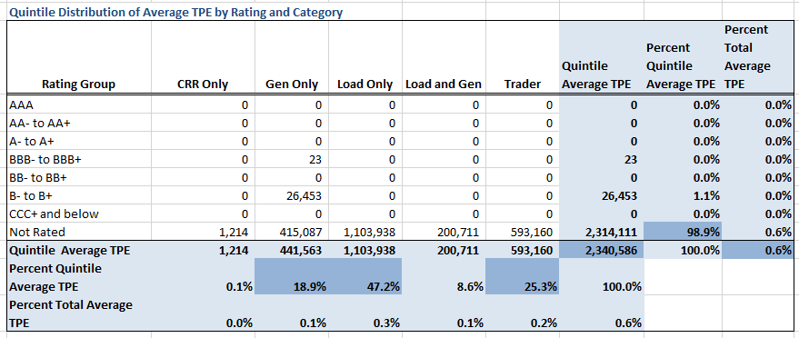
Credit Exposure Update
Average TPE distribution in the Bottom Quintile Based on Excess Collateral

Slide 12
Credit Exposure Update

Slide 13
Credit Exposure Update

Slide 14
Credit Exposure Update
Questions

