Slide 1
PDCWG Report to ROS
Chair: Percy Galliguez, Brazos Electric Power Cooperative, Inc.
Vice Chair: Lei Ye, Austin Energy
ROS
August 3rd, 2017

Slide 2
Report Overview & Notes
Report Overview
  Meeting Minutes
  BAL-001-TRE-1 FMEs & IMFR
    9 FME in the month of June
  Frequency Control Report

Slide 3
Meeting Minutes
PDCWG Meeting 7/19/17
  NPRR 815/828 Discussion
  Regulation & Frequency Control Reports
  GREDP Performance Analysis
    Data will be provided but analysis will only be reported on request
  BAL-001-TRE-01 R6 Combined Cycle Steam Unit SAR
  MOD-026-1 & MOD-027-1 Discussion
    NOGRR Proposal/Review Status
Notes:
PDCWG discussed NPRR 828 once again in its July meeting. PDCWG had previously discussed NPRR 828 at its June meeting and had laid out their concerns to ERCOT. In the July meeting ERCOT brought back responses to those concerns which included a draft set of comments to modify NPRR 828. ERCOT addressed PDCWG’s concerns. PDCWG discussed these responses further and did not have any additional actions for ERCOT. Three PDCWG members did have some reservations on the NPRR 828 and were planning on addressing their concerns individually.

Slide 4
Frequency Measurable Events Performance

Slide 5
Frequency Measurable Events
There was 9 FMEs in June
  6/2/2017 10:03:08
    Loss of 589 MW
    Interconnection Frequency Response:
    6 of 43 Evaluated Generation Resources had less than 75% of their expected Initial Primary Frequency Response.
    5 of 43 Evaluated Generation Resources had less than 75% of their expected Sustained Primary Frequency Response.
  6/6/2017 18:08:00
    Loss of 452 MW
    Interconnection Frequency Response:
    14 of 45 Evaluated Generation Resources had less than 75% of their expected Initial Primary Frequency Response.
    12 of 45 Evaluated Generation Resources had less than 75% of their expected Sustained Primary Frequency Response.

Slide 6
Frequency Measurable Events
  6/11/2017 3:52:34
    Loss of 443 MW
    Interconnection Frequency Response:
    13 of 49 Evaluated Generation Resources had less than 75% of their expected Initial Primary Frequency Response.
    15 of 49 Evaluated Generation Resources had less than 75% of their expected Sustained Primary Frequency Response.
  6/11/2017 21:42:16
    Loss of 848 MW
    Interconnection Frequency Response:
    4 of 39 Evaluated Generation Resources had less than 75% of their expected Initial Primary Frequency Response.
    4 of 39 Evaluated Generation Resources had less than 75% of their expected Sustained Primary Frequency Response.

Slide 7
Frequency Measurable Events
  6/14/2017 16:55:34
    Loss of 522 MW
    Interconnection Frequency Response:
    13 of 53 Evaluated Generation Resources had less than 75% of their expected Initial Primary Frequency Response.
    11 of 53 Evaluated Generation Resources had less than 75% of their expected Sustained Primary Frequency Response.
  6/16/2017 7:46:23
    Loss of 550 MW
    Interconnection Frequency Response:
    7 of 75 Evaluated Generation Resources had less than 75% of their expected Initial Primary Frequency Response.
    5 of 75 Evaluated Generation Resources had less than 75% of their expected Sustained Primary Frequency Response.

Slide 8
Frequency Measurable Events
  6/16/2017 16:14:23
    Loss of 508 MW
    Interconnection Frequency Response:
    12 of 56 Evaluated Generation Resources had less than 75% of their expected Initial Primary Frequency Response.
    10 of 56 Evaluated Generation Resources had less than 75% of their expected Sustained Primary Frequency Response.
  6/19/2017 9:10:19
    Loss of 449 MW
    Interconnection Frequency Response:
    12 of 58 Evaluated Generation Resources had less than 75% of their expected Initial Primary Frequency Response.
    8 of 58 Evaluated Generation Resources had less than 75% of their expected Sustained Primary Frequency Response.

Slide 9
Frequency Measurable Events
  6/27/2017 15:50:36
    Loss of 594 MW
    Interconnection Frequency Response:
    8 of 46 Evaluated Generation Resources had less than 75% of their expected Initial Primary Frequency Response.
    7 of 46 Evaluated Generation Resources had less than 75% of their expected Sustained Primary Frequency Response.

Slide 10
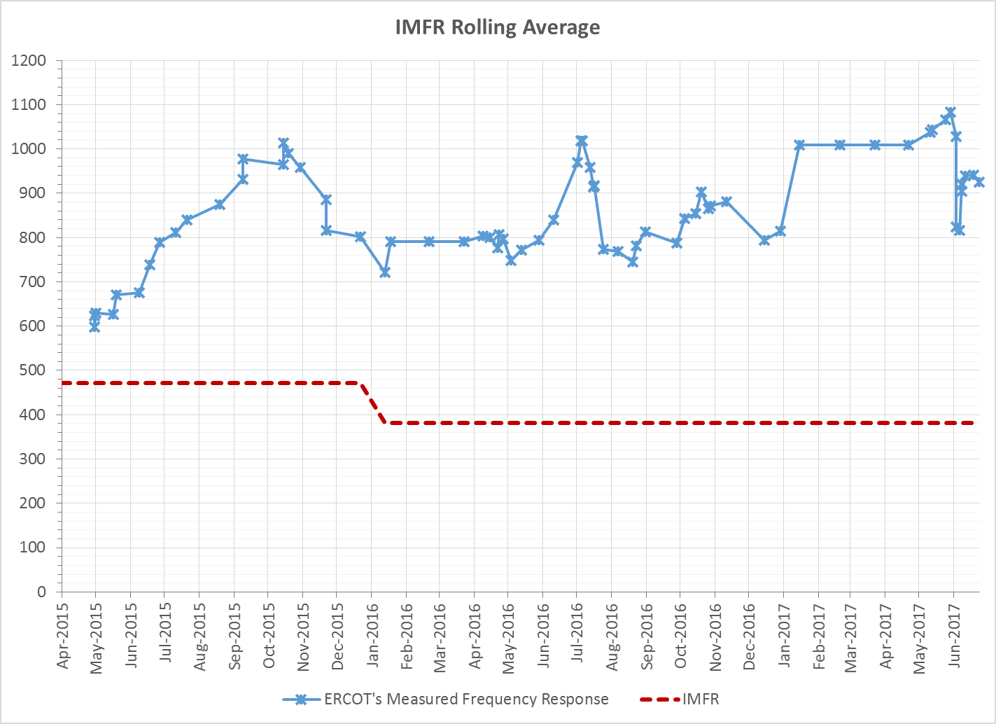
Interconnection Minimum Frequency Response (IMFR) Performance
IMFR Performance currently 924.84 MW/0.1Hz

Slide 11
Frequency Control Report
June 2017

Slide 12
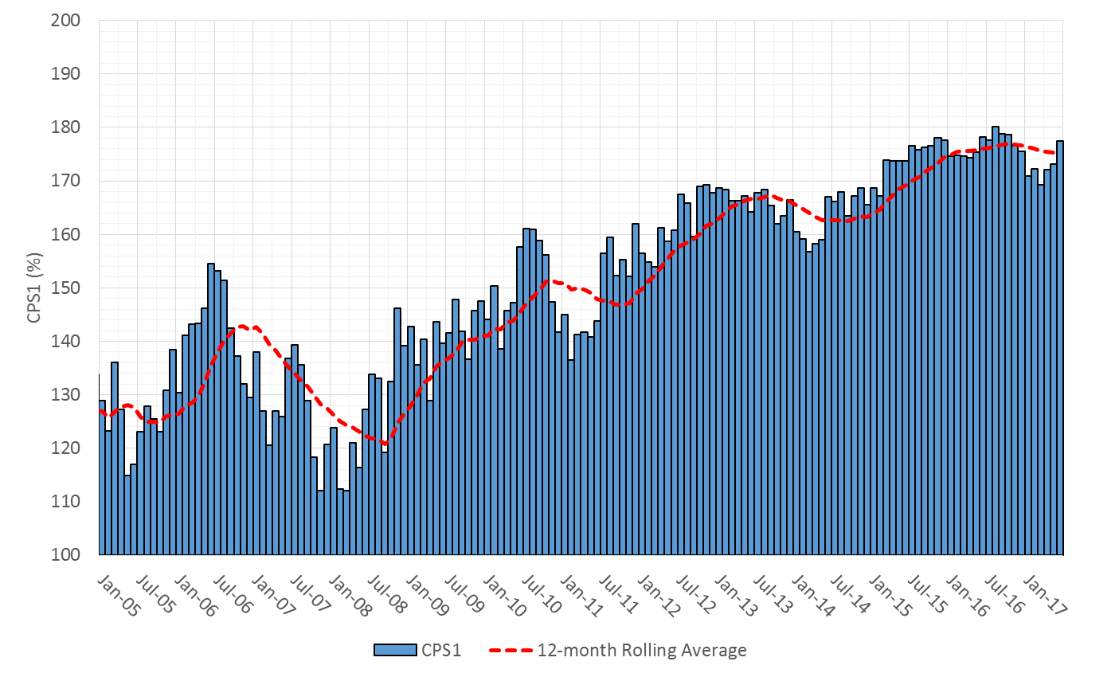

CPS1 Performance

Slide 13
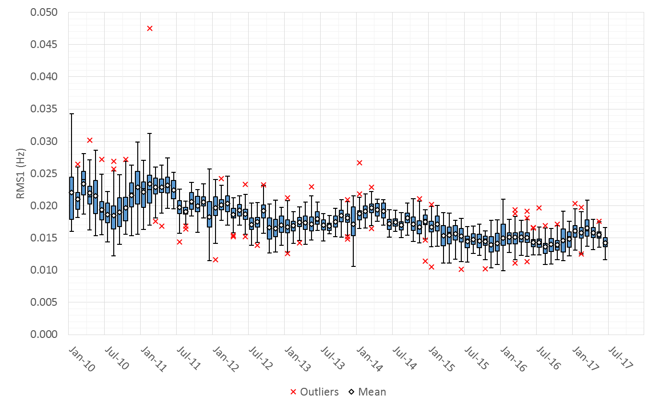
RMS1 Performance of ERCOT Frequency

Slide 14
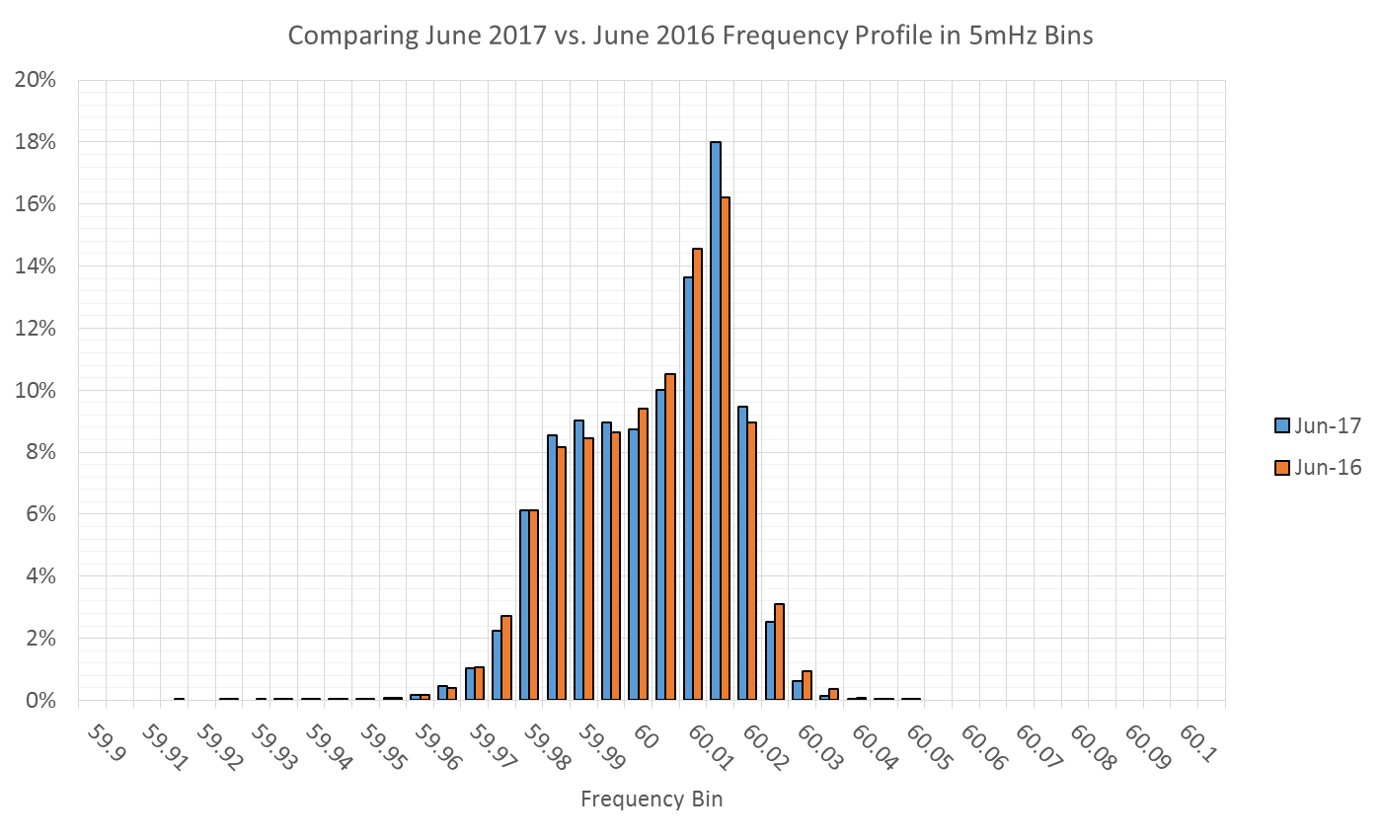
Frequency Profile Analysis

Slide 15
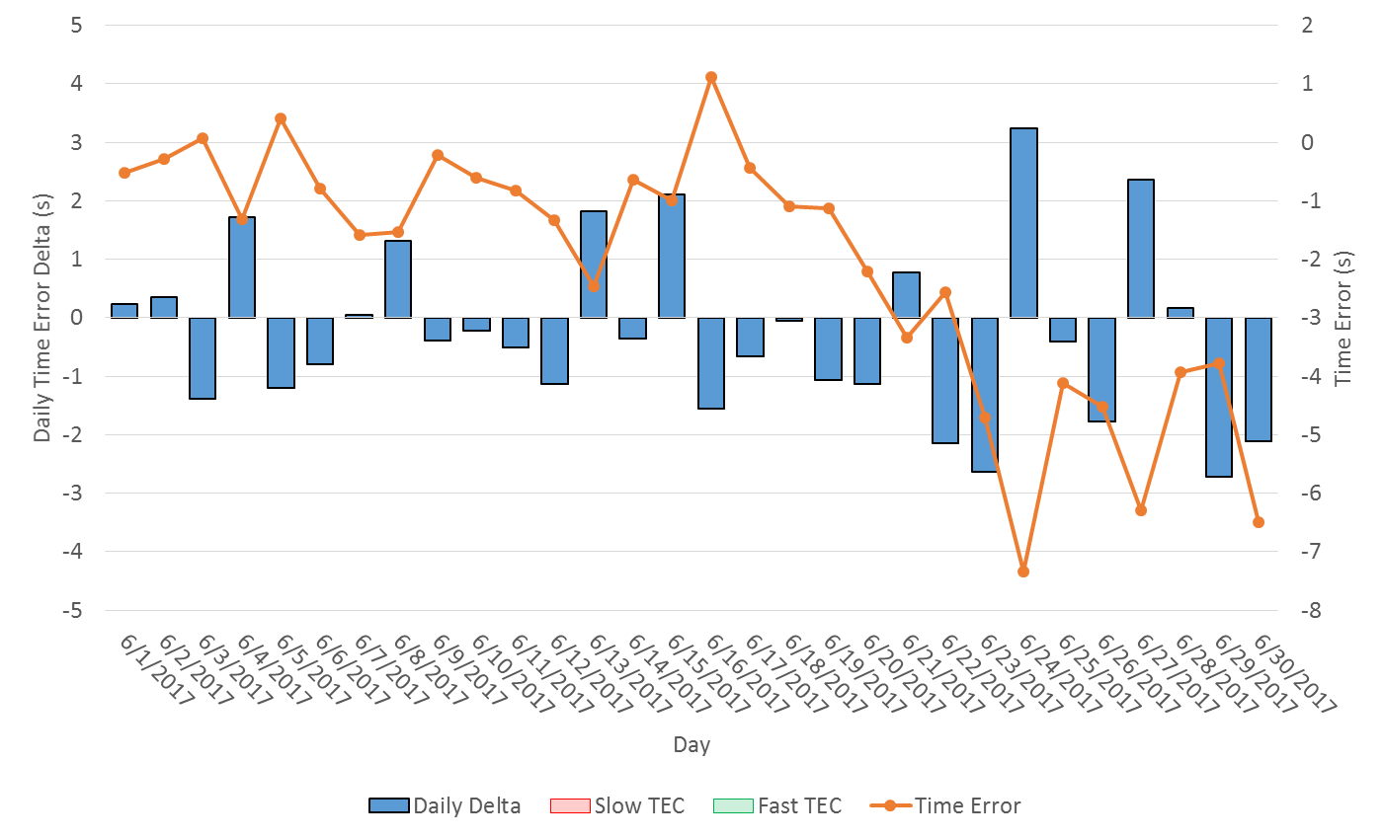
Time Error Corrections
There were no Time Error Corrections (TEC) in May
Notes:
TEC occurred on 12/03/2016 at 23:30. Time Error was 30.06

Slide 16
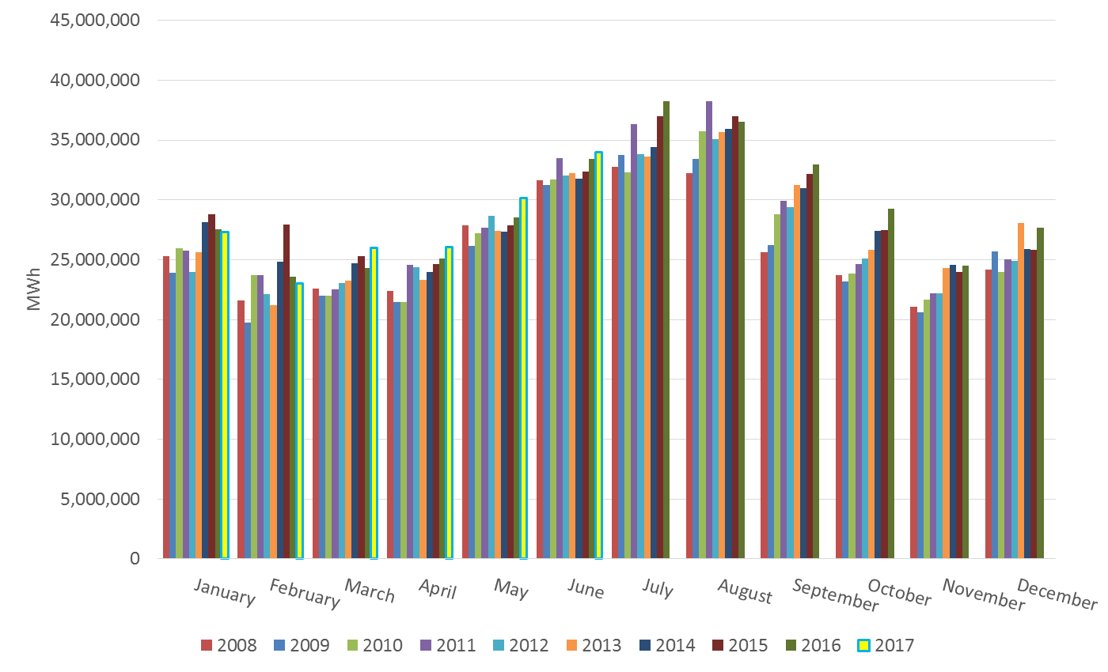
ERCOT Total Energy

Slide 17
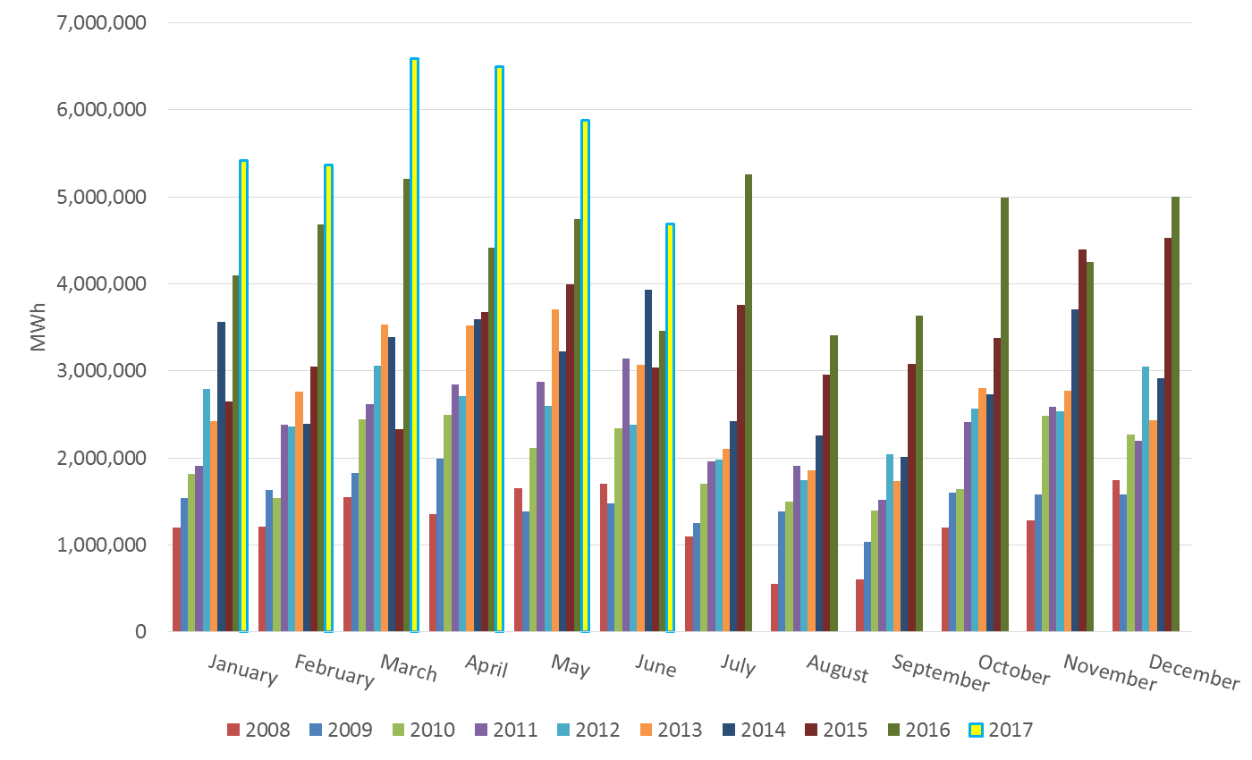
ERCOT Total Energy from Wind Generation

Slide 18
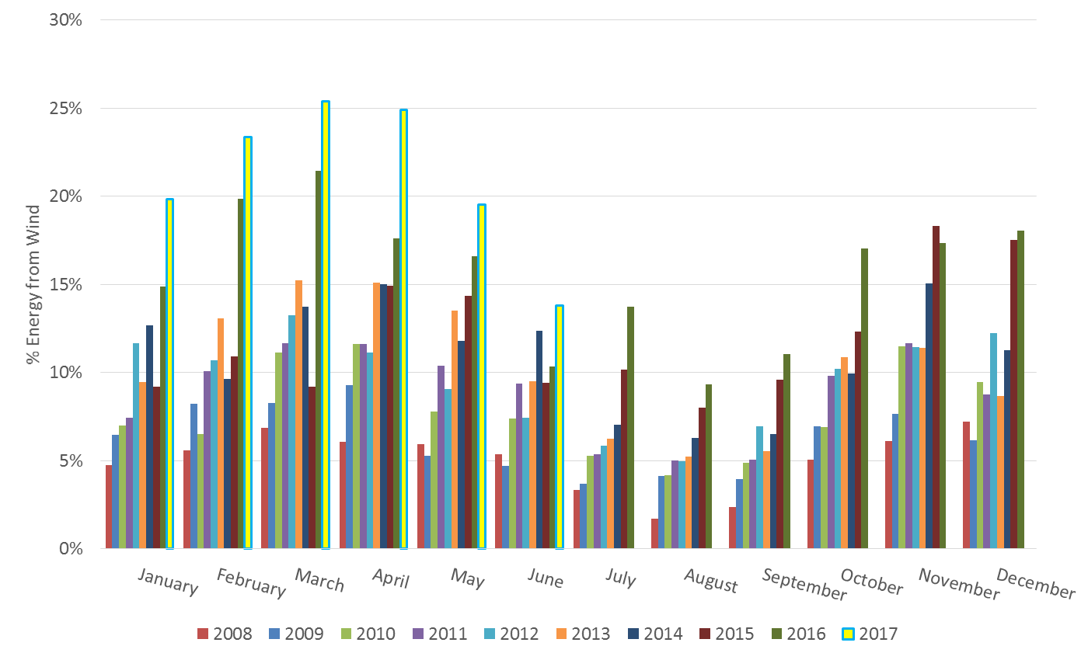
ERCOT % Energy from Wind Generation

Slide 19
Questions?

