Slide 1
ERCOT’s Response to ERS Capacity from ERS Generators Self-Deploying during Pricing Events
Mark Patterson
Manager, ERCOT Demand Integration

Slide 2
ERS Generator Response during Pricing Event and near 4CP Day
ERS Generator fleet obligation ≈ 310 MWs
ERS generators that deploy only for emergencies/ERCOT instruction have a total ERS Obligation ≈ 14 MWs (not included in this analysis).
ERS generators that also deploy outside of emergencies/ERCOT instruction have a total ERS Obligation ≈ 296 MWs
November 29th was the largest price response by ESI-IDs on real-time pricing or block and index in 2016. This should provide a worst case scenario for the ERS fleet responding to prices.
August 2nd was chosen because it was both a pricing event and near 4CP day

Slide 3
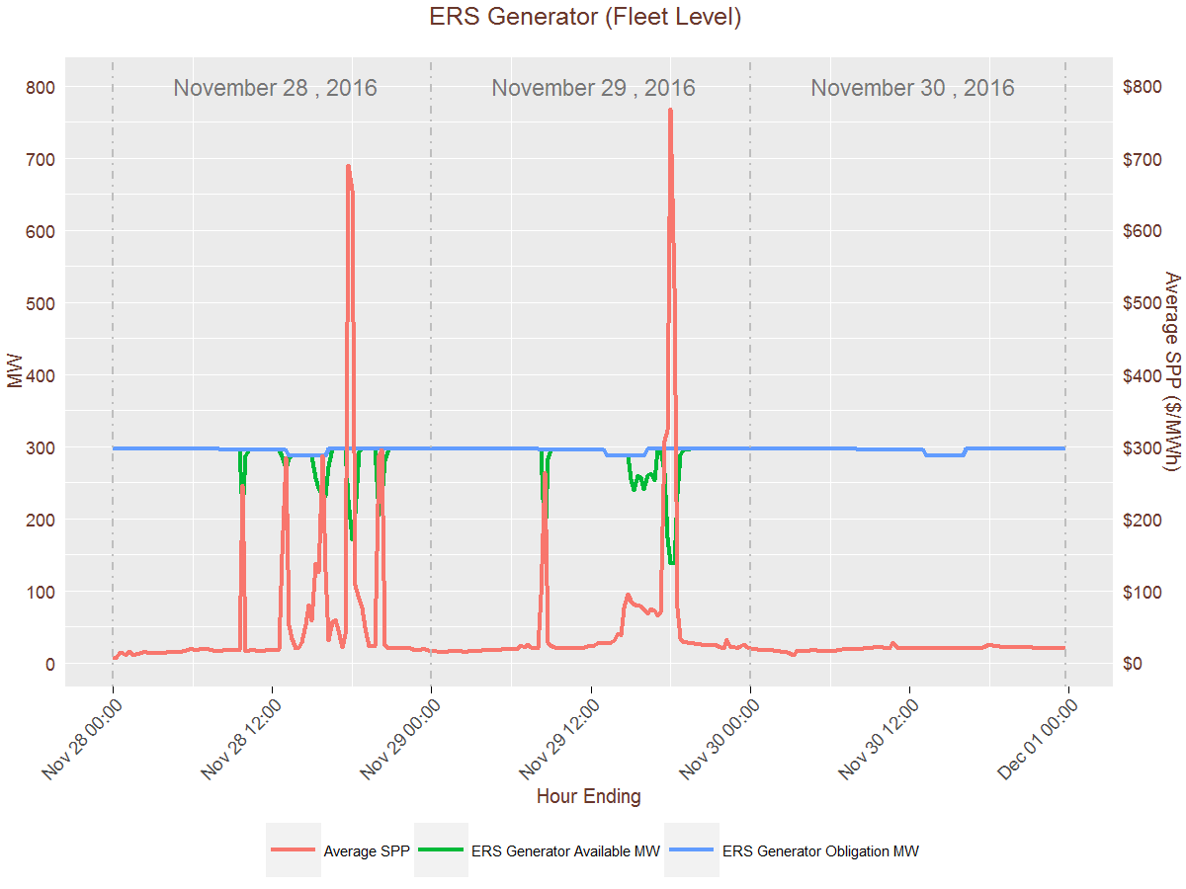
ERS Generator (Fleet Level)

Slide 4
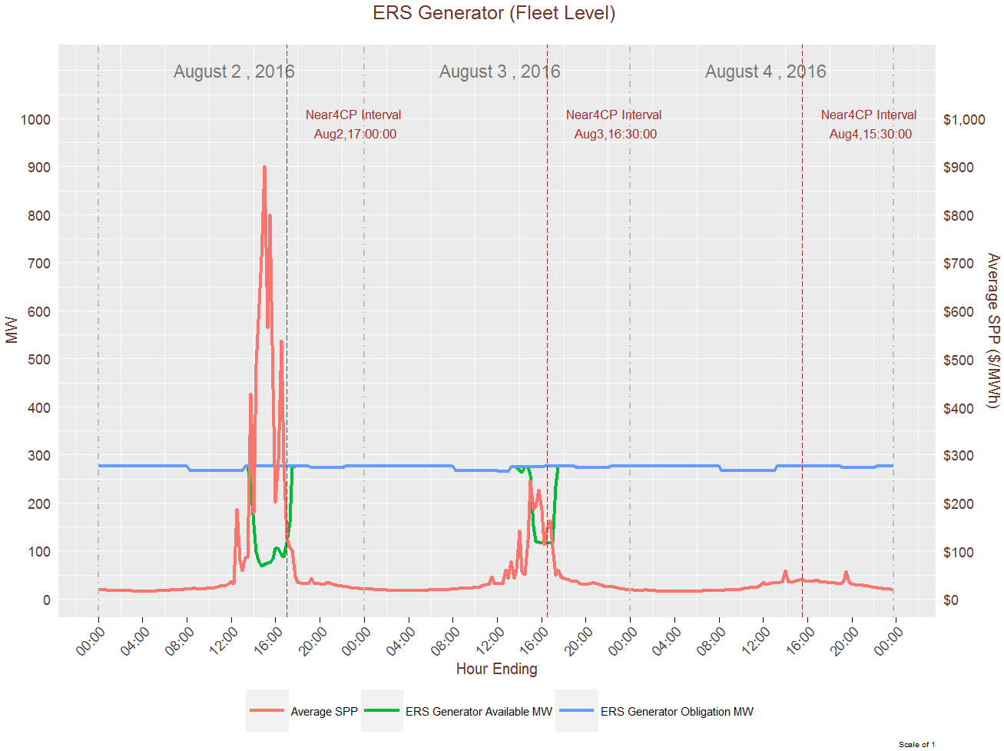
ERS Generator (Fleet Level)

Slide 5
WMS Request to ERCOT
Bring back suggestions for resolving the issue of ERS Generators self-deploying during pricing events.

Slide 6
Capacity from ERS Generators
Capacity Reserved for ERS*
Total Output Capacity from ERS Generator
Injection Capacity
Self–Serve Capacity
* Only Capacity Reserved for ERS is obligated to provide ERS and therefore ERS payments are based on this capacity’s ability to meet its availability and performance criteria

Slide 7
Clawback Suggestion for Capacity from ERS Generators Reserved For ERS
  3 year Transition Period
    1st Year – 1/3 of any revenue received from ERCOT for energy payments* will be clawed back from the ERS Payment, not to exceed total ERS payment for the ERS Contract Period.
    2nd Year – 2/3 of any revenue received from ERCOT for energy payments* will be clawed back from the ERS Payment, not to exceed total ERS payment for the ERS Contract Period.
    3rd Year and after – 100% of revenue received from ERCOT for energy payments* will be clawed back from the ERS Payment, not to exceed total ERS payment for the ERS Contract Period.
* Energy payments are exclusive of energy when deployed for ERCOT instructed events (emergency and test) and properly scheduled self-tests

Slide 8
Clawback Suggestion for Capacity from ERS Generators Reserved For ERS
The clawback of the ERS Payment will be applied at the ERS Resource level. In addition, the clawback will be applied to only ERS Time Periods in which the energy payments were realized.
For ERS Generators which are co-located and opting for joint evaluation, the ERS payment for both the ERS Generator and ERS Load will be subjected to clawback.
If known in time for an ERS RFP, any money clawed back will be carried forward to the ERS Expenditure Limit for the ERS Program Year.

Slide 9
Clawback Suggestion for Capacity from ERS Generators Reserved For ERS
Even with the clawback of the ERS Payment the ERS Generator and any co-located load will retain its ERS obligation throughout the ERS Standard Contract Term.

