Slide 1
Rescheduled Outages
Project P215-01
NPRR 758 Improved Transparency for Outages having a High Economic Impact.
OTWG
July 20, 2017

Slide 2
August 8th Webex Agenda
Project Background
High Impact Outage Definitions and Terminology
High Impact Outages & High Impact Transmission Elements
How Generated
MIS Posting
Examples
New and Revised Protocol Language
Outage Scheduler User Interface Revisions
The High Impact Outage Process
High Impact Outage Reports

Slide 3
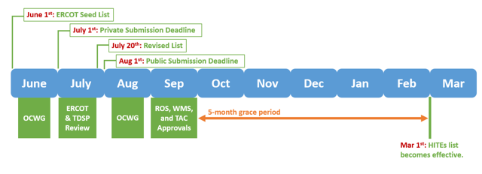
Updating the High Impact Outage List
Annually, the Outage Coordination Working Group (OCWG) will update the current Major Transmission Element list.
Revised list based on previous 12 months (May 1st to April 30th)
ERCOT will post the High Impact Transmission Element list for the subsequent year by July 20th.
Revised High Impact Outage/High Impact Transmission Element list will become effective the following March 1st.

Slide 4
HIO Process Overview
Planned Transmission Outages with elements on the HITE list are classified as a High Impact Outage (HIO)
HIOs submitted with 90 days or less notice are posted daily to the MIS and are not eligible for Rescheduling.
HIOs submitted with greater than 90 days notice may be eligible for Rescheduling if ERCOT must consider for Withdrawal.
ERCOT will discuss Rescheduling with Requestor.
If Requestor cannot Reschedule – ERCOT will Withdraw
If Requestor can Reschedule – ERCOT will convert into a Rescheduled Outage.
Requestor must submit revised Planned Start and Planned End dates and times (3 day minimum applies)
Requestor may remove Elements and modify selection fields after Rescheduled Dates are submitted.
ERCOT will re-evaluate and, if no security violations exist, issue Approval.

Slide 5
Future Training
Additional WebEx presentation will be offered Post Go-Live in the Fall of 2017
The following Outage Scheduler-related documents on ERCOT.Com and the Learning Management System will be updated with Rescheduled Outage requirements:
QSE and TSP Outage Scheduler ILT
QSE and TSP Outage Scheduler User Guide
Outage Scheduler for QSEs and TSPs Web-Based Training

Slide 6
NPRR 758 - Rescheduled Outage Process
Questions?

