Slide 1
NPRR 776 NDSWG
Stephen Solis
System Operations Improvement Manager
ERCOT Public
July 18, 2017

Slide 2
Voltage Set Points
NPRR 776 implements requirements for transparency of both the actual measured value and desired Set Point for the Point of Interconnection (POI) voltage between all affected entities (TO, ERCOT, QSE, and RE).
ERCOT is working to leverage existing telecommunications infrastructure (e.g. ICCP) to minimize additional expenses.
ERCOT will have a majority of Voltage Set Point work (NPRR 776) in place by 1Q of 2018.
  Working towards making points available to QSEs by Dec 2017.

Slide 3
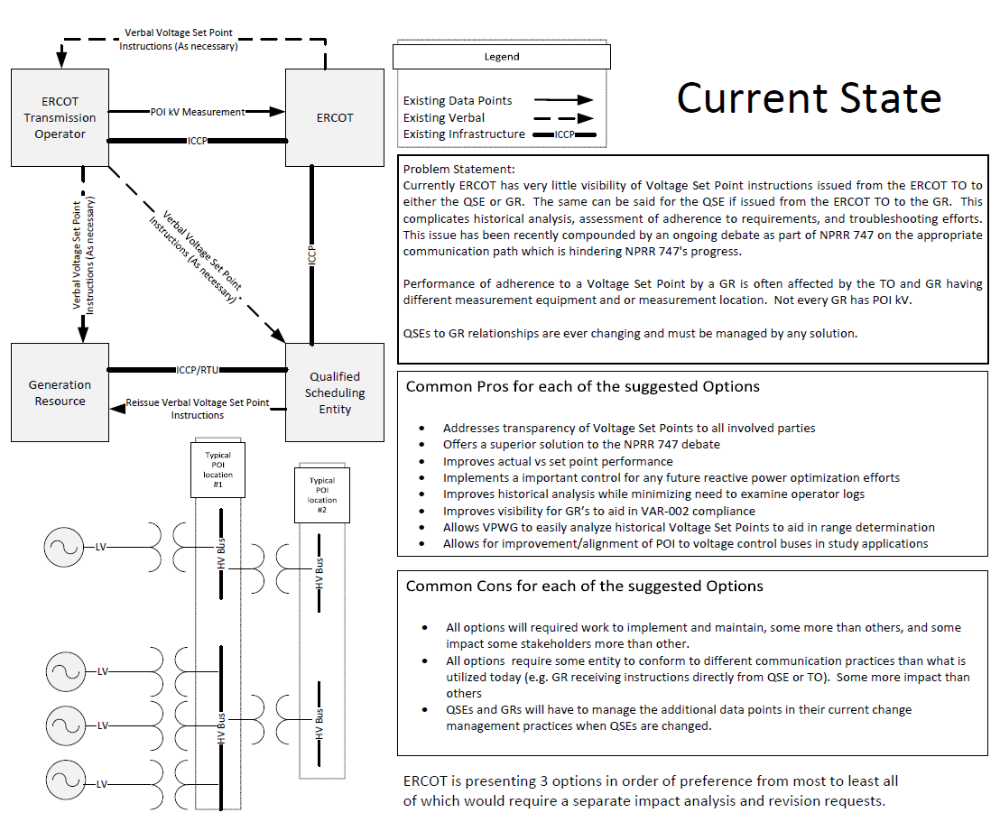
Voltage Set Points – Current State

Slide 4
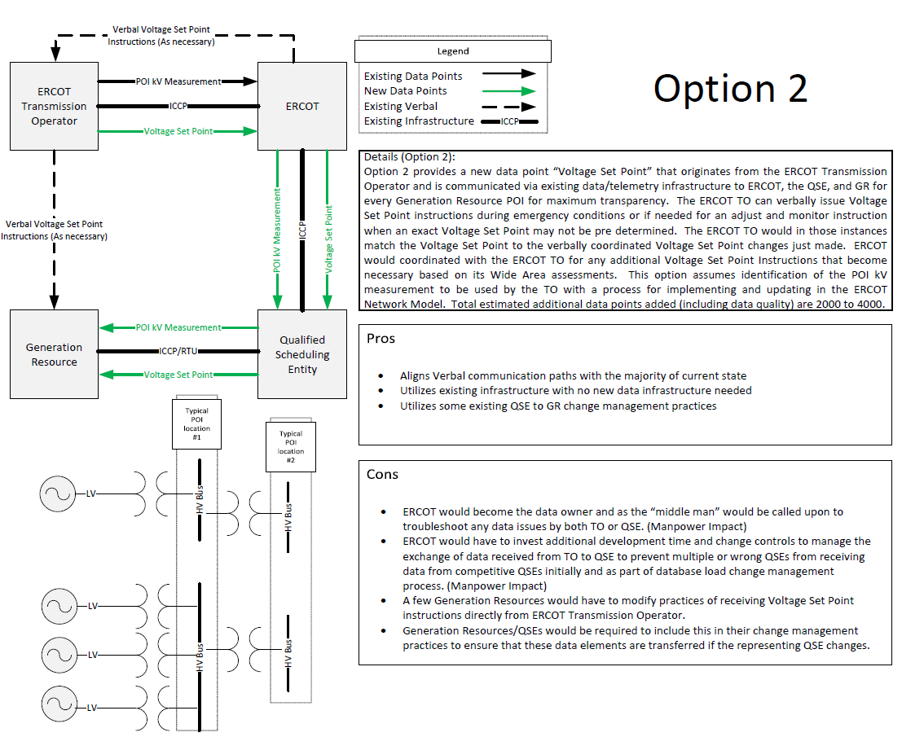
Voltage Set Points – Post NPRR 776 implementation

Slide 5
Voltage Set Points
TSPs will be associating the two ICCP points (Set Point and actual) and generator relationships to the POI kV Measurement device (e.g. on busbar, line, xfmer).
ERCOT will be using these relationships in its EMS to map and make available the ICCP points to the appropriate QSE.
QSEs are required to send the two ICCP points (Set Point and actual POI kV) to the appropriate Generation Resource.
Naming convention should remain for kV measurements, set points/targets should be same but have a .kvt suffix instead of .kv
ERCOT will update the ICCP Handbook to reflect naming convention for defined points for QSE and TSP.

Slide 6
Voltage Set Points
Total # of POIs 243
Total # of POIs where ERCOT currently has kV measurements 200
Total # of POIs where TSPs currently have KV measurements but will be getting them to ERCOT 29
Total # of POIs where TSPs must add KV measurements 14

Slide 7
Voltage Set Points (29) TSP has kV but not ERCOT
Total # of POIs where TSPs currently have KV measurements but will be getting them to ERCOT 29
TSP must submit a NOMCR to create a kV measurement placeholder in the model.
These points can then be mapped via ICCP to bring into ERCOT.

Slide 8
Voltage Set Points (14) TSP has no kV measurement
Total # of POIs where TSPs must add KV measurements 14
TSP must install measurement equipment.
TSP must submit a NOMCR to create a kV measurement placeholder in the model.
These points can then be mapped via ICCP to bring into ERCOT.
The desired set point and relationships can still be modeled, just with no measurement until the measurement equipment is installed.

Slide 9

Discussion / Q&A

