Slide 1
PDCWG Report to ROS
Chair: Percy Galliguez, Brazos Electric Power Cooperative, Inc.
Vice Chair: Lei Ye, Austin Energy
ROS
July 13th, 2017

Slide 2
Report Overview & Notes
Report Overview
  Meeting Minutes
  BAL-001-TRE-1 FMEs & IMFR
    2 FME in the month of May
  Frequency Control Report

Slide 3
Meeting Minutes
PDCWG Meeting 6/14/17
  NPRR 815/828 Discussion
  Regulation & Frequency Control Reports
  GREDP Performance Analysis
  BAL-001-TRE-01 R6 Combined Cycle Steam Unit Discussion
  MOD-026-1 Discussion
    NOGRR Proposal/Review Status
  Two FMEs Reviewed for May
    5/19/2017 19:25:37
      Loss of 416 MW
      800 MW/0.1Hz
      2 of 21 Evaluated RRS Providers had less than 75% of their expected Initial Primary Frequency Response.
      1 of 21 Evaluated RRS Providers had less than 75% of their expected Sustained Primary Frequency Response.

Slide 4
Meeting Minutes
PDCWG Meeting 6/14/17(Cont’d)
  Two FMEs Reviewed for May(Cont’d)
    5/21/2017 18:25:03
      Loss of 448 MW
      830 MW/0.1Hz
      2 of 19 Evaluated RRS Providers had less than 75% of their expected Initial Primary Frequency Response.
      2 of 19 Evaluated RRS Providers had less than 75% of their expected Sustained Primary Frequency Response.

Slide 5
Frequency Measurable Events Performance
May 2017

Slide 6
Frequency Measurable Events
There was 2 FMEs in May
  5/19/2017 19:25:37
    Loss of 416 MW
    Interconnection Frequency Response:
    12 of 42 Evaluated Generation Resources had less than 75% of their expected Initial Primary Frequency Response.
    9 of 42 Evaluated Generation Resources had less than 75% of their expected Sustained Primary Frequency Response.
  5/21/2017 18:25:03
    Loss of 448 MW
    Interconnection Frequency Response:
    6 of 47 Evaluated Generation Resources had less than 75% of their expected Initial Primary Frequency Response.
    5 of 47 Evaluated Generation Resources had less than 75% of their expected Sustained Primary Frequency Response.

Slide 7
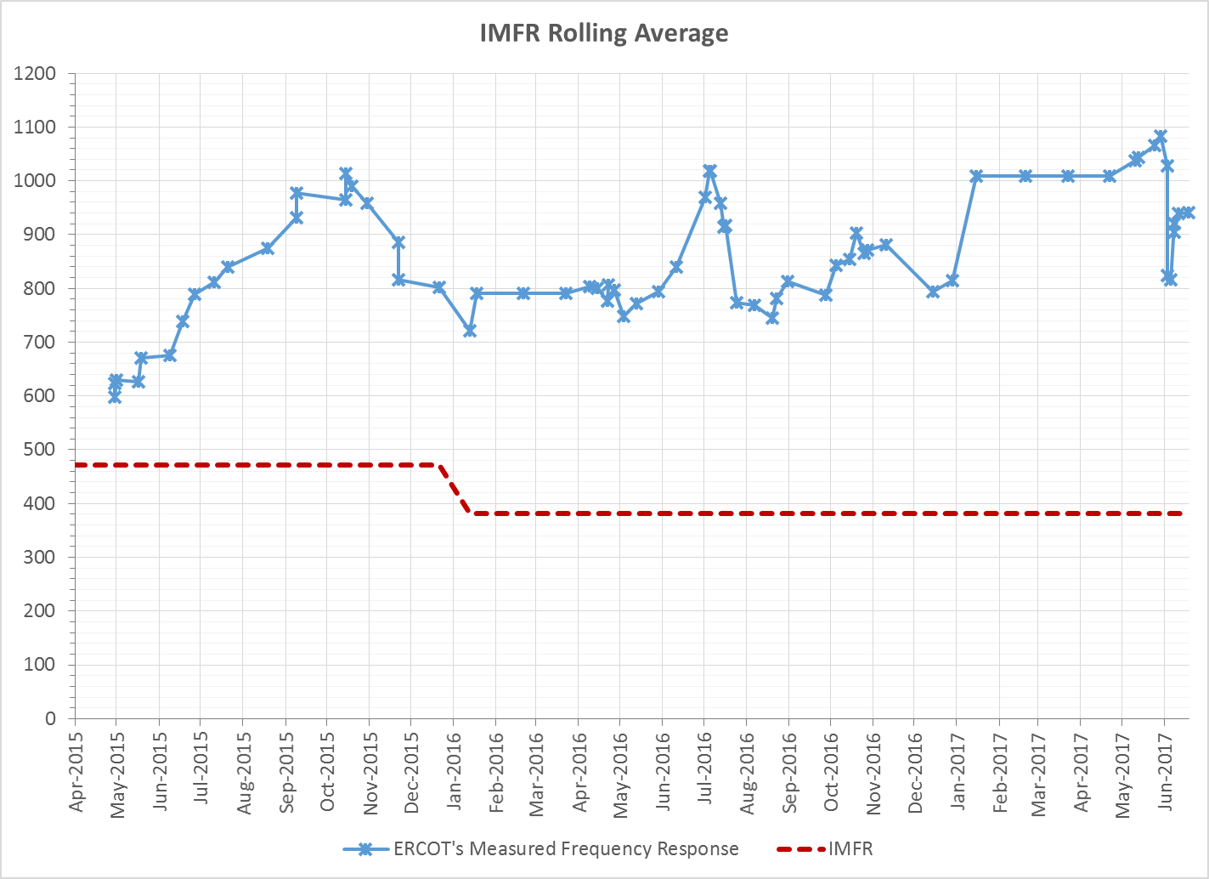
Interconnection Minimum Frequency Response (IMFR) Performance
IMFR Performance currently 941.63 MW/0.1Hz

Slide 8
Frequency Control Report
May 2017

Slide 9
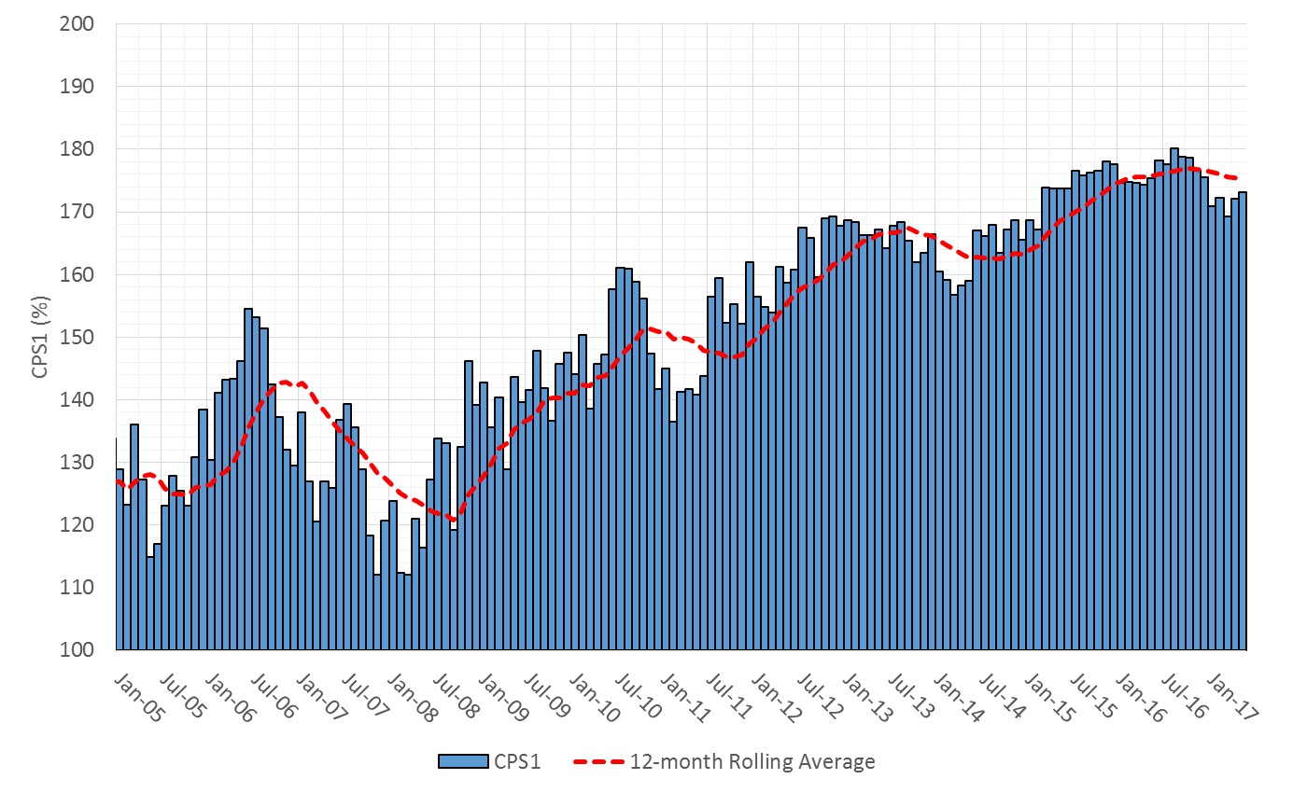

CPS1 Performance

Slide 10
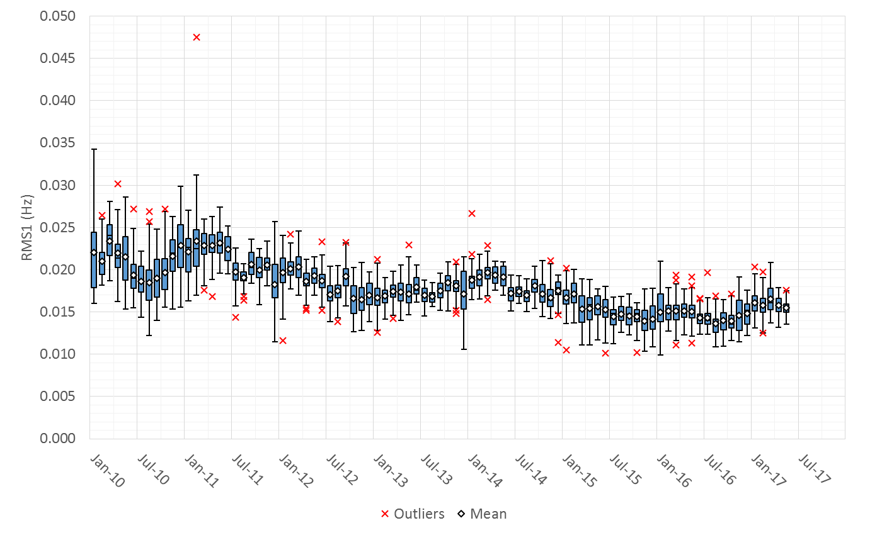
RMS1 Performance of ERCOT Frequency

Slide 11
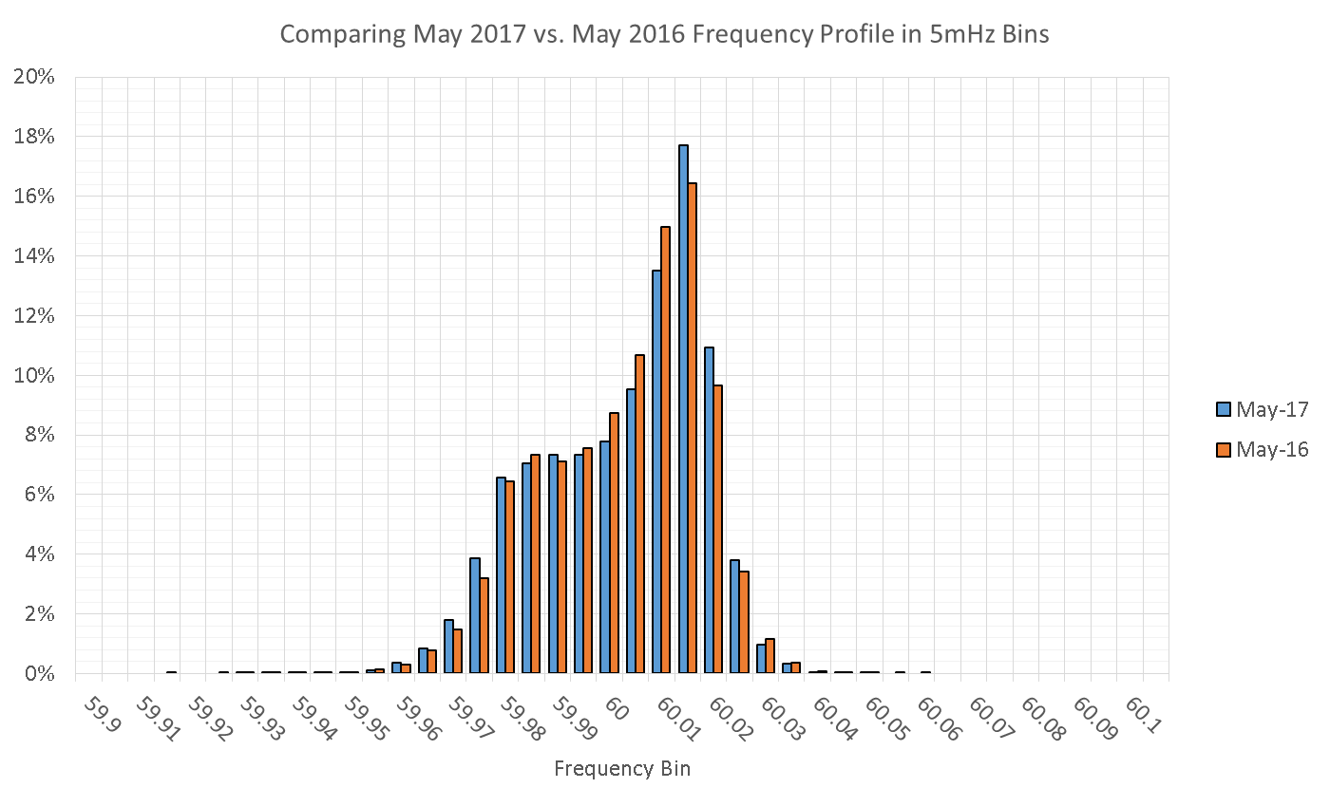
Frequency Profile Analysis

Slide 12
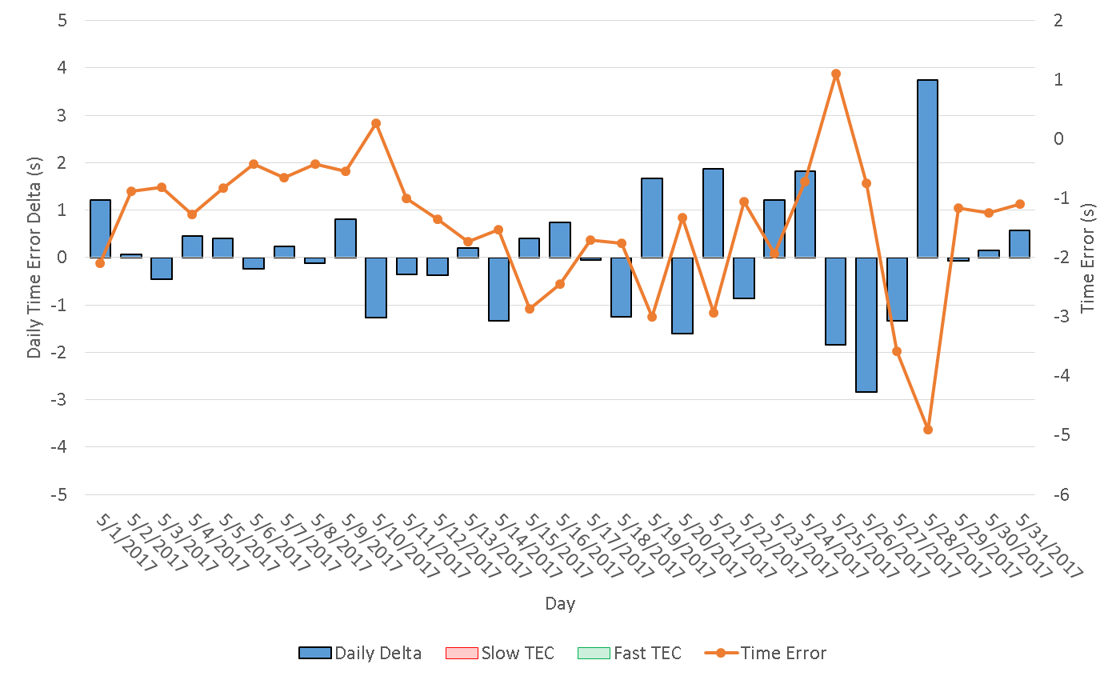
Time Error Corrections
There were no Time Error Corrections (TEC) in May
Notes:
TEC occurred on 12/03/2016 at 23:30. Time Error was 30.06

Slide 13
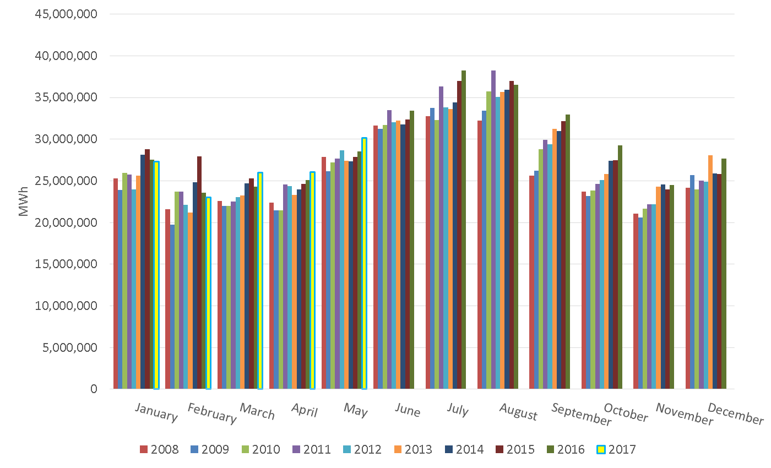
ERCOT Total Energy

Slide 14
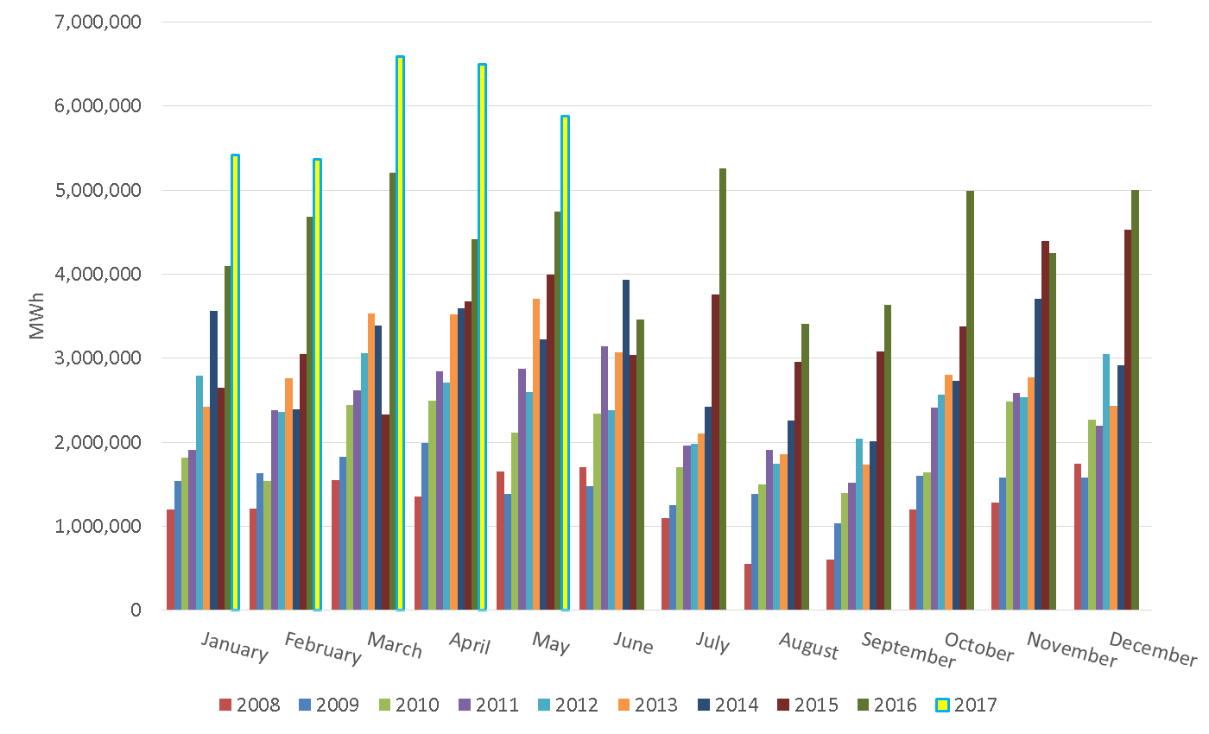
ERCOT Total Energy from Wind Generation

Slide 15
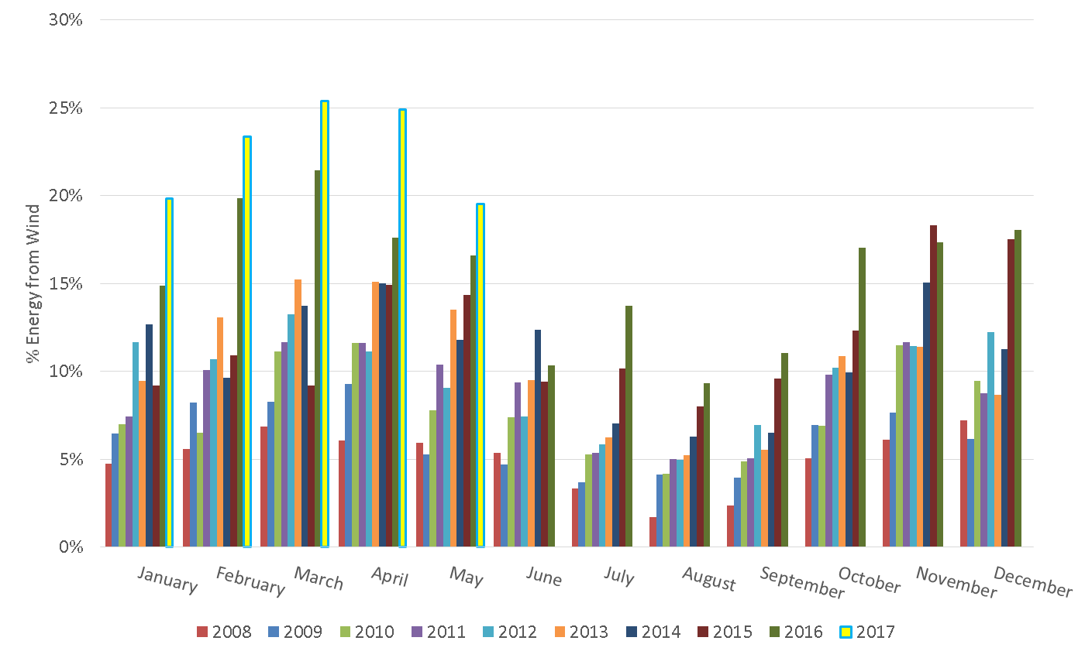
ERCOT % Energy from Wind Generation

Slide 16
Questions?

